Slide 1
Applying Market Design to
School Choice in Boston
Tony Bakshi, Grey Joyner and Danielle Marshak
November 28, 2012

Slide 2
What we’ll cover today:
What is school choice?
What is the Boston Mechanism?
Why was the Boston Mechanism replaced?
The Boston Mechanism rises again
Alternative mechanisms
What’s happening in Boston now?

Slide 3
What is school choice?

Slide 4
What is School Choice?
That’s a pretty ambiguous term, isn’t it?
In many public school systems, students have the ability to indicate their preference for schools when entering elementary, middle, and high school (Grades: Pre-K, K, 6, 9)
We are going to focus on Boston
Students have strict preferences over schools
Schools have weak preferences over students
  Sibling
  Walk zone
  Quota
Must allocate these students to schools with the sole goal of maximizing the students’ welfare
This is what makes this problem different from college admissions

Slide 5
Just a Little Bit of Notation
This should be familiar to you!
A set of schools S = {a, b, … z}
A quota for each school {q_{a} … q_{z}}
A set of students T = {α, β, … γ}
A matching μ is stable if
  There is no student who prefers to be unmatched rather than be with the school to which she/he is matched
  There is no student/school pair that each prefers the other to the school/student to which it/she/he has been matched

Slide 6
Justified Envy
Stability in the Boston environment
Corresponds to pairwise stability in two-sided matching
  A matching u eliminates justified envy if there is no unmatched student–school pair (i, s) such that:
    Student i prefers school s to her assignment under u
    Student i has higher priority at school s than some other student who is assigned a seat at school s under u.
    Chen and Sonmez (2006)

Slide 7
History of School Choice in Boston
1974: Race taken into account
1999: Race no longer a factor
  Beginning of “The Boston Mechanism”
2005: Final year of Boston Mechanism
  Used to assign more than 75K students in 7 years
2006-2007: End of BM, start of Deferred Acceptance

Slide 8
How does the Boston Mechanism work?
Students submit strict preference list of five schools
Schools have four priority groups for students:
  Both sibling and walk zone
  Sibling only
  Walk zone only
  Everyone else
Random lottery to rank preferences within priority groups
Round one: schools only look at students who ranked them 1st
  Ends when no seats left or no more students have ranked it 1st
Round two: schools only look at students who ranked them 2nd
Ends after five rounds (preference list includes five schools)
Students not assigned get put on a waitlist

Slide 9

How does the Boston Mechanism work?
Setting up our example
Student Preferences
School Priorities
1
2
1
3
1
1
3
2
2
1
2
3
2
2
3
1
3
1
2
3
3
2
3
1

Slide 10
The Boston Mechanism in action
Not Yet Matched
Final Matching
1
2
3
1
2
3

Slide 11
Why was the Boston Mechanism replaced?

Slide 12
What was the Problem with the Boston Mechanism?
It’s not strategy-proof!
Take for example a student who has ranked two overdemanded schools 1 and 2
  Overdemanded means that more students have ranked this school 1st than there are spots at that school
If this student doesn’t get his 1st choice, there is no chance of him getting his 2nd choice
The student would have had a better shot with his/her 3rd choice had he/she ranked it 2nd
This means that it is a dominant strategy NOT to rank a school second if it is overdemanded, meaning that students do not reveal true preferences

Slide 13
Boston Mechanism is not strategy proof
Student 2 can benefit by manipulating his preferences
Student Preferences
School Priorities
1
2
1
3
1
1
3
2
2
1
2
3
2
2
3
1
3
1
2
3
3
2
3
1

Slide 14
Student 2 manipulates his preferences
Not Yet Matched
Final Matching
1
2
3
1
2
3

Slide 15
Manipulation improves student 2’s outcome in Boston Mechanism
Receives 3rd choice when revealing true preferences
Receives 2nd choice through manipulation
1
2
3
2
3
1
2
3
1
3
2
1

Slide 16
Empirical Evidence
It’ll cost you if you don’t strategize!
Roth, Abdulkadiroglu, Pathak and Sonmez (2006) found that 19% of all students over various years listed two overdemanded schools 1st and 2nd
  These students/parents are called “naïve” decision makers
Of these students, 27% (5% of the total) ended up unassigned
Overall, if a student does not get his/her 1st or 2nd choice, there as a greater than 50% chance he/she will end up on the waitlist
There is a lot of pressure on students and parents to strategize about their rankings

Slide 17
Quotes from Actual Parents
Emails to Boston’s West Zone Parents Group (2005)
“For those of you considering putting the Haley as a first choice, ... you may want to put a safer school second than you had been planning to, in case the momentum builds even more than you had expected. You'll probably be fine and automatically get it as a first choice, but you may want to still play it safe.”
“We're also having trouble with deciding on a secure 2nd choice. We are struggling with deciding between the Manning and the Haley for our 1st choice. They are both in our walk zone but for logistics and time ... the Manning works best for our family. We really loved the Haley but I'm afraid that it is not a safe 2nd choice anymore.
(Abdulkadiroglu, Pathak, Roth and Sonmez, 2006)

Slide 18
Why people wanted change
Comments from parents at a 6/8/2005 Parent Hearing
“It angers the parents who figure it out [how to strategize] because they are told not to make their first choice the first one. And it hurts those who don't figure it out because they choose a popular school and end up in the [waitlist].”
“It [changing assignment algorithms] is a long time coming. I'm extremely pleased to see the adopting of an assignment method that does not penalize students for ranking one school over another.”
(Abdulkadiroglu, Pathak, Roth and Sonmez, 2006)

Slide 19
Mechanism Comparison
Property | Boston Mechanism | Deferred Acceptance | Top Trading Cycles (TTC)
Strategy-proof | ✕ | ✓ | ✓
Always Pareto efficient | ✕ | ✕ | ✓
Eliminates justified envy | ✕ | ✓ | ✕
Unavoidable tradeoff between elimination of justified envy, Pareto efficiency and strategy-proofness
If students submitted true preferences in BM, Pareto efficient result
Abdulkadiroglu and Sonmez (2003), Chen and Sonmez (2006)

Slide 20
The Decision
Superintendent Thomas Payzant (May, 2005)
    “The most compelling argument for moving to a new algorithm is to enable to list their true choices of schools…”
    But that is true of both DA and TTC!
    “There may be advantages to (TTC), particularly if two lesser choices can be ‘traded’ for two higher choices. … TTC is less transparent — and therefore more difficult to explain to parents — because of the trading feature executed by the algorithm, which may perpetuate the need or perceived need to ‘game the system.’”

Slide 21
DA outcome using our original example
Not Yet Matched
Final Matching
1
2
3
1
2
3

Slide 22
Can student 3 benefit from manipulation?
i.e. Can he end up with his second choice instead of his third?
Student Preferences
School Priorities
1
2
1
3
1
1
3
2
2
1
2
3
2
2
3
1
3
1
2
3
3
2
3
1

Slide 23
Student 3 still ends up with his 3rd choice
Not Yet Matched
Final Matching
1
2
3
1
2
3

Slide 24
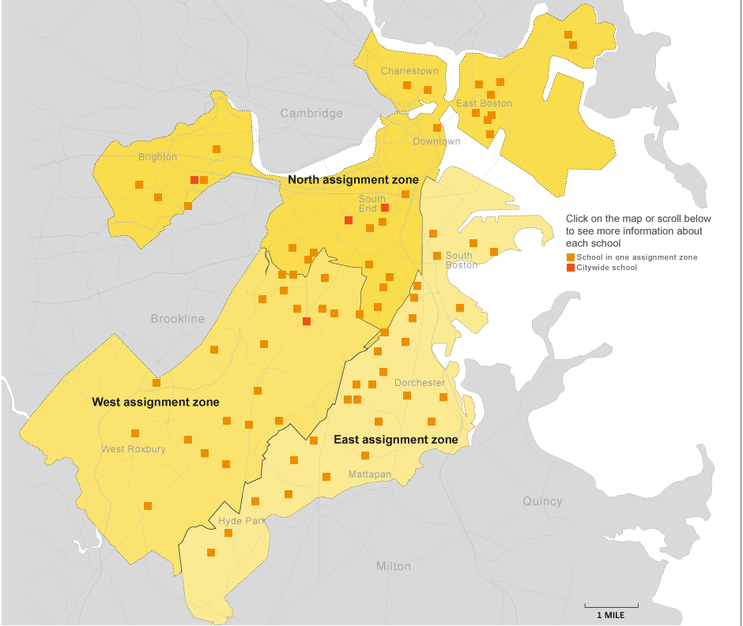
Current Zoning
School Year 2011-2012:
57,000 students across 125 schools and 3 zones

Slide 25
The Boston Mechanism rises again

Slide 26
Although DA is strategy-proof, BM can improve welfare under some conditions
Correlated ordinal preferences
  Students rank school similarly
Coarse priorities
  Schools are indifferent between most students, except for those in different priority groups
Consider welfare using cardinal preferences
  This allows us to rank preferences over probabilistic outcomes
Measure ex-ante welfare
  Welfare is a probabilistic function of unknown lottery numbers and preferences of other students
Abdulkadiroglu, Che and Yasuda (2011)

Slide 27
Assumptions are reasonable in the Boston school choice context
Correlated ordinal preferences
  Supported by anecdotal evidence found by the Boston Globe
Coarse priorities
  True in Boston, not necessarily true in other cities
Cardinal preferences
  Two students may rank a school as their first choice, but one may have a stronger preference for that school over their second choice
  Manipulation in BM allows students to express preference intensities
Ex-ante welfare
  Students know own preferences and priority ranking within schools
  Know distribution of other students’ preferences; lottery number unknown
Abdulkadiroglu, Che and Yasuda (2011)

Slide 28
Given these assumptions, BM improves welfare compared to DA
In a symmetric equilibrium of BM, students are weakly better off than in dominant strategy equilibrium of DA
Naïve players can benefit from the presence of sophisticated players
  Sophisticated players may avoid ranking popular schools as their first choice, increasing chance that a naïve player gains a place there
  Researchers disagree on this point—see Miralles (2008)
Truth-telling is an equilibrium, though not a dominant strategy
  When participants tell the truth, BM is Pareto efficient
Abdulkadiroglu, Che and Yasuda (2011)

Slide 29
Empirical results confirm that BM can improve on DA
Graph from Miralles (2008)
As students’ preferences become more correlated and more schools are considered, BM shows more improvement over DA

Slide 30
Returning to our example, overall welfare is greater when using BM over DA
Boston Mechanism Results
Two students receive 1st choice, one receives 3rd choice
Deferred Acceptance Results
Two students receive 2nd choice, one receives 3rd choice
1
2
3
2
3
1
2
3
1
1
2
3

Slide 31
Alternative mechanisms

Slide 32
Alternative Mechanisms
Summary
“Efficiency-Adjusted Deferred Acceptance Mechanism” (EADAM)
  Identify interrupters who propose to school but are eventually not matched to it and remove school from their preference rankings
Choice-Augmented Deferred Acceptance (CADA)
  Introduces a signaling device (“target” school) that allows students to express preference intensity
BM Corrective Device
  Protects naïve players by removing overdemanded schools with no available spots from preference lists before each round

Slide 33
EADAM mechanism may balance tradeoffs between BM and DA
Kesten (2010) proposes “Efficiency-Adjusted Deferred Acceptance Mechanism”
Mechanism overview
  Identify “interrupters” who propose to a school in DA, replacing another student, but do not eventually match with that school
  Remove this school from the interrupter’s preferences and re-run DA, if student consents to have priority waived
Efficiency and incentive properties
  Pareto-dominates DA
  Not strategy-proof, but truth-telling is an equilibrium and manipulation is difficult
  Students have no incentive against consenting to waive priority

Slide 34
Student 3 is an interrupter…
Not Yet Matched
Final Matching
1
2
3
1
2
3

Slide 35
…by waiving his priority at school 1, he can improve the other students’ outcomes
Not Yet Matched
Final Matching
1
2
3
1
2
3

Slide 36
Choice-Augmented Deferred Acceptance
CADA – Abdulkadiroglu, Che, Yasuda (2012)
Adds a form of signaling to the DA mechanism
  Gives students the (beneficial) option of revealing cardinal preferences
Applicable in coarse priority environments, like Boston
Takeaway: “CADA implements a more efficient ex ante allocation than the standard DA algorithms, without sacrificing the strategyproofness of ordinal preferences.”

Slide 37
CADA Steps
Preference Revelation
Step 1: Students submit ordinal preferences, like usual, but also name one “target school”
Step 2: Each student assigned two lottery numbers: a regular one and a target one.
  Take students in first priority group and order them using target lottery number. Order those who did not target the school below them. Then repeat this process for all following priority groups.
Step 3: Use DA mechanism to assign students using the redesigned priority lists from Step 2.

Slide 38
CADA Example
Five students: K = {1, 2, 3, 4, 5}
Two schools (no priorities): S = {A, B}
Regular lottery result: R(K): {3 – 4 – 1 – 2 – 5}
Targets: A: 1, 3, 4 B: 2, 5
Target lottery: T(K): {3 – 5 – 2 – 1 – 4}
Priority Lists
  P_{A}(K): 3 – 1 – 4 – 2 – 5
  P_{B}(K): 5 – 2 – 3 – 4 – 1

Slide 39
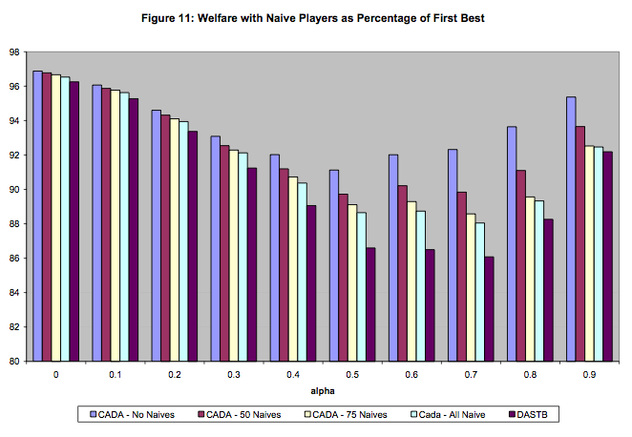
Welfare Comparison (CADA vs. DA)
Alpha: randomly drawn value from 0 to 1 that determines student preferences (α=0 means completely uncorrelated preferences)

Slide 40
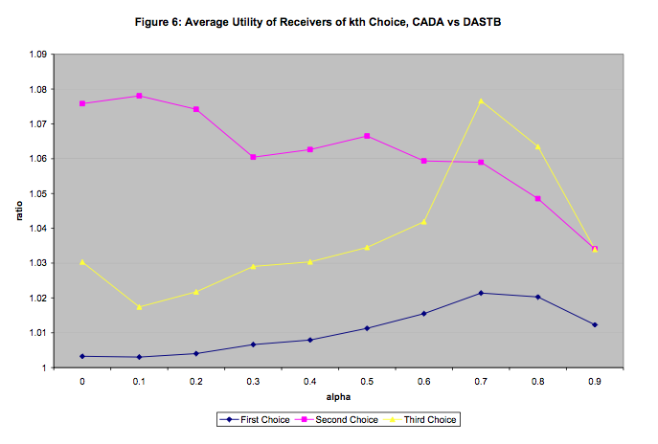
Benefits of Cardinal Preference Revelation
    “Those who have less to lose from the second- or third-best choices are more likely to target those schools, and are thus more likely to comprise such assignments.”

Slide 41
Drop Overdemanded Schools
Miralles (2008)
Corrective device in BM: In each round, move overdemanded schools that are filled to the bottom of students’ preference rankings. Then move up each subsequent school by one slot.
Benefits
  Protects naïve students/parents
  Simple addition, not costly

Slide 42
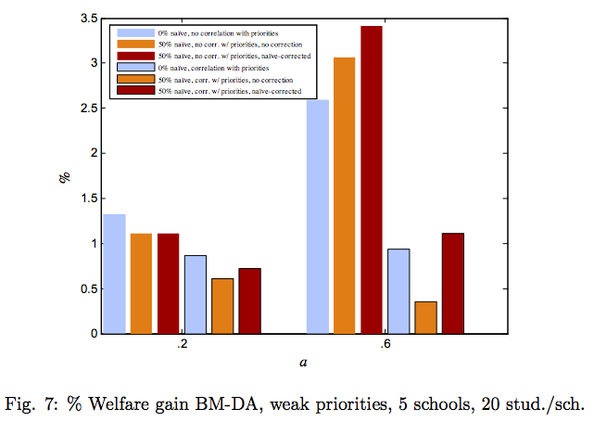
Welfare Comparison (Corrective Device vs. DA)
Corrective device increases welfare gains in environment with naïve students
Key point: sophisticated students not harmed in a simulated but realistic environment
In this case, no tradeoff between efficiency and fairness!

Slide 43
What’s happening in Boston now?

Slide 44
Boston’s current situation
Summary
Mayor ordered new mechanism for 2014-2015 implementation
Deferred acceptance is no longer well-received
  Community complaints: difficult to navigate, time-intensive process, etc.
  Has not contributed to racial equality in BPS
  Has not stemmed outflow of students from BPS
Charged External Advisory Committee (EAC) with proposing new plans
  Came up with 5 plans: 4 of 5 involve increasing # of zones (reducing choice)
  MIT graduate student has proposed his own plan that is the current favorite
  TBD!

Slide 45
People no longer like Deferred Acceptance
The current plan “has the unintended effect of driving families out of the city.” -Glyn Polson, city parent
  More than 50% of children who do not get desired K or pre-K program leave the public school system for good
Feedback (mostly complaints) about the current mechanism*
  Too complicated
  Takes too much to research with no certainty of desired result
  Difficult to navigate
  Current priorities (siblings and walk zones) should be kept
*More than 2000 survey respondents (online and community forums)

Slide 46
Insufficient fairness
Racial equality has not been achieved
The current system is “highly unequal and segregated in a variety of ways.”
-Metropolitan Area Planning Council
 | % of total BPS students | % attending high- or medium-quality schools
Hispanic | 42 | 61
Black | 35 | 52
White | 13 | 84
Asian | 8 | 77

Slide 47
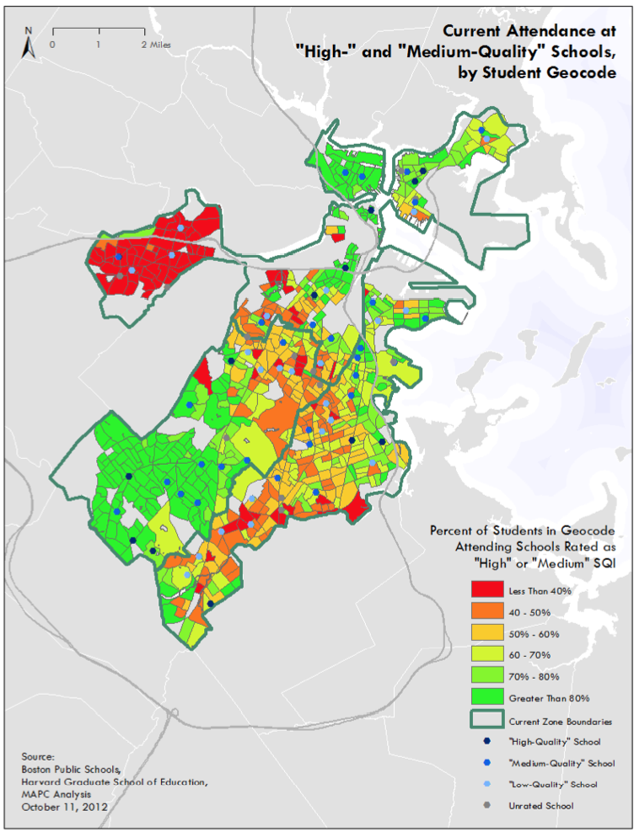
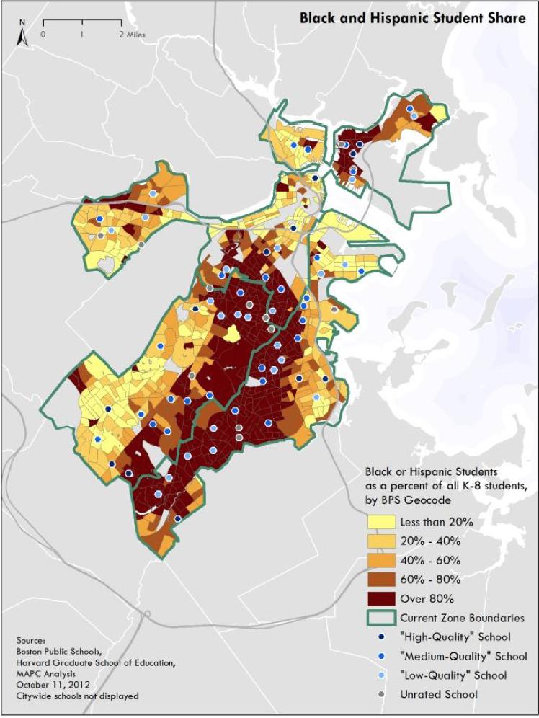

Slide 48
Call for Change
In Jan. 2012 State of the City address, Boston Mayor Thomas Menino vowed to change the school choice mechanism
“Today’s system is too complicated, frustrating, and unpredictable for too many of our families.”
Wants to implement a new mechanism that is “fair, follows the laws of common sense, and prioritizes placing students in quality schools that are closer to their homes.”

Slide 49
High transportation costs
Cause and effect?
Transportation Costs
The importance of neighborhoods
$80.4M per year
9.3% of BPS’s operating budget
    More than double the national average
About $1500/student cost
Racial history must be noted
  Student busing is an especially sensitive issue
“These children can be together, and they can work with each other on homework. … That’s what we want to get to.”
  –Mayor Menino
“The neighborhood loses this bond between families if the children in it aren’t friends.”
-Lisa Gonsalves, professor of education at UMass-Boston

Slide 50
Proposals
The original five
The External Advisory Committee (EAC) formed by Menino released the following five plans in Sept. 2012
Four simply readjust the number of zones (fewer choices!)
  6, 9, 11, 23 zones
Fifth eliminates all zones: students assigned to school closest to home that has available seats
According to the Boston Globe, 9-zone proposal was frontrunner

Slide 51
Back to the drawing board
MIT graduate student Peng Shi’s plan
Step 1: At least four schools in a student’s walk zone that have available spots are offered to the student as options
Step 2: The “override” mechanism
  If all of these schools are bad, a matching scheme makes at least one better school in a different district available to the student
Immediate concern: But what about the kids living near those good schools?
Co-chair of EAC Helen Dajer: “Creative and dynamic” plan that is the best starting point for the committee’s recommendation

Slide 52
Timeline
Recommendation to superintendent and School Committee:
November → now mid-December
School Committee vote:
December → maybe in mid-January
Implementation:
A new mechanism should still be used to assign students for 2014-2015

Slide 53
Summary: What have we learned?
The Boston Mechanism is not strategy-proof, and therefore was seen as unfair to naïve students in BPS
DA was chosen to replace it because it was simple, strategy-proof and eliminated justified envy
But, the Boston Mechanism may achieve greater overall welfare than Deferred Acceptance when using realistic assumptions about school priorities and student information
Boston is currently preparing to switch from DA to a new mechanism, as yet undecided

Slide 54
Perhaps it’s not the mechanism’s fault…
  “I commend the [EAC] for looking at ways that would ensure equitable access to quality schools, but at the end of the day there just isn’t enough quality to go around.”
-Kim Janey
MAPC senior project director

Slide 55
References
Abdulkadiroglu, Atila, Yeon-Koo Che, and Yosuke Yasuda. 2008. “Expanding ‘Choice’ in School Choice.” Unpublished.
Abdulkadiroglu, Atila, Yeon-Koo Che, and Yosuke Yasuda. 2009. “Resolving Conflicting Preferences in School Choice: The ‘Boston’ Mechanism Reconsidered.” Unpublished.
Abdulkadiroglu, Atila, Parag Pathak, and Alvin E. Roth. 2005. “The Boston Public School Math,” American Economic Review, Papers and Proceedings, 95, 368-371.
Abdulkadiroglu, Atila, Parag Pathak, Alvin E. Roth, and Tayfun Sönmez. 2006. “Changing the Boston School Choice Mechanism.” National Bureau of Economic Research Working Paper 11965.
Abdulkadiroglu, Atila, and Tayfun Sönmez. 2003. “School Choice: A Mechanism Design Approach.” American Economic Review, 93(3): 729–47.

Slide 56
References (cont.)
Chen, Yan, and Tayfun Sonmez. 2006. “School Choice: An Experimental Study," Journal of Economic Theory, 127: 2002-231.
Ergin, Haluk, and Tayfun Sönmez. 2006. “Games of School Choice under the Boston Mechanism.” Journal of Public Economics, 90(1–2): 215–37.
Featherstone, Clayton, and Muriel Niederle. 2008. “Ex Ante Efficiency in School Choice Mechanisms: An Experimental Investigation.” National Bureau of Economic Research Working Paper 14618.
Kesten, Onur. 2008. “School Choice with Conesnt,” Quarterly Journal of Economics.
Miralles, Antonio. 2008. “School Choice: The Case for the Boston Mechanism.” Unpublished.
Pathak, Parag A., and Tayfun Sönmez. 2008. “Leveling the Playing Field: Sincere and Sophisticated Players in the Boston Mechanism.” American Economic Review, 98(4): 1636–52.

Slide 57
References (cont.)
"A Bid for Equity in School Choice Plan." The Boston Globe,
http://www.bostonglobe.com/metro/2012/10/26/low-income-students-could-get-priority-student-assignment/XGrl73xhZvIOwMSWUzAEpK/story.html 2012.
Andersen, James Vaznis and Travis. "Plans Upend Boston School Assignments." The Boston Globe, http://www.bostonglobe.com/metro/2012/09/24/boston-school-assignment-plans-unveiled/VwPfsawAqC8waWF24ZzqmI/story.html 2012.
Cook, Gareth. "School Assignment Flaws Detailed." The Boston Globe, https://www2.bc.edu/~sonmezt/Bostonglobestoryonschoolchoice.htm 2003.
Ebbert, Jenna Russell and Stephanie. "The High Price of School Assignment." The Boston Globe, http://www.boston.com/news/education/k_12/articles/2011/06/12/the_high_price_of_school_assignment/ 2011.
Ebbert, Stephanie. "Selection Process Starts with Choices, Ends with Luck." The Boston Globe, http://www.boston.com/news/education/k_12/articles/2011/03/13/selection_process_starts_with_choices_ends_with_luck/ 2011.
Fox, Jeremy C. "Ripples of Worry over Quincy School’s Future." The Boston Globe, http://www.bostonglobe.com/metro/2012/10/21/ripples-worryover-school-future/RfDMzWMIC0zRR8veWCvK8J/story.html 2012.

Slide 58
References (cont.)
Glaeser, Edward L. "Boston School-Assignments: Listen to the Nobel Committee." The Boston Globe, http://www.bostonglobe.com/opinion/2012/10/18/boston-school-assignments-listen-nobel-committee/x1TwBic9f5Ex5iHxtDtSMM/story.html 2012.
Handy, Delores. "Debate on Overhauling Boston Schools’ Assignment System Continues." WBUR (NPR), http://www.wbur.org/2012/11/13/boston-school-assignment-system.
Harmon, Lawrence. "Finally, Getting Kids Off the Bus." The Boston Globe, http://www.bostonglobe.com/opinion/2012/03/03/finally-getting-kids-off-bus/fXVQbSURHy75QlNliNeugO/story.html 2012.
"Let Students Stay near Homes — but Offer Choice as Needed." The Boston Globe, http://www.bostonglobe.com/opinion/editorials/2011/12/14/let-students-stay-near-homes-but-offer-choice-needed/cEOD12oXMK6TM4eP6pkRsN/story.html 2011.
"MIT Has Plan for Boston School Assignments." The Boston Globe, http://www.bostonglobe.com/metro/2012/10/27/boston-panel-winnow-options-for-school-assignment-changes-new-mit-proposal-leaps-top/jy8yIsqjLM23w9ECHXpknM/story.html 2012.
"Parents’ Anxiety Grows as Summer Fades." The Boston Globe, http://www.boston.com/news/education/k_12/articles/2011/08/14/parents_anxiety_grows_as_summer_fades/ 2011.

Slide 59
References (cont.)
Reardon, Tim. "Comparative Analysis of Boston Public School Proposed Assignment Plans " In http://bostonschoolchoice.files.wordpress.com/2012/10/mapc_bps_assignmentmemo_10_12_12_2.pdf: Metropolitan Area Planning Council, 2012.
"Relief, Dismay, Even Guilt Greet Student Placements." The Boston Globe, http://www.boston.com/news/education/k_12/articles/2011/03/28/boston_parents_get_school_assignments/ 2011.
Russell, Jenna. "An Early Education in the Meaning of ‘No’." The Boston Globe, http://www.boston.com/news/education/k_12/articles/2011/05/08/in_boston_school_lottery_living_close_simply_isnt_enough/ 2011.
Russell, Stephanie Ebbert and Jenna. "A Daily Diaspora, a Scattered Street." The Boston Globe, http://www.boston.com/news/education/k_12/articles/2011/06/12/on_one_city_street_school_choice_creates_a_gap/ 2011.
Seelye, Katharine Q. "4 Decades after Clashes, Boston Again Debates School Busing." The New York Times, http://www.nytimes.com/2012/10/05/education/new-boston-busing-debate-4-decades-after-fervid-clashes.html?pagewanted=all&_r=0 2012.
"Split Decisions on School Lottery." The Boston Globe, http://www.boston.com/news/education/k_12/articles/2011/04/22/parents_shut_out_of_boston_pre_k_classes_despair_while_others_rejoice_in_top_picks/ 2011.

Slide 60
References (cont.)
Vaznis, Andrew Ryan and James. "Menino Vows Change in School Assignment System " The Boston Globe, http://www.bostonglobe.com/metro/2012/01/17/boston-mayor-thomas-menino-vows-radically-change-boston-school-assignment-lottery-state-city-speech/fUHyHSZmn3OqhXfhSfk07O/story.html 2012.
Vaznis, James. "Taking a Chance, Making a Choice." The Boston Globe, http://www.boston.com/news/education/k_12/articles/2011/03/13/taking_a_chance_making_a_choice/ 2011.
"Who Is That Masked Man?". http://parentimperfectct.wordpress.com/2012/10/31/who-is-that-masked-man/, 2012.

