Slide 1
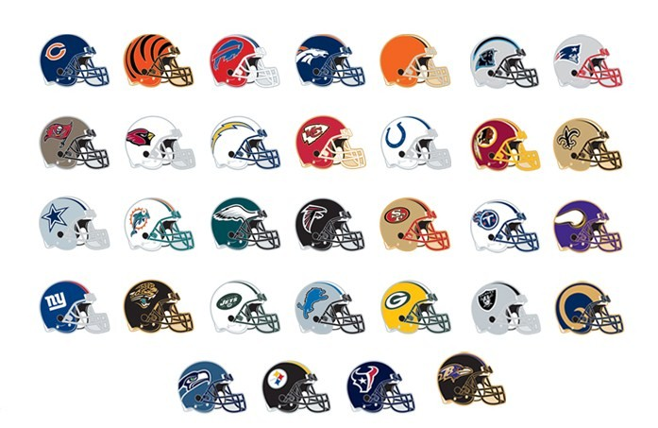
NFL Draft
Market Design Applications and Alternative Proposals
Robby Yass and Gordon Hood

Slide 2
History of NFL Draft
Annual Event since 1936
All 32 NFL teams select new eligible players
7 rounds, 32 picks per round (first two rounds)
Teams with worst record gets first pick in each round, team with second worst record gets second pick, etc. (excluding trades)
NFL Draft 2010 was over a three day period (previously was completed in two days)
Notes:
In third-seventh rounds there are an additional 32 picks that each team gets. These picks, known as "compensatory picks," are awarded to teams that have lost more qualifying free agents than they gained the previous year in free agency.
Three day- more TV ratings. Sell more draft day tickets
These new eligible players mostly include collegiate players coming out of their junior or senior year.
4th bullet- first team to lose first in playoffs gets 20th pick, superbowl champ gets last pick.

Slide 3
Current Draft Rules
Earlier picks generally get the highest contracts
10 minutes per pick in 1st round
7 minutes per pick in 2nd round
5 minutes per pick in 3-7th rounds
NFL allots each team a certain amount of money from its open salary cap to sign its drafted rookies
Notes:
You don’t get a contract when drafted – usually discussed between player, agent, and team at a later date.

Slide 4
Problems with Current System
Teams with worst records often are forced to draft players at prices they cannot afford (trade difficulties)
2007 study suggested that the first pick of the NFL draft is the least valuable pick of the first round
Players do not have a contract once drafted: often leads to holdouts by players
Draft format has barely changed in 75 years despite a highly transformed league.
No way of knowing what a player is worth on the open market
Notes:
Example of no way of knowing what a player is worth on the open market:
In 1998, the Indianapolis Colts used the first pick to draft Peyton Manning, who has gone on to become an excellent NFL quarterback. The next year, the Cleveland Browns used their top pick on Tim Couch, who was even at the time considered much worse than Peyton. Nonetheless, Tim Couch still got a nearly identical salary of $48 million and a signing bonus of $12 million. Tim Couch ended up played only 62 games before retiring.
4th bullet- ironic because NFL is a league that tries to fix everything (helmet to helmet, low hits, fines, etc).

Slide 5
2007 Study
Paper by Massey-Thaler
“The Loser’s Curse: Overconfidence vs. Market Efficiency in the NFL Draft”
Teams are overconfident in their abilities to choose best players
The top picks are overvalued relative to later picks, both in terms of what teams are willing to trade to move up in the draft and in terms of salary

Slide 6
Problems with Current System
Both players and agents agree a more free-market system would work better for both.
Many complain that the draft takes too long and is dull (affect TV ratings)
Roger Goodell thinks problems teams have signing first-round picks can be solved by limiting rookie salaries.
NFL players union is firmly against lowering salaries(talk of a lockout for 2011 season)
Notes:
Roger Goodell is the NFL Commissioner
By limiting rookie salaries, the NFL then can drive down salaries in general.

Slide 7
Alternative Solution
All 32 teams still get seven draft picks (tradable)
Each team is given a certain salary that they can spend on players in the draft
Teams with the worst records will get the highest amount to spend
Every team will bid on a certain player at the same time
Simultaneous ascending auction
Notes:
Three Economists from Harvard – Coffman, Ashlagi, Fainmesser
Each team would make their 7 picks all at once and bidding wars would ensue for teams that bid on the same player.

Slide 8
Example

Slide 9
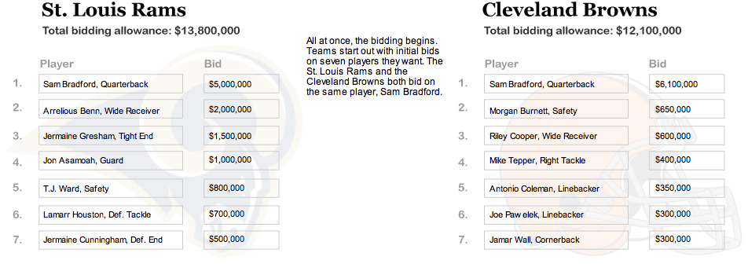

Slide 13
Issues with this proposal
Hard to track player’s progress
Very different from current draft (Goodell may be reluctant to sign off on it)
Could be very long, drawn out process
May not translate to real-world.
Not necessarily good for TV or spectators (how to televise it)
This long of a continuous auction could cause confusion among teams and draftees (abstract)
Notes:
4th bullet- makes sense for market design but not all may understand it.

Slide 14
Revised Alternative Solution
Matching mechanism (players to teams)
Works similar to auction markets
Same as previous draft examples except for these changes:
There is the same current draft format in today’s NFL draft with the exception:
The team who would have gotten the first pick in today’s draft now instead elects a player to bid for at their choice of a starting price (they may not necessarily get the player they elect)
Notes:
For the maximum amount of bidding rounds, the final round can be known as the “Final Bid” where no matter what, the team with the highest bid will get the player for that value or the value of the second highest bidder.

Slide 15
Revised Alternative Solution
All other interested teams bid on the elected player simultaneously
The draft board will consolidate the highest bids and there will be a re-bid
Teams indicate their maximum value for a player next to their actual bid which only the draft board sees (hidden from other teams)
Teams will continually re-bid until no team wants to outbid the highest bidder (may be a possible limit to amount of bidding rounds)

Slide 16
Example Bid (for Sam Bradford)
The St. Louis Rams have the worst regular season record and are designated $14 million dollars in draft salary
The Cleveland Browns (2nd worst) are designated $12 million dollars
The Detroit Lions (3rd worst) are designated $10 million dollars
5 other teams want Sam Bradford and have draft salaries ranging from $5-6 million
Notes:
Sam Bradford was the 2008 Heisman Trophy winner and was the highest valued player at the draft by most teams.

Slide 17
Example Bid (for Sam Bradford)
All Bids are made at the same time
Rams with first pick, elect to bid on Sam Bradford at a starting price of $5 million, $9 million*
Browns bid $6.5 million, $7 million*
Lions bid $5.25 million, $5.5 million*
No other remaining teams have maximum value over $4 million
Notes:
$12 million is the maximum value for Bradford that the Rams have. Browns have a maximum value for Bradford of $7 million, etc.

Slide 18
Example Bid (for Sam Bradford)
Rams and Browns are the remaining contenders for Bradford
New Bidding Round:
Rams bid $7.5 million
Lions do not participate in second round bidding because 6.5 is greater than their maximum value
Browns bid their max bid of $7 million
Rams win bid and pay $7 million
Notes:
Per round there should be an increment that the teams need to increase their bid by (could be a percentage of the highest bid)
e.g. 5% of the highest 1st round bid (Brown $6.5 million would be 325,000 so Browns next smallest big could be $6.825 million)

Slide 19
Minimum Bids in Subsequent Rounds
Minimum bid on a player would still be the NFL league minimum (for rookies in 2010 is was $325,000)
Some teams may not wish to draft a player for more than minimum
The team who elects to bid the minimum on a player will get him if no other teams bid more

Slide 20
Example of a later round Bid
It is the 6th round, 23rd pick of the draft
Philadelphia Eagles get to elect a player to bid on
They choose Jorrick Calvin.
Chargers and Titans are also interested
All teams bid minimum ($325,000)
Rebid (unless Chargers and Titans maximum is equal to $325,000)

Slide 21
Rebid Possibilities
1) No teams want to pay higher → Eagles win
2) Chargers bid $341,250
Eagles are given option to match bid
If they match it and Chargers do not rebid at $357,500 or more, Eagles Win, and pay $341,250
3) Chargers bid $357,500 in third round of bidding
Eagles do not elect to bid higher. Chargers pay $341,250 and win Jorrick Calvin
Overall, gives slight advantage to elector
Notes:
Can’t use mock drafts as order – teams should choose to elect player in every round in the same order as it were in previous drafts.

Slide 22
Salaries
Bids then become salaries for players
Contractual Salary: Pay is broken down to per game pay, limits the risk of busts
Excludes injuries
Notes:
When it comes to bidding for minimum salary players, the next lowest bid for a player would be $325,000 + $16,250 =$341,250. ($325,000 x .05 = $16,250)
Last slide point on electing of bidding is talked about in later slides along with bid increments.
What is the average salary of a player drafted in each rounds.

Slide 23
Determining Team Draft Salary Caps
NFL would set salary cap standards with worst team getting the highest salary cap and the best team from previous year receiving the least amount of money to spend.
This allows the NFL to regulate salaries and still keep players happy
Players will be getting paid the most possible (within cap range)

Slide 24
Cautionary Note
Both designs could lead to repugnance
Walking someone onto a stage bidding on them for physical service could be bad for the NFL's image
Somewhat resembles a slave auction
Notes:
If this becomes an issue, one could easily refrain from putting the player on stage, and he won’t walk up until the final bid is made.

Slide 25
Other Possibilities
Best Record First
Secret Picks
Paper Scrap Out of Hat
Free Market

