Slide 1
Undergraduate Projects at Brown University
Brown University
Human Research Protection Program
Office of research integrity
Https://www.brown.edu/research

Slide 2
Who is the IRB and What Do They Do?
Institutional Review Board
Ensures that all approved research complies with the letter and spirit of human research protection regulations
Notes:
IRBs consist of scientists, non-scientists, community members
Committee tasked with reviewing research proposals to ensure that they comply with federal regulations protecting the rights of human research participants.
Balance potential benefits and risks for participants
Make sure participants are adequately informed about what they will be doing and can freely give their consent to participate.

Slide 3
Research + Human Subjects
= IRB Review
45 CFR 46.102
Notes:
Code of Federal Regulations that guide all of our work at the IRB comes from Title 45 CFR (Public Welfare – Department of Health and Human Services) Part 46 (Protection of Human Subjects)
If RESEARCH is being conducted with HUMAN SUBJECTS, then the study needs to be reviewed by an IRB

Slide 4
A human subject is defined by federal regulations as “a living individual about whom an investigator conducting research obtains (1) data through intervention or interaction with the individual, or (2) identifiable private information.” (45 CFR 46.102(f)(1)(2))
Federal Regulations define research as “a systematic investigation, including development, testing, and evaluation, designed to develop or contribute to generalizable knowledge”.(45CFR46.102(d))
Learning how to conduct ethical research with human subjects is a vital part of many students’ educational experience.
Often undergraduate student projects do not meet the federal definition of human subjects research

Slide 5
What is a Human Subject?
“A living individual about whom an investigator conducting research obtains:
Data / biospecimens through intervention or interaction with the individual (primary data collection),
or
Identifiable private information / biospecimens (secondary data collection)
Notes:
Now that we’ve defined what research is, what about human subjects?
“Living” – research on deceased individuals does not meet this definition (cadaver studies; researching medical records of deceased patients)
“About whom” – research needs to be ABOUT a live person; not just collecting data FROM a live person.
Primary or secondary data collection: intervention or interaction with the person OR Secondary data collection – receive data from another source that has identifiable private information.
Identifiable means you can reasonably ascertain the person’s identity (not just name, but could include photograph, voice recording, address, social security number).
Private means not publicly available – need permission to access

Slide 6
Learning how to conduct ethical research with human subjects is a vital part of many students’ educational experience
Often undergraduate student projects do not meet the federal definition of human subjects research
A human subject is defined by federal regulations as “a living individual about whom an investigator conducting research obtains (1) data through intervention or interaction with the individual, or (2) identifiable private information.” (45 CFR 46.102(f)(1)(2))
Federal Regulations define research as “a systematic investigation, including development, testing, and evaluation, designed to develop or contribute to generalizable knowledge”.(45CFR46.102(d))
One’s ambition to publish the results of a project in a journal does not in and of itself make the project “research.”

Slide 7
Key Informants vs Human Subjects
Key Informants
Human Subjects
Any individual who provides information on topics other than themselves. Examples may be describing a clinic's intake policy or demographics of a local community. When conducting surveys or interviews, a key informant is not considered a human subject since they do not share personal information or opinions, therefore this activity does not require review.
A living individual about whom an investigator (whether professional or student) conducting research: (i) Obtains information or biospecimens through intervention or interaction with the individual, and uses, studies, or analyzes the information or biospecimens; or (ii) Obtains, uses, studies, analyzes, or generates identifiable private information or identifiable biospecimens.

Slide 8
That finally makes sense!
Now what should I do to conduct an Undergraduate project?

Slide 9
Consult with Faculty Advisor Responsibilities of Faculty Advisors:
Mentor the student project researcher in the proper conduct of research and the protection of human subjects
Faculty Advisors must mentor their student researchers regarding ethical principles for the protection of human subjects, which includes completion of the CITI training
Review the student’s Undergraduate Project Application and submit the form to the HRPP
Review all methods and instruments used in the project
Document that the student receives permission to conduct the project at any institutions or organizations outside of Brown University
Notes:
The IRB recognizes only ONE PI for each protocol
The PI has ultimate responsibility for the research activities
Protocols that require skills beyond those held by the PI must either be modified to meet the investigator’s skills, OR have one or more additional qualified faculty as co-investigator(s).
Undergraduates cannot be the PI – the advisor must be listed as the PI

Slide 10
Faculty Advisors Continued
Oversee any change to the project to ensure that they comply with the terms the Undergraduate Project Application’s assurances
Upon discovery, notify HRPP of any change to the project that do not comply with the terms the Undergraduate Project Application’s assurances
Monitor the project and inform the HRPP immediately if any significant problems arise.

Slide 11
Faculty Advisors
Who should be a faculty advisor?
An active mentor to the student researcher
Experience with human subject research at Brown
Notes:
Can: Brown faculty; not visiting, not outside; does not have to be the same as thesis advisor or committee chair; must be CITI trained
Should: active mentor; experience with HSR, preferably at Brown; willing to work with you and sign off on all documents, measures, etc. They are considered an investigator with a vested interest and say in the research

Slide 12
Training
The Collaborative Institutional Training Initiative: http://www.citiprogram.org
Principle Investigator (PI) and advisor
Different groups/curricula (group 1, 2, or 3)
Other institutions’ appropriate trainings completed within the past 3 years
Refresher (up to 3 times)
Notes:
CITI Program has training modules for research ethics and compliance, and this program is what Brown and many other institutions use.
The principle investigator (PI) and his/her advisor (if PI is a student) must be CITI trained before beginning human subjects research. We will not approve a study if the PI/advisor are not CITI trained or have an equivalent certification. Certification is good for 3 years.
CITI offers different modules or groups for different types of research: Group 1, 2, or 3 (G1 = social behavioral educational researchers; G2 = biomedical researchers; G3 = biomedical data or specimens only researchers)
Group 4 = Brown researchers who have completed a basic CITI training course at another institution within the past 3 years; must provide copy of current certification.
Group 5 = HIPAA certification, if you will be collecting or receiving protected health information (PHI)
GCP = Brown researchers who will be conducting an NIH-funded clinical trial
Once you have a Brown CITI certification, every 3 years you can take an abridged refresher course to renew your certification.

Slide 13
Level 1: Undergraduate Work That Does Not Require IRB/HRPP Oversight
The activity is designed for learning purposes only or done for a class project or grade
Data collection procedures present only minimal risk to the subjects
minimal risk: The probability and magnitude of physical or psychological harm that is normally encountered in the daily lives or in the routine medical, dental, or psychological examination of healthy persons.
Vulnerable populations (i.e. children, prisoners, cognitively impaired individuals) are not used
Data is collected in a manner such that subjects are not identifiable.

Slide 14
Level II Review: Undergraduate Work That Requires HRPP Notification
The project is designed and conducted solely for the purpose of the student’s educational experience or undergraduate thesis
No use of children or other vulnerable populations
Risk is not more than minimal
All software or services are approved and listed in Brown’s Software Catalog

Slide 15
Level II Review: Undergraduate Work That Requires HRPP Notification
No use of deception
deception: Occurs when an investigator gives false information to, or otherwise intentionally misleads, a research participant about some key aspect of the research to avoid biased responses.
No use of video recording
Data is collected in a manner such that the subjects are not identifiable or their confidentiality is protected

Slide 16
Level III Review
Any undergraduate project involving human subjects that falls outside of the above conditions requires a standard IRB application submission found on our Forms & Templates webpage with the Faculty Advisor acting as the Principal Investigator.

Slide 17
COVID-19
Provide resources to participants when asking about their experiences with the pandemic
Examples provided here
Include remote procedures in your Undergraduate Project Application

Slide 18
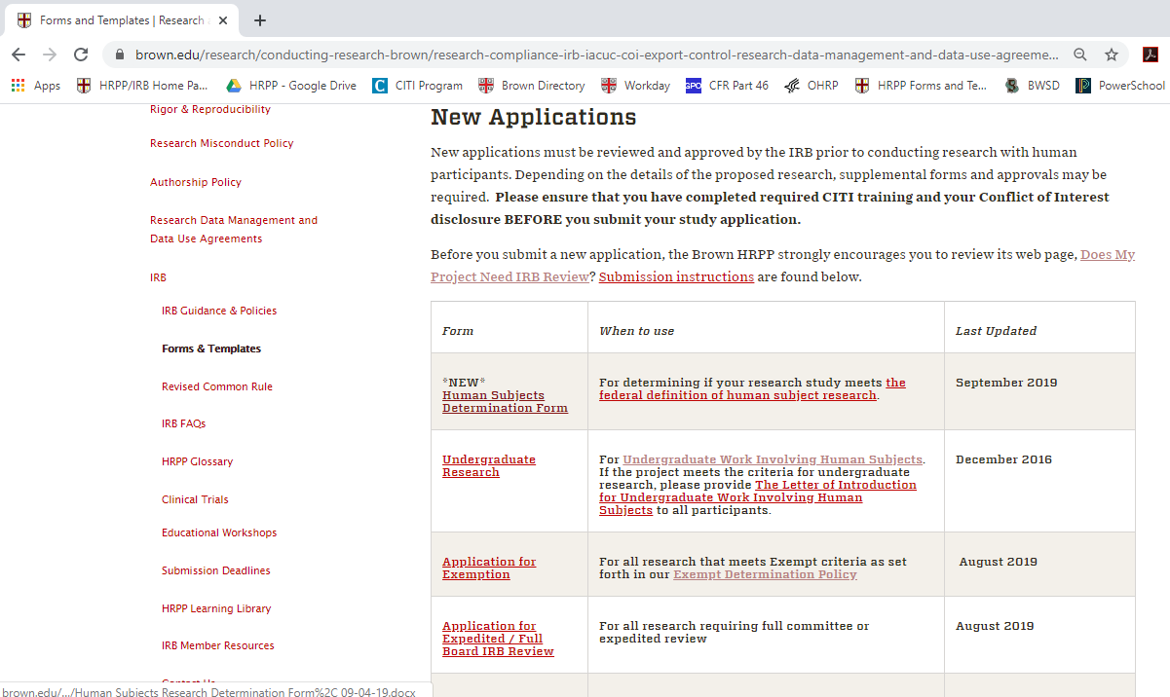

Slide 19
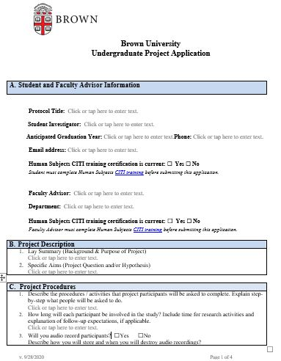
Notes:
Letter of Intro
Wait until Monday if you can

Slide 20
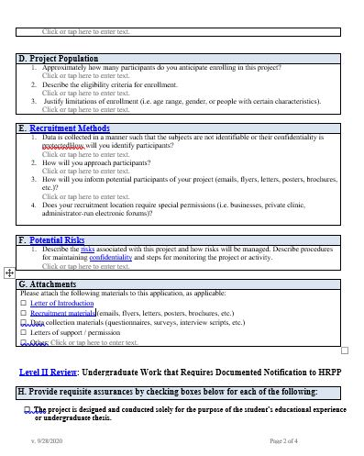

Slide 21
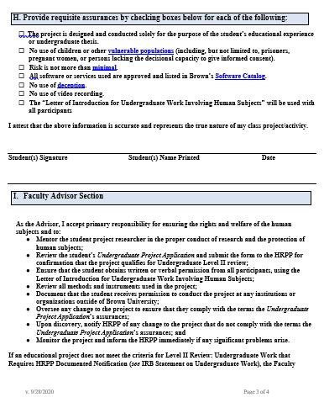

Slide 22
Application Preparation
Determine type of review
Complete application
Include attachments (consent documents, survey/interview/focus group questions, letters of support, recruitment materials, etc.)
Submit as a single pdf to IRB@brown.edu
Notes:
If HRPP asks for more information or attachments, include full PDF again

Slide 23
What happens after you submit?
Approval
Contact PI
HRPP review
Entire application
Expert consultations
Additional reviews
Notes:
Consultants (CIS, clinicians, consultant on prisoner studies)
Additional reviews – IAAs
Back and forth with PI with feedback and responses
Then…
Timeline considerations:
Number of submissions
Completeness of submission
Additional expert reviews
Last minute submission for JIT

Slide 24
Submission Pitfalls
Review times
Submit as soon as your application is complete.
Check the HRPP website for current review times
Education
Choose your level of review
Include all attachments needed for review
Make sure the application is signed by both you and your faculty advisor

Slide 25
How can I get approval to work in a lab on campus in light of Brown’s current COVID-related restrictions?
The faculty PI of the lab, and not the undergraduate themselves, must submit a request to add an undergraduate to the lab’s safety plan.
The faculty PI can consult pages 9-10 of the resuming research guidelines for further instructions, and can contact resuming_research@brown.edu with questions. It typically takes 2-4 weeks for such a request to be approved.

Slide 26
Contact Us!
IRB@brown.edu
All HRPP Staff: 863-3050

