Slide 1
A MOSFET Opamp with an
N-MOS Dfferential Pair
Very-like but not quite your assignment

Slide 2
The Schematic: (DxDesigner Drawing)
Startup Set bias current Set cascode Differential pair and current Output stage and load
bias voltage mirror

Slide 3
Device Parameter Estimates from SPICE
Parameter Table for MOSFET Opamp Example
element | model | vds | vgs | vth | vov | id | gm | ro
m1 | nssb | 0.748 | 0.851 | 0.547 | 0.304 | 3.77E-05 | 2.90E-04 | 5.54E+05
m10 | nssb | 3.368 | 0.851 | 0.547 | 0.304 | 4.12E-05 | 3.11E-04 | 8.09E+05
m12 | nssb | 0.711 | 0.711 | 0.546 | 0.165 | 3.51E-05 | 5.01E-04 | 5.05E+05
m13 | nssb | 0.838 | 0.851 | 0.547 | 0.304 | 3.79E-05 | 2.91E-04 | 5.92E+05
m14 | nssb | 3.078 | 1.079 | 0.840 | 0.239 | 3.51E-05 | 3.27E-04 | 8.12E+05
m15 | nssb | 1.092 | 1.092 | 0.836 | 0.256 | 3.79E-05 | 3.31E-04 | 6.32E+05
m18 | nssb | 0.023 | 1.930 | 0.559 | 1.371 | 5.36E-06 | 3.42E-06 | 4.34E+03
m2 | nssb | 3.156 | 0.752 | 0.547 | 0.205 | 1.89E-05 | 2.22E-04 | 1.36E+06
m20 | nssb | 3.929 | 0.023 | 0.594 | -0.571 | 7.88E-12 | 4.17E-13 | 1.00E+12
m3 | nssb | 3.089 | 0.752 | 0.547 | 0.205 | 1.89E-05 | 2.22E-04 | 1.36E+06
m9 | nssb | 1.654 | 0.851 | 0.547 | 0.304 | 5.63E-05 | 4.29E-04 | 5.19E+05
m11 | pssb | 0.478 | 1.632 | 0.746 | 0.886 | -4.1E-05 | 6.34E-05 | 2.13E+04
m11a | pssb | 1.154 | 1.154 | 0.793 | 0.362 | -4.1E-05 | 2.08E-04 | 6.64E+05
m16 | pssb | 1.072 | 1.072 | 0.737 | 0.335 | -3.5E-05 | 1.92E-04 | 7.27E+05
m17 | pssb | 3.070 | 1.072 | 0.727 | 0.344 | -3.8E-05 | 1.99E-04 | 7.14E+05
m19 | pssb | 4.977 | 3.070 | 0.781 | 2.289 | -5.4E-06 | 4.35E-06 | 9.43E+07
m4 | pssb | 0.512 | 1.048 | 0.812 | 0.236 | -1.9E-05 | 1.42E-04 | 8.52E+05
m5 | pssb | 0.579 | 1.047 | 0.812 | 0.235 | -1.9E-05 | 1.42E-04 | 9.19E+05
m6 | pssb | 0.584 | 1.096 | 0.741 | 0.355 | -1.9E-05 | 9.73E-05 | 1.09E+06
m7 | pssb | 0.585 | 1.096 | 0.741 | 0.355 | -1.9E-05 | 9.73E-05 | 1.10E+06
m8 | pssb | 3.346 | 1.164 | 0.726 | 0.437 | -5.6E-05 | 2.35E-04 | 5.96E+05

Slide 4
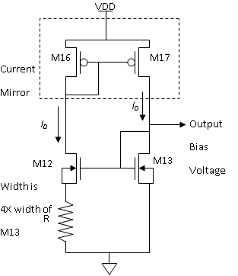
Setting the Bias Current
You don’t have to do this. I give you a current source for your assignment. This is one way to separate the amplifier bias from the exact VDD
M16 and M17 are a conventional current mirror with the input side on the left. M12 and M13 are a modified mirror with input on right and output on the left.
M12 is 4X wider than M13, probably made by parallel connection of 4 copies of M13. Notice that the body of M12 is connected to the source, not to ground (VSS).
ID13 times R is the difference in the overvoltages of M12 and M13. Equating ID13 to ID12 and using KVL, we have:
This has two solutions: both current and V_{OV13} are zero or
This means that

Slide 5
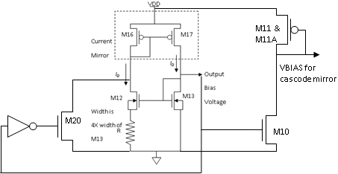
Starting Up the Bias & Providing Cascode Bias
The inverter has a very low gate threshold voltage so its output is only high when the bias voltage is too low.
M20 forces current into the top mirror until the output bias voltage is enough to settle to a final value.
M10 matches M13 so it is a current source with the same standard value as M13.
The current ID10 sets VGS for M11 & M11A (effectively a single transistor) that is used to bias the cascode current mirror.

Slide 6
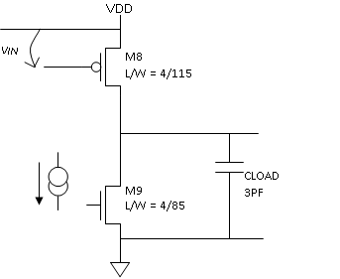
Output Stage at Low Frequency
Common Source Amplifier
Output load impedance from Channel Length Modulation (r₀) in M8 and M9 together with the load and parasitic capacitances
Load resistance =
Gain proportional to the transconductance of M8
Pole at output: f = ??

Slide 7
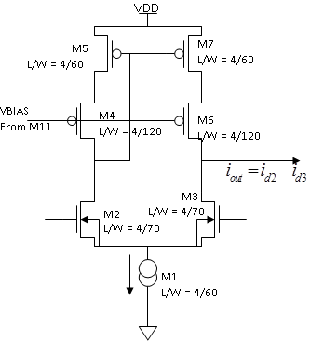
First Stage: NMOS Differential Pair with Cascoded Current Mirror
Output current gain is the transconductance of one of the differential pair transistors (2.22e-4 sie).
The current mirror output impedance is the same problem as the Widlar source and the exam problem.
The differential pair output resistance is just r₀ for one of the differential pair transistors (1.36e6 ohms.)
Node impedance is essentially r₀ of M3.
Gain is

Slide 8
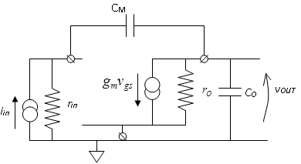
Transfer Function with RM = 0
Zero – Bad for phase!!!
Second pole Miller effect
Dominant pole

Slide 9
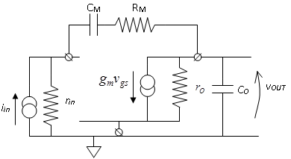
Transfer Function with RM in Place
Zero term bad for phase
Zero – New term good for phase
Make R_{M} > 1/g_{m}

Slide 10
Where Are the Poles?
Denominator polynomial is a quadratic polynomial for which the zeros are:
Using a Taylor series approximation:
Pole frequencies show “splitting” – first pole is lowered and second pole is raised from positions without feedback:

Slide 11
What Is the Slew Rate?
This circuit has a classic differential input pair (M2 and M3) for high CMRR and low DC drift.
It also has a current mirror (M4 – M7) with bias from the drain current of M1: I_{M1Q} = 38 μamps.
A large step input puts all 38 μamps into the Miller capacitor C_{M} = 5.5 pf for S.R. = 6.9 V/ μsec.
C_{M}
VDD
I_{M1Q}
I_{M1Q}
I_{M1Q}
-A₀
i_{in} = I_{M1Q}
v_{OUT}

Slide 12
Final Performance Specifications
Amplifier Property | Value
A₀ – DC Gain | 86 DB (X20,000)
f_{p} – dominant pole position | 400 Hz
f_{GBW} | 8.0 MHz
f_{U} – unity gain frequency | 5.6 MHz
Output stage resistance at low frequency | 277 K
Zero position | 10.7 MHz
Slew Rate | V/sec
Output stage quiescent current | 65 μa
Opamp quiescent current | 103 μa
Bias circuit quiescent current | 104 μa
Total system quiescent current | 210 μa
VDD | 5.0 volts
Total system power | 1.1 mW
Phase margin = 60 deg.

