Slide 1
Why segregate blocking and non-blocking assignments to separate always blocks?
always blocks start when triggered and scan their statements sequentially
Blocking assignment: = (completes assignment before next statement executes)
Non-blocking: <= (all such statements complete at once at end of the always block)

Slide 2
A mixed always block for a funny shifter
module funnyshifter (input data, clk, output reg [3:0] yout);
reg [3:0] asig;
initial asig = 4'b0000;
always @ (posedge clk) begin
asig[1] = asig[0]; // Value of asig(0) on entry written to asig(1) at // end of loop - D-ff
asig[2] = asig[1]; // Value of asig(1) as step written is already // updated so asig(2) = asig(0) at end of loop
asig[3] = asig[2]; // Value of asig(2) as step written is already // updated so asig(3) = asig(0) at end of loop
asig[0] = data; // asig(0) = data at end of loop - D-ff
yout[3:1] <= asig[3:1]; // non-blocking unambiguous D-ff's
yout[0] <= data;
end
endmodule

Slide 3
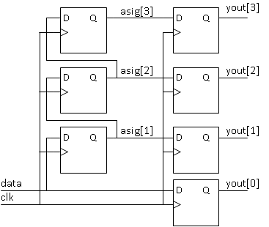
Designer’s Probable Intention – Block Diagram

Slide 4
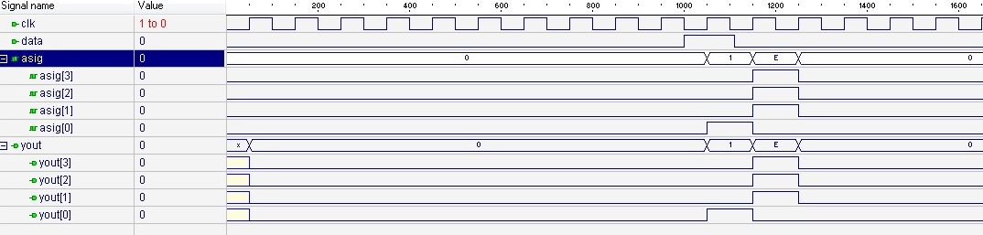
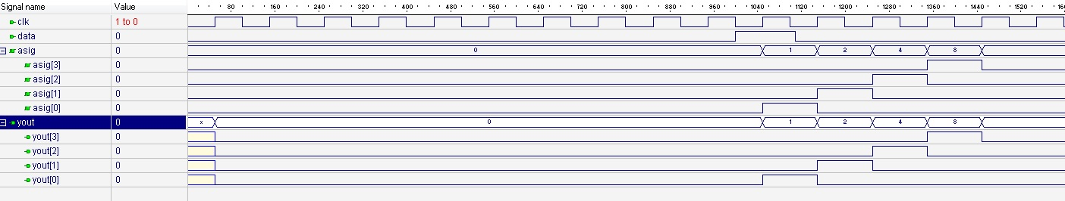
Simulation results for different order of statements
Result with first statement order: asig[3:1] are redundant
Swap first and third lines and there is a double shift register

Slide 5
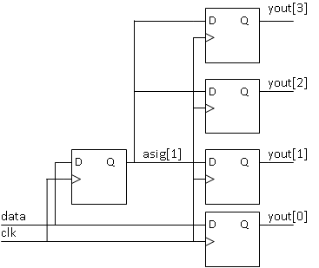
What You Actually Get – Block Diagram

Slide 6
Same mixed always block but different statement order - designer’s probable intention
module funnyshifter (input data, clk, output reg [3:0] yout);
reg [3:0] asig;
initial asig = 4'b0000;
always @ (posedge clk) begin
asig[3] = asig[2]; // Value of asig(2) on entry written to asig(3) at // end of loop - D-ff
asig[2] = asig[1]; // Value of asig(1) on entry written to asig(2) at // end of loop - D-ff
asig[1] = asig[0]; // Value of asig(0) on entry written to asig(1) at // end of loop - D-ff
asig[0] = data; // asig(0) = data at end of loop - D-ff
yout[3:1] <= asig[3:1]; // non-blocking unambiguous D-ff's
yout[0] <= data;
end
endmodule

Slide 7
The right way to do it:
module funnyshifter (input data, clk, output reg [3:0] yout);
reg [3:0] asig;
initial asig = 4'b0000; // Note: this line initializes only the simulator
// and has no effect on hardware. I needed it to generate the
// simulator output by starting in a known state.
always @ (posedge clk) begin
asig <= {asig[2:0], data}; // non-blocking unambiguous D-ff's yout[3:1] <= asig[3:1];
yout[0] <= data;
end
endmodule

Slide 8
Suggested Rules and Styles
“Avoid writing modules that… mix the creation of state… in an always @ posedge block with the definition of the next-state function. .. (This) sidesteps a tremendous amount of confusion and frustration that result from incorrect use of blocking = versus non-blocking <= assignment.”
Dally and Harting, Digital Design a Systems Approach, pp. 593-594
“Two rules are so important this is the only place that you’ll find bold font in this book.
    Always use blocking assignments (=) in always blocks intended to create combinational logic.
    Always use non-blocking assignments (<=) in always blocks intended to create registers.
    Do not mix blocking and non-blocking logic in the same always block.”
John F. Wakerly, Digital Design Principles and Practices, pg. 316.

Slide 9
A Strong Style Preference:
Rule: in any always block, you must not leave ambiguity – all possible input conditions should have fully specified output conditions
Common logic expression formats include:
always @ (*) begin
if (adv = 1’b1) next = 0; // will get latch or permanent 0;
end
always @ (*) begin // PREFERRED STYLE
case() // USE case() for multiple choices
1’b1: next = 0;
1’b0: next = 1; // Preferable to include all cases
default: next = 1; // ALWAYS supply a default.
endcase
assign next = adv ? 0 : 1; // Satisfactory for single bit usage inside or outside always block

