Slide 1
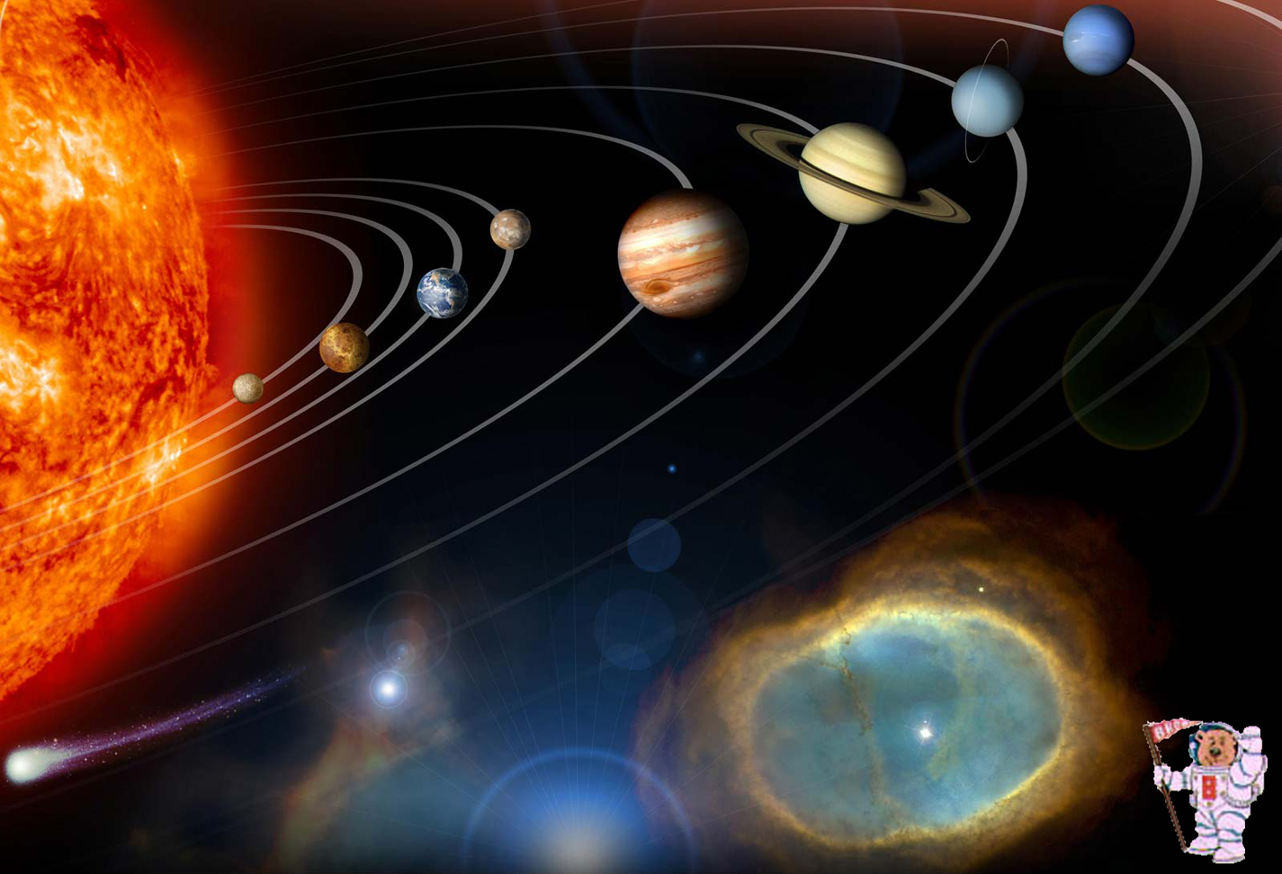
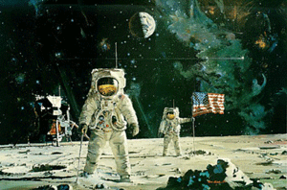
MicroRover Space Horizons Workshop
Research and innovation in the design and utilization of microvehicles
for planetary research and other space applications.
Microvehicles in Planetary Science Missions
James W Head
(james_head@brown.edu)
Department of Geological Sciences
Brown University
Providence, Rhode Island 02912 USA

Slide 2
MicroRover Space Horizons Workshop
Research and innovation in the design and utilization of microvehicles
for planetary research and other space applications.
Microvehicles in Planetary Science Missions
Exploration Legacy.
Science and Engineering Synergism.
Challenge, Innovation, Architecture and Context.
Iteration, Empathy, Feedback and Feedforward.
Destinations.

Slide 3
MicroRover Space Horizons Workshop
Research and innovation in the design and utilization of microvehicles
for planetary research and other space applications.
Microvehicles in Planetary Science Missions
Exploration Legacy.
Science and Engineering Synergism.
Challenge, Innovation, Architecture and Context.
Iteration, Empathy, Feedback and Feedforward.
Destinations.

Slide 4
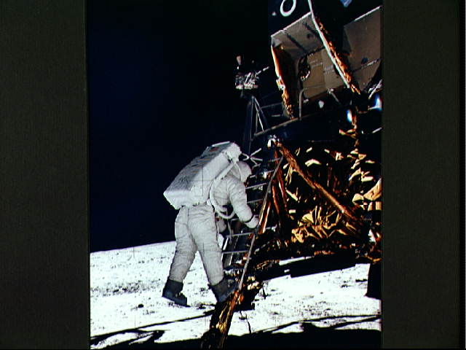
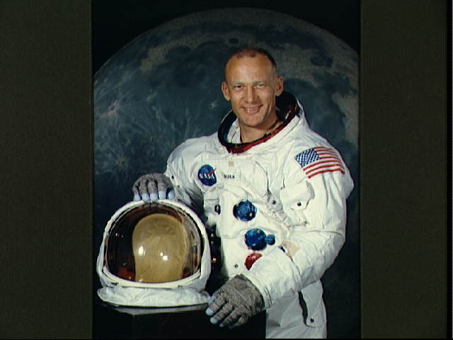
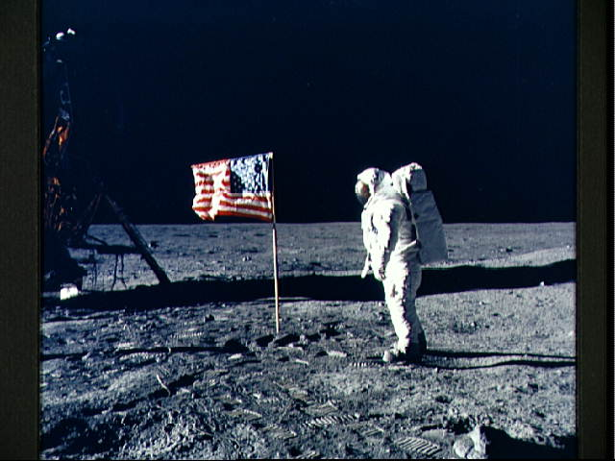
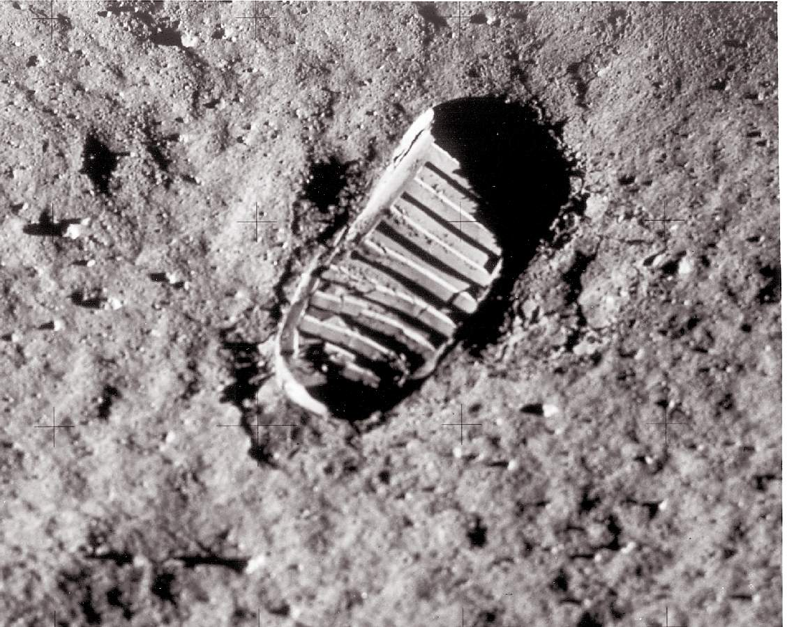
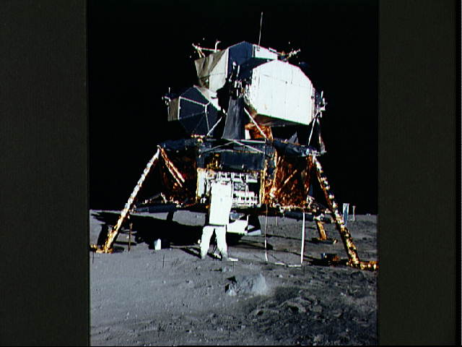
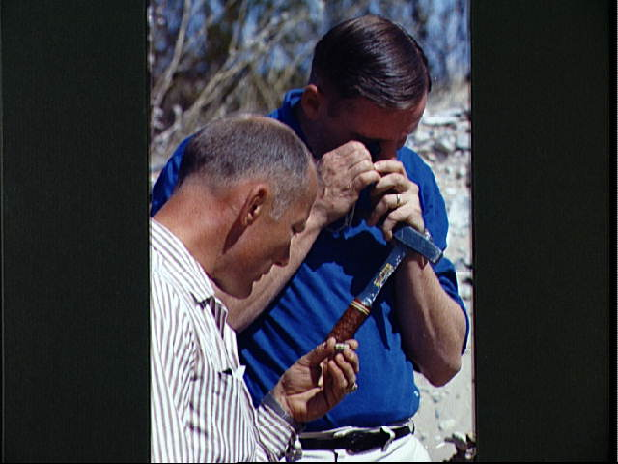
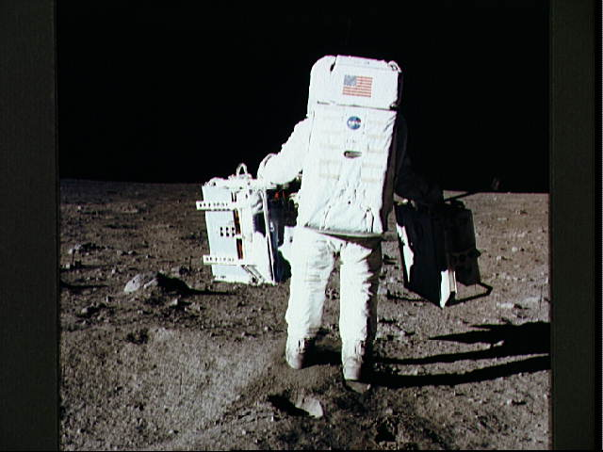
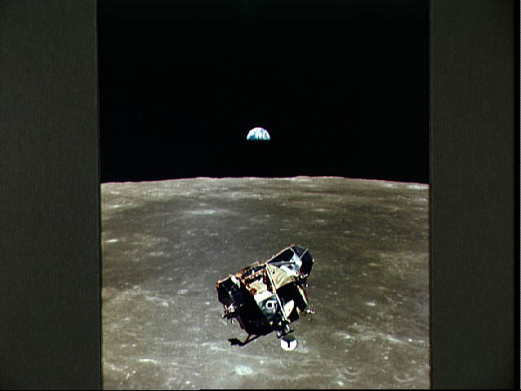
Apollo 11

Slide 5
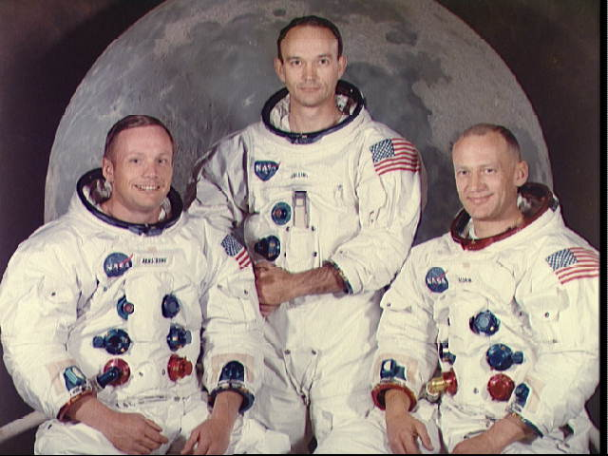
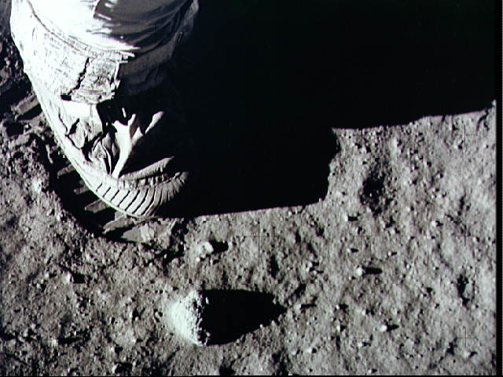
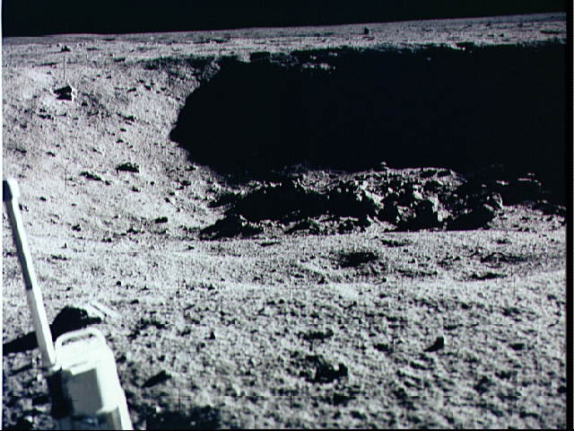
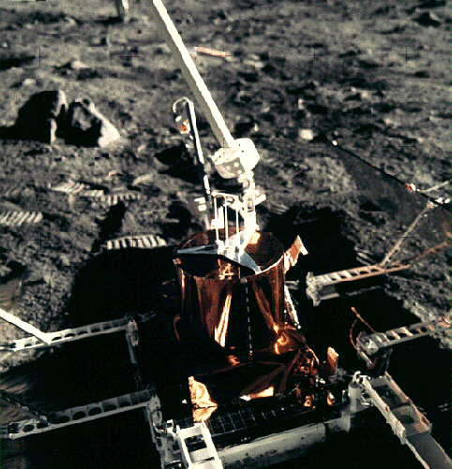
Apollo 11

Slide 6
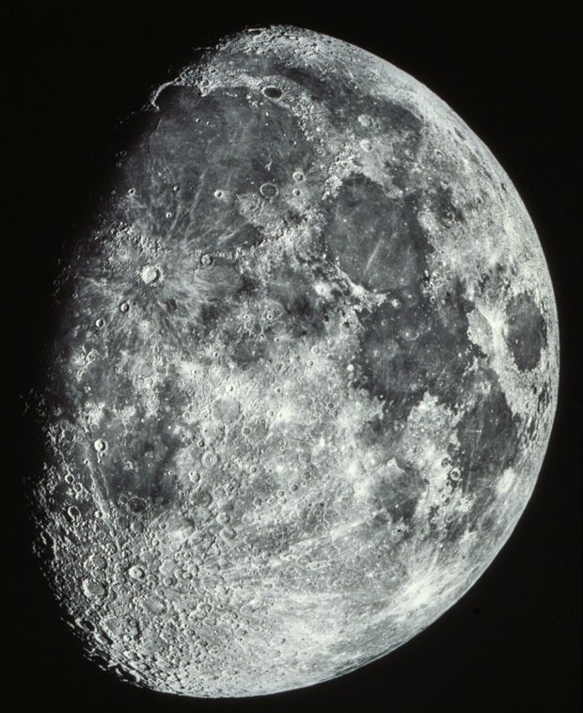
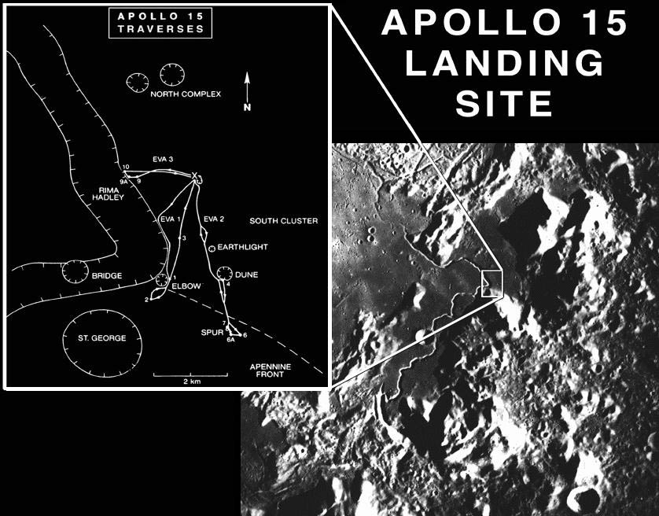
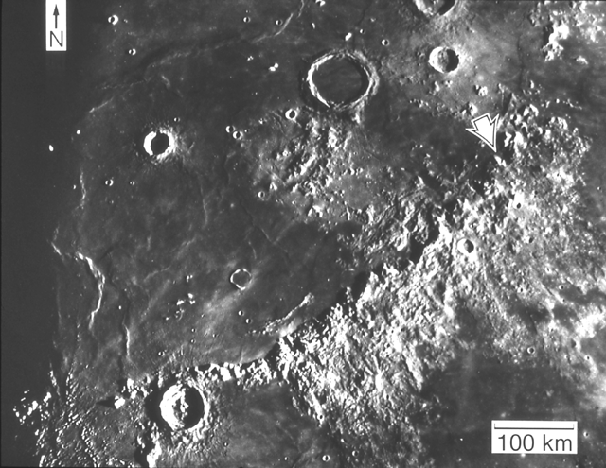

Slide 7
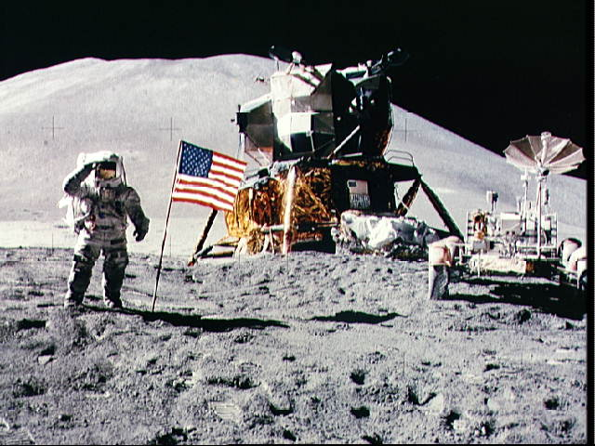

Slide 8
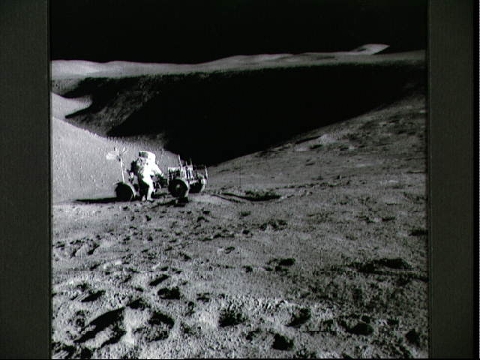
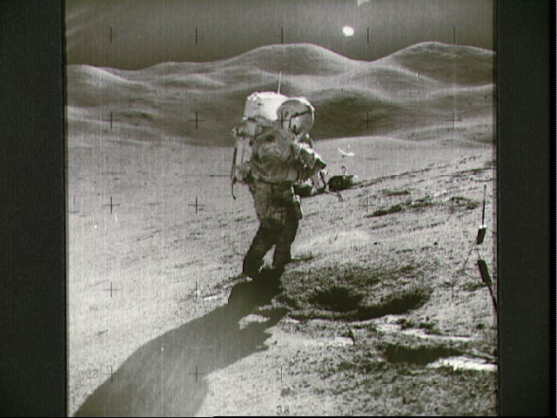
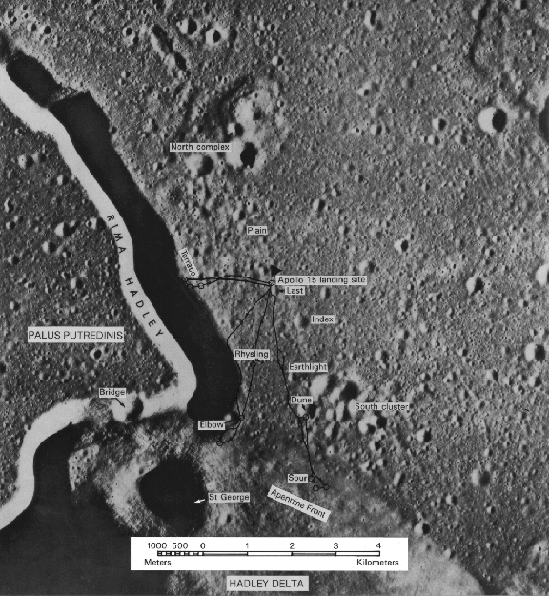
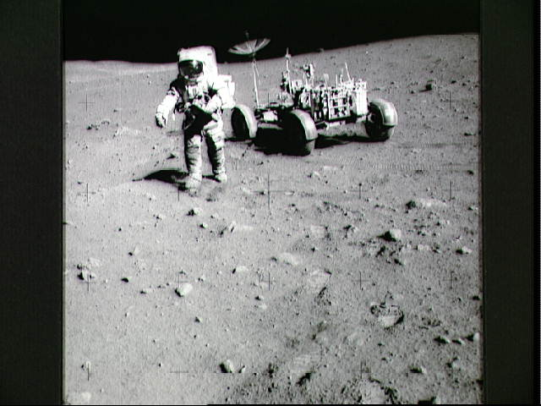
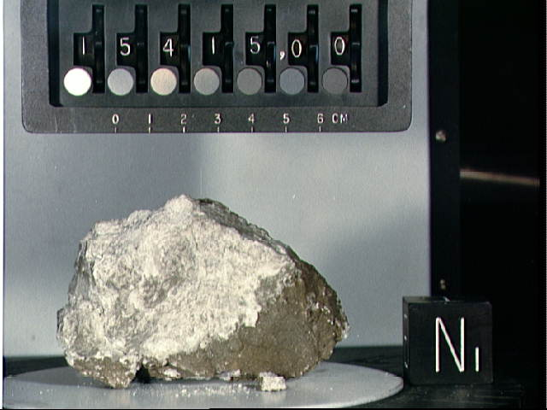
Apollo 15

Slide 9
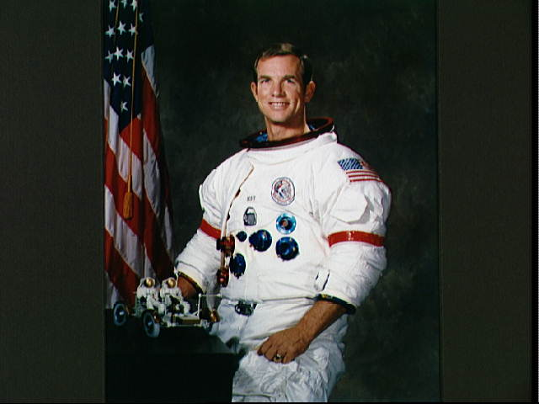
David Scott
Commander
Apollo 15 Mission to the Moon

Slide 10
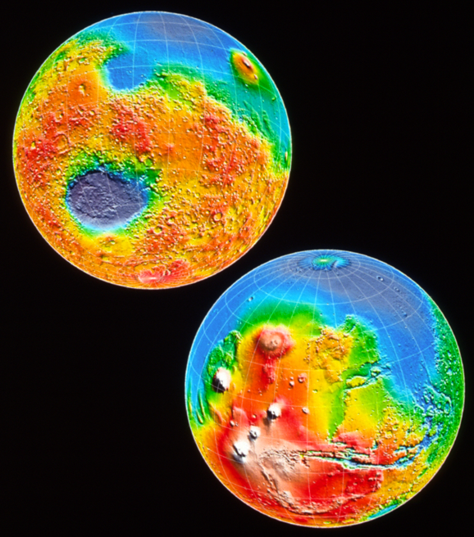
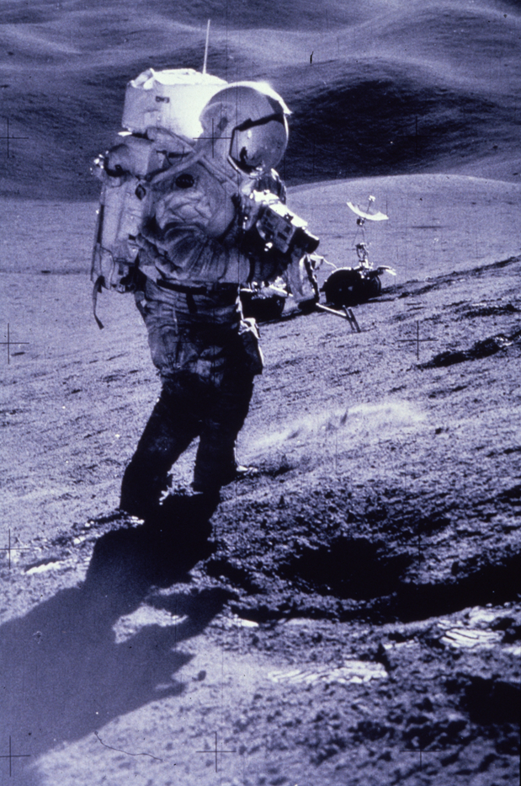
Human Exploration of Mars: Lessons Learned from an
Apollo 15
500-Day Mission
Apollo 15 Commander David R. Scott
James W. Head
and Members of the
Brown Planetary Geosciences Group

Slide 11
MicroRover Space Horizons Workshop
Research and innovation in the design and utilization of microvehicles
for planetary research and other space applications.
Microvehicles in Planetary Science Missions
Exploration Legacy.
Science and Engineering Synergism.
Challenge, Innovation, Architecture and Context.
Iteration, Empathy, Feedback and Feedforward.
Destinations.

Slide 12
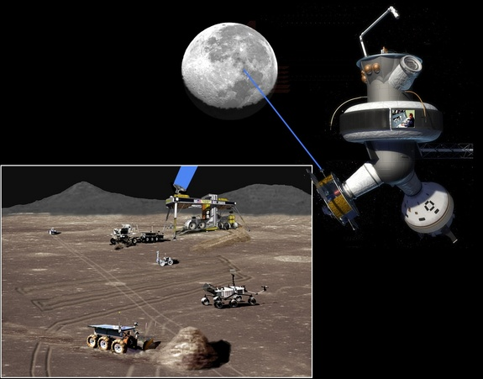
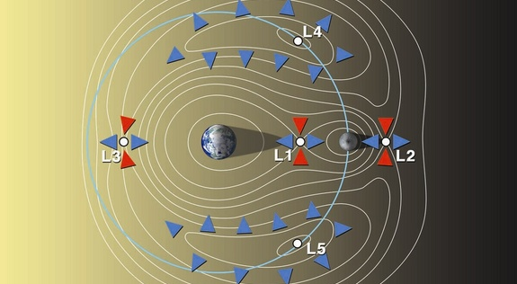
Low-Latency Human-Robotic
Teleoperation from L2

Slide 13
MicroRover Space Horizons Workshop
Research and innovation in the design and utilization of microvehicles
for planetary research and other space applications.
Microvehicles in Planetary Science Missions
Exploration Legacy.
Science and Engineering Synergism.
Challenge, Innovation, Architecture and Context.
Iteration, Empathy, Feedback and Feedforward.
Destinations.

Slide 14
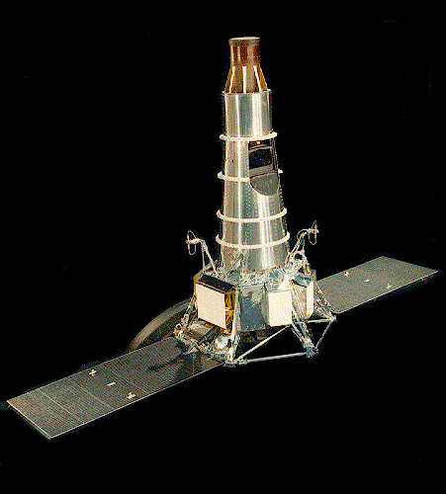
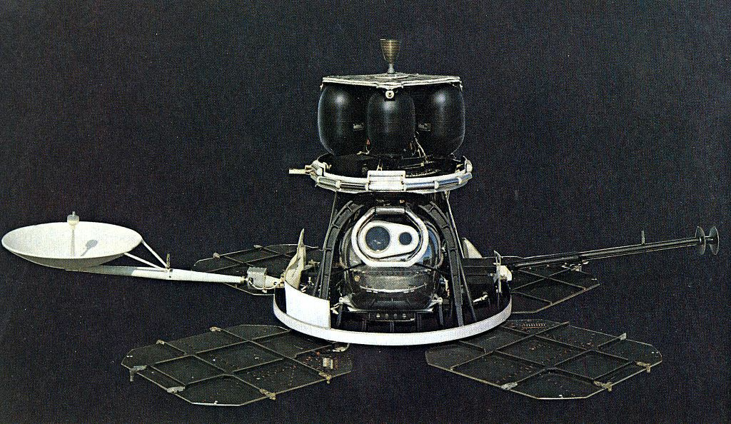
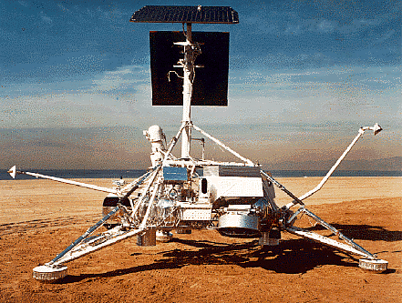
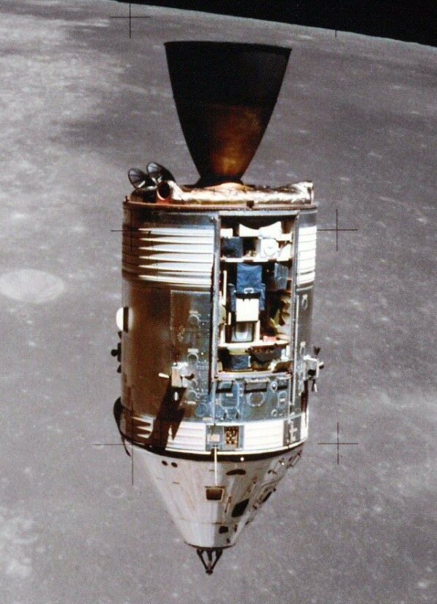
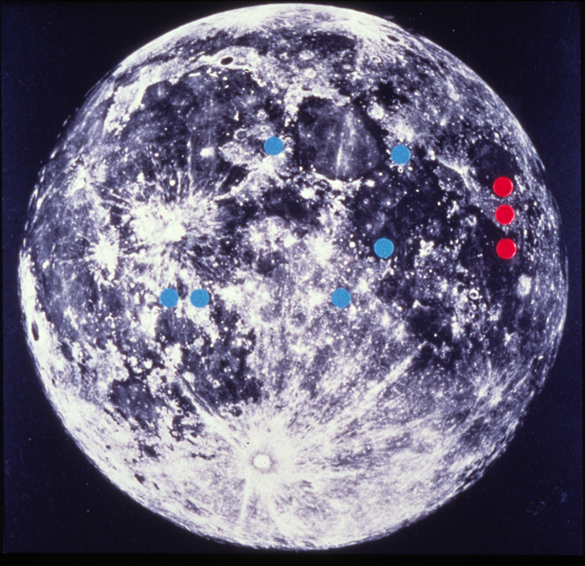
Architectural Context and Destinations
Scouts.
Precursors.
Partners.
Followup.
Interpolation.
Integration.
In Depth.

Slide 15
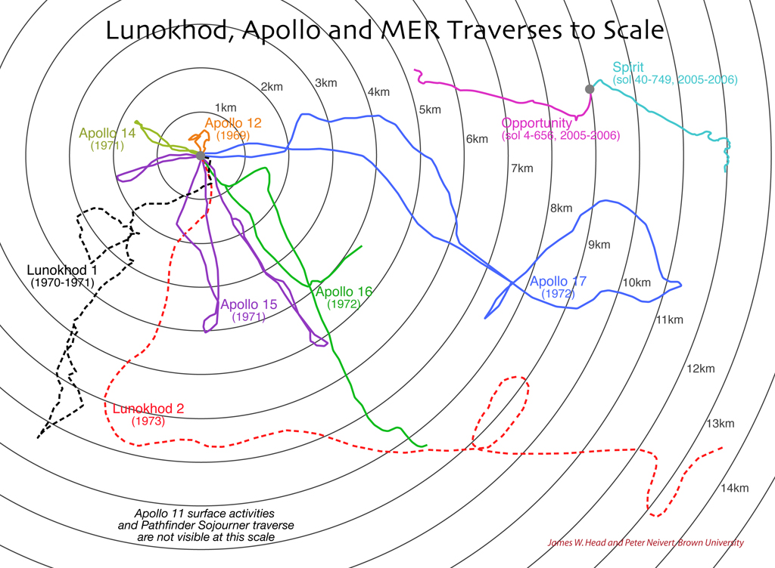

Slide 17
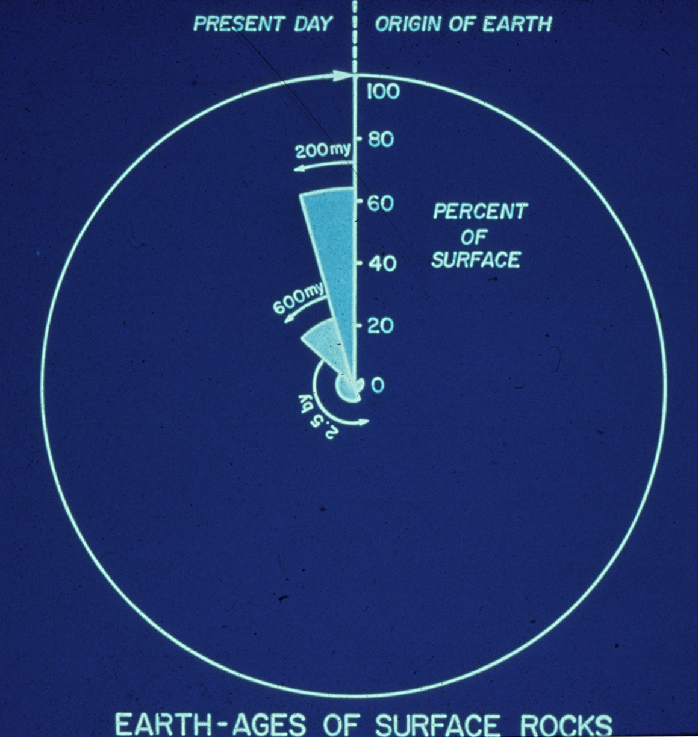
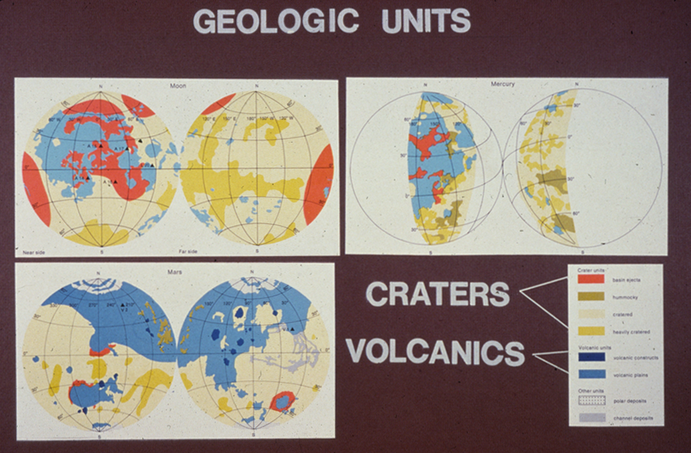
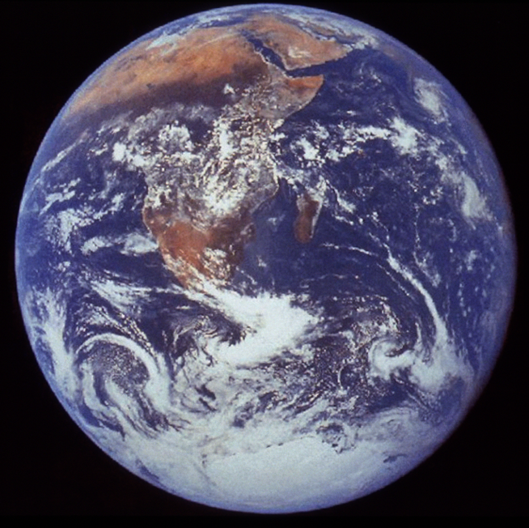
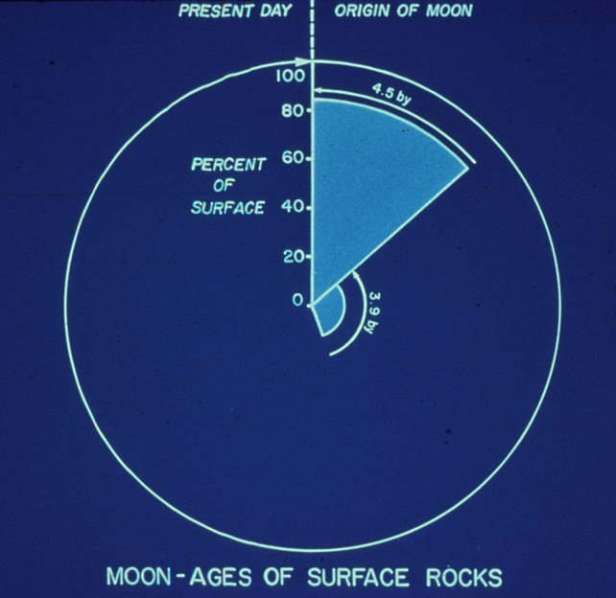
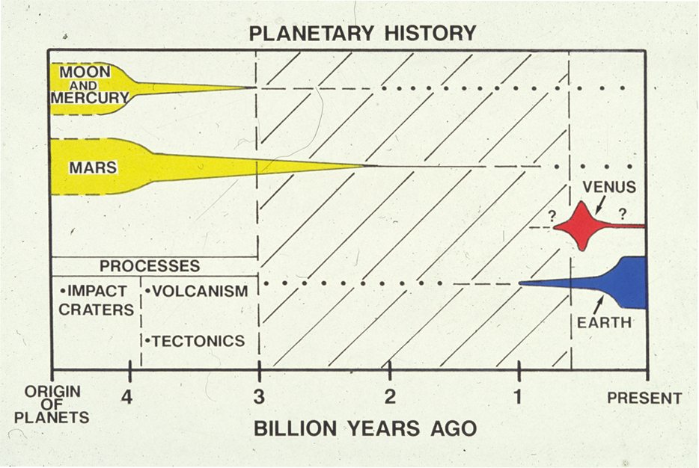
The Legacy: Scientific Results from Exploration: The Earth in Perspective

Slide 18
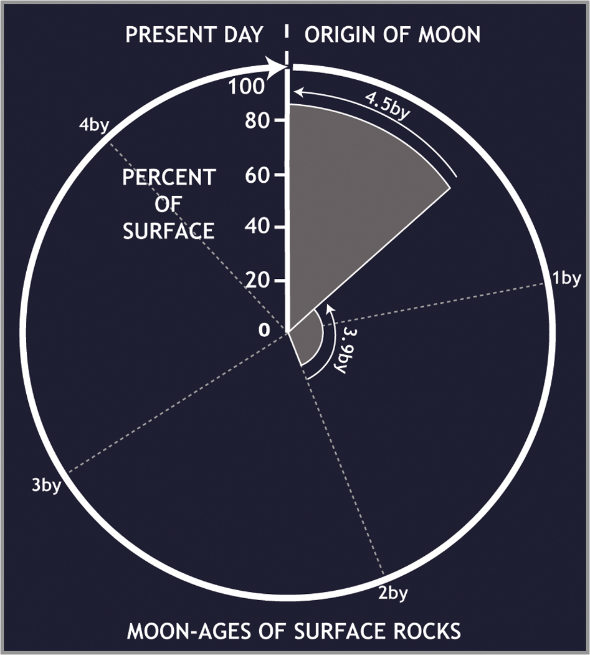
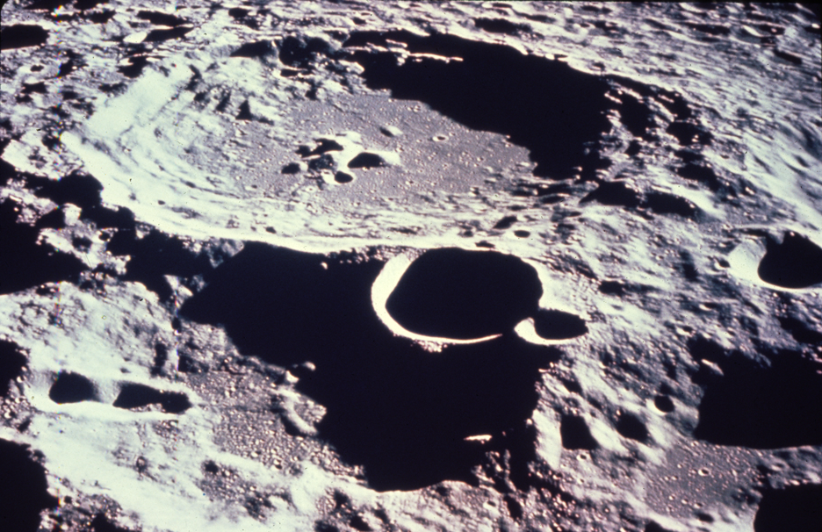
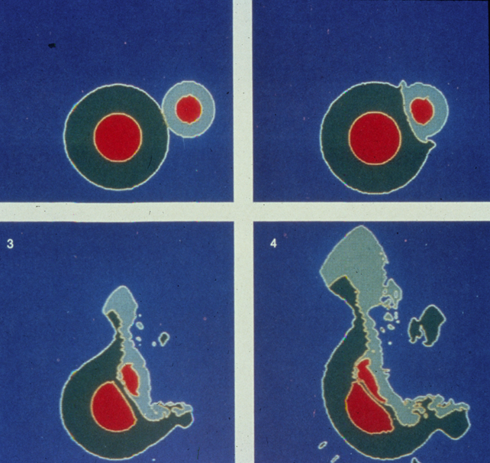
Moon: Insights into the formative years of planetary history.
Ancient age of lunar crust.
Magma Ocean: Concept of wholesale melting.
Linkage of geological observations and accretionary theory.
Moon formed from impact of Mars-sized object into early Earth.
Lunar Interior: Crust, lithosphere and thermal evolution.
Differentiation, segregation instability and overturn.
The Moon as a “one-plate” planet in contrast to Earth.
Impact cratering is a fundamental geological process.
Cometary volatiles may accumulate near poles.
The Moon is a record of the first half of solar system history.

Slide 19
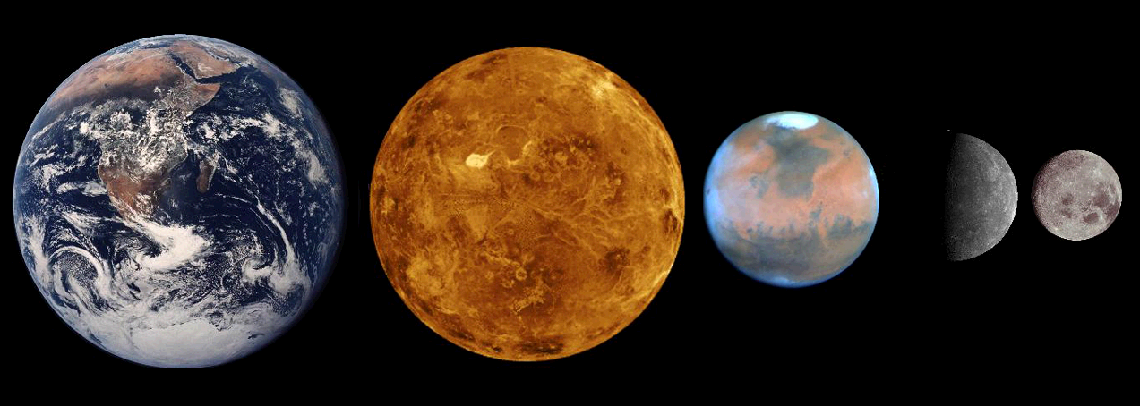
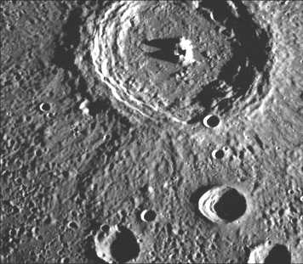
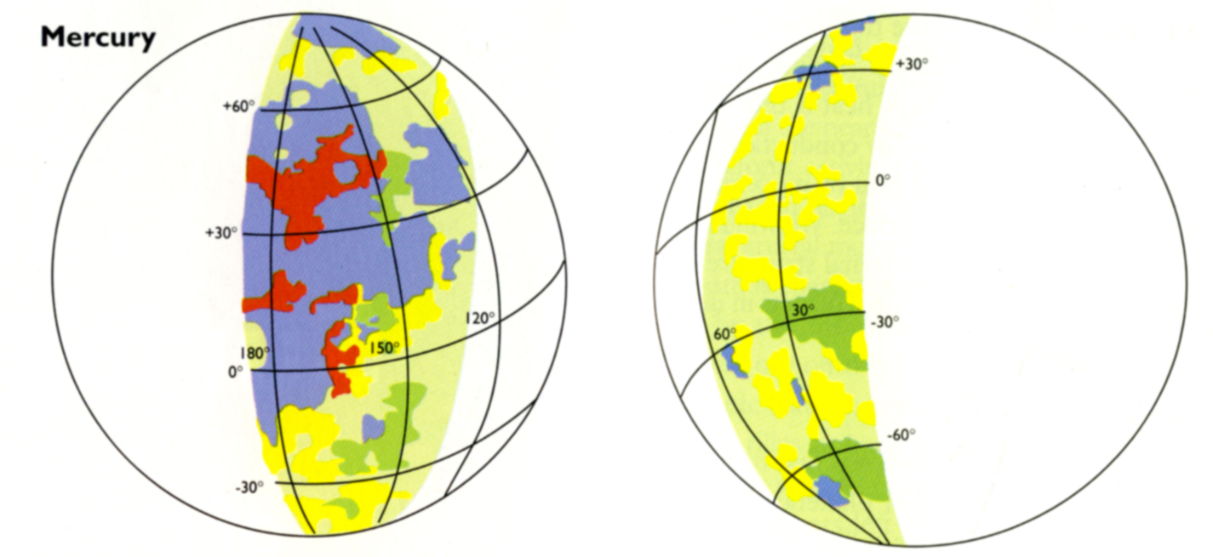
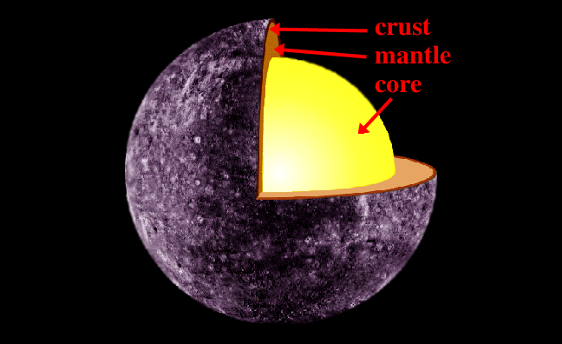
Mercury: Lunar-like surface, Earth-like interior
Mercury is Moon-like!
Impact craters and plains dominate the surface.
Are the plains volcanic or impact?
Tectonic one-plate planet, but with huge tectonic scarps.
Magnetic field: Is the core liquid and convecting?
Mariner 10 raised more questions than it answered.

Slide 20
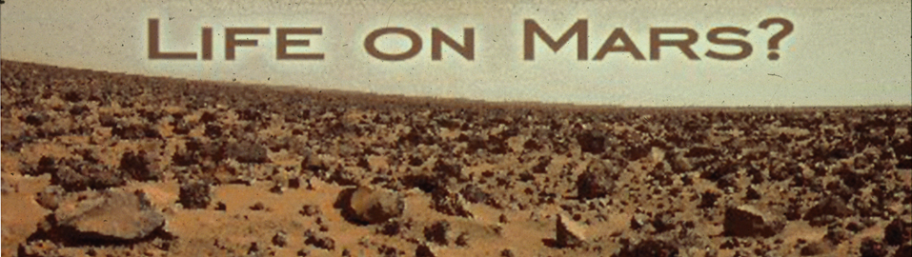
Mars: Moon/Mercury with Water and Climate
Differences from the Moon and Mercury:
1) Global crustal dichotomy:
2) Tharsis and Elysium topographic rises.
3) Volcanic activity extends up to the geological present.
4) Mars is a "water" planet: Rivers, lakes and oceans.
5) Extreme oscillations in spin-axis obliquity characterize Mars.
6) Huge crustal magnetic anomalies.
7) True polar wander may have occurred.
8) An early "warm and wet" Mars
is a likely habitat for
the formation and evolution of life.
Mars may be the true Rosetta stone of
Early Earth history, filling in the missing transition.

Slide 21
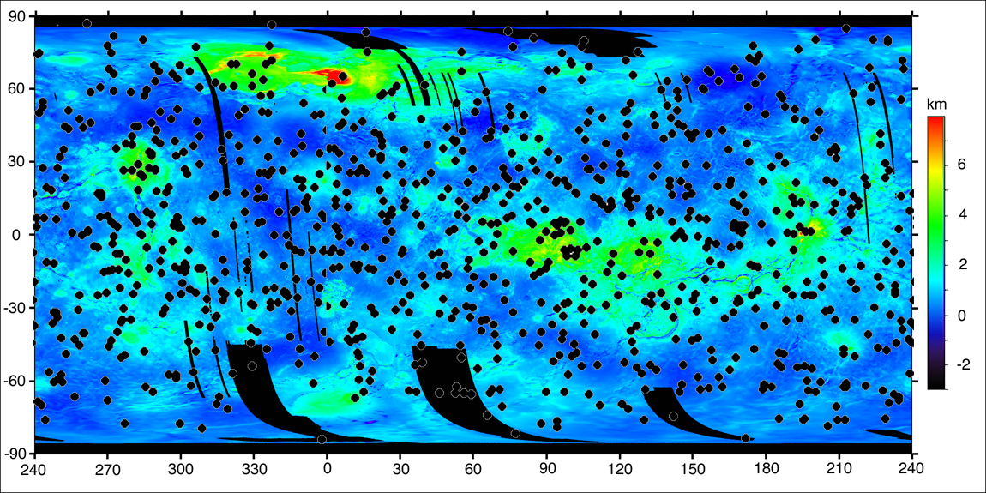
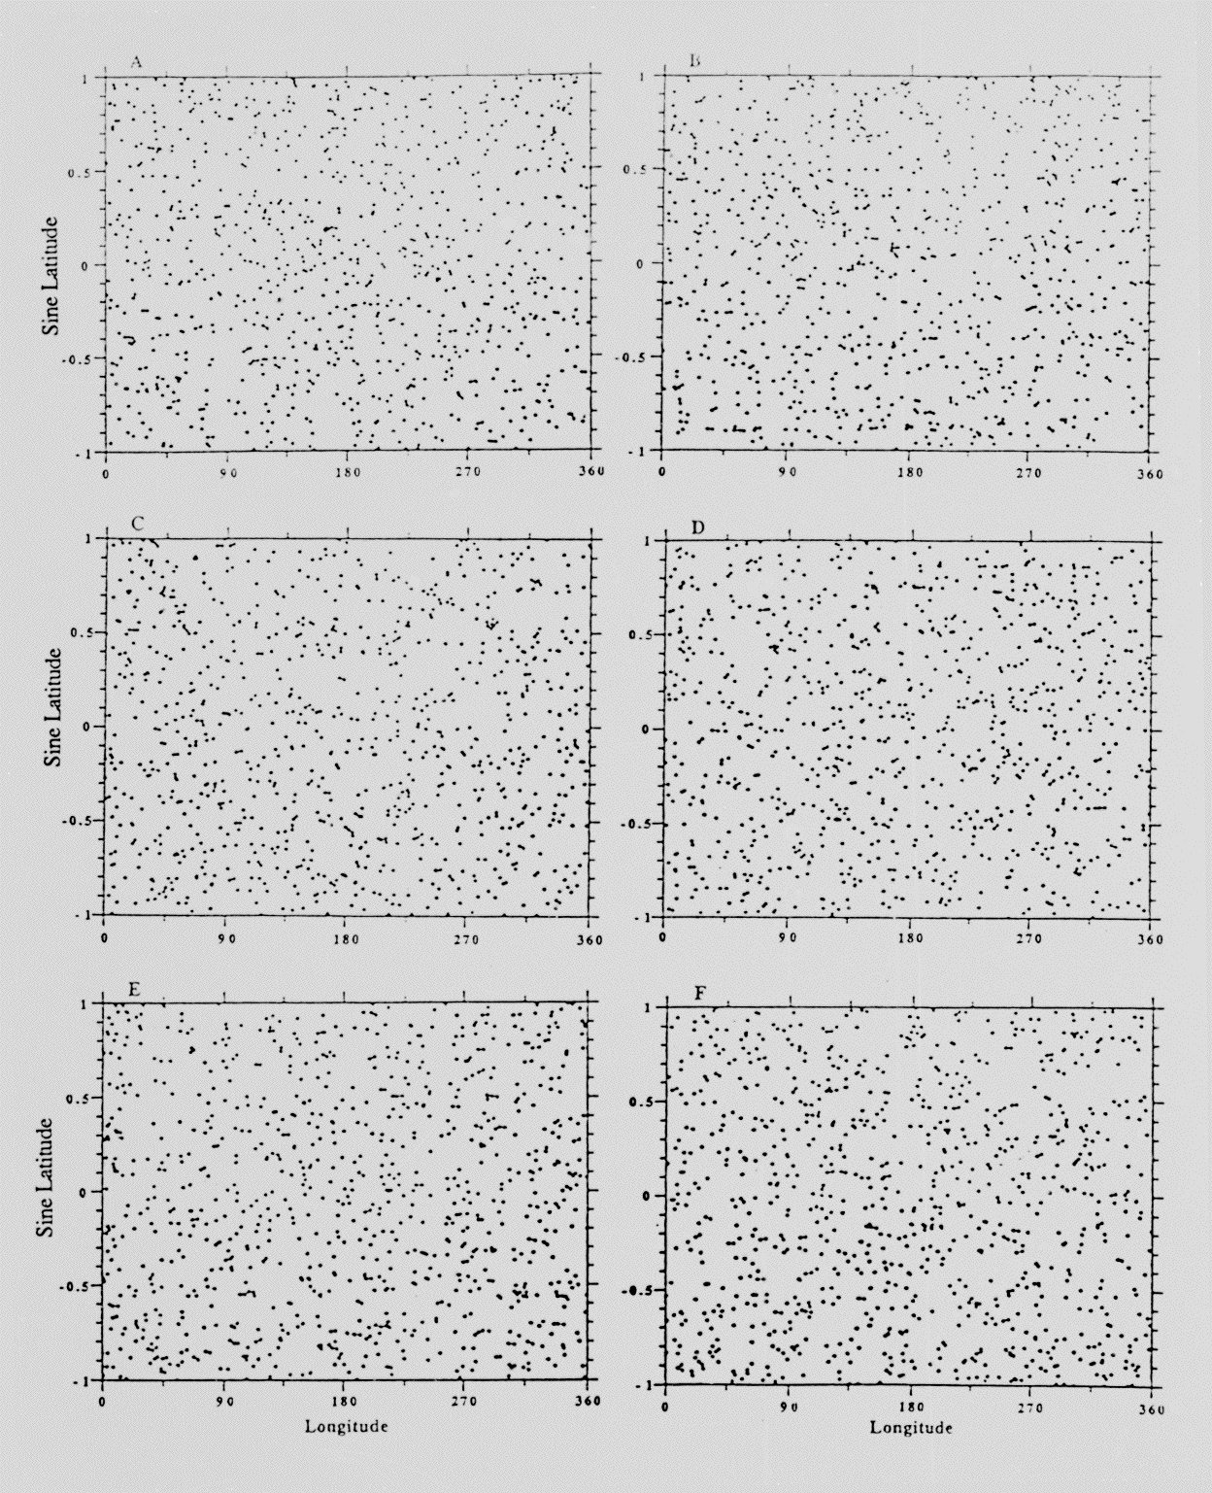
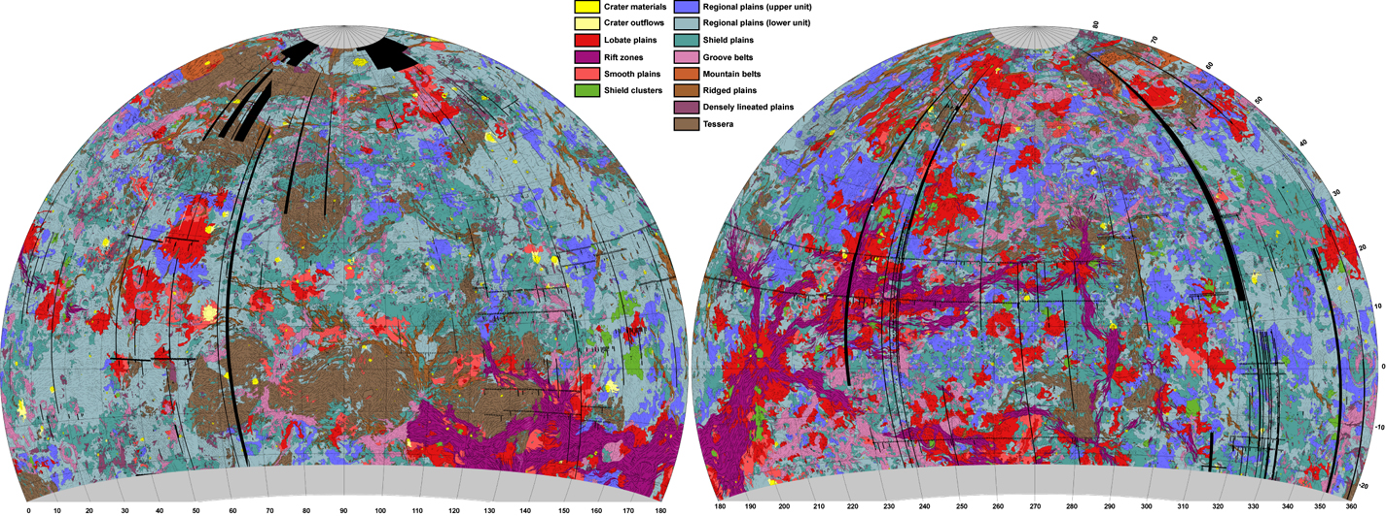
Venus: An Earth gone astray?
There is no ancient heavily-cratered terrain.
The surface is predominantly volcanic in origin.
Tesserae: Intensely tectonically resurfaced terrain.
Impact cratering record is sparse.
Average age of the surface < a billion years.
Crater population nearly completely spatially random and the vast majority of the craters have not been modified.
Mikhail Ivanov, Vernadsky Institute, RAS

Slide 22




55 Years Since Sputnik:
The next 50 Years?
Answers to these questions lie in the results of space missions to be undertaken in the next 50 years of Solar System exploration! The challenge is yours!

Slide 23


