Slide 1
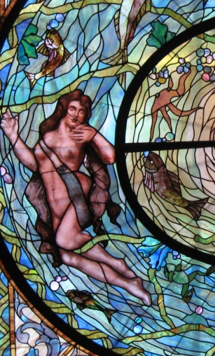
Archaeological Report on
Armilla:
“the city of baths”
By Chelsea Tarvin

Slide 2
The History of the Founding of Armilla
    The city of Armilla was originally inhabited by a small population of farmers. The site contained several natural hot springs that the people of the town utilized for drinking and irrigation. This water came to have a reputation for its therapeutic and healing powers. Eventually, the Armillian people created a thriving industry selling the mineral water to others in surrounding areas.
    Archaeological evidence shows that at the city’s industrial peak, a fire ravaged Armilla and destroyed the entire town. The citizens of Armilla attributed the fire to the water goddess, Aquafina. Local myth indicates Aquafina caused the fire because she was angry that the inhabitants had allowed her sacred water to be carried outside the precinct. Therefore, in order to appease the goddess, the citizens of Armilla dedicated the site to the her and created an elaborate open air bath complex in place of the town This sanctuary was explicitly meant for the enjoyment of the water goddess and her naiads. Citizens could enter the bath city to give offerings or pray to the goddess, but it was no longer a place to dwell.
    Based on the archaeological evidence and the written account of Marco Polo, it appears that the site has since remained uninhabited and associated with water and bathing.

Slide 3
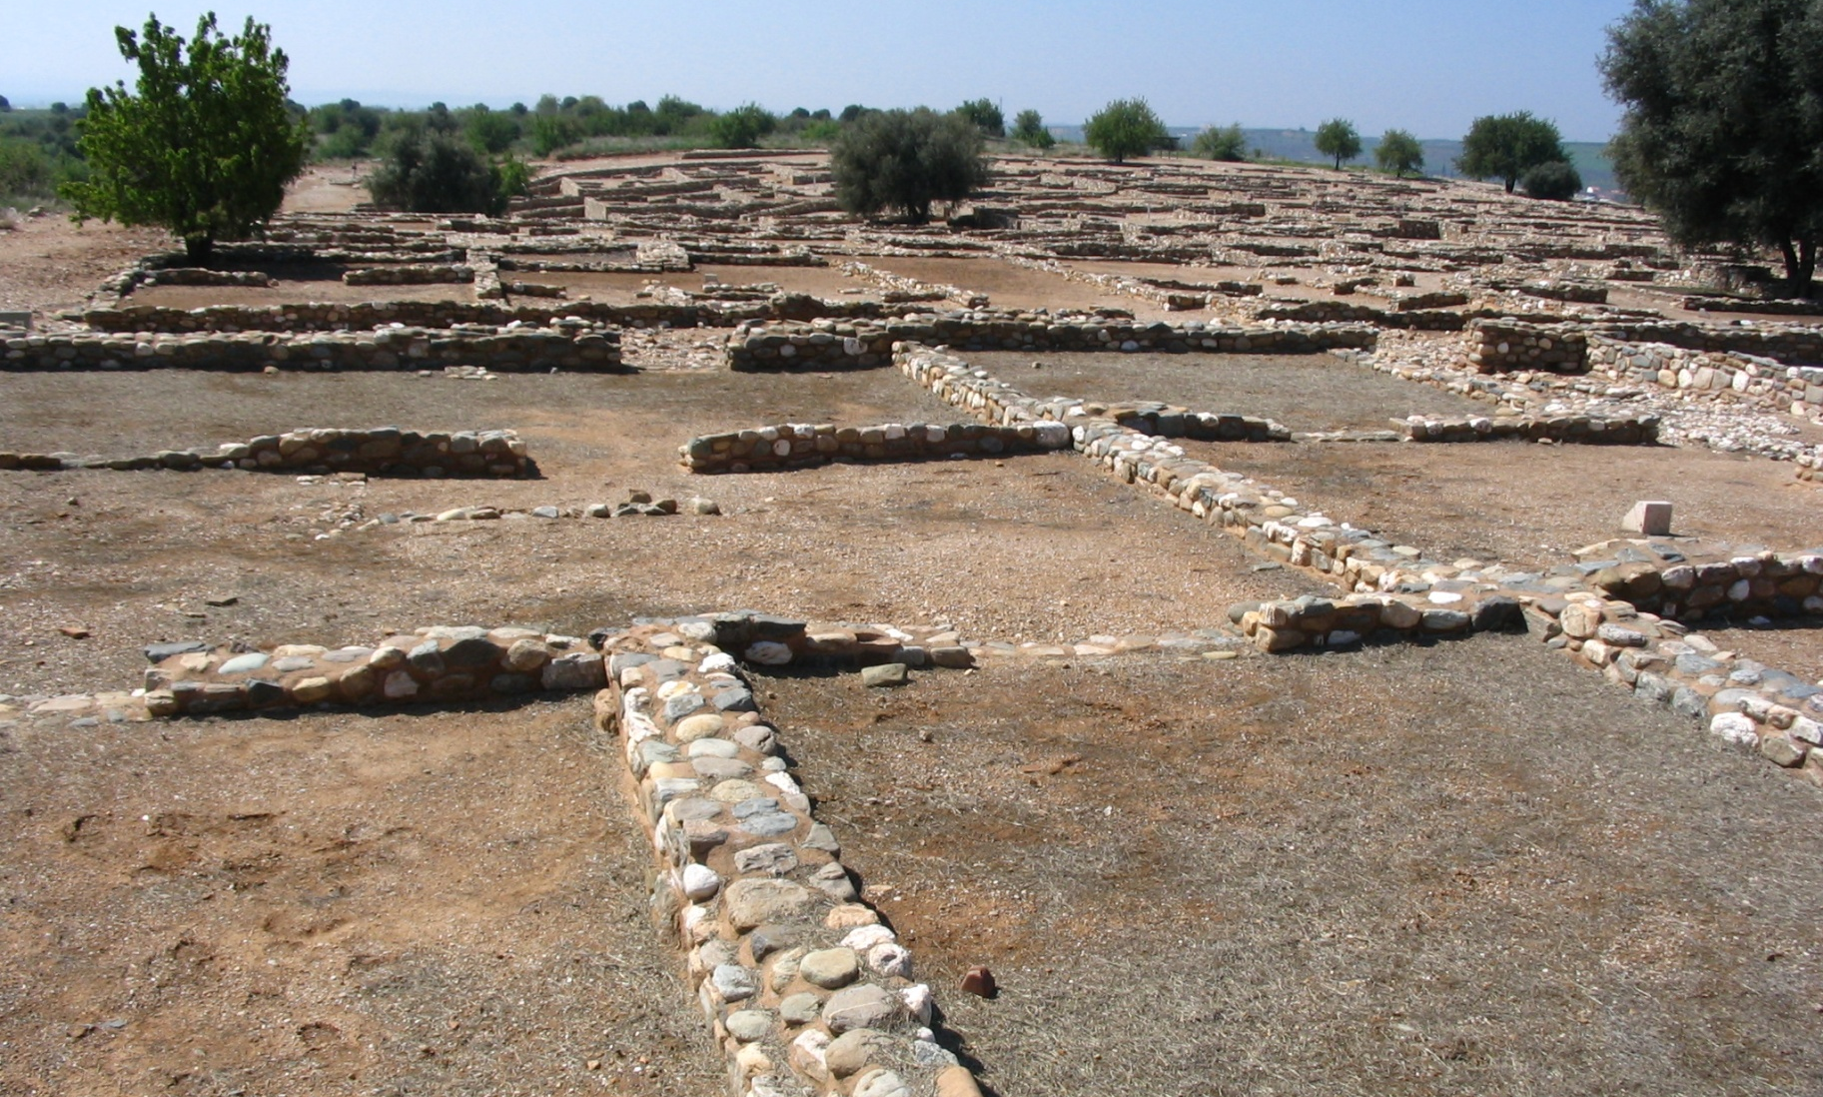
The site of Armilla as it appears today.
The foundation of the original city can still be seen at Armilla today.

Slide 4
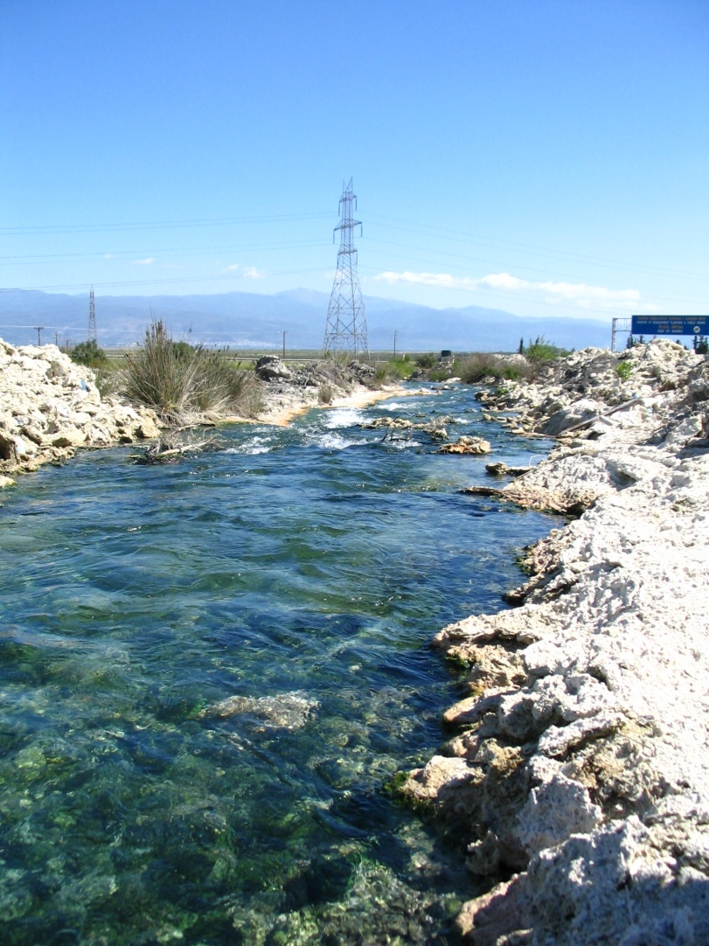
The Hot Springs of the Aquafina

Slide 5
Reconstructing Armilla
Although it is difficult to imagine what Armilla looked like in antiquity, the art and artifacts found at the site allow archaeologists to gain a better understanding of its appearance and function.

Slide 6
Dressing Complex
Detail of Armilla
City Plan
Pool with Wave Mosaic
Hot Spring
The Cult of Aquafina in Antiquity
During antiquity, the cult of Aquafina gained popularity, not only with the Armillians, but with neighboring cities as well. Visitors would come from miles away to pay homage to the goddess, bringing her votive offerings.
The Armillians began holding annual festivals in honor of Aquafina. People would travel from the new village of Armilla, carrying images of the goddess and elaborate amphorae. When the procession reached the sanctuary, the people would fill the amphorae with the spring water and pour libations for the goddess and pray for the prosperity of their city.
Temple of Aquafina
Well
Peristyle Court
Bathing Complex
Processional Gateway
Fountain House

Slide 7
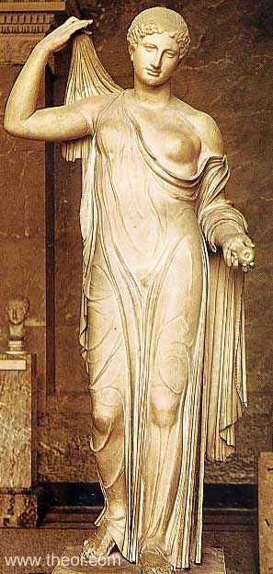
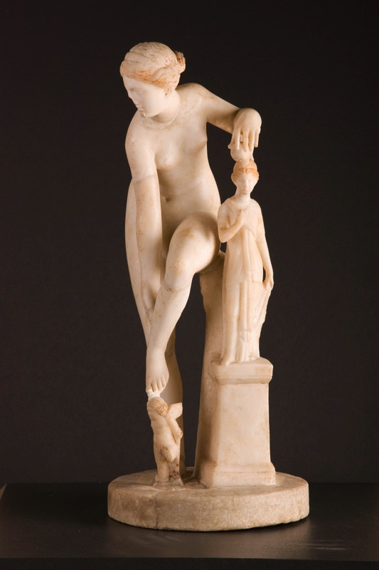
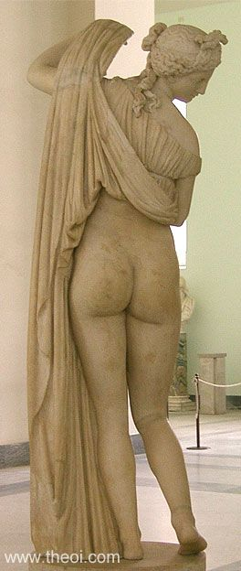
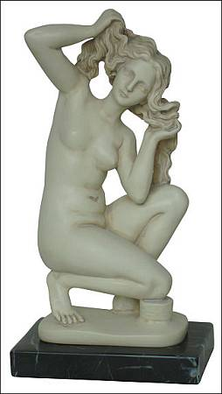
Statues of Aquafina
The goddess was most frequently depicted in the act of bathing. These statues found at Armilla are exquisite examples of the degree of craftsmanship reached by the Armillian artists. These artists likely specialized in statues of Aquafina which they sold to visitors of the sanctuary and offered to the goddess as dedications.

Slide 8
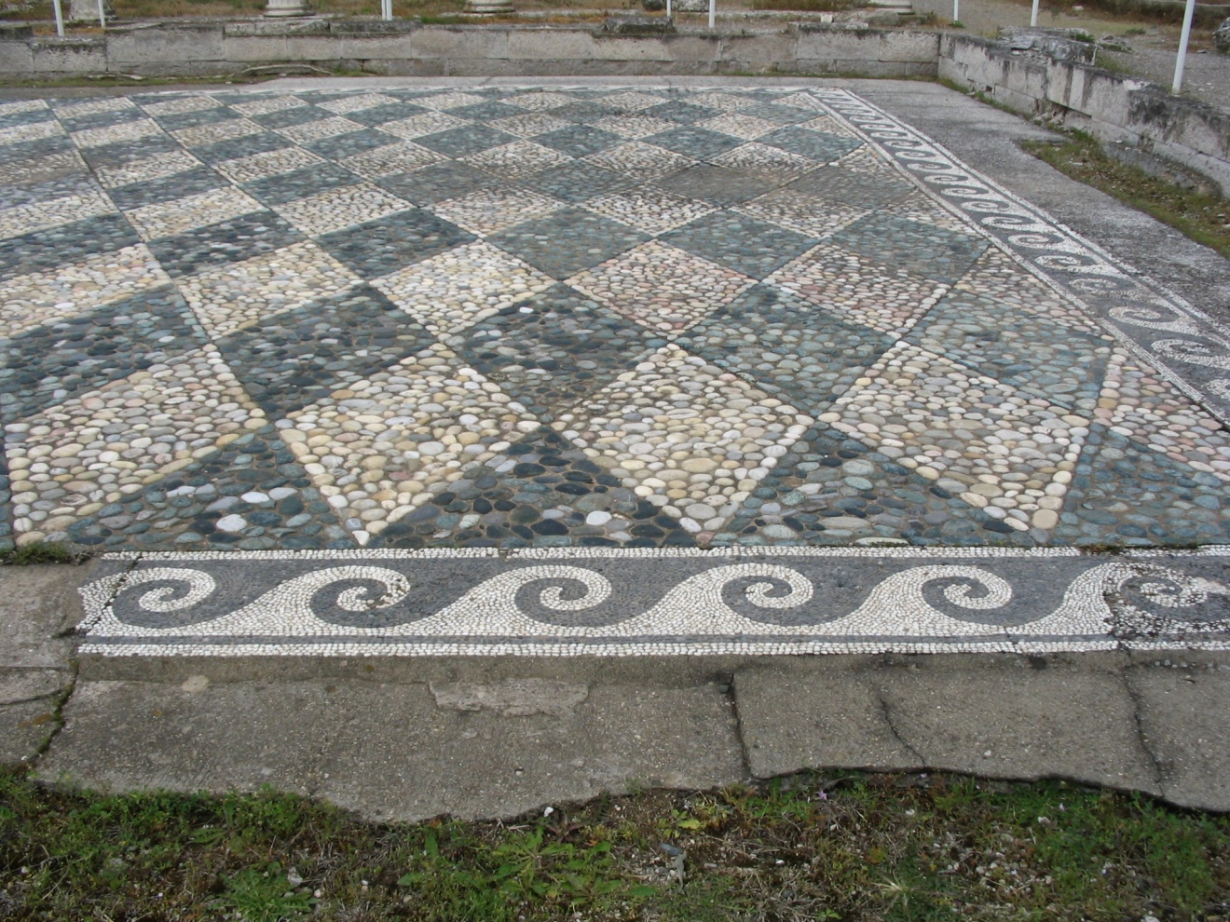
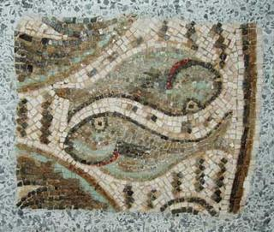
Mosaics from the Baths
Mosaics recovered from Armilla often have nautical themes as exhibited by the wave design (left) and these fish (above).

Slide 9
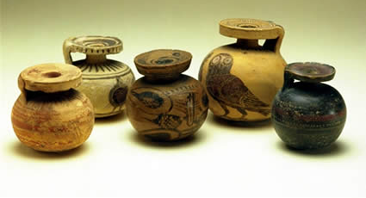
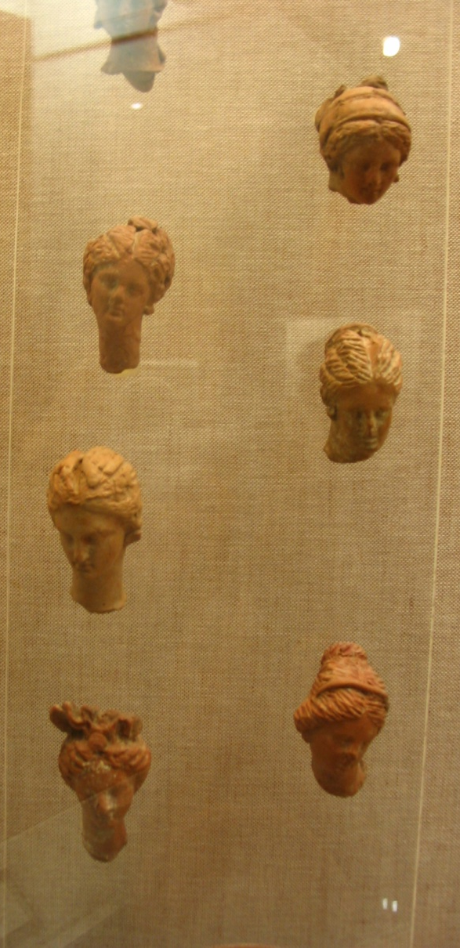
Artifacts found in Armilla
Visitors to the sanctuary would often leave votive offerings to the goddess in the form of oil jars (full of perfume) and small statuettes of the goddess. Suppliants also brought objects for the goddess’s beautification such as hair brushes, combs, and jewelry.

Slide 10
Ancient Accounts of Armilla
In the sanctuary of Aquafina, the sound of rushing water replaces the noises of congestion that fill other cities. The air is rich with the smell of perfumed oils left for the goddess and her naiads by humble worshipers and the earthly sulfur of the spring. As I wonder the mazes of aqua pools, I see glimpses of dolphins and fish below. For a moment they seem real, they move and splash in the water. Upon closer inspection, I find they are mosaic creatures instead of flesh and blood. The goddess herself stands among them. She is frozen in time, ever caught in the act of removing her diaphanous garments. Statues of the goddess with her naiads and nymphs can be seen everywhere within Armilla. They are undoing their hair on the rocky slope where the hot spring has its source. They lie in the rich grasses between the baths as if awaiting their turn. And, of course, they stand amid the flowing waters. In addition to baths, this divine retinue of stone has been gifts dressing closets, a temple, and many extravagantly ornamented fountains which dot the sanctuary like the petals of a flower, giving it its shape and defining its beauty. It is truly and earthly paradise, but it can never be enjoyed by mortals. This place is reserved for the gods.
Source: Unknown
We, the previous citizens of Armilla, dedicate this sanctuary to the Goddess so that she may enjoy the waters of the spring. May she hence forth protect and look with kindness on the people Armilla.
Epigraphic Inscription outside the sanctuary

Slide 11

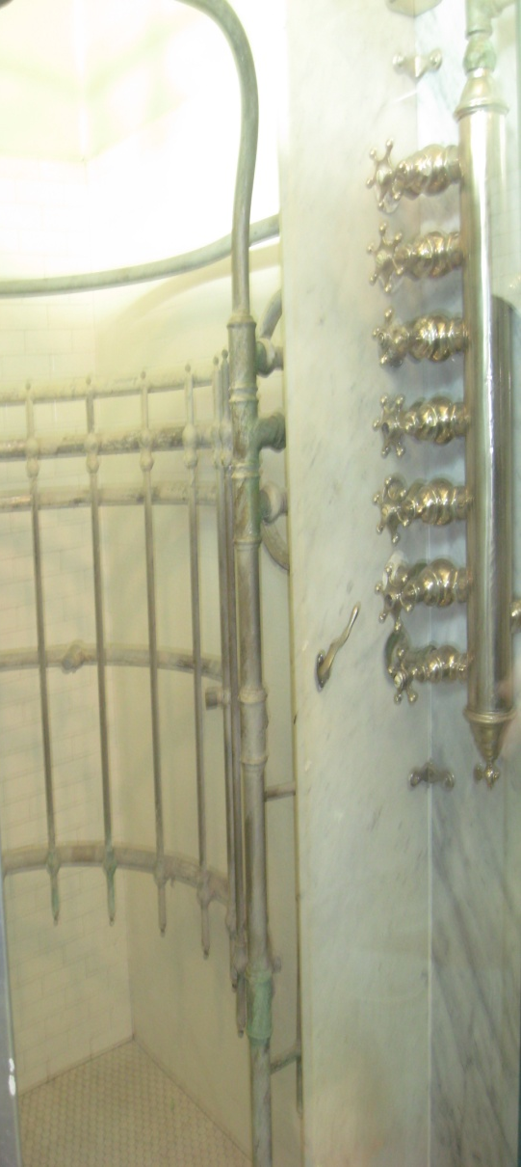

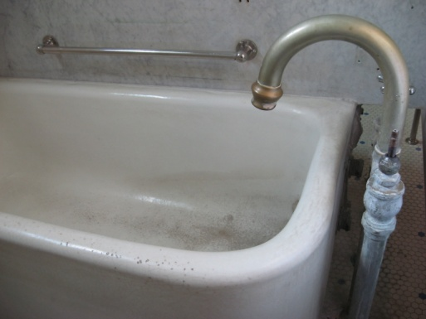
Account of
Marco Polo (1347)
While Marco Polo visited Armilla at a time when the city’s original purpose had been forgotten, the memory of this site’s association with water remained. No mention is made in his description of the sanctuary’s original mosaics and statues or the bubbling springs. What he sees instead is a modern version of the ancient bathing sanctuary. He describes the updated plumbing structure as “a forest of pipes that end in taps, showers, spouts, overflows.” The reasoning behind the baths has become speculation studded with fragments of uncertain truth. However, the modern people of Armilla still populated this site, not with people, but with plumbing. Marco Polo even seems to sense the spirit of the goddess Aquafina among the modern porcelain structures.
At any hour, raising your eyes among the pipes, you are likely to glimpse a young woman, or many young women, slender, not tall of stature, luxuriating in the bathtubs or arching their backs under the showers suspended in the void, washing or drying or perfuming themselves, or combing their long hair at a mirror. […] In the morning you hear them singing.
Thousands of years have passed and the goddess has become nameless, but she is still indulging in the waters of Armilla, ever divine and elusive.

