Slide 1
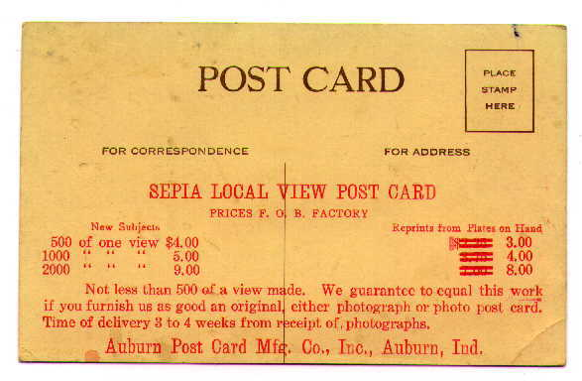
Maurilia
MAURILIA
City of Nostalgia
An Exercise in Nostalgia

Slide 2
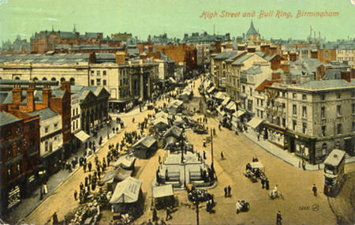
‘In Maurilia, the traveler is invited to visit the city, and, at the same time, to examine some old post cards that show it as it used to be.’
Let us take a journey through old Maurilia, seen through post cards. Collective memory of how a city used to be is a powerful thing- but how far does the memory of the ‘good old days’ reflect reality?

Slide 3
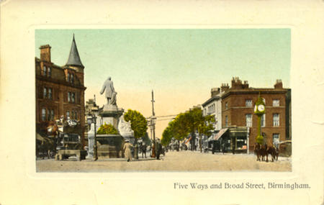
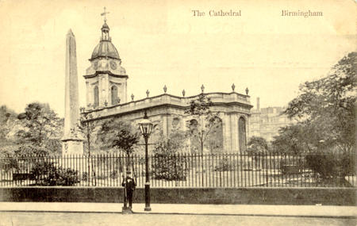
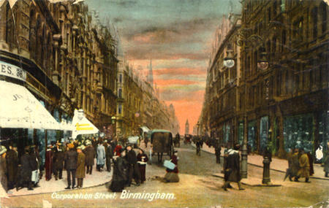
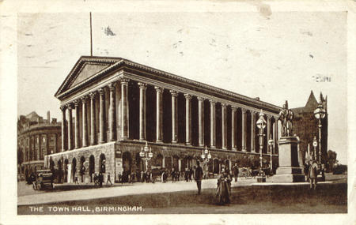
‘If the traveler does not wish to disappoint the inhabitants, he must praise the postcard city and prefer it to the present one’
And why would he not prefer the postcard city when the views presented are so beautiful? No noise or smell to sully the panorama, no dirty traffic, fancy costumes and fancy architecture. No beggars harrass the viewer of the postcard as they do the traveler in the modern city.

Slide 4
‘When that provincial Maurilia was before one’s eyes, one saw absolutely nothing graceful and would see it even less today, if Maurilia had remained unchanged.’
What would the man standing in the postcard have thought about his city?
He might be standing in front of monumental architecture now, but where did he go home to at night?

Slide 5
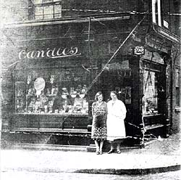
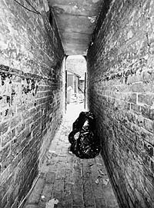
Old Maurilia is suddenly less charming; but then we are not in the Maurilia of the postcards anymore.
“When we were young we used to make our own entertainment. I used to play games with my brother where we would both run a matchbox up the bedroom wall to see how many bugs we could catch. We’d drag the edge of the matchbox up the wall and then we’d open it up and count how many we’d caught.”

Slide 6
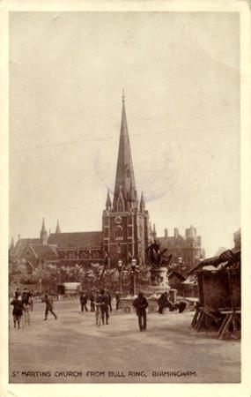
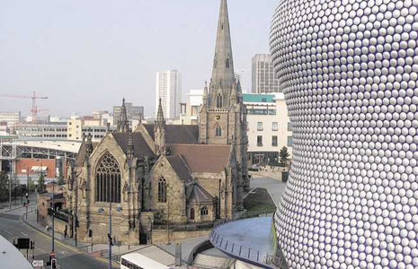
And what of New Maurilia?
New has imposed itself on old:
‘The magnificence and prosperity of the metropolis Maurilia, when compared to the old, provincial Maurilia, cannot compensate for a certain lost grace’
Though as we have seen, such ‘grace’ is a phantom, created by the postcard maker, presenting a utopia which never truly existed.

Slide 7
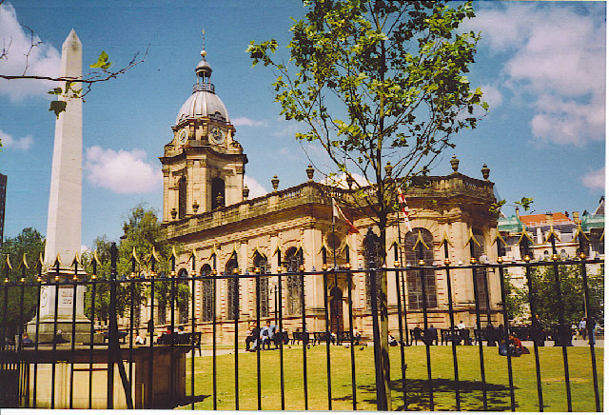
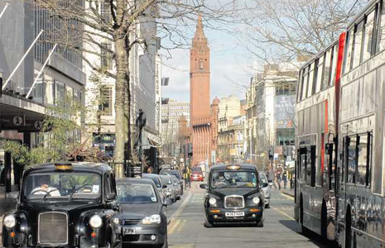
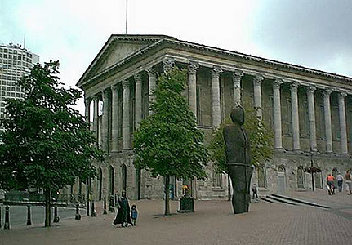

Slide 8
The rigidly bipartite distinction the Maurilians make between ‘New Maurilia’ and ‘Old Maurilia’ is an illusion.
In reality, there are three cities depicted here: Old Postcard Maurilia, the Old Maurilia of the man in the postcard and New Maurilia.
Perhaps the pictures of New Maurilia do not represent New Maurilia at all, but New Postcard Maurilia.
The permutations are endless, and perhaps not one of them can ever accurately represent Maurilia in its entirety.
Of course, none of these pictures are of Maurilia at all, but they represent a ‘real’ city.
But the same process could be repeated for any city, and the results would be the same; Maurilians exist in every city, and allow their experience of their city to be coloured by the postcard propaganda of the past.

