Slide 1
Cities & Reflection
By: jed DeMoss

Slide 2
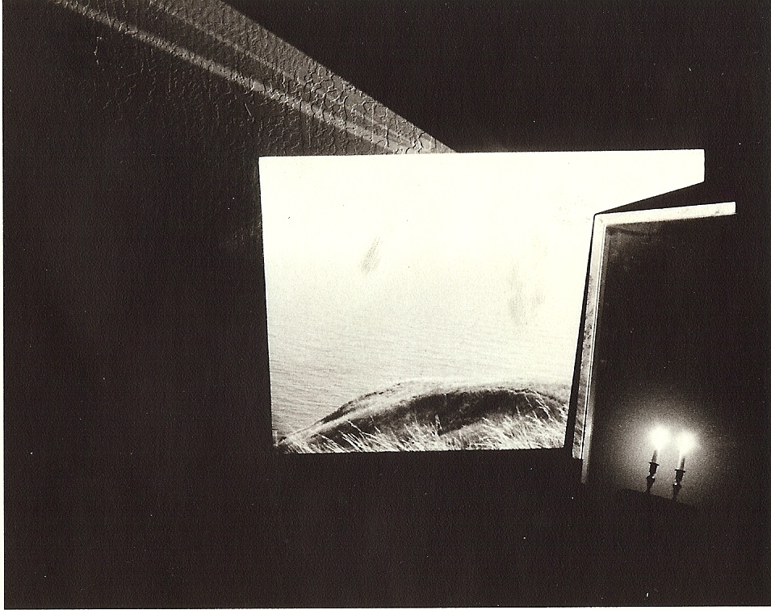
Zaira:
“The City, however, does not tell its past, but contains it like the lines of a hand, written in the corners of the streets… every segment marked in turn with scratches, indentations, scrolls.”
p.11

Slide 3
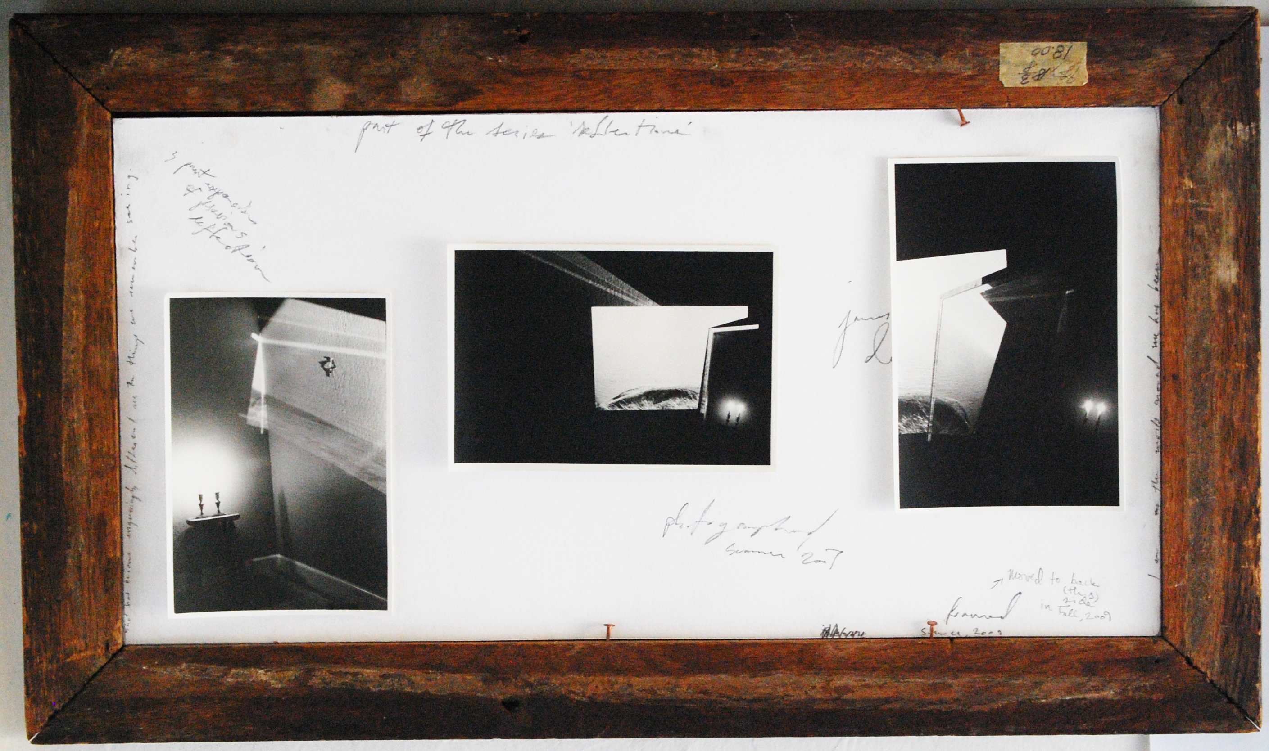
Zaira:
“A description of Zaira as it is today should contain all Zaira’s past.” p. 10

Slide 4
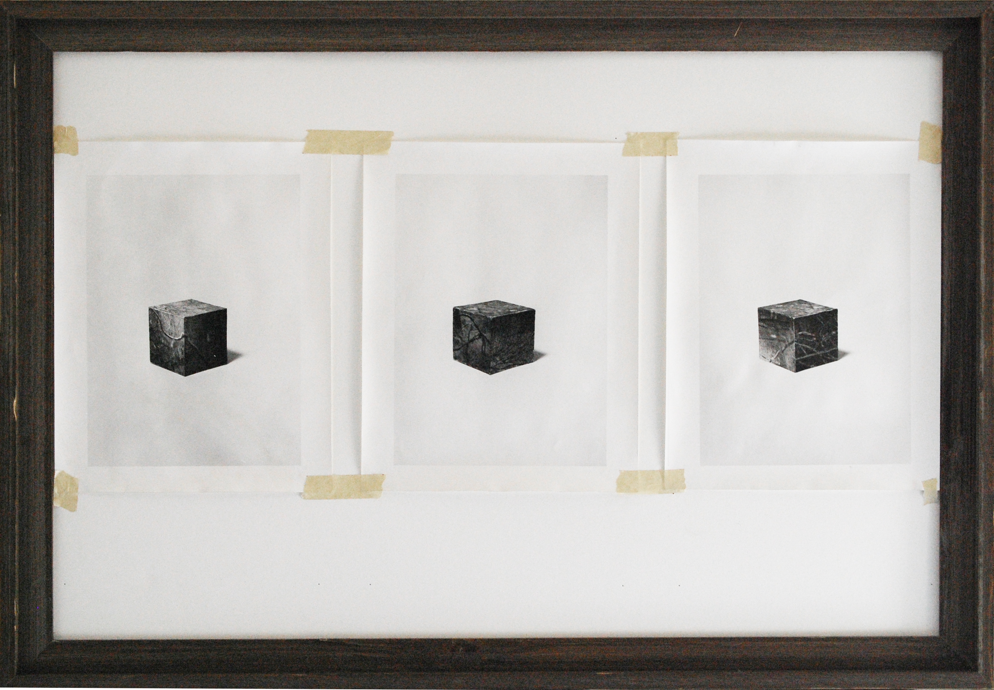
Tamara:
“The eye does not see things but images of things that mean other things: pincers point out the tooth-drawer’s house; a tankard, the tavern; halberds, the barracks; scales, the grocer’s.”
p.13
Notes:
Or else the cloud hovered, having barely left the lips, dense and slow, and suggested another vision: the exhalations that hang over the roofs of the metropolises, the opaque smoke that is not scattered, the hood of miasmata that weighs over the bituminous streets. Not the labile mists of memory not the dry transparence, but the charring of burned lives that forms a scab on the city, the sponge swollen with vital matter that no longer flows, the jam of past, present, future that blocks existences calcified in the illusion of moment: this is what you would find at the end of your journey

Slide 5
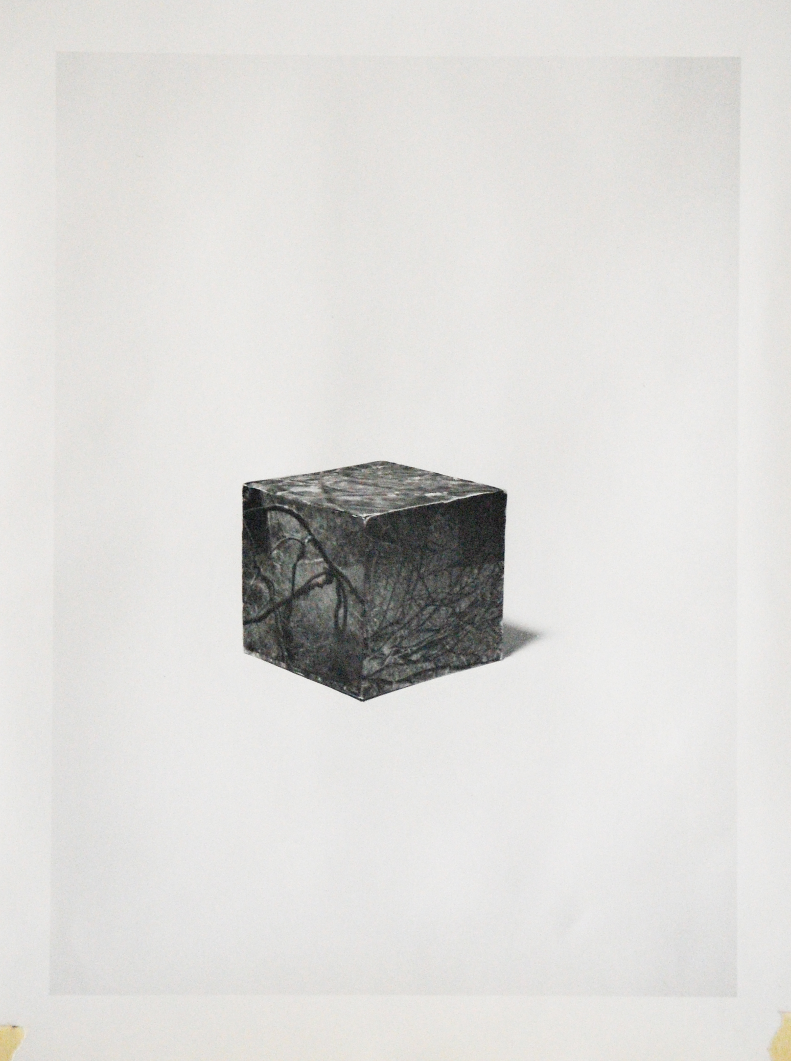
“However the city may really be, beneath this thick coating of signs, whatever it may contain or conceal, you leave Tamara without having discovered it.”
p. 14

