Slide 1
Cooking in Antiquity, Cooking Like Antiquity Today
Katherine Harrington
November 13, 2013

Slide 2
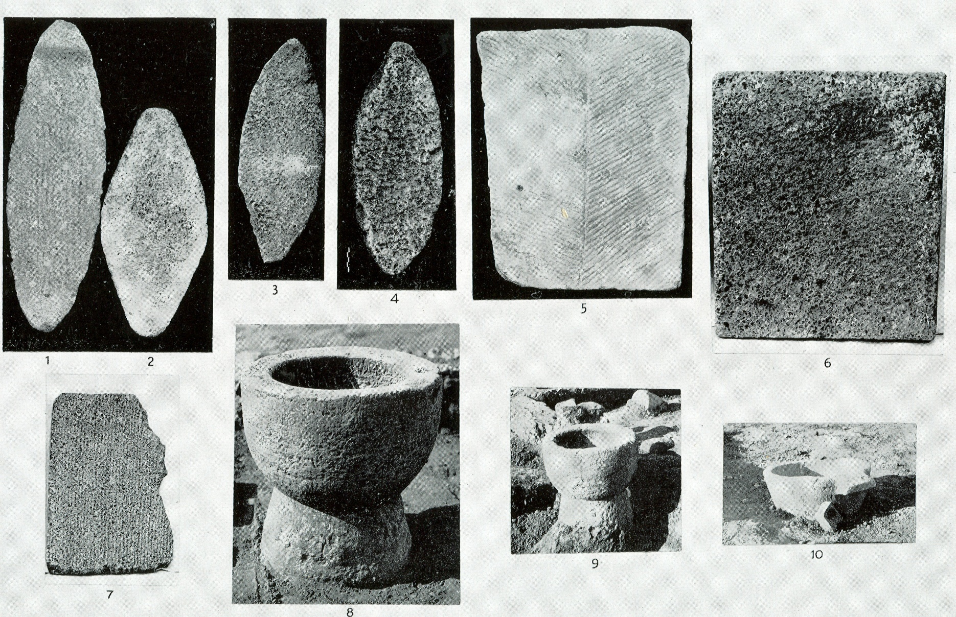
Food Processing
Notes:
Food processing: mortars and querns for grinding grain. These objects would likely be associated with the domestic spaces of women and slaves.

Slide 3
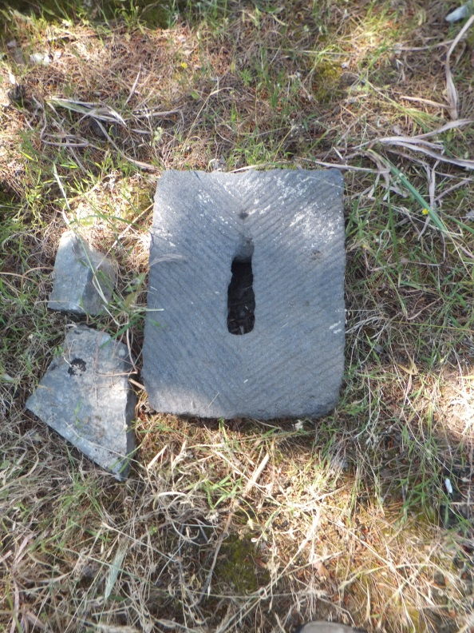
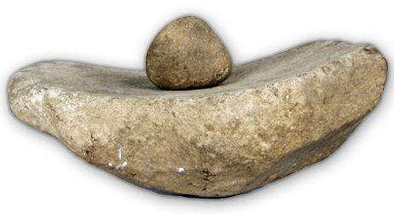
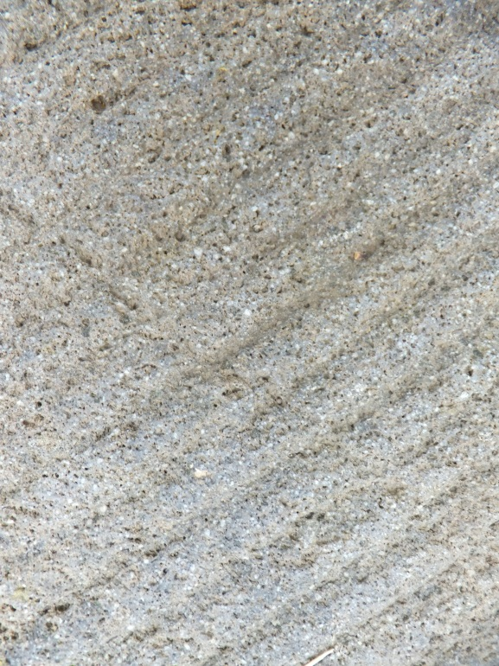
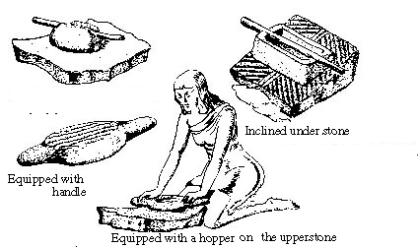
Grains
Saddle Quern

Slide 4
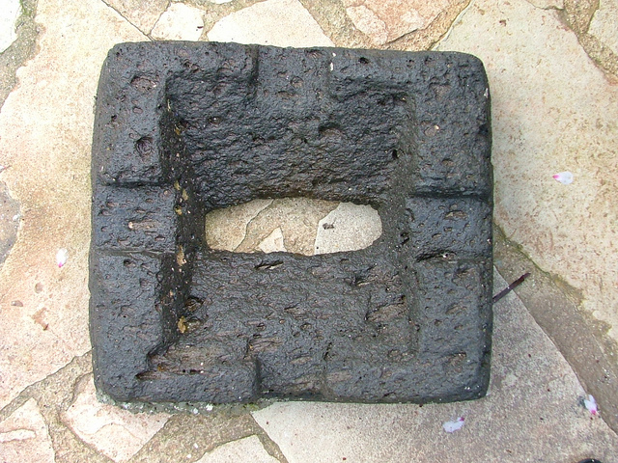
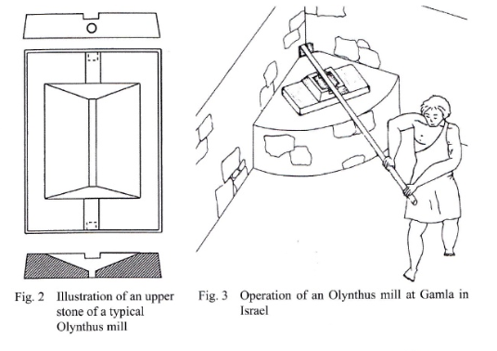
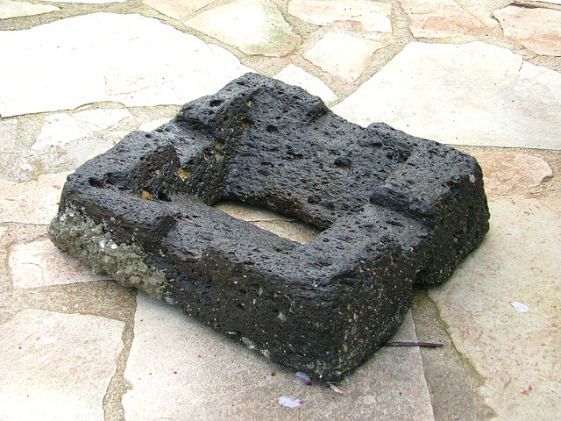
Grains
Olynthus Mill/Hopper Mill

Slide 5
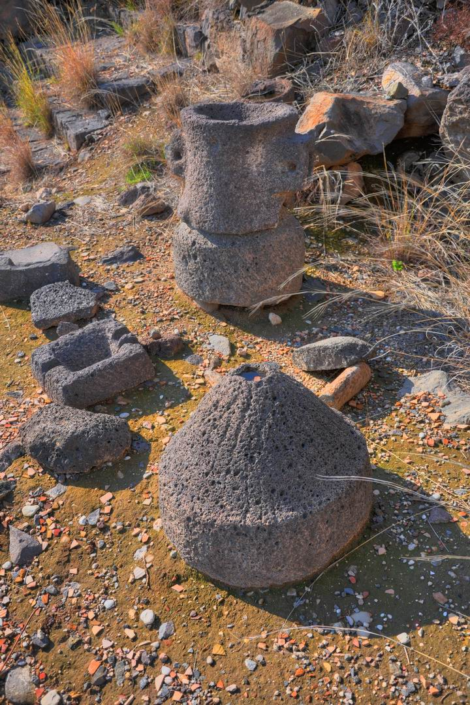
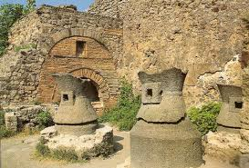
Grains
“Pompeii Mill,” other mills

Slide 6
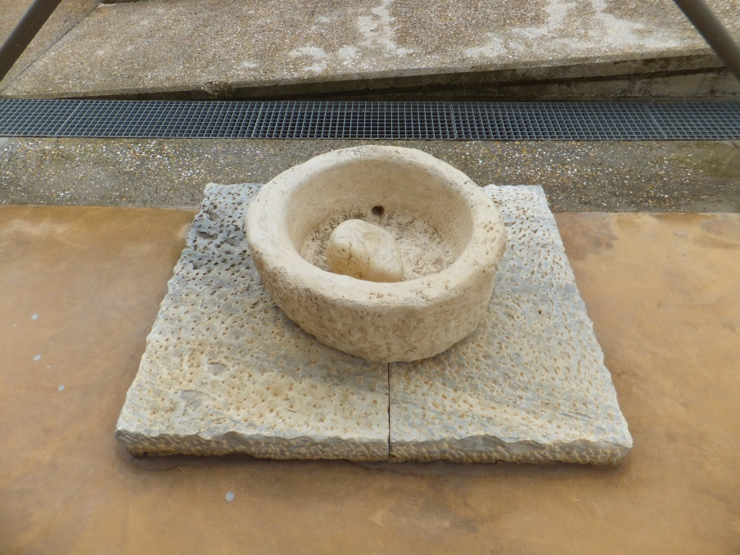
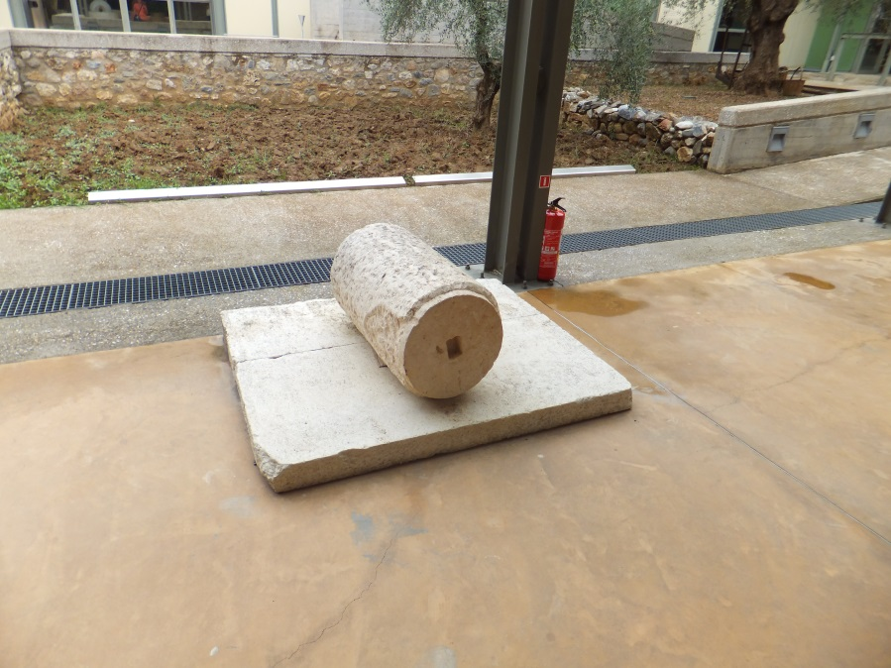
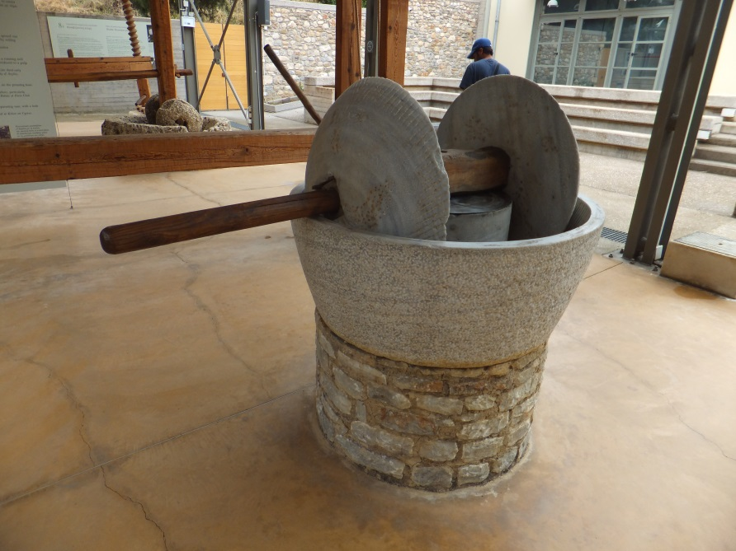
Olives (Crushing)
Trapetum

Slide 7
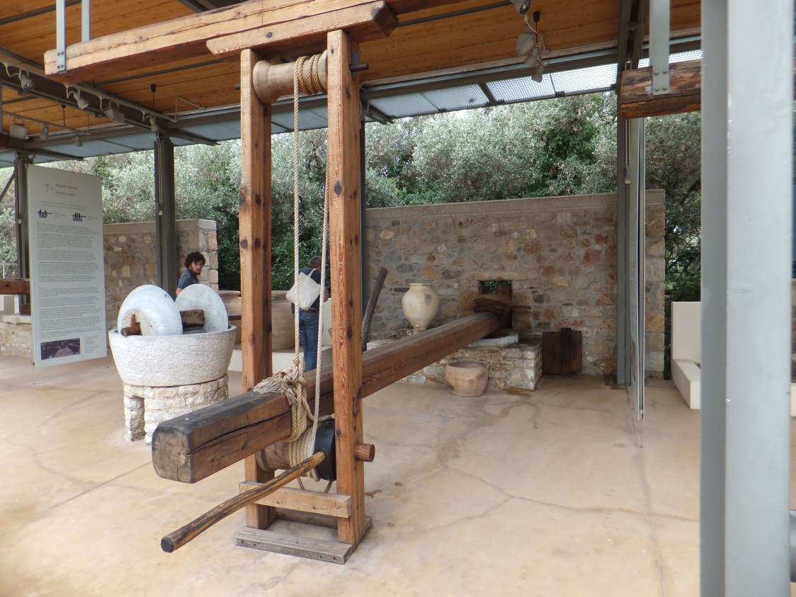
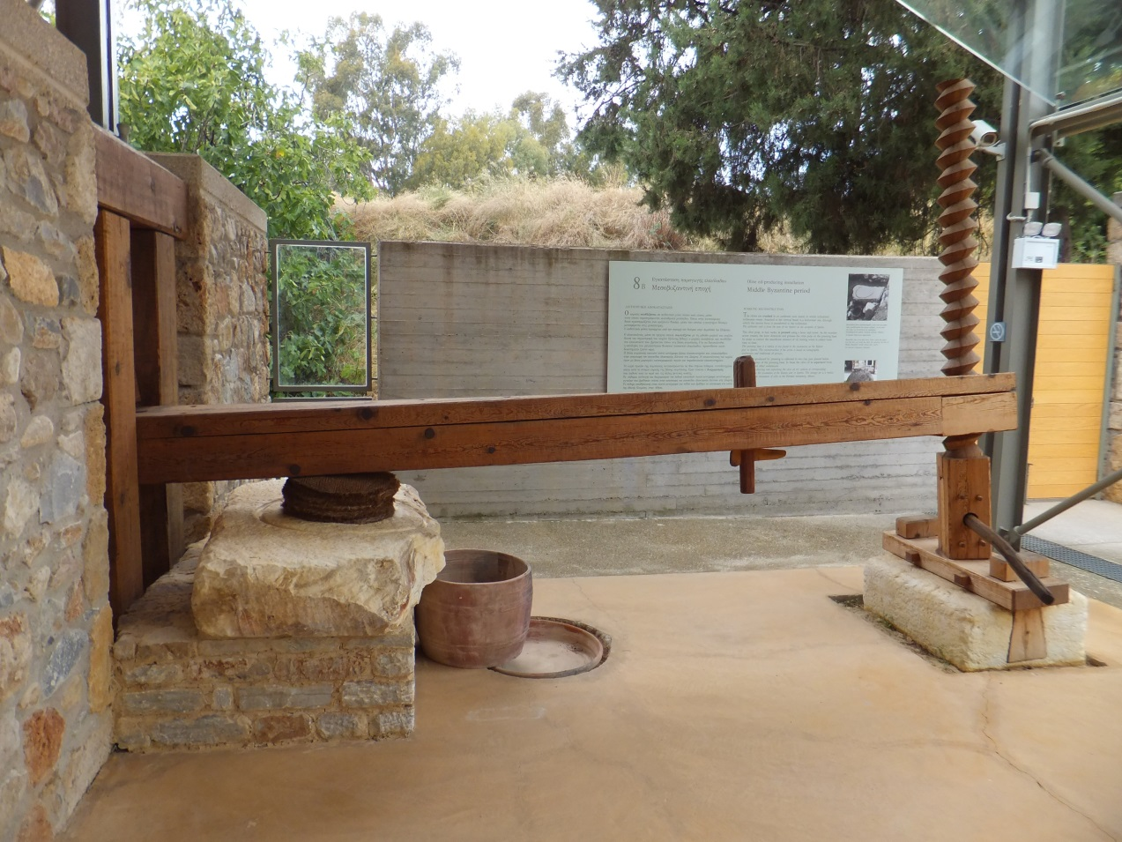
Olives (Pressing)
Who owned them?

Slide 8
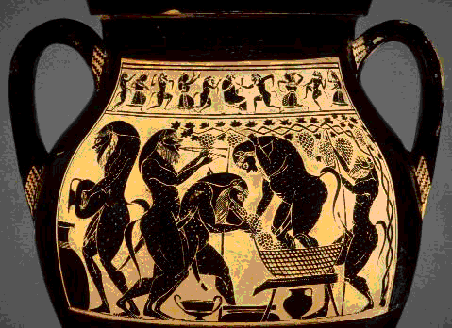
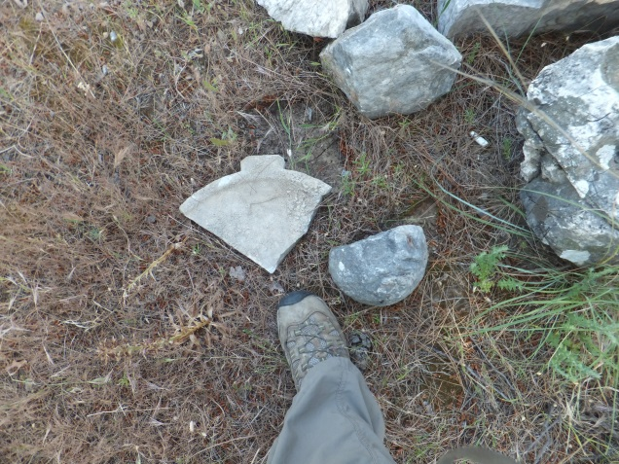
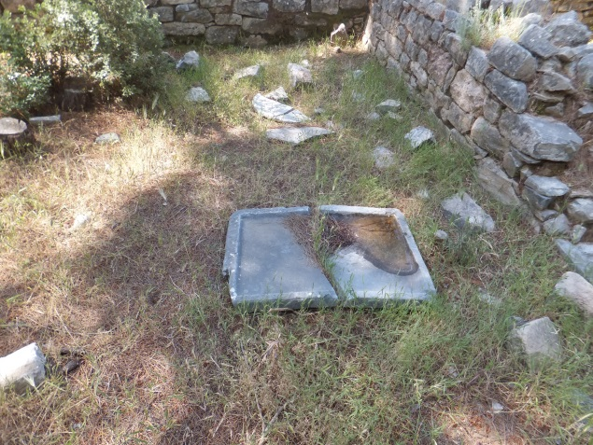
Grapes

Slide 9
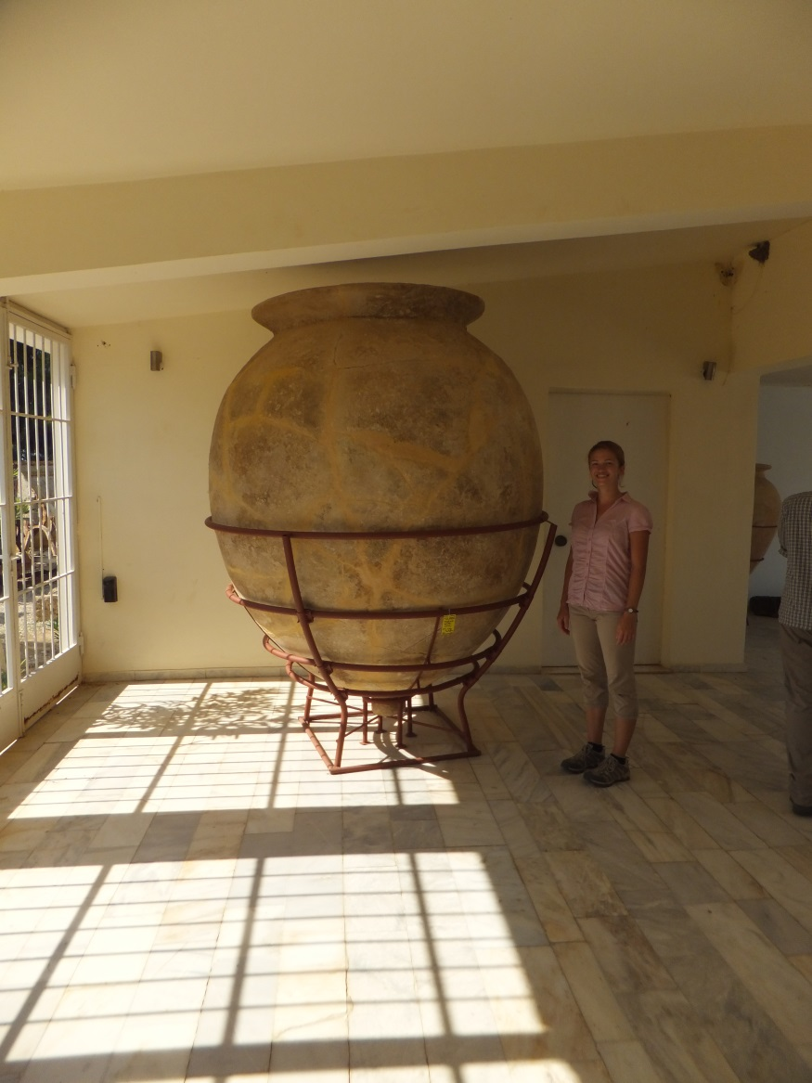
Storage

Slide 10
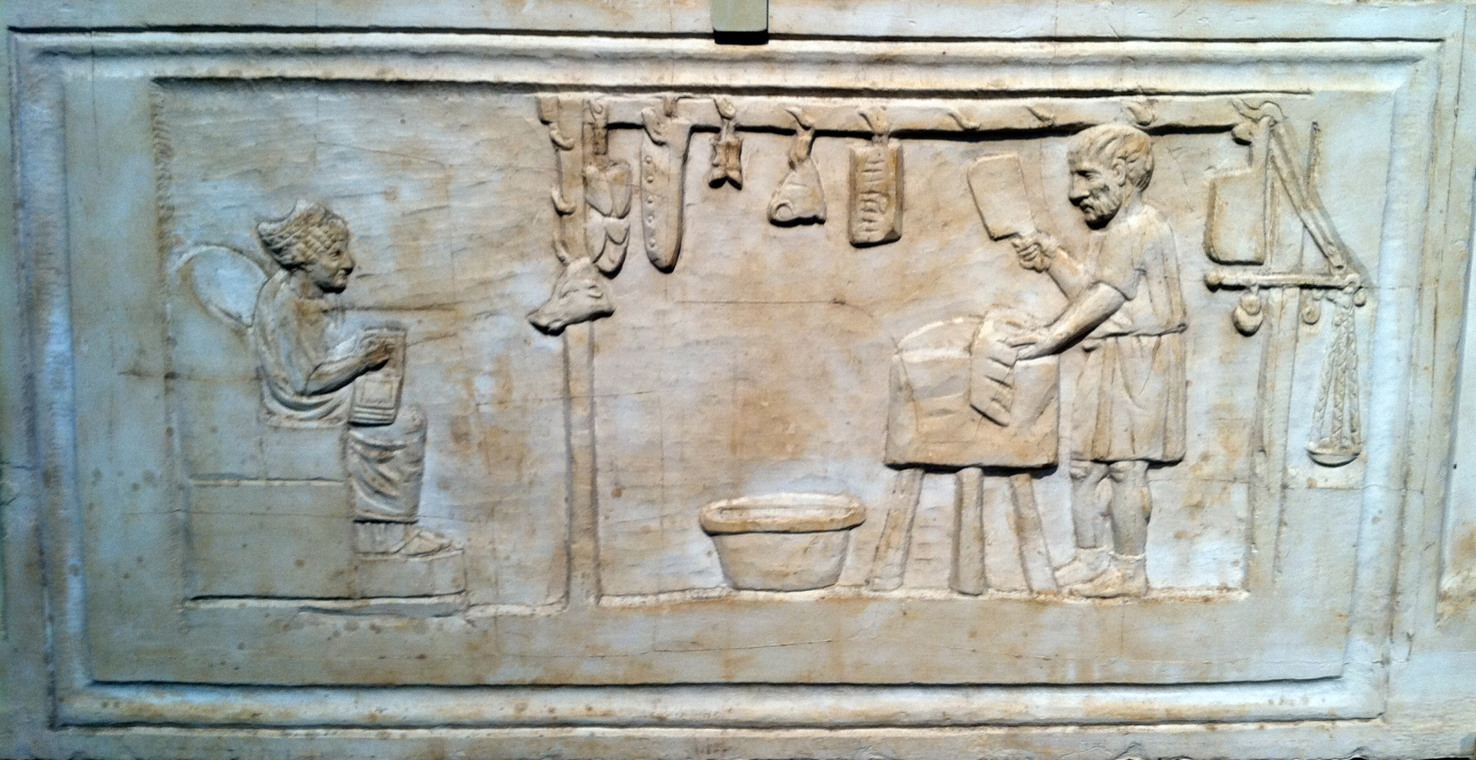
Animal Products
Roman relief of a butcher.

Slide 11
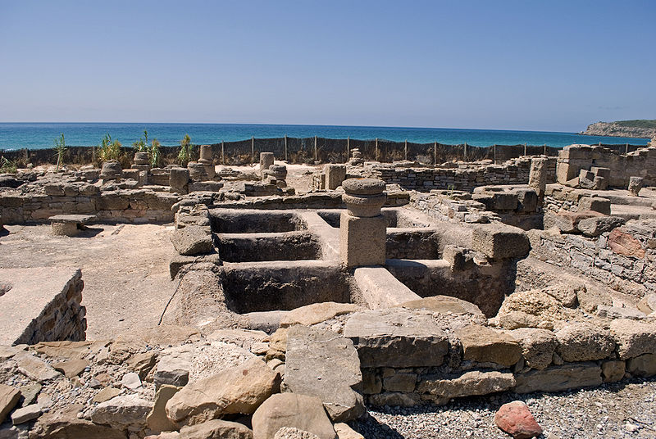
Animal Products: Garum, Salted Fish
Garum factory, Baelo Claudio, Spain

Slide 12
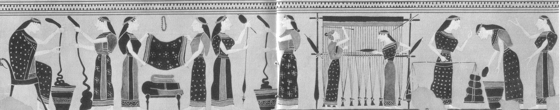
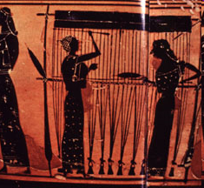
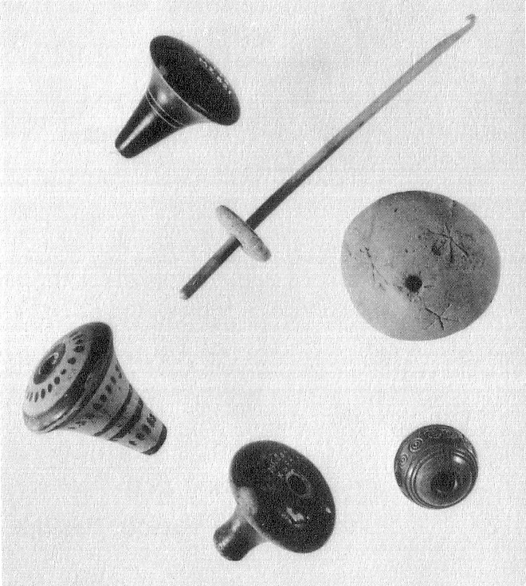
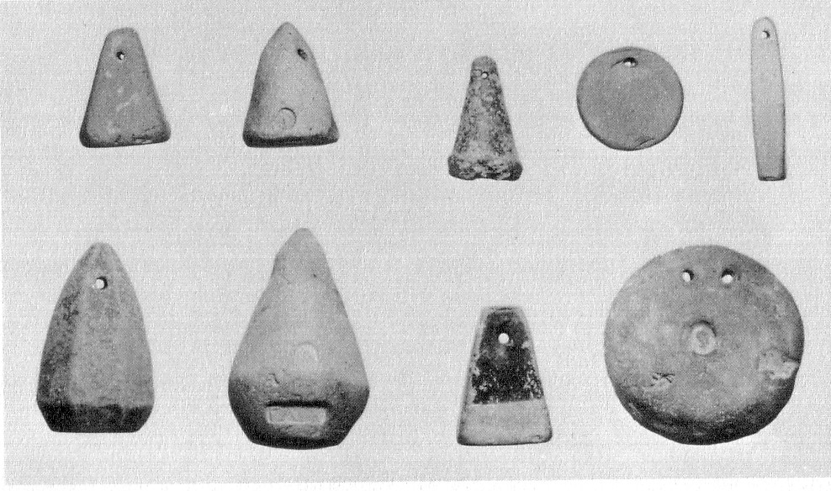
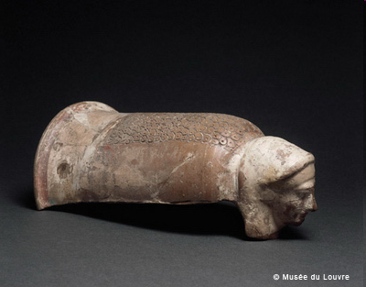
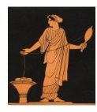
Animal Products: Weaving
Notes:
Women’s domestic space: One of the primary responsibilities of women in the household was the production of cloth. The Attic BF scene above shows this process. Below are spindle whorls and loomweights that are the material residues of this process often found by archaeologists.
12

Slide 13
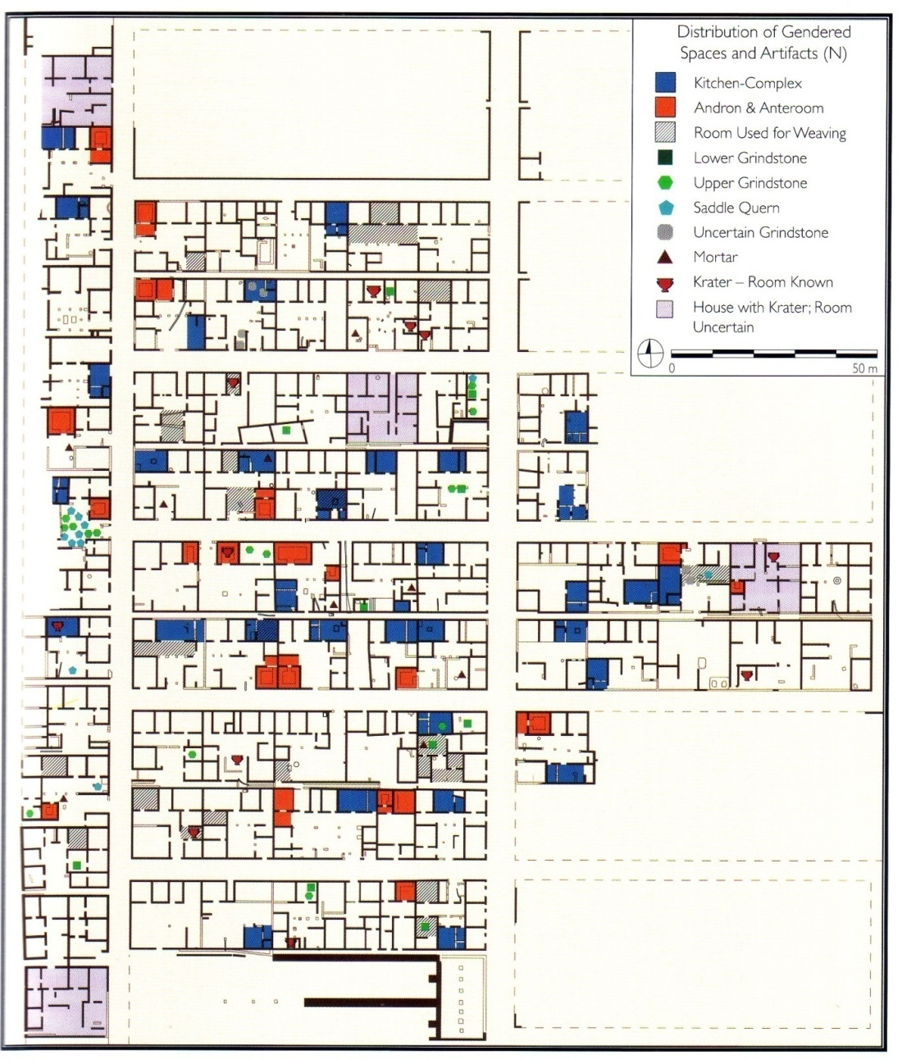
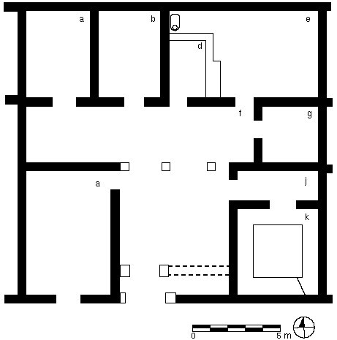
Ancient Greek KiTchens?
“kitchen-complex”
But is it really a kitchen?

Slide 14
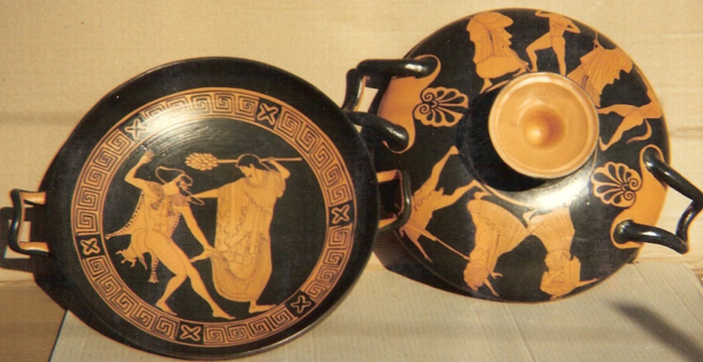
Cooking Ware

Slide 15
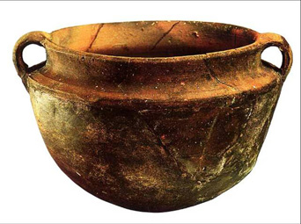
Cooking Ware

Slide 16
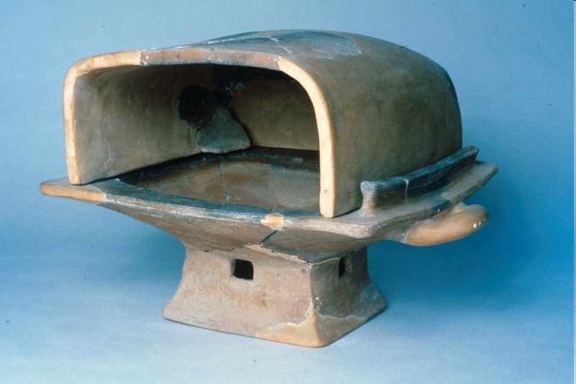

Slide 17
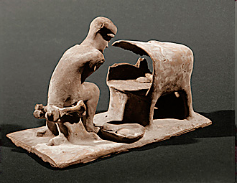
From Athens (c. 425-400 BCE), a portable oven on top of large rectangular eschara (or braizer).

Slide 18
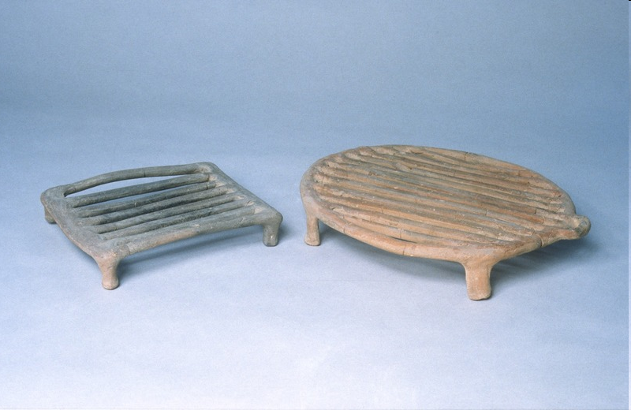

Slide 19
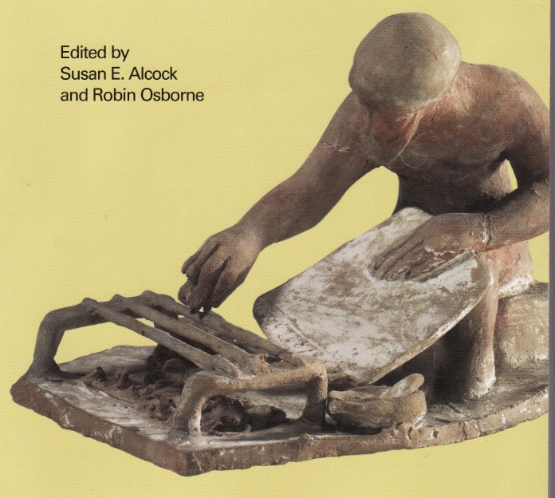
From Athens, 4th-5th c. BCE, Terracotta Grills

Slide 20
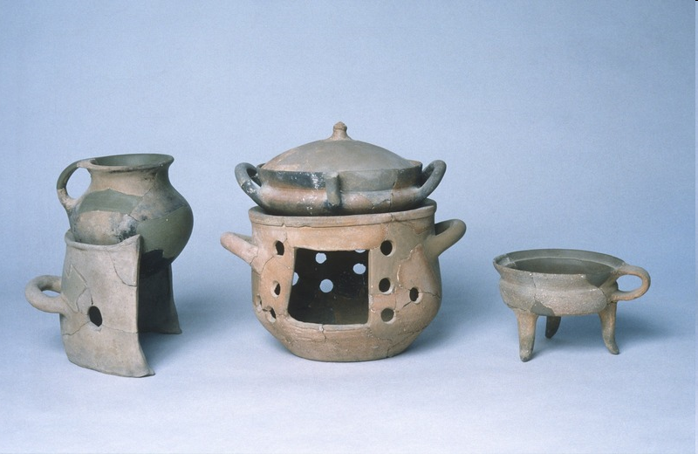

Slide 21
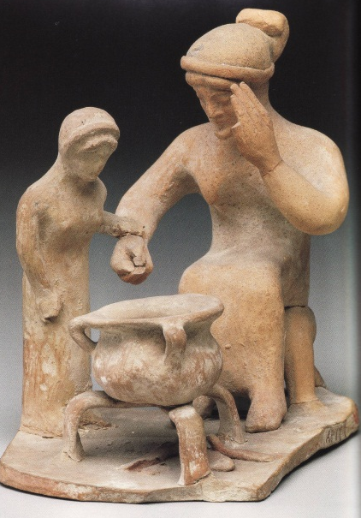
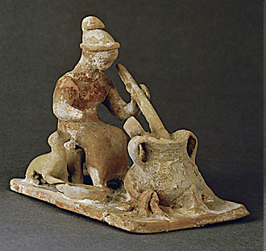
Unglazed kitchen wares from Athens dating to the Classical Period demonstrating various ways of suspending cooking pots above heat. Left to right; chytra on top of cooking stand, lopas with lid, on top of brazier, and tripod casserole dish.

Slide 22

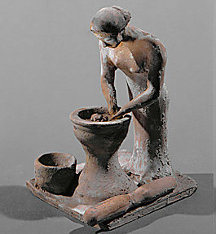
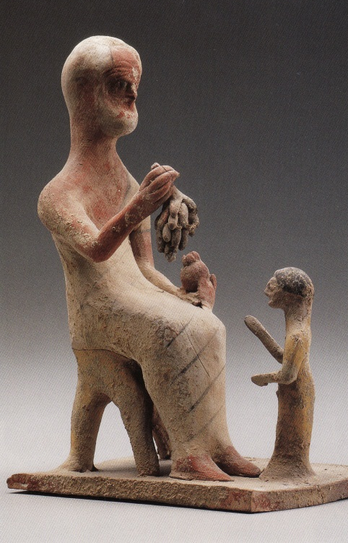
Late Archaic (c. 525-475 BCE) terracotta figurines from Boeotia (?) depicting various types of household work.

Slide 23
Provenance:
Where did the artifact come from? Where was it found, where did it originate?
Why is this so important?
What does it mean if we don’t know the provenance of these terracotta figurines?

Slide 24
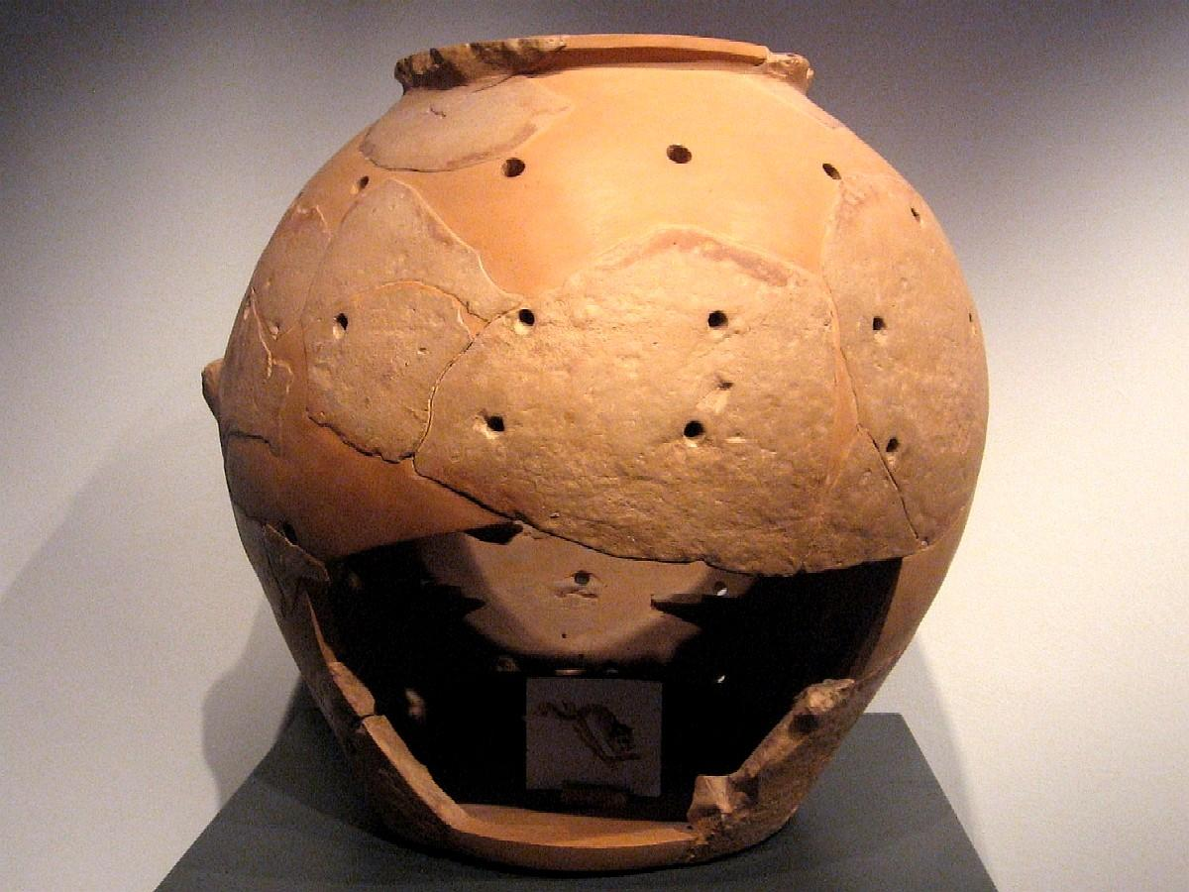
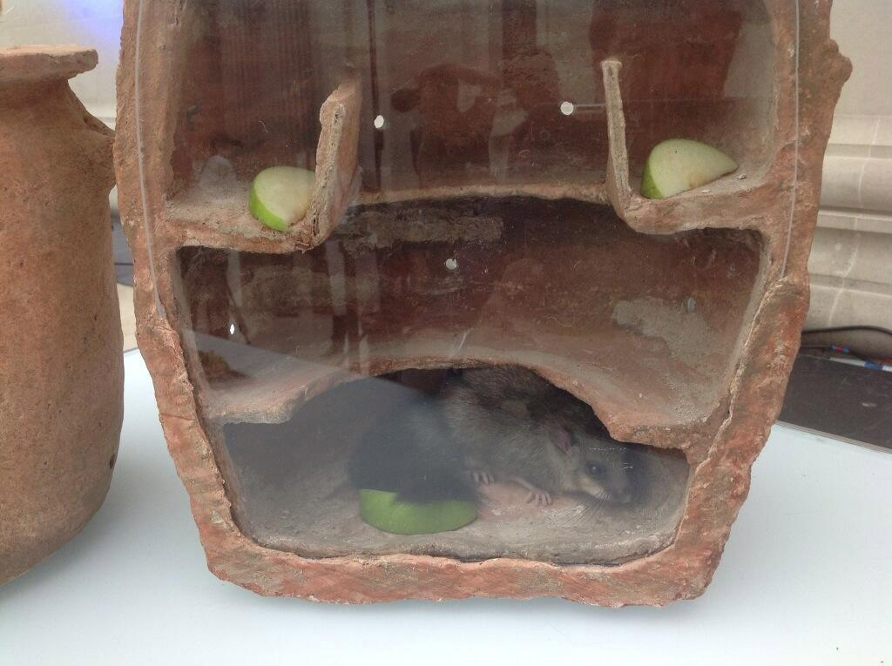
Roman Cooking Tools
Jars for fattening dormice…

Slide 25
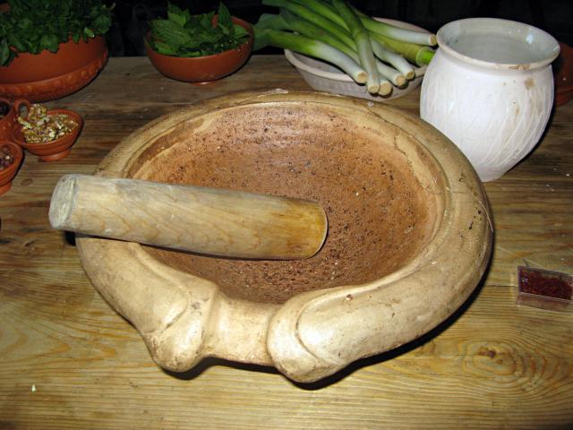
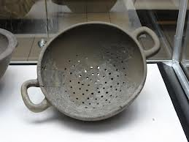
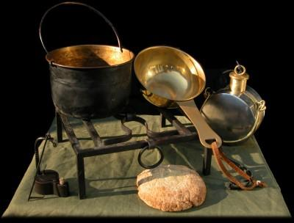
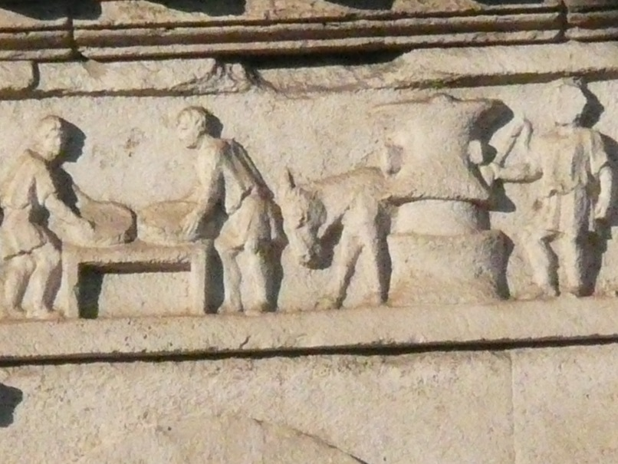
Roman Cooking Tools

Slide 26
Reconstructing Ancient Cooking Today
Archaeologists
Entrepreneurs
Enthusiasts

Slide 27
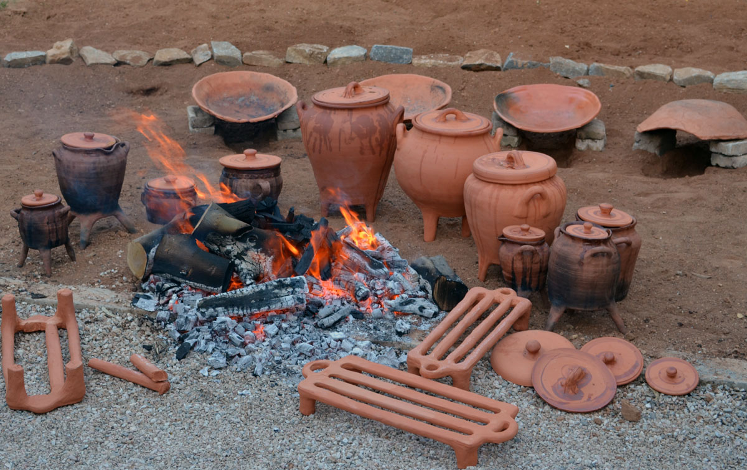

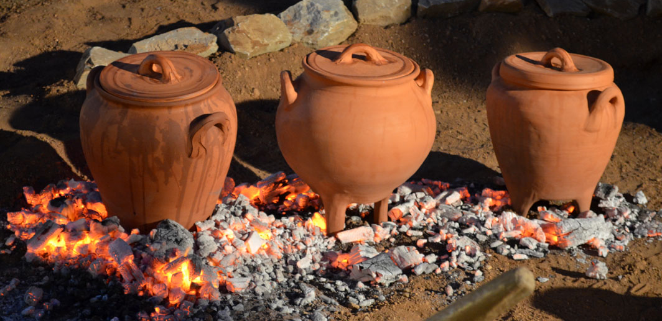
Archaeologists
Case Study:
“Minoiton Gefseis brings ancient flavors to the people of today in the style of a modern catering company. We achieve this by following the footsteps of the ancient cooks using Minoan style earthenware cooking pots and techniques. Our culinary experience is based on current scientific research that is designed to incorporate archaeological, ecological and environmental evidence to produce our interpretation of Minoan tastes. Minoiton Gefseis engages all of your senses.”

Slide 28
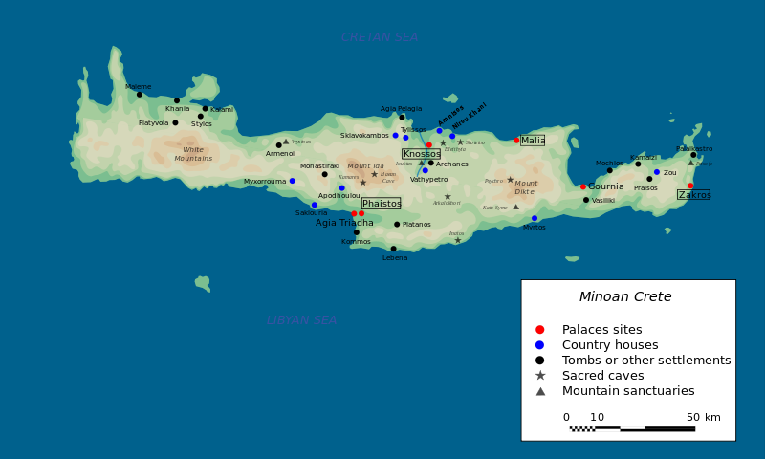
The Minoans
On Crete, during the Bronze Age. Flourished ~2700-1400 BCE.

Slide 29
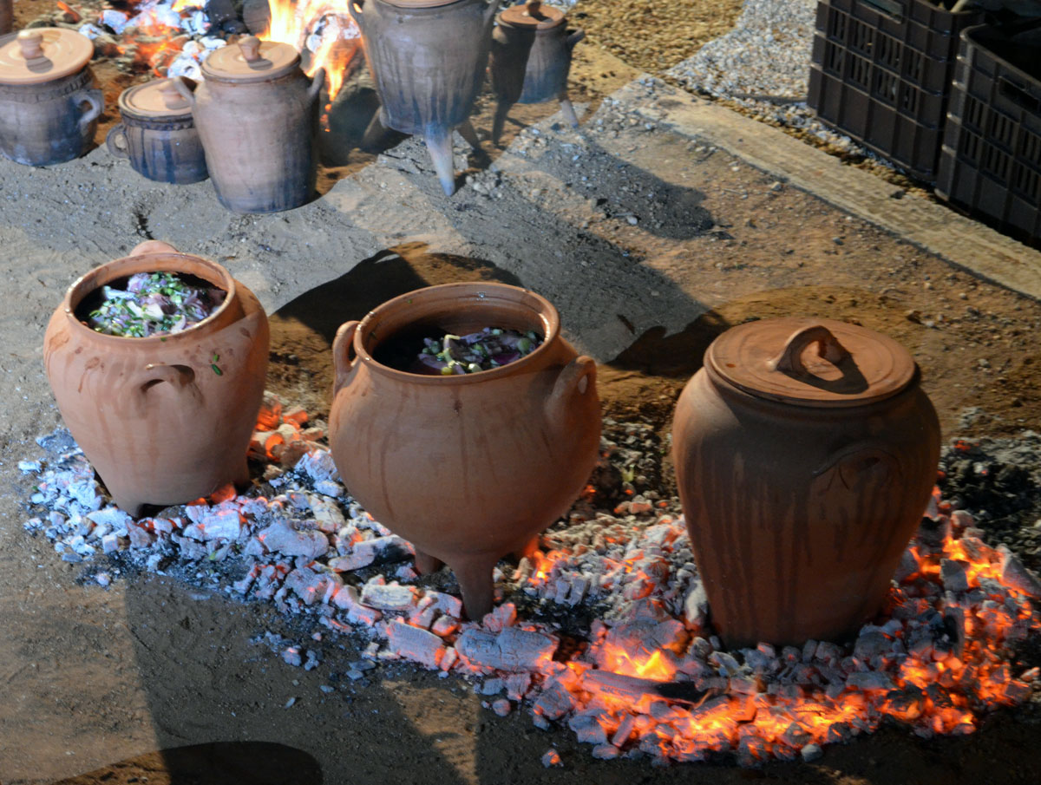




Slide 30



Strategies:
Reconstruct ancient vessels
Use only foods available during the Minoan era
Experiment with different cooking techniques, based on archaeological evidence.

Slide 31



Entrepreneurs
Case Study: Archaion Gefsis Restaturant, Athens, Greece

Slide 32







Slide 33




Slide 34


Slide 35


Enthusiasts
Case Study: Ancient Food Blogs

Slide 36


Blog: Ancient Foods Today!

Slide 37


Blog: Pass the Garum

