Slide 1
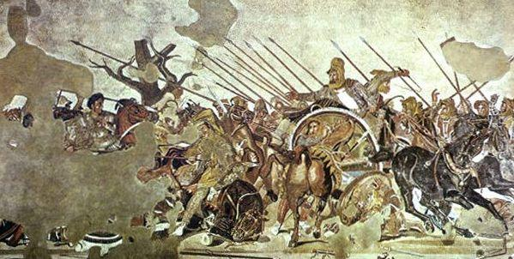
The House of The Faun
Roman Opulence on Display
By Benjamin Cohen

Slide 2
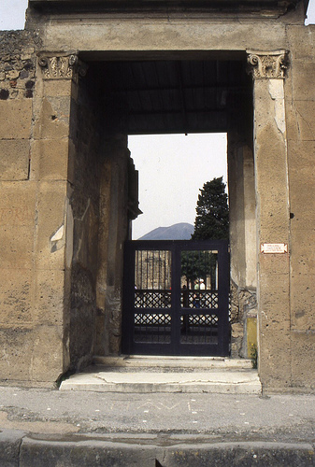
The Entrance

Slide 3
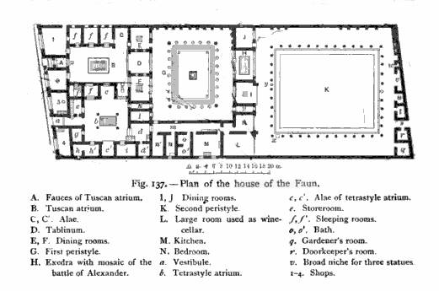
Layout and Floorplan

Slide 4
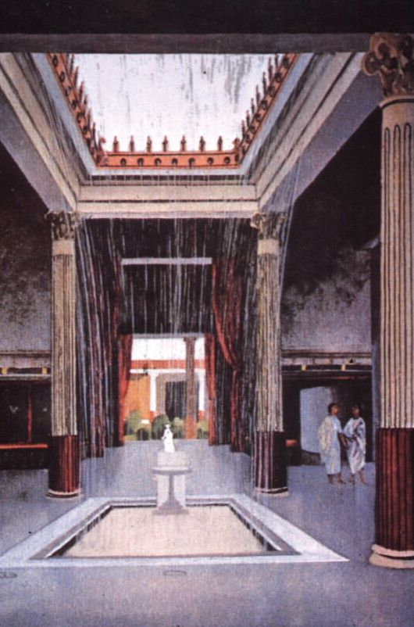
The Atrium (Artistic Representation)

Slide 5
Faun Statue

Slide 6
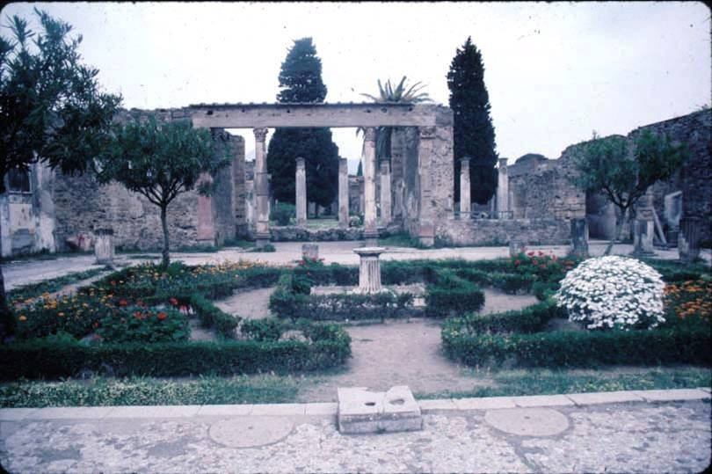
Peristyled Garden

Slide 7
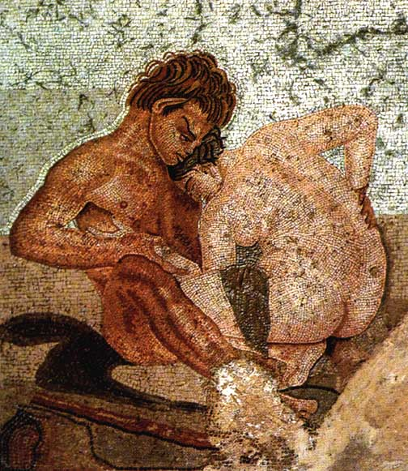
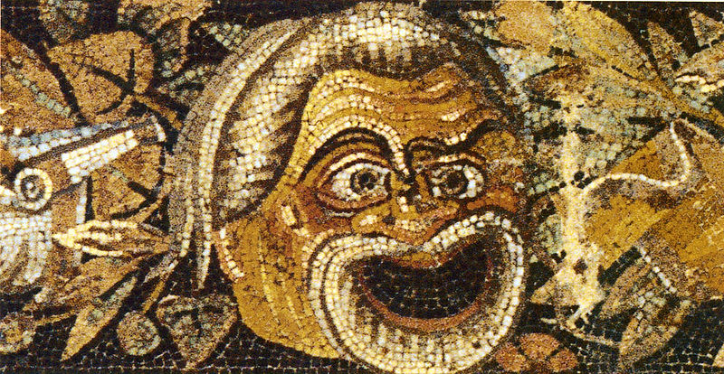
Mosaics

Slide 8
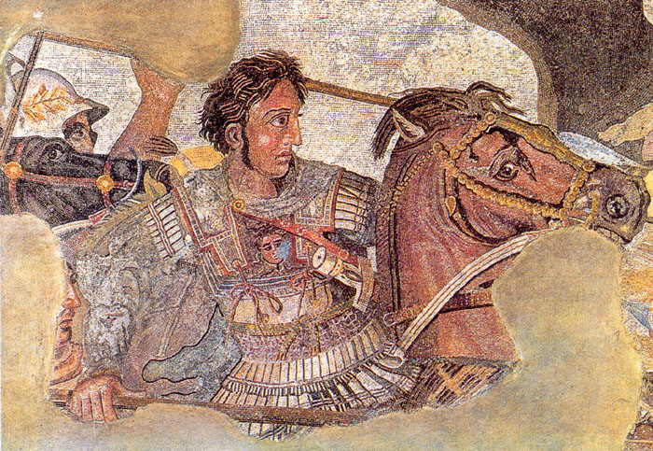
Portrait of Alexander the Great

Slide 9
Inscriptions and Importance

Slide 10
Bibliography
1. Amery, C. and B. Curran Jr. The Lost World of Pompeii. Los Angeles: The J. Paul Getty Museum, 2002.
2. De Franciscis, A. Pompeii: monuments past and present. Rome. 1995.
3. Richardson, L. Pompeii: An Architectural History. Baltimore: The Johns Hopkins University Press, 1998.

