Slide 1
Digital Site Report-Extra Credit
The Temple of Jupiter
Andrew Marks
HIAA 3040

Slide 2
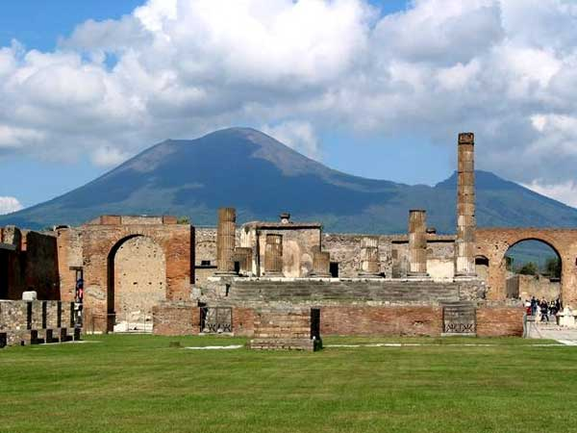
When was it built?
The Temple of Jupiter was built in 150 B.C.E.

Slide 3
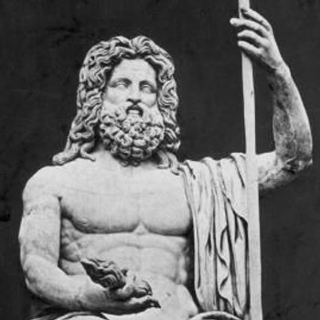
History of the Temple
The Temple was dedicated to the God Jupiter. Jupiter was the ruler of the gods and the protector of Rome, where his temple was the center of Roman Religion.
Statue of Jupiter

Slide 4
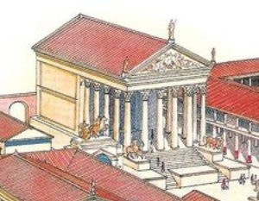
What it looked like
Reconstruction of the Temple was thought to look like

Slide 5
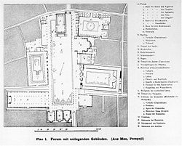
Why the temple was built
In towns newly conquered, such as Pompeii, it was not uncommon for the Romans to build temples to honor Jupiter or the Capitoline Triad (Jupiter, Juno, and Minerva).
Map of the Forum with Temple
of Jupiter at the top

Slide 6
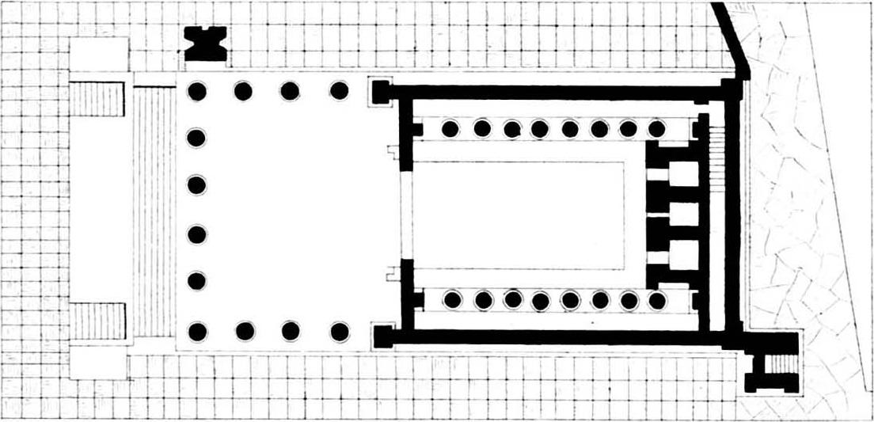
Inside the Temple
Inside the temple laid 3 niches. All three were occupied by statues of Jupiter, Juno, and Minerva.
Outline of Temple

Slide 7
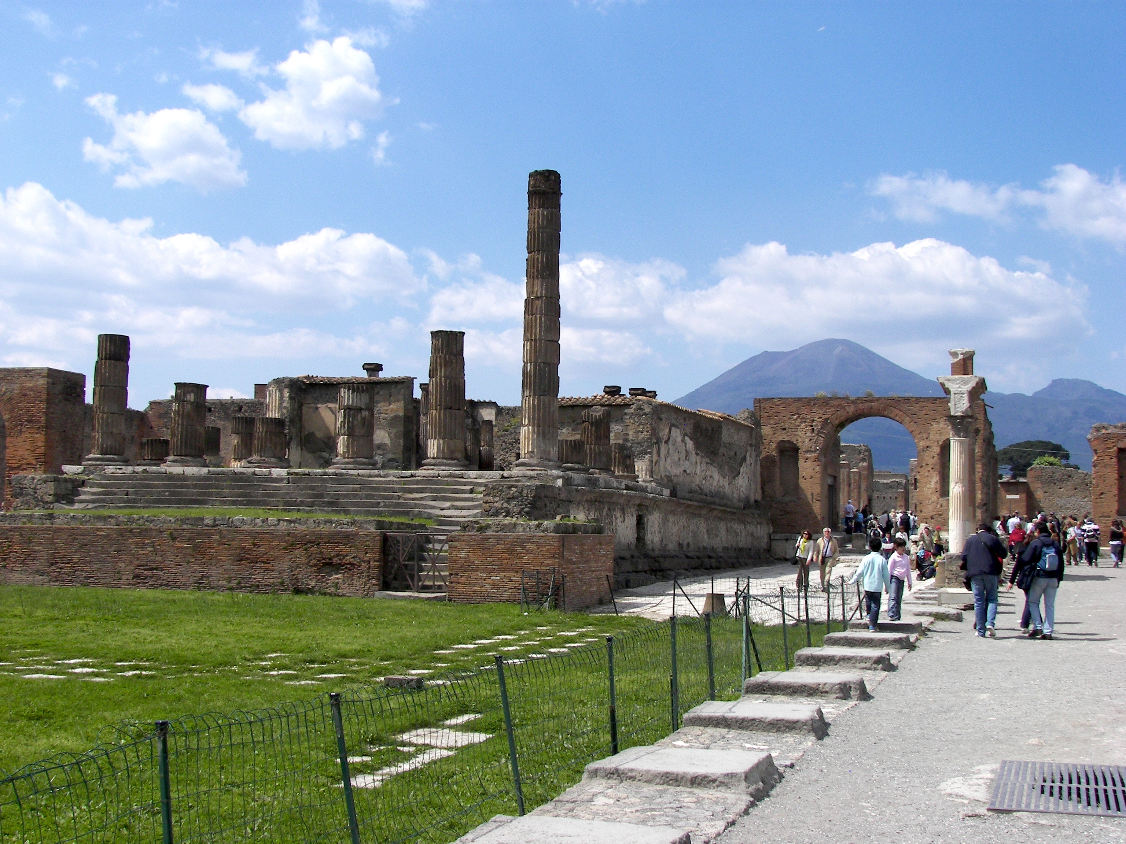
Roman Influence
The Temple and Pompeii was originally heavily influence by The Greeks’ but when the Roman arrived they altered the style of the Greeks.

Slide 8
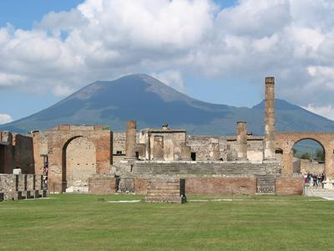
Restoration of the Temple
The Temple remained in pretty good shape throughout most of the Roman rule until an earthquake in 62 CE. After that the Temple was in the process of being restored when Mt. Vesuvius erupted in 79 CE.
Temple of Jupiter with Mt. Vesuvius
in the background

Slide 9
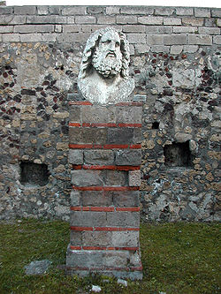
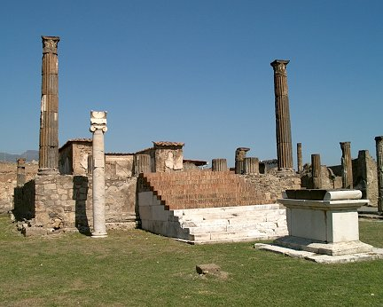
Restoration cont.
Today even with the eruption of Mt. Vesuvius, the temple can be seen. Although the temple site and a lot of other sites in Pompeii were not preserved well we can still get a good idea of what some archeological sites looked like.

Slide 10
Bibliography
De Franciscis, A. Pompeii: monuments past and present. Rome. 1995.
Amery, C. and B. Curran Jr. The Lost World of Pompeii. Los Angeles: the J. Paul Getty Museum, 2002.
Richardson, L. Pompeii: An Architectural History. Baltimore: The John Hopkins University Press, 1998.

