Slide 1
Temple of Isis
Claire Huang

Slide 2
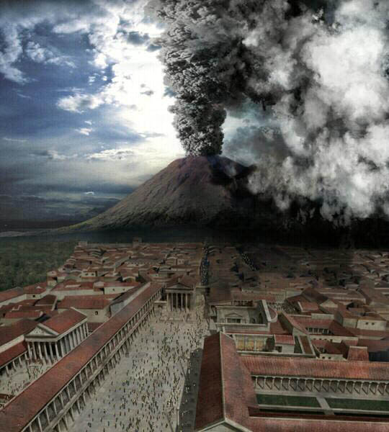

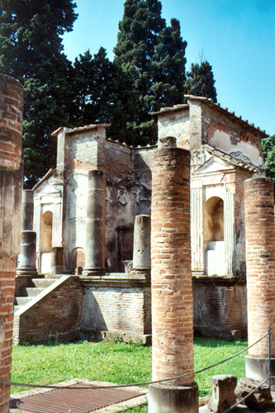
Pompeii

Slide 3
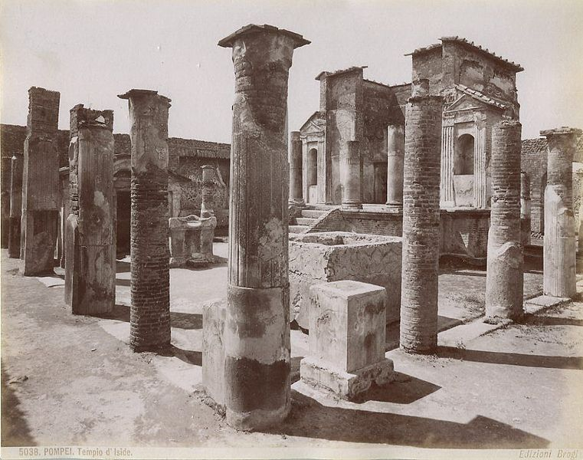
The Temple of Isis

Slide 4
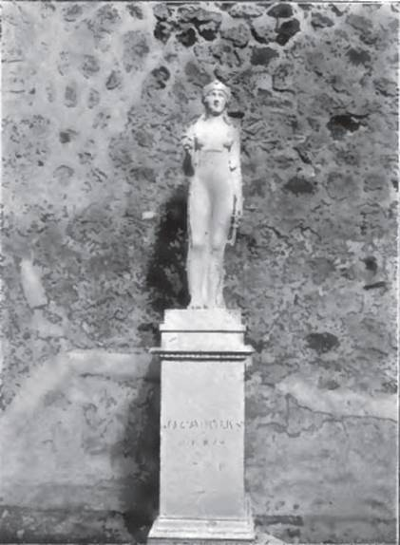
Isis
“Oh holy and blessed Lady the perpetual comfort of humankind who by thy bounty and grace nourishs the whole world and bears a great compassion to the troubles of the miserable as a loving mother would”
-Lucius Apuleius

Slide 5
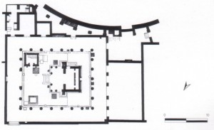
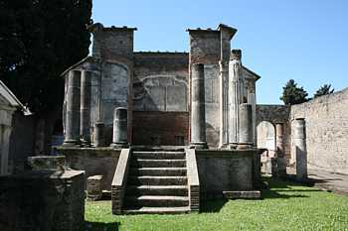
The Structure of the Temple of Isis

Slide 6
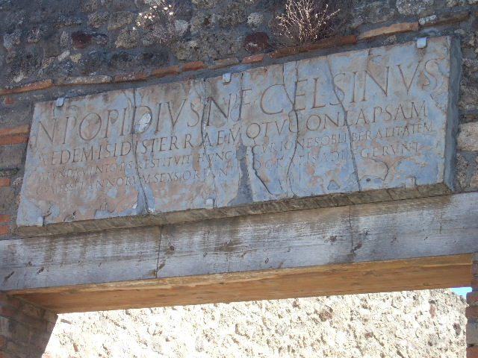
Excavation of Temple of Isis

Slide 7
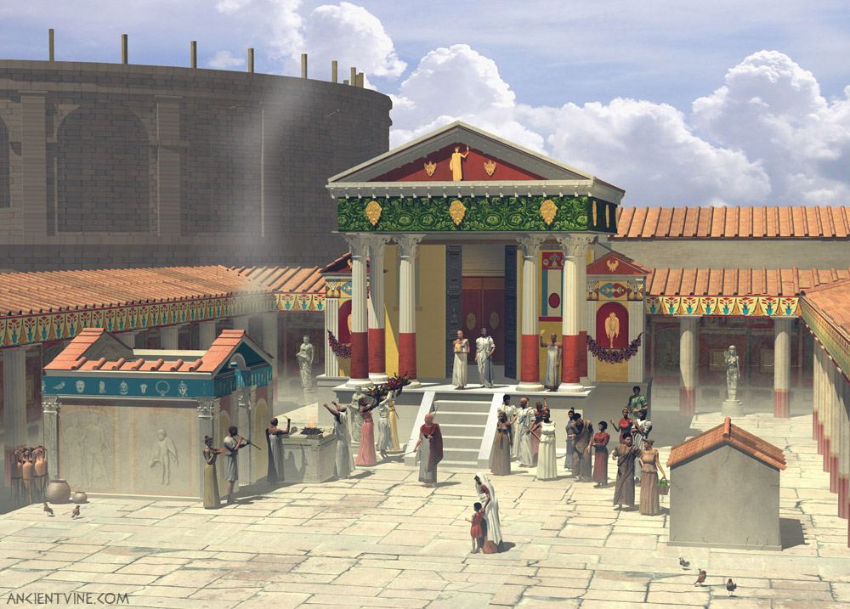
Significance of Temple of Isis

Slide 8
Bibliography
Balch, D.L. (2003). The Suffering of Isis/Io and Paul's Portrait of Christ Crucified (Gal. 3:1): Frescoes in Pompeian and Roman Houses and in the Temple of Isis in Pompeii.
Blanchard, Paul. "Blue Guide, Southern Italy; From Rome to Calabria", New York: W. W. Norton & Company Inc., 1982.
"Blog Picture." Do as the Romans did ... in "Pompeii" --- a novel by Robert Harris. Web. 10 May 2011. <http://www.yorkblog.com/books/2007/09/do-as-the-romans-did-in-pompei.html>.
"Brogi, Giacomo (1822-1881) - Pompei - Tempio d'Iside - n. 5038 - ca. 1870." File:Brogi, Giacomo (1822-1881) - Pompei - Tempio d'Iside - n. 5038 - ca. 1870.jpg. Web. 10 May 2011. <http://en.wikipedia.org/wiki/File:Brogi,_Giacomo_%281822-1881%29_-_Pompei_-_Tempio_d%27Iside_-_n._5038_-_ca._1870.jpg>.
Hackworth Petersen, L. (2006). "The Freedman in Roman Art and Art History", Cambridge University Press.
Jacobson, Jeffrey. "Historical Background." http://www.planetjeff.net/. N.p., n.d. Web. 10 May 2011. <http://www.planetjeff.net/isis/verbage/background.html>.

Slide 9
Bibliography
"Pompeii the last day 1." File:Pompeii the last day 1.jpg. Web. 10 May 2011. <http://commons.wikimedia.org/wiki/File:Pompeii_the_last_day_1.jpg>.
R.E Witt, "Isis in the Ancient World", p. 7, 1997.
"Temple of Isis - Pompeii." Ancientvine. Ancientvine.Com, 2008. Web. 10 May 2011. <http://www.ancientvine.com/templeofisis.html>.
"TEMPLE OF ISIS - POMPEII." Pompeii tours: Pompeii is the most popular tourist attraction in Italy.. POMPEII.ORG.UK, n.d. Web. 10 May 2011. <http://www.pompeii.org.uk/m.php/museo-tempio-di-iside-pompei-it-77-m.htm>.
"The Church in Ancient Society: From Galilee to Gregory the Great", Henry Chadwick, p526, Oxford University Press, 2003.
"The Forgotten City of Pompeii; A First Look ." Tour of Italy for the Financially Challenged. Tour of Italy for the Financially Challenged/touritaly.org, 2008. Web. 10 May 2011. <http://touritaly.org/pompeii/pompeii-main.htm>.
"VIII.7.28 Pompeii. 1906. Statue of Isis in situ on north wall." Pompeiiin Pictures. Web. 10 May 2011. <http://www.pompeiiinpictures.com/pompeiiinpictures/R8/8%2007%2028%20p5.htm>.

