Slide 1
Are Exotic Plant Invaders All That Bad?
Part II
Results and Concern for the Cost

Slide 2
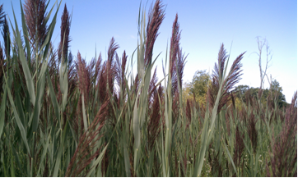
We’ve been looking at how competition for limiting resources can cause competitive exclusion of native species, potentially leading to their local extinction. That’s why most park management officials and conservation biologists believe exotic invasive species like this Phragmites australis should be eradicated. Perhaps Lee’s research might help to better understand the effects exotic invasive plants on the communities around them when compared to the effects of native monoculture plants.

Slide 3
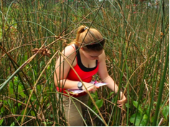
Overall, Lee found that biodiversity, biological fitness, and general health of the plants growing any patch type were lower than the control groups. However, in addition to how each patch type affects other species, we have to consider the number of patches per species and patch size.

Slide 4
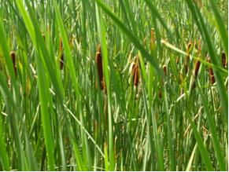
Conservation biologists aren’t going to be as concerned about a species that is only in a few spots. The plant with the largest number of patches was Typha x glauca and each patch covered a lot of area.

Slide 5
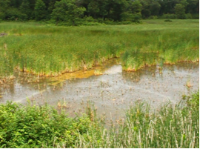
That means that based on the area of the ponds affected, cattails had the biggest impact other species by using the most limiting factors.

Slide 6
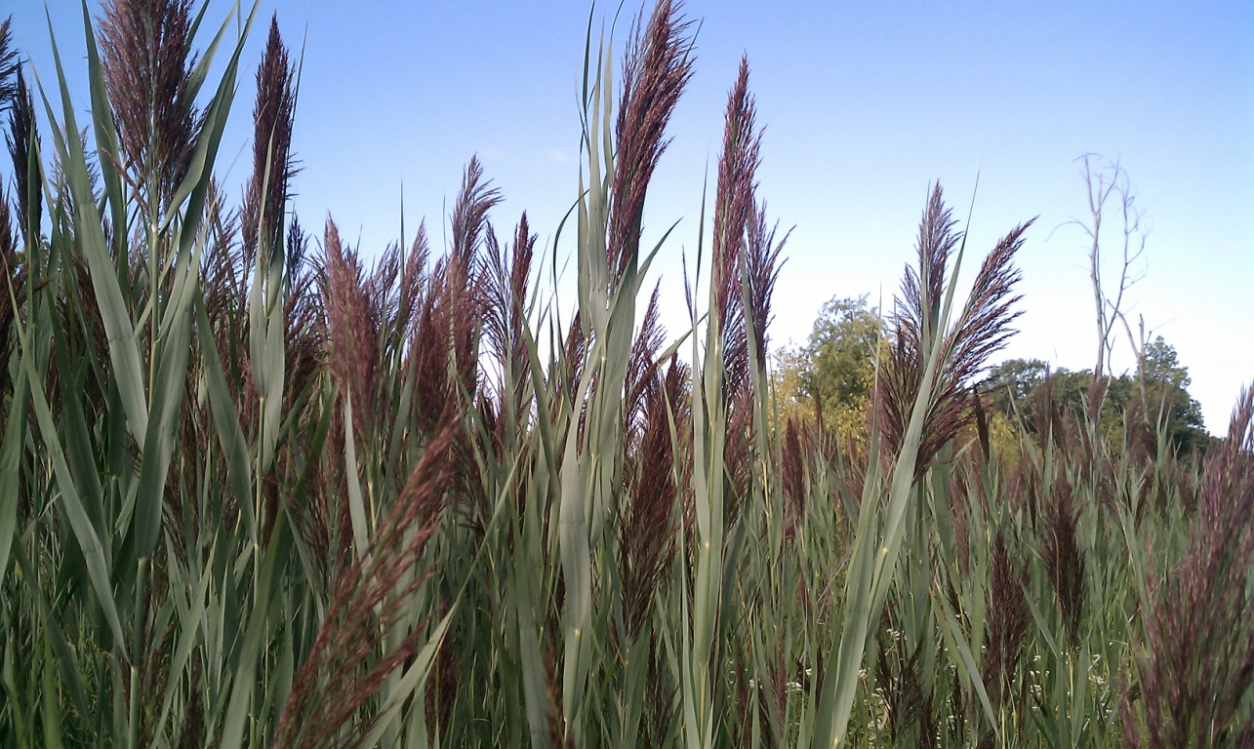
There were slightly fewer stands of Phragmites australis, the other exotic invasive tested, and each took up a little less space in the ponds. Both exotic species had far more patches than Cephalanthus occidentalis and Schoenoplectus acutus.

Slide 7
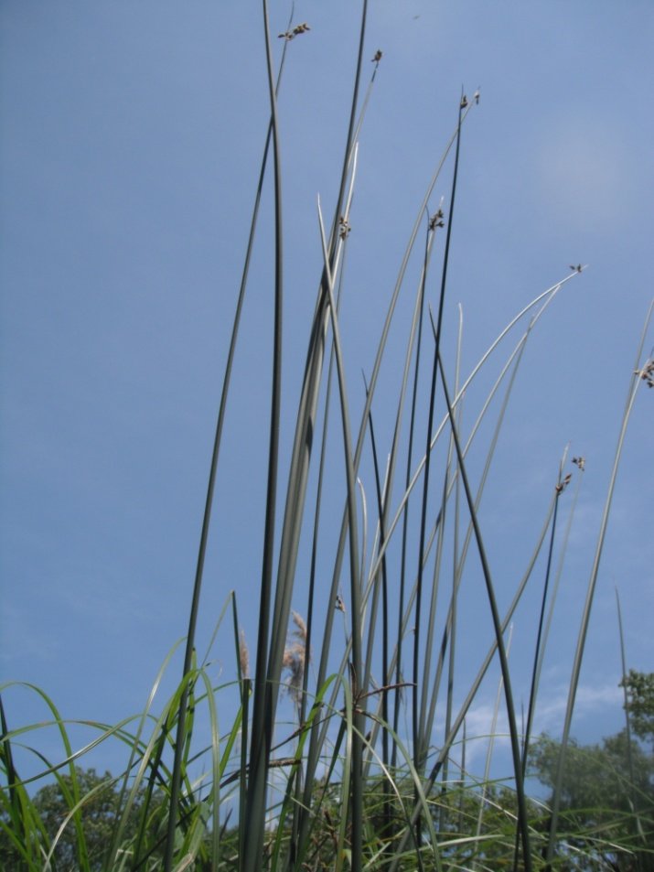
While Schoenoplectus stands still consumed important resources, there were very few stands of in the ponds and these stands were the smallest.

Slide 8
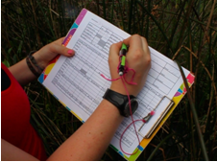
Therefore, while all four of the species tested had a negative impact on the species growing around them, the exotic invasive species really do take up more limiting resources than the native species when we consider the whole area of Indiana Dunes.

Slide 9
The study's unique contribution to conservation biology is that it compares how four plant species cause different amounts of competitive exclusion and local extinction. The next step is to inform Park Management of the findings so they can use the data to help decide which patches of invasive exotics are worth the cost of removing. After all, it isn’t' easy to get rid of these plants once they have taken over an area.

Slide 10
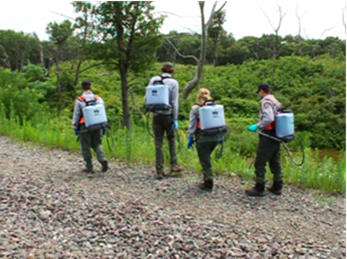
Native species could recolonize any area where exotics were removed. However, we often need to help them get started, and monitor the area for exotic regrowth. The real issue is balancing the limited resources that we have for exotic removal.

Slide 11
Clearly, if we're going to remove these species at all, we need to be choosy about where to do it, and to what extent. Data from previous research shows that these exotic species weren't here as little as 30 years ago, or at least they weren’t a problem- but today they're everywhere we look. If they aren't spreading to new areas, then maybe we can leave them alone.

Slide 12
But can we take the risk? What about the fact that the Miller Woods ponds within the Indiana Dunes are the last remnants of the Calumet Lake Plain? Isn't there some historical value worth keeping the ponds biodiversity and pre-human state? But at what cost? These are all big gaps for ecologists to fill, and good examples of how the answers aren't always straightforward in science.

Slide 13
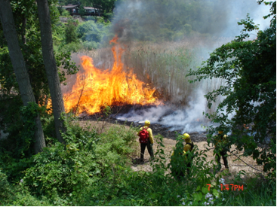
The best way to get rid of Phragmites is to burn it 2-3 years in a row. Their roots are so strong and grow so deep that burning them one time is never enough; they would just grow back the next year.

Slide 14
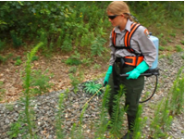
Many of the things we use to remove plants we don't want, such as fire or toxic chemicals, requires workers with special skills and expensive equipment.

Slide 15
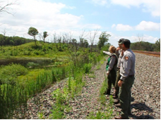
Roadside ditch of Phragmites &/or Cattail W explanation voice over Many of the wetlands you see along roads, like this one, are overrun with exotic invasive species. Should resources and the difficult physical labor needed to eradicate the exotic invaders be used everywhere, or only in places like parks? It gets tricky.

Slide 16
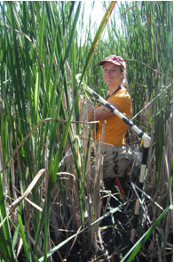
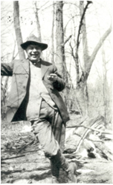
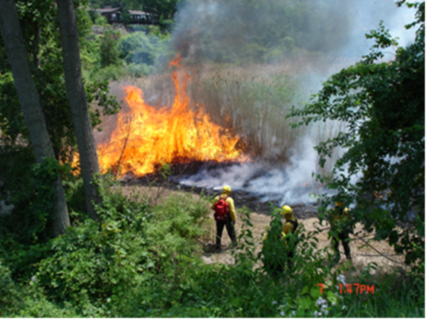
Hopefully Lee’s research has helped you to learn a little bit more about invasive exotic species in the wetlands, and how they are limiting the availability of resources that other plants in the community need to survive and reproduce. Thanks for following along!

