Slide 1
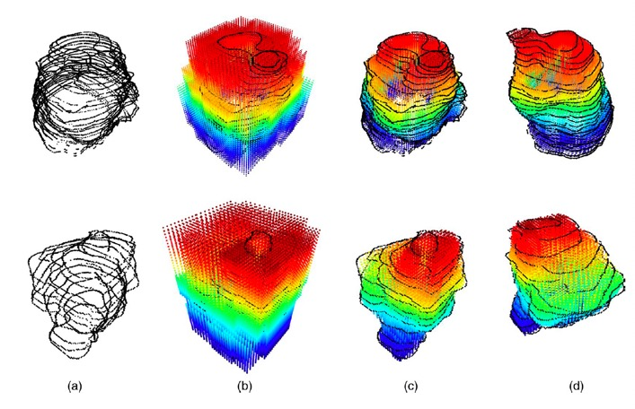
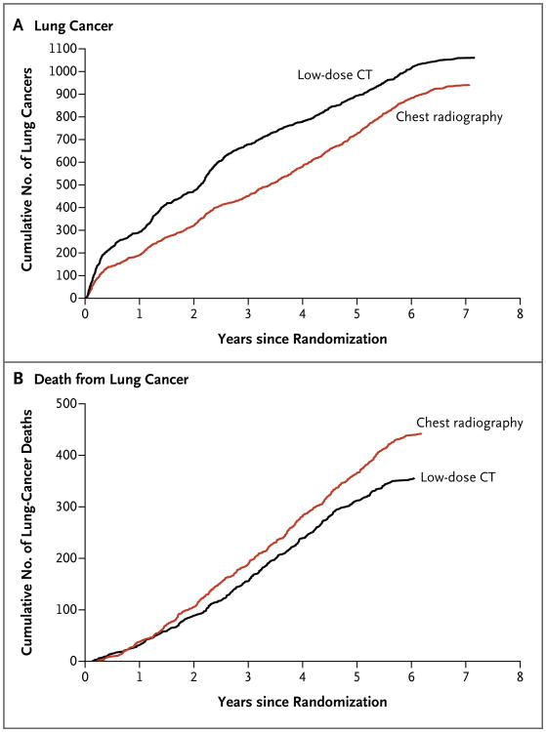
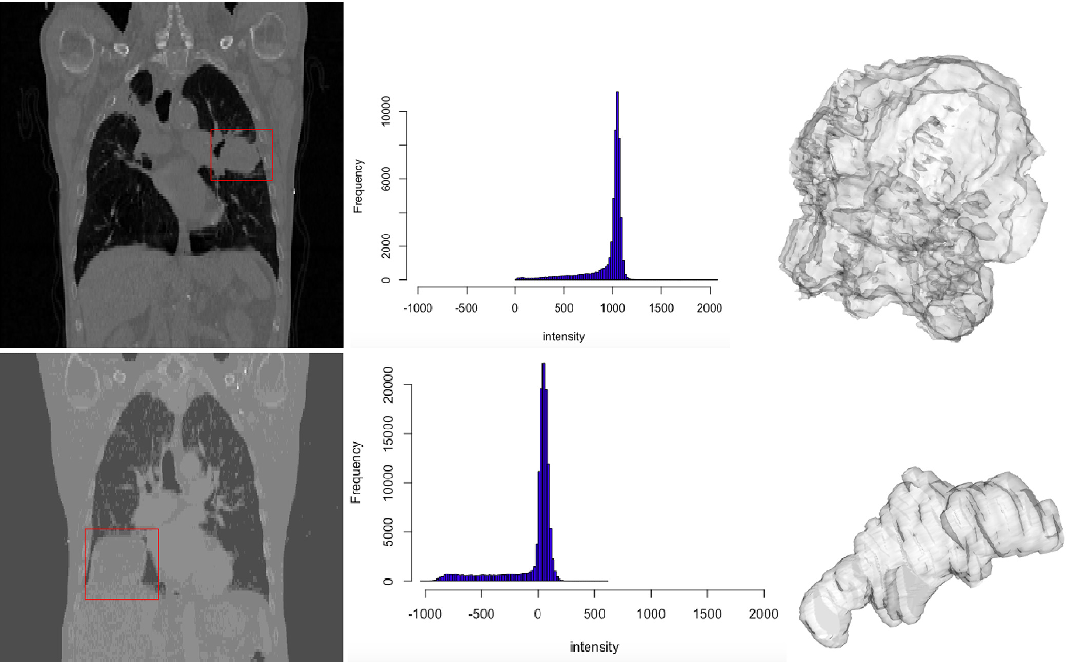
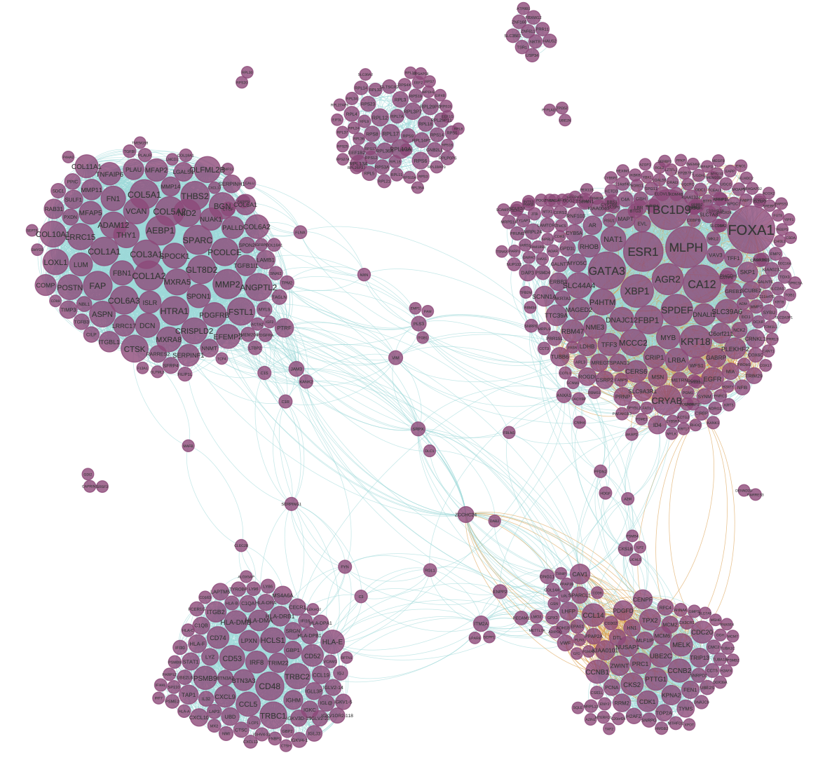
Biostatistics Shared Resource
Joseph W Hogan, Director
Overview
Examples of Scientific Impact and Expertise
Key Publications
The Biostatistics SR offers faculty-level biostatistics and data science collaboration on projects and grant proposals; develops reproducible data pipelines; generates innovative methods to address key analytic and computational challenges; facilitates scientific monitoring of studies and trials; ensures use of rigorous and modern methods for study design, analysis and reporting.
The services ensure that LCC members can have access and utilize rigorous and innovative analytic methods that make optimal use of data associated with investigator-initiated research projects.
Radiomics and topological data analysis for
characterizing tumor features from CT scans
Design and analysis of randomized trials
Huntington, K.E., Louie, A.D., Srinivasan, P.R., Schorl, C., Lu, S., Silverberg, D., Newhouse, D., Wu, Z., Zhou, L., Borden, B.A. & Giles, F.J. (2023). GSK-3 inhibitor elraglusib enhances tumor-infiltrating immune cell activation in tumor biopsies and synergizes with anti-PD-L1 in a murine model of colorectal cancer. International Journal of Molecular Sciences, 24(13), 10870.
De Souza A.L., Mega A.E., Douglass J., Olszewski A.J., Gamsiz Uzun E.D., Uzun A., Chou C., Duan F., Wang J., Ali A., Golijanin D.J., Holder S.L., Lagos G.G., Safran H., El-Deiry W., Carneiro B.A. (2023). Clinical features of patients with MTAP-deleted bladder cancer. Am J Cancer Res.
Bocage A., Orang’o O., Liu T., Itsura P., Tonui P., Muthoka K., Stephen K., Sam S.S., Caliendo A., Cu-Uvin S (2022). HIV-1 RNA genital tract shedding after cryotherapy for visual inspection with acetic acid-positive cervical lesions in western Kenya. Am Journal of Obstetrics & Gynecology 226, 291-292.
Ma, Y., & Zhou, X. (2022). Spatially informed cell-type deconvolution for spatial transcriptomics. Nature Biotechnology, 40, 1349–1359.
Comstock, C. E., Gatsonis, C., et al. (2020). Comparison of Abbreviated Breast MRI vs Digital Breast Tomosynthesis for breast cancer detection among women with dense breasts undergoing screening. JAMA, 323(8), 746-756.
Steingrimsson, J. A., Gatsonis, C., Li, B., Dahabreh, I.J. (2023). Transporting a Prediction Model for Use in a New Target Population. Am J Epidemiol, 192(2), 296-304.
Morrison, S., Gatsonis, C., Eloyan, A., Steingrimsson, J.A (2023). Survival analysis using deep learning with medical imaging Int J Biostat.
Carlos, R. C., Obeng-Gyasi, S., Cole, S. W., Zebrack, B. J., Pisano, E. D., Troester, M. A., Timsina, L., Wagner, L. I., Steingrimsson, J. A., Lee, C. I., Adams, A., & Wilkins, C. H. (2022). Linking Structural Racism and Discrimination and Breast Cancer Outcomes: A Social Genomics Approach. Journal of Clinical Oncology, 40(13), 1407-1413.
Partridge, S.C., Steingrimsson, J.A., Newitt, D.C., Gibbs, J.E., Marques, H.S., Bolan, P.J., Chenevert, T.L., Rosen, M.A., & Hylton, N.M. (2022). Impact of Alternate b-Value Combinations and Metrics on Predictive Performance and Repeatability of Diffusion-Weighted MRI in Breast Cancer Treatment: Results from the ECOG-ACRIN A6698 Trial. Tomography, 8(2), 701-717.
Xu K., Diaz A.A., Duan F., Lee M., Xiao X., Liu H., Liu G., Cho M.H., Gower A.C., Alekseyev Y.O., Spira A., Aberle D.R., Washko G.R., Billatos E., Lenburg M.E.; DECAMP investigators (2023). Bronchial Gene Expression Alterations Associated with Radiographic Bronchiectasis. Eur Respir J, 61(1):2200120.
Hu L, Ji J, Ennis R, Hogan JW (2022). A flexible approach for causal inference with multiple treatments and clustered survival outcomes. Statistics in Medicine 41, 4982-4999.
Stack B.C Jr, Duan F., Romanoff J., Sicks J.D., Subramaniam R.M., Lowe V.J., (2023). Impact of Neck PET/CT Positivity on Survival Outcomes-Visual and Quantitative Assessment: Results From ACRIN 6685. Clin Nucl Med, 48(2):126-131.
Black, W. C., Gareen, I. F., …, Gatsonis, C. (2014). Cost-effectiveness of CT screening in the National Lung Screening Trial. New England Journal of Medicine, 371(19), 1793-1802.
Pisano ED, Gatsonis C, Hendrick E, et al. Diagnostic Performance of Digital versus Film Mammography for Breast-Cancer Screening. NEJM 2005; 353:1773-83. PMID: 16169887
National Lung Screening Trial Research Team. Reduced Lung-Cancer Mortality with Low-Dose Computed Tomographic Screening, NEJM 2011; 365(5): 395-409.
Comstock CE, Gatsonis C, et al. Comparison of Abbreviated Breast MRI vs Digital Breast Tomosynthesis for breast cancer detection among women with dense breasts undergoing screening. JAMA. 2020 25;323(8):746-756
Meng, K. and Eloyan, A. (2021) Principal Manifold Estimation via Model Complexity Selection. JRSSB 83, 2, 369-394.
Eloyan, A. Yue, M.S., Khachatryan, D. (2020) Statistical Analysis of Tumor Heterogeneity for Radiomics in Cancer. Statistics in Medicine. 39: 4704–4723
Key Services
Project-specific faculty-level collaboration on new projects and grant proposals
Bioinformatics and computational biology support for experimental design, data acquisition, preprocessing, visualization, and pipeline development for mapping and preprocessing in –omics platforms
Ensure quality control and reproducibility of pipelines and data analyses by maintaining archives for data and code
Consultation and collaboration on analysis of observational data (e.g. EHR) and cohort studies
Facilitate access to Brown computing resources
Provide staffing for SRMC
Polygenic risk scores for breast and prostate cancer
Reproducibility of gene networks in breast cancer
Ying Ma, Snehal Patil, Xiang Zhou, Bhramar Mukherjee, and Lars G Fritsche. (2022). ExPRSweb: An online repository with polygenic risk scores for common health-related exposures. AJHG S0002-9297(22)00404-9. PMID: 36152628
Lars G Fritsche, Ying Ma, Daiwei Zhang, et al (2021). On cross-ancestry cancer polygenic risk scores. PLoS Genetics, 17(9), e1009670. PMID: 34529658
De Vito R., Bellio R., Trippa L., Parmigiani G. Multi-study factor analysis. Biometrics,75(1), 337-346 (2019)
De Vito R., Bellio R., Trippa L., Parmigiani G. Bayesian multi-study factor analysis for high-throughput biological Data. Annals of Applied Statistics, 15(4), 1723-1741 (2021)
Value Added
Data Workflow and Pipeline
Access to specialized biostatistics faculty expertise
Ensure optimal study design for expensive data
Ensure rigorous and cutting edge analytic methods for grant proposals and manuscripts
Ensure reproducibility of analyses
Key Personnel
Project PI and Research Team
Project Statistician
Faculty
Joseph Hogan (Director)
Zhijin Wu (Associate Director)
Consulting faculty in biostatistics and bioinformatics
Technical staff
Technical Director/Manager – TBN
Data manager (100%)
Scientific programmer (100%)
Software engineer / developer (50%)
Key areas of expertise
Primary
Data Collected
Project Database
Analysis Dataset
Project Archive
Future Plans
Design and analysis of randomized trials
rNA-seq and single-cell rNA methods
Spatial transcriptomics
Causal inference for observational cohort data
Machine learning and prediction
Radiomics and image analysis
Design and analysis for pre-clinical studies and in-vivo experiments
Recruit faculty with SPH / LCC support
Build user base
Formalize Shared Resource operations and budgetary support
Program of research focused on developing innovative statistical and data science methods
Data Systems Specialist
Statistical Programmer/
Analyst

