Slide 1
Children’s Behavioral Health in Rhode Island March 26, 2019
Presented by: Susan Lindberg, LICSW
Associate Director
Community Services & Behavioral Health

Slide 2
Rhode Island’s Children
One in five (19.0%) children ages 6 to 17 has a diagnosable mental health problem; one in ten (9.8%) has significant functional impairment.¹
In 2017, 13.3% of RI children ages 3-17 years received treatment or counseling from a mental health professional.³
9.3% nationally
In 2017, 64.4% of RI children ages 3-17 years that received mental health care did NOT have a problem getting it.⁴
51.2% nationally
In SFY 2017, 21% (25,084) of children under age 19 enrolled in Medicaid/RIte Care had a mental health diagnosis.²
Under 6 (21%), 7 to 12 (39%) 13 to 18 (40%)
41% females, 59% males
In FFY 2017, the two primary hospitals in RI that specialize in providing psychiatric care to children, Bradley and Butler, treated 1,300 children on an inpatient basis.⁵

Slide 3
Rhode Island’s Continuum of Care is Managed Across Multiple State Agencies
RIDE
EOHHS/Medicaid
DCYF
BHDDH
DOH
Early Intervention
Cedar
PCMH Kids
Medicaid Managed Care Services
Child Psych Access
Psychiatric Hospitals
Acute Residential Treatment Services
Family Care Community Partnerships
Residential Treatment
Specialized Foster Care
34 Home & Community Based Services
Healthy Transitions Grant
Substance Abuse Block Grant -(Individual; Group; Outpatient; IOP, PHP, Home-Based)
Early Childhood Services
Multi-Tiered Systems of Support
Social & Emotional Learning (SEL)
Project AWARE Grant
Family Home Visiting
Suicide Prevention
Project LAUNCH Program

Slide 4
Prevention and Targeted Early Intervention Services
Services for Mild/Moderate Cases of Mental Illness
Intensive Services for More Complex Mental Illness and/or SUD
Residential Services for Complex Mental Illness and/or SUD
Emergency and Other Acute Behavioral Health Inpatient Services
Rhode Island’s Continuum of Care for Children
Family Visiting Programs
Suicide Prevention Information and Resources for Educators (SPIRE)
Rhode Island Youth Suicide Prevention Project (RIYSPP)
Screening, Brief Intervention, and Referral to Treatment (SBIRT)
Family Care and Community Partnership (FCCP)
Local Prevention Coalitions
Health Equity Zones (HEZ)
Medicaid Early, Periodic, Screening, Diagnosis, and Treatment (EPSDT)
Non-Profit Human Service Agencies
Community Action Programs
Independent Providers or Small Group Providers
School Based BH Services
Early Intervention Programs
Kids Connect
Community Mental Health Centers
Partial Hospitalization Programs (PHP)
Intensive Outpatient Programs (IOP)
Home-Based Therapeutic Services (HBTS)
Enhanced Outpatient Services (EOS)
Family Care and Community Partnership (FCCP)
Cedar
DCYF Home-Based
Alternative Educational Programs
Residential Treatment Centers
Group Homes
Short-Term Treatment for Substance Abuse
Psychiatric Hospital
Acute Residential Treatment Program
Kids' Link RI™

Slide 5
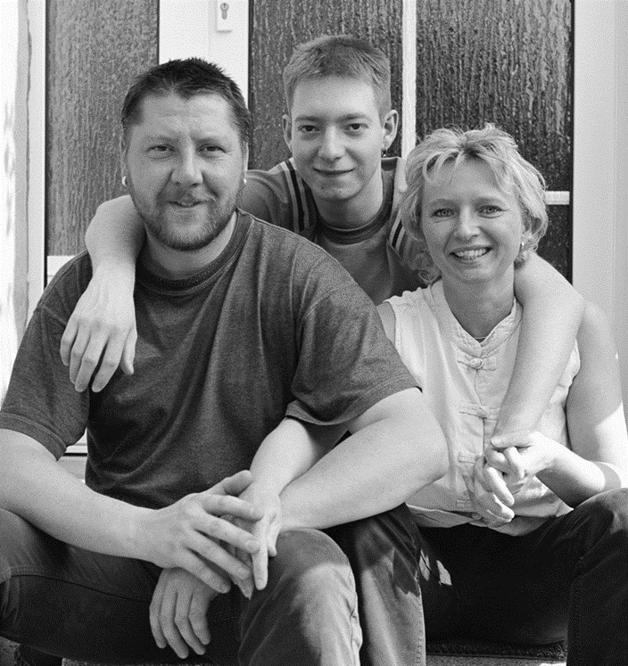
Funding Sources for Children’s Behavioral Health
Multiple funding sources
Commercial insurance (source of payment for most Rhode Islanders).
Medicaid managed care organizations (majority of the State’s Medicaid enrollees).
Medicaid Fee-for-Service.
State general revenue.
Other government funding sources, predominately federal grant and federal entitlement funding sources.

Slide 6
Rhode Island Has Made Important Advances in Key Areas of Children’s Behavioral Healthcare
Family Home Visiting programs through the DOH have helped with the challenge of identifying behavioral health issues early and directing young children to treatment.
RIDE recently received two grants totaling over $11 million to significantly enhance the provision of mental health resources in schools
Through the State Innovation Model (SIM) grant, Pedi-PRN, a child psychiatric access program, along with PCMH Kids & Integrated Behavioral Health were established.
In 2018, DCYF’s Family Care Community Partnerships (FCCPs), a network of non-profit service providers utilizing Wraparound services, strengthened its assessment of a child’s or youth’s behavioral health needs
In 2017, DCYF established a robust network of home-based programs, many that are evidence-based, that serve 1,700 families at any one time.

Slide 7
Challenges to Delivering Effective Behavioral Healthcare in Rhode Island
Gaps in services, including child psychiatry, mobile crisis, adolescent residential SUD, and linguistic and culturally competent workers and resources.
Limited availability of home-based behavioral health services for children and youth with higher levels of acuity.
Care planning and care management are often not integrated across multiple levels.
In Rhode Island, there is a need for more trauma-informed care and resources for systems that serve children and youth.
Rhode Island has a limited number of prevention or early intervention activities, for both mental health and substance use, but particularly for mental health.

