Slide 1

Community Engaged Research in
Behavioral Health
Beneficiary, Provider and Investigator Perspectives
Rhode Island Community-Academic Partnership for Behavioral Health

Slide 2
What is Comparative Effectiveness Research?
“. . . encompasses both the synthesis of existing evidence and the generation of new evidence that compares alternative approaches to the prevention, diagnosis or treatment of a health condition or the delivery and the provision of health care services.” (Dverka et al, 2013)
As opposed to, e.g. FDA approval:
Superior to placebo, at least on average
  Heterogeneity of effect of little concern, e.g. antidepressants are effective for about 15% of users
Using outcome measures chosen by investigators
  How important these are to patients is not always asked
  May be “surrogate endpoints” that aren’t even proven relevant to actual morbidity and mortality
Possibly safe, or at least safe enough
  But we don’t really know because trials are not specifically designed to detect adverse events and follow-up is typically short

Slide 3
Stakeholder
Engagement in CER
Who are the “stakeholders”?
People who have the problem (possibly defined as a disease) or are at risk, and their significant others
  Sub-categories: SES, age, severity, co-morbidity, ethnicity . . .
  “Professional patients”
Communities affected by the research focus
Disease societies (= who exactly?)
Health care providers
  Individuals
  Organizations
Payers – public and private
The ultimate payers – taxpayers and ratepayers

Slide 4
Patient-Centered Outcomes Research
Basically, CER that is strongly informed by patient perspectives
Biomarkers of clinical effectiveness vs. Patient Centered Outcomes
PCOs may be derived from qualitative formative research translated into structured surveys, and more structured choice experiments
  Generally focus on quality of life – including for others
  Can take account of psychological and other burdens of treatment
  Need for cognition, autonomy
  May be highly diverse among different subjects
  Patient preferences may be “irrational” in biomedical terms

Slide 5
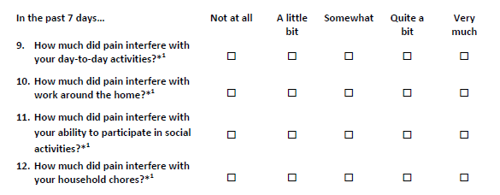
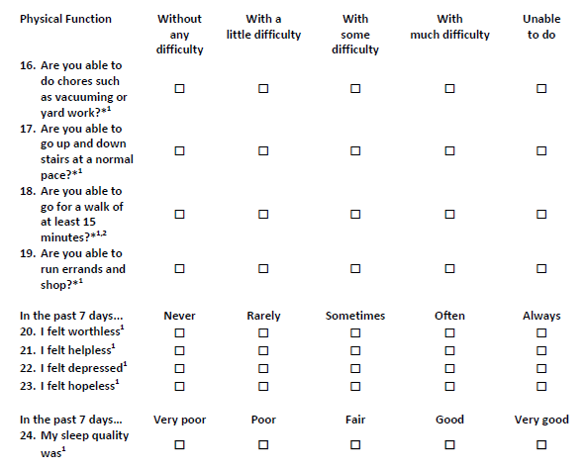
Example: Chronic low back pain
Does not incorporate burden of treatment
IMHO, available measures for mental health are not as good – they still consist of symptom checklists
Measures for SUD are more comprehensive

Slide 6
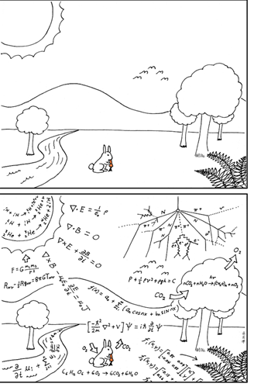
Two Worlds
The lifeworld
  Qualitative sets, fungible boundaries
  Values and heuristics (i.e., short-hand
  decision rules)
  Specific to time, place and person
The scientific world
  Rigorously defined units
  Measurable, quantifiable
  Repeatable
  Generalizable

Slide 7
What do academic investigators want?
Generate generalizable knowledge, answer interesting questions
Solve meaningful problems, improve public health
AND
Publish in peer-reviewed journals, present at academic conferences
Other publications, presentations and activism
Get Funding
Career Advancement
  Promotion
  Tenure
  Salary increase
  Prestige
(Not that there’s anything wrong with that …)

Slide 8

Funding, Peer Review, the Bias of Science
What questions to ask
  “Fashionable” problems
  Funders may solicit proposals to address specific questions, or have priorities
    Politics may be involved, e.g. no gun violence research
  Investigators have ongoing programs of research, proprietary methods, personal interests
  Academic advancement tends to reward narrow focus
Prestige of methods
  Qualitative research less valued
  Complex, hard to understand, novel analytic methods tend to impress reviewers
  Specific standard measures are favored (e.g. Hamilton Depression Inventory)
Publication bias
  Negative results less likely to be published
    “p hacking”
  Novel findings more valued than replication – but contradiction of accepted wisdom may be rejected
Personal stake of investigators, spin

Slide 9
Potential Benefits of Stakeholder Engaged Research
Research is meaningful to people
Research is more likely to be influential with policy makers
Hypothesis generation
Questionnaire validation and administration
Higher response rate
Richer interpretation
Richer experience
Oh yeah, some funders like it

Slide 10
Disease vs. Illness
These have the same meaning in everyday language, but . . .
Sociologists and anthropologists use them to label different concepts.

Slide 11
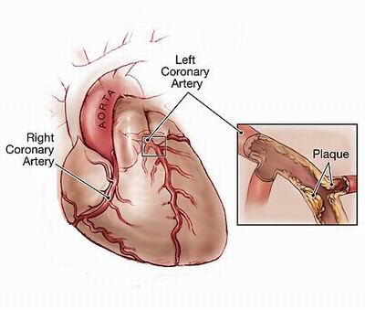
Disease
A “Disease” is a label a
applied by a physician.
Diseases are biomedical entities – conditions or processes which correspond to specific biological phenomena.
Diseases are abstract entities which are thought of as similar regardless of the psychosocial setting or the afflicted individual.
However, in behavioral health the classification of disease does not depend on identifiable biological phenomena.

Slide 12

Illness
“Illness” refers to the patient’s experience.
No two people have the same illness, even if they have the same disease.
You can have a disease with no illness, or an illness which doctors can’t label as a disease.
Same illness (or syndrome) may be result of different diseases, or no disease
Asymptomatic diseases may become illnesses when they are labeled – i.e. diagnosis can cause illness.

Slide 13
Dueling Expertise
Scientists
  Experimental design
  Quasi-experiments
  Mathematical models to draw causal inferences from observational data
  Biological plausibility
  Quantifiable measurement of outcomes
  Quantifiable comparison of different outcomes * probability

Slide 14
Dueling Expertise
Real people
  What outcomes matter and how much
  Functional capacity more important than symptoms per se
  Risk aversion – loss vs. gain framing
  Tolerance for pain and disability
    Temporary vs. long-term
  Well-being of SOs
  Community impact
  Out-of-pocket costs
  Psychological burden of knowledge, labeling, stigma

Slide 15
Examples of Diseases
ICD-10 Code | ICD-10 Code Description
I13.0 | Hypertensive heart and chronic kidney disease with heart failure and stage 1 through stage 4 chronic kidney disease, or unspecified chronic kidney disease
I13.10 | Hypertensive heart and chronic kidney disease without heart failure, with stage 1 through stage 4 chronic kidney disease, or unspecified chronic kidney disease
I13.11 | Hypertensive heart and chronic kidney disease without heart failure, with stage 5 chronic kidney disease, or end stage renal disease
I13.2 | Hypertensive heart and chronic kidney disease with heart failure and with stage 5 chronic kidney disease, or end stage renal disease
N17.0 | Acute kidney failure with tubular necrosis
N17.1 | Acute kidney failure with acute cortical necrosis
N17.2 | Acute kidney failure with medullary necrosis

Slide 16
Diagnosis of Mental Disorders
Rather than ICD-10, mental health providers (and researchers) use the Diagnostic and Statistical Manual of Mental Disorders (DSM-5), developed by the American Psychiatric Association.*
Unlike most ICD-10 diagnoses, DSM diagnoses typically have no specific physiological criteria – no physical finding, microbe culture, blood test, or X-ray.
Some DSM diagnoses are unreliable, i.e. different diagnosticians will make different diagnoses, or same person’s diagnosis changes over time.
Etiology (causal process) largely unknown.*
Controversy over whether some are “diseases” at all.
* Current version is agnostic about etiology, relies only on assessment of symptoms.

Slide 17
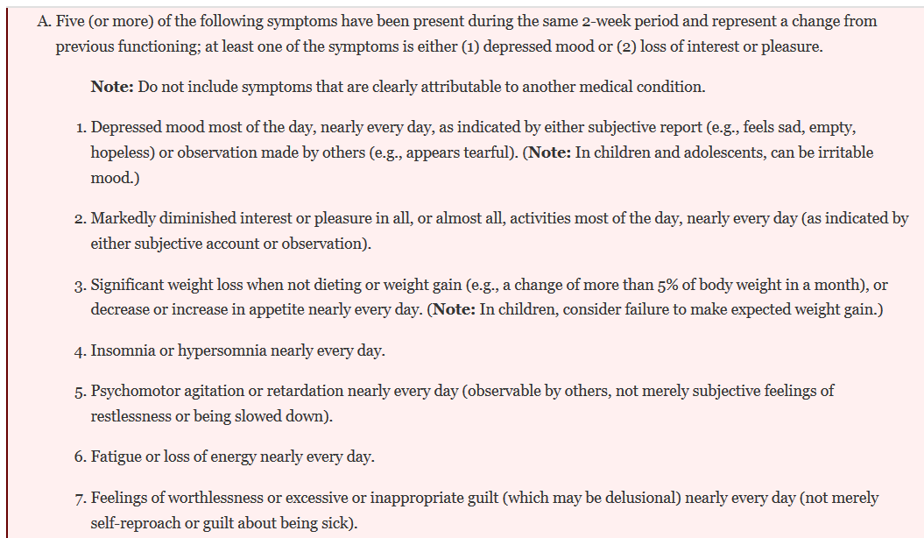
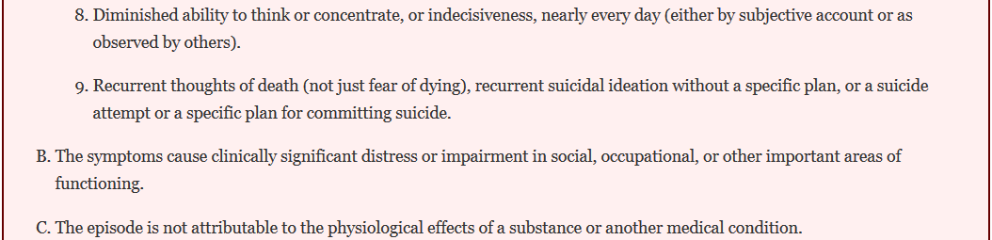
Example: Major Depressive Disorder
2 people w/ Dx may have only one symptom in common
Or none at all – even opposite symptoms

Slide 18
PCOs in behavioral health
Most research uses checklists of symptoms to measure outcomes.

Slide 19
SAMHSA’s Definition Of Recovery
A process of change through which individuals improve their health and wellness, live a self-directed life, and strive to reach their full potential.
Thanks to Stephen Gumbley for the next three slides

Slide 20
Bill White’s Definition Of Recovery
The ongoing experience through which individuals, families and communities use internal and external resources to resolve these problems by actively managing continued vulnerabilities to such problems …

Slide 21
Recovery is dynamic
Risks
Vulnerabilities
RECOVERY
Resilience
Recovery Capital

Slide 22
Provider Perspectives
To a large extent, providers are allied with patients/beneficiaries – they want good outcomes, but:
They are concerned about financial viability and practicality of interventions. They want to get paid and save time.
  This is a legitimate concern for beneficiaries and payers as well, but providers are more aware of it
They may be committed to established ways of doing things
  There is not a good evidence base for many interventions that are widely used
  Even when treatments are proved to be ineffective, it’s hard to get providers to stop using them
They are likely to favor interventions for which they feel well-trained and competent – there is resistance to learning new skills in mid-career
Stigmatization of people with behavioral health disorders by providers is a well-established phenomenon.
May not incorporate PCOs – have own ideas about good outcomes

Slide 23
A Model for Stakeholder Engagement

Slide 24
Types of Study Designs
Non-experimental design – observational and natural history studies
  Can be qualitative, quantitative, or both
  Qualitative research allows people to tell their own stories, aims to give voice to the patient/community
Quantitative Observational studies
    Cross-sectional study
    Case-control study
    Cohort study
Quasi-experimental design
Experimental design
Notes:
Experimental design: includes random assignment, a control and experimental and experimental group and observations of both (usually prior to and always after the intervention). Results usually yield the most interpretable, definitive and defensible evidence of effectiveness. Greatest control over the major factors that would influence internal validity.
Quasi-experimental design: includes the establishment of an experimental and a comparison group by methods other than random assignment. Observe/measure both. Results may yield interpretable and supportive evidence of program effects. Have some control over biases, but still may have issues affecting internal validity
Non-experimental design: does not include random assignment or a control group. Asserts little or no control over the major factors that confound interpretation of an observed effect.
Time series design is a slightly better version uses subjects in the program as their own control group. Same measurement is made on the same group of people at regular intervals several times before and several times after the program.

Slide 25
Qualitative Studies
Usually in-depth individual interviews or focus groups
People are encouraged to discuss their experiences, preferences, values and goals in an open-ended way
Investigators identify themes and patterns in the responses, try to translate participants’ perspectives succinctly for the benefit of readers
Can be repeated over time to track natural history
Can elicit perspectives of various participants e.g.
  Providers and patients
  Multiple family members
Discovers phenomena, but cannot establish how prevalent or common they are (typically uses small convenience samples)

Slide 26
Cross-Sectional Study
Assessment of status of individuals with respect to presence or absence of exposure, or outcome or both at the same time point
Measures: prevalence, or relative risk or prevalence
Strengths: cheap and fast
  Usually survey research, or using available data, e.g. health records
Important limitation: Cannot establish causality
Methodological requirements
  Probability sample from a defined population
  Verified assessment methods
  Adequate sample size

Slide 27
Oops. Pardon the interruption . ..
. . . but we need to discuss hypothesis testing, statistical significance – “p” -- and sample size – “n”
In quantitative research, we’re usually comparing 2 or more groups, who we know to be different in some way, e.g.
  They were exposed to an environmental hazard, or not
  They received Treatment 1 or Treatment 2, or no treatment
  They have some intrinsic characteristic – male or female, old or young, rich or poor
Does having characteristic A make characteristic B more or less likely? (Or we could be asking if the amount of A is associated with more or less likelihood or amount of B)

Slide 28
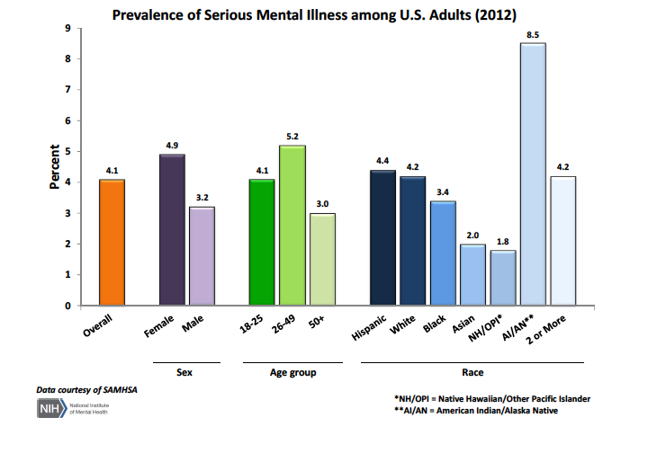
For example . . .

Slide 29
Why this is hard
We can’t include everybody in the world in our sample, we have to pick a smaller group to make our measurements.
Purely by chance, the people we pick who have A might be more likely to also have B, even though this is not true for the total population.
The difference between group 1 and group 2
in the proportion (or average amount)
of B may be real, or may be due to chance.

Slide 30
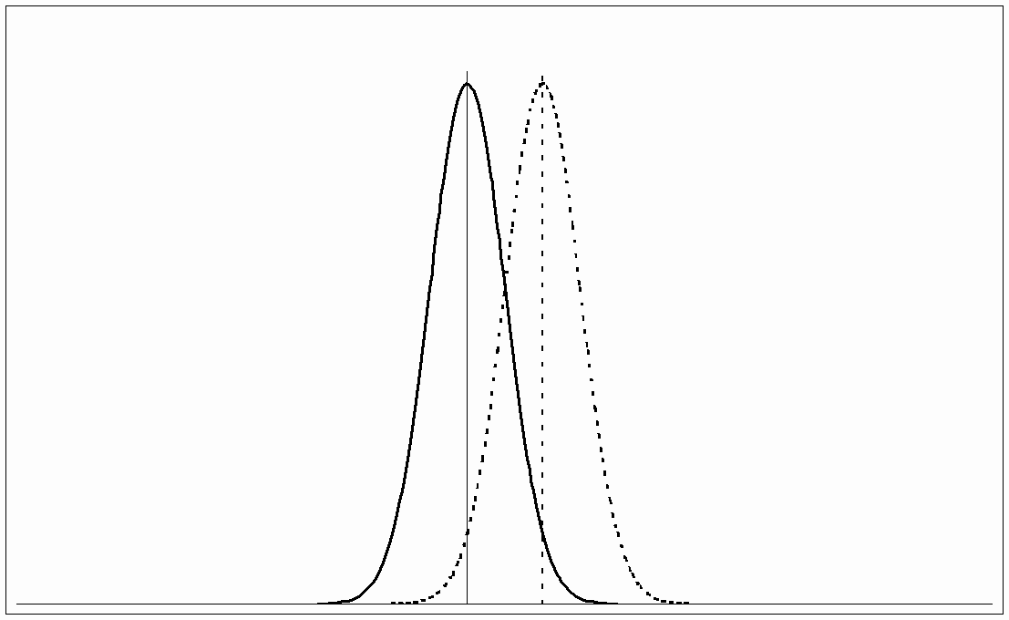
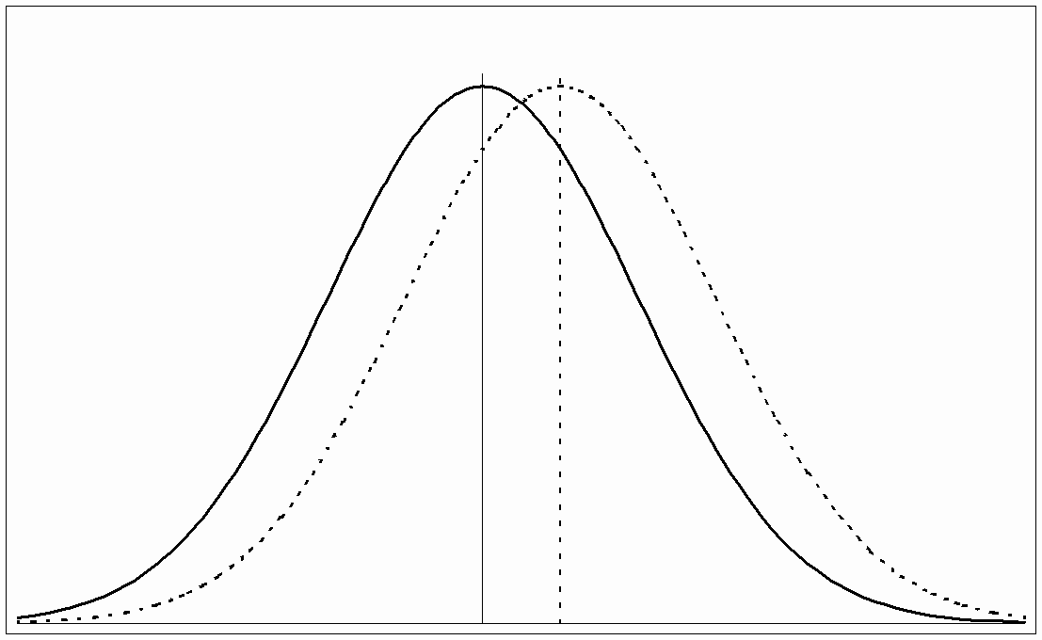
The meaning of p
p is the probability that you would see the difference you actually observed between Group 1 and Group 2 if there is no real difference between them in the total population.
The smaller p is, the more likely the difference actually exists. E.g., if p=.05 (i.e. 5%), in principle (not necessarily in reality) there’s only a 5% chance that the difference isn’t real.
p depends on 3 quantities:
  The size of the difference between the groups. The bigger it is, the smaller p will be.
  The size of the groups (n). The bigger the groups, the smaller p will be.
  How “spread out” the values of B are, and of other variables in the 2 groups that might matter.

Slide 31
what p is not
It does not give us any information about the causal relationship between A and B, if any
With a large sample, p may be small but the difference between A and B is also too small to really care about
“Statistical Significance”
Purely arbitrarily, for meaningless historical reasons, p<.05 is conventionally called “statistically significant.”
If p>.05, that does not mean you can conclude that there is no real difference.
If p<.05, that does not mean you have proved your case. (In fact, for many reasons, many or most findings with p<.05 are
probably wrong. )
p value is not valid at all if hypothesis not specified in advance
If you make multiple comparisons, you have to correct the p value

Slide 32
Implications
You need a big enough sample to detect a real difference of the size you expect and care about.
  Can be difficult and expensive
  An important consideration for whether you will be funded
“Statistically significant” doesn’t really mean anything.
  Doesn’t tell us whether a result matters – is “significant” – in any way we care about.
  Credible evidence depends on consistent and replicable findings, not one study.
It’s important that the groups be well matched
  There are ways mathematically to adjust for differences, but they reduce the power and credibility of your study.

Slide 33
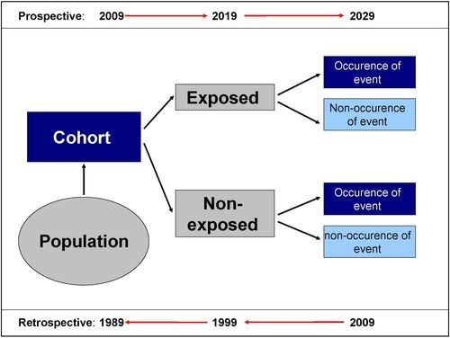
Cohort Study
Note: Exposure could by definition be something that happened prior to 2009. Outcome comparison is a rate or risk ratio as of 2029.
If exposure can happen at any time during study period, or is ongoing, analysis is more complicated, called an incidence ratio per given time period.

Slide 34
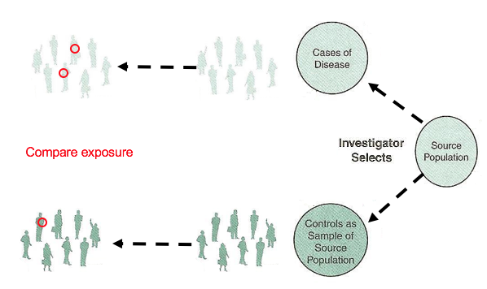
Case-Control Study

Slide 35
Limitations of Observational Studies
Weak – often misleading – evidence for causation
Confounding: We observe A B but in reality
A B
C
The association between exposure and outcome is calculated as what’s call an Odds Ratio (OR)
  The OR is not equal to the relative risk, and we can’t actually calculate the risk unless we know the prevalence in the total population.
  However, if the outcome is rare the OR is close to the risk.
  Case control studies do not provide strong evidence for causation; they are suggestive but not definitive.

Slide 36
Experimental Studies
The generally accepted “gold standard” for establishing the efficacy of an intervention is the randomized controlled trial.
RCT paradigm is subject to criticism in some situations.
  Requires pre-specified endpoints (though PROMs can be used)
  Narrowly selected populations not necessarily representative of real world
  Carefully monitored intervention, with adherence support and other non-ordinary conditions
In public health, it is often not feasible or not ethical.

Slide 37
Basic RCT design . . .
Random assignment means the groups are likely to be similar on initial characteristics, but this does need to be assessed.
Blinding – participants and assessors don’t know group assignment
Control Group
Outcome
Measure-
Target
ment
Population
Random Assignment
(Defined characteristics,
measurement on items of
Outcome
Intervention
Interven-
Measure-
interest)
Group
tion
ment

Slide 38
What’s wrong with this picture?
Public health interventions are frequently designed, and often assessed, at the level of the community. Random assignment of communities may be possible, but in that case the n is very small, and the communities are likely to be very different and not truly comparable.

Slide 39
What’s wrong with this picture? – Cont.
Participant blinding generally impossible in community level, and many behavioral health interventions (you know if you’re being counseled)
Assessor blinding may also be difficult or impossible
Outcomes have complex causal chains, are likely to be affected by exogenous developments (I.e., events not included in the study and not under your control), and may be difficult to measure directly

Slide 40
What’s wrong with this picture? – cont.
Even for client-centered interventions that are generally more suitable for RCTs, there are often ethical or practical difficulties, e.g.
  Can’t withhold an intervention which is already standard, such as many social work interventions, substance abuse counseling, etc.
  Relevant outcomes may be very long-term, such as life-long career satisfaction, refraining from substance abuse, etc. Determining effect on the life-span and life course of interventions offered to children and adolescents is extremely difficult.

Slide 41
Pros and Cons of Randomized Trials
Pros
Many potential sources of bias can be controlled
Strongest support for causal inference
Considered “gold standard”
Cons
May not be feasible or ethical
Costly in time and resources
Sample size must be large enough to detect meaningful differences
May be hard to justify if an unproved method has become widely accepted
Notes:
“Double blind” is best to avoid biases
Use of a random device to select subjects
or to assign patients to treatments
Random devices
Dice, lots, coin flip
Random number tables
Computer programs (SAS® PROC PLAN)
Human beings are not good random number generators!
Haphazard is not random
Convenience samples are not random
Many biases associated with outcome assessment can be controlled by blinding
Random device used to construct study groups
Exposure or treatment randomly assigned
Subjects may be paired or grouped into homogeneous “blocks” before randomization
to remove effects of other factors
Generally “double blind” to avoid biases
May include sham operation or treatment to
avoid placebo effect
Single blind: when either the subjects or the researchers (not both) do not know the nature/specifics of the interventions and whether they have a control or intervention.
Double blind: When both the subjects and the researchers do not know the nature/specifics of the interventions.

Slide 42
Group Randomized Trials
Experiments in which the intervention occurs at the level of the group (organizations like clinics, schools, worksites, etc.)
But observations are made on individuals within the groups (e.g., patients, students, employees, etc.)

Slide 43
Control vs. Comparison Groups
Control Group: term usually used in context of a randomized trial
  Selected at random from the same population as the intervention group but that does not receive the intervention
Comparison group: term usually used in context of quasi-experiment, e.g. comparison communities in community level interventions
  May be exposed to another intervention
Usage is not always consistent however

Slide 44
Factors to Consider in the Choice of a Control or Comparison Group
Goodwill of the community
Ethics
Resources
Design/purpose of study
Results of past studies
Effect Size
Other?
}
Collect data but provide no intervention

Slide 45
Examples of Control/Comparison Groups
No treatment
Usual care
Minimal intervention
Part of an intervention (dismantling studies)
Different Intervention/Attention placebo
Delayed treatment or waitlist
Notes:
Randomized Controls: Targets are randomly divided into an experimental group, to whom the intervention
is administered and “randomized controls,” from whom the intervention is withheld.
Constructed Controls: Targets to whom the intervention is given are matched with an “equivalent” group, constructed controls, from whom the intervention is withheld.
Statistical Controls: Participant and nonparticipant targets are compared, holding constant statistically differences between participants and nonparticipants.
Reflexive Controls: Targets who receive the intervention are compared to themselves, as measured before the intervention.
Generic Controls: Intervention effects among targets are compared with established norms about typical changes occurring in the target population.
Shadow Controls: Targets who receive the intervention are compared to the judgments of experts, program administrators, and/or participants on what changes are “ordinarily to be expected” for the target population.

Slide 46
Group-randomized trial is the best design to evaluate an intervention that:
Operates at a group level
Manipulates the social or physical environment
Or cannot be delivered to individuals, i.e. because of contamination risks or other issues
Notes:
Different units of assignment are allocated to each study condition. This action nests the assignment units within the study conditions. Typically involve only a limited number of assignment units in each study condition.
Group randomization is particularly useful when there is a high risk for contamination if group members are randomized as individuals. For example, an investigator studying the effects of a clinical practice guideline can't assume that a provider caring for patients in the intervention arm will not apply this knowledge to the patients assigned to the control arm. Such contamination biases the study toward a finding of no effect. Randomizing at the level of the physician avoids this source of contamination because physicians are either exposed or not exposed to the intervention. If there are concerns that intervention physicians will contaminate control physicians in the same clinic, randomization should occur at the clinic level.

Slide 47
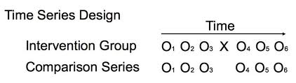
(Controlled) Time-Series Design
Notes:
A research design in which measurements of the same variables are taken at different points in time, often with a view to studying social trends. For this reason such designs are sometimes also known as trend designs and are distinguishable from ‘one shot’ cross-sectional designs in which measurements are taken only once. Time series designs can be used in conjunction with official data, for example by plotting crime rates for the same area but for different point in time (monthly, quarterly, annually). This acts as a basis for making statements about trends in levels of crime. It is possible to plot the trends for different variables at one and the same time with a view to making inferences about their relationship, for example, to map unemployment rates against crime ...

Slide 48
Recruitment Strategy: Community involvement
Use lay outreach workers from the targeted population (cultural insider)
Community-based organizations, particularly for marginalized communities
Places of Worship: Although some investigators have identified religiosity as a barrier due to a fatalistic view of disease –others have found religiosity to be positively associated with willingness to participate – depends on the study questions
Notes:
Differences in findings for religions participation may be attributable to the health problem being studies—cancer looked more as fatalistic wehre as HIV responded to reliegious participation, yancey

Slide 49
“Quasi-Experiments”
Take advantage of existing differences in events or exposures to make causal inferences

Slide 50
Interrupted Time-Series Design
A single group of participants is tested repeatedly both before and after a manipulation or a natural event
  Essentially a single-group, pretest-posttest design with multiple before and after measures
The multiple measures allow us to detect many confounding variables
  Regression to the mean, history, maturation, etc.

Slide 51
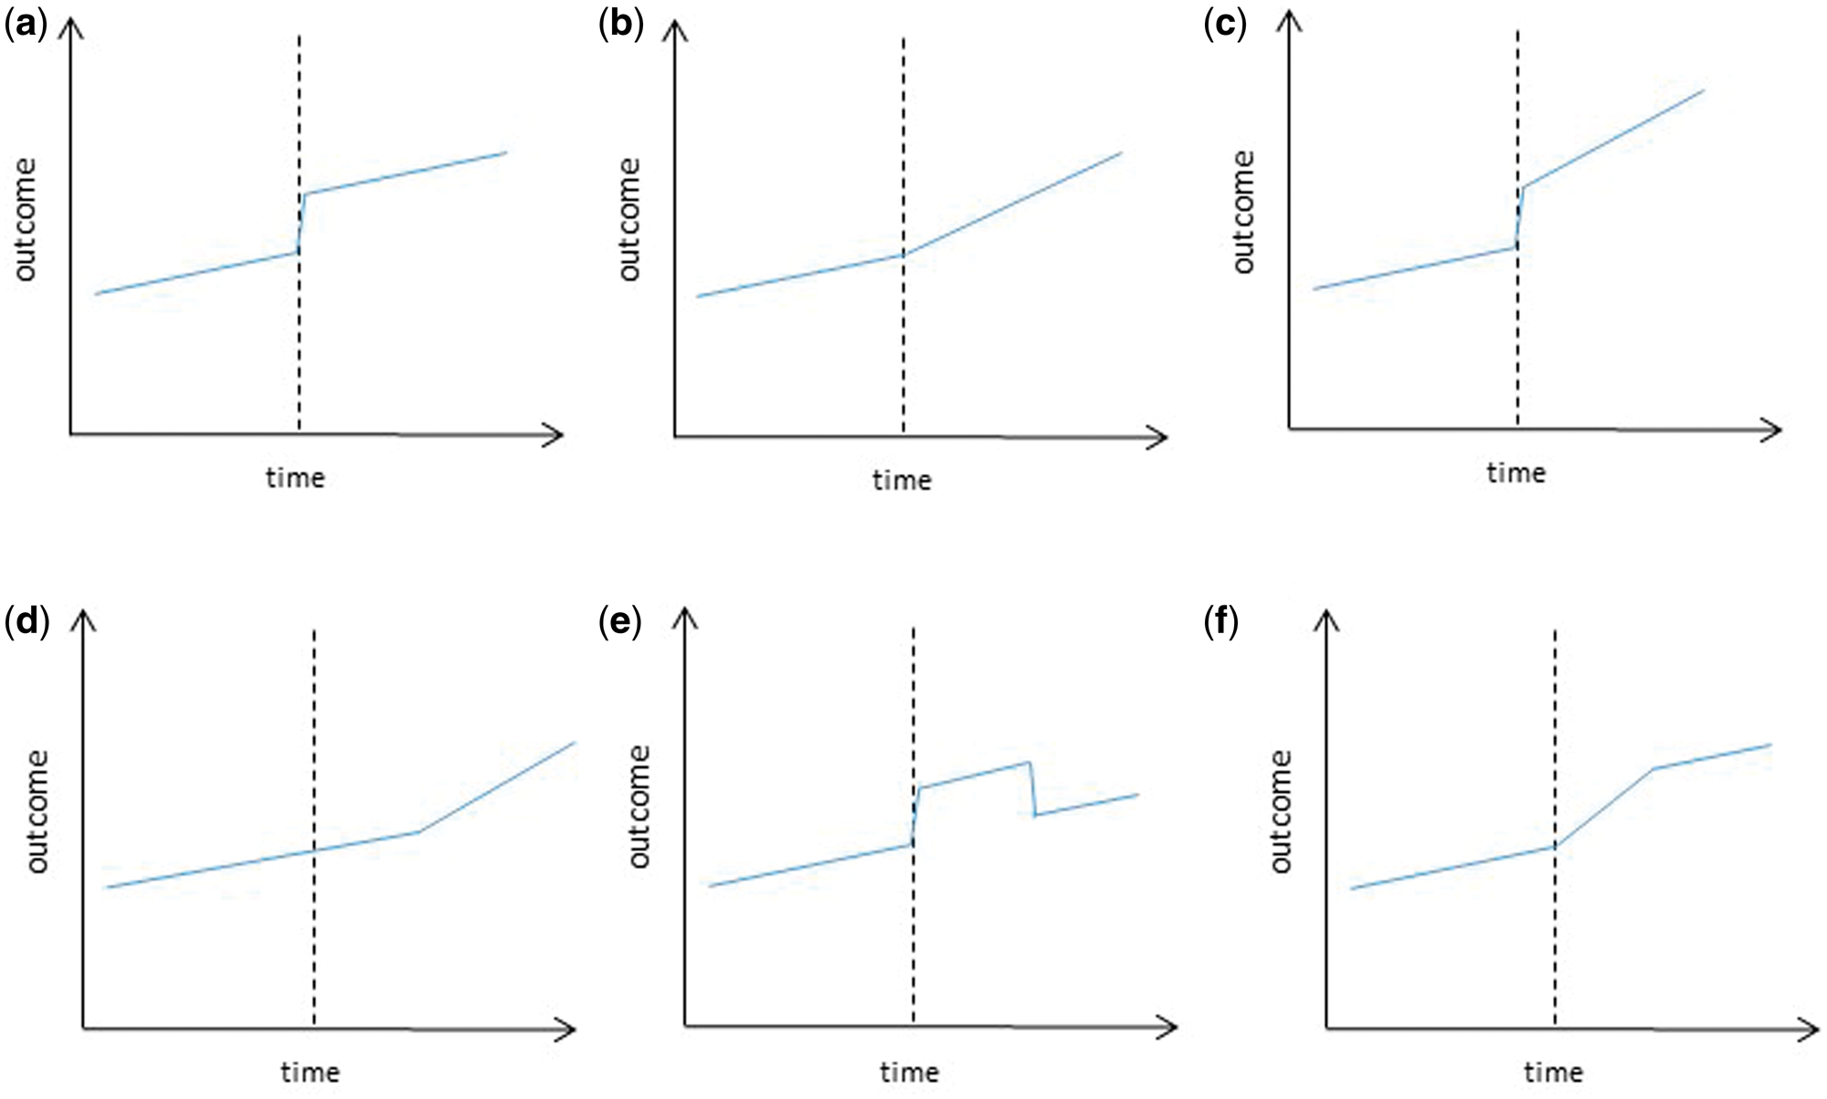

Figure 2 Examples of impact models used in ITS
(a) Level change; (b) Slope change; (c) Level and slope change; (d) ...
Notes:
Figure 2 Examples of impact models used in ITS
(a) Level change; (b) Slope change; (c) Level and slope change; (d) Slope change following a lag; (e) Temporary level change; (f) Temporary slope change leading to a level change.
Unless provided in the caption above, the following copyright applies to the content of this slide: © The Author 2016. Published by Oxford University Press on behalf of the International Epidemiological Association.This is an Open Access article distributed under the terms of the Creative Commons Attribution License (http://creativecommons.org/licenses/by/4.0/), which permits unrestricted reuse, distribution, and reproduction in any medium, provided the original work is properly cited.

Slide 52
There are more complex possible designs, e.g Factorial Design (Example)
Video Tapes
NO
YES
NO
Control
Video
Counseling
YES
Counseling
Video &
Counseling
Notes:
Examples: SENIOR study. 2x2 exercise only, nutrition only, both, control (fall prevention). Strategies: 12 month stage-tailored intervention including manuals, newsletters, expert system assessments and reports, telephone coaching.
Strecher: 2x2 factorial design: tailored print, tailored telephone, both, neither (generic print). Strategies: 4 treatments of intervention over an 18 week period. Tailored booklets, telecounseling based on prompts.

Slide 53
Process Evaluation
Measurements obtained during the implementation
of program activities to document, control, assure,
or improve the quality of performance or delivery.
How much of (and how well) the intervention was provided, to whom, when, and by whom.
Green & Lewis, 1986
Notes:
Process: Together with preprogram studies, makes up formative evaluation.
Impact evaluation: designed to assess intervention efficacy or
effectiveness in producing midterm (e.g., 12-24 months)
cognitive, belief, skill, and/or behavioral impact for a defined
population at risk.
Outcome evaluation: designed to assess intervention efficacy or
effectiveness in producing long-term changes (e.g., 1-10 years)
in the incidence or prevalence of morbidity rates, mortality rates,
or other health status indicators for a clinically diagnosed medical
condition among a defined population at risk.
Summative evaluation: Any combination of measurements and judgments that permit conclusions to be drawn about impact, outcome, or benefits of a program or method.
An evaluation designed to produce data and information during the
developmental phase of an intervention (program) to be used to
improve it and to document the feasibility of program implementation,
immediate (1 hour to 1 week) or short-term (e.g., 1 week to 6 months)
cognitive, affective, psychomotor (skill), and/or behavioral impact
of a program and the appropriateness of content, methods, materials,
media, and instruments.

Slide 54
Purposes of Process Evaluation
To improve the appropriateness and quality of the program and guide refinements in interventions (formative)
To document the interventions that were conducted and explain the resulting impacts and outcomes
To describe the program, organizational, and implementation factors related to why an intervention is being implemented in certain way
To describe the actual activities implemented in the intervention and the extent of participant exposure
To determine to what degree decisions regarding program methods and strategies were appropriate
Notes:
Negative outcomes due to ineffective programs can be distinguished from negative outcomes due to insufficient program delivery
Links impact and outcome data to intervention activities (summative)
By collecting information about the extent, fidelity, and quality of the intervention, answers about how and why the outcome was achieved can be obtained.
The results of process evaluation during the feasibility phase of a project can also be used to help monitor and refine intervention components.
Additionally, attribution of “no impact” to a program that was not implemented properly (type 3 error) can be avoided by including a process evaluation component .
Lack of accountability of programs (esp. public programs)
❖ Documentation that program actually took place
❖ Documentation that appropriate participants were served
in way intended (follow original design)
❖ Inform program designers of implementation problems
❖ Uncover unexpected results and unwanted side effects
4. McGraw SA, Stone EJ, Osganian SK, et al. Design of process evaluation within the Child and Adolescent Trial for Cardiovascular Health (CATCH). Health Educ Q 1994;suppl 2:S5–26.

Slide 55
Purposes of Process Evaluation
To document the degree to which program procedures were conducted according to a plan (quality assurance)
Variability in delivery among intervention sites can be elucidated
To identify and describe the participants and see how many (and who) are being reached
To determine how feasible the intervention is and whether it can be replicated by others
To be accountable to funding agencies
To document external and competing programs
Notes:
Type III Error : The failure to implement a health education intervention
In studies in which there is a failure to implement the program as planned, one can conclude erroneously that poor results are because of the conceptual or methodological underpinnings of a particular intervention.
By collecting information about the extent, fidelity, and quality of the intervention, answers about how and why the outcome was achieved can be obtained.
The results of process evaluation during the feasibility phase of a project can also be used to help monitor and refine intervention components.
Additionally, attribution of “no impact” to a program that was not implemented properly (type 3 error) can be avoided by including a process evaluation component .
Lack of accountability of programs (esp. public programs)
❖ Documentation that program actually took place
❖ Documentation that appropriate participants were served
in way intended (follow original design)
❖ Inform program designers of implementation problems
❖ Uncover unexpected results and unwanted side effects
4. McGraw SA, Stone EJ, Osganian SK, et al. Design of process evaluation within the Child and Adolescent Trial for Cardiovascular Health (CATCH). Health Educ Q 1994;suppl 2:S5–26.

Slide 56
Type III Error
Failure to correctly implement an intervention
In studies in which there is a failure to implement the program as planned, one can conclude erroneously that poor results are because of the conceptual or methodological underpinnings of a particular intervention.
Notes:
Type III Error : The failure to implement a health education intervention
In studies in which there is a failure to implement the program as planned, one can conclude erroneously that poor results are because of the conceptual or methodological underpinnings of a particular intervention.
You've made a type I error when there really is no difference (association, correlation..) overall, but random sampling caused your data to show a statistically significant difference (association, correlation...). Your conclusion that the two groups are really different (associated, correlated) is incorrect. False +
•You've made a type II error when there really is a difference (association, correlation) overall, but random sampling caused your data to not show a statistically significant difference. So your conclusion that the two groups are not really different is incorrect. False -

Slide 57
Process Evaluation
Reach
Fidelity
Proportion of the intended groups who are participating
People receiving the program representative of the intended populations
Implemented as Intended =
Adherence to the Program
Quality of Program Delivery
Dose
Participant Responsiveness
Program Differentiation

Slide 58
Program Differentiation
Identifying unique features of different components or programs so that they can be reliably differentiated from one another
Which elements of programs are essential (without which the program would not have its intended effect)
Can be key to assessing aspects of fidelity that are related to behavioral impacts
Notes:
identifying unique features of different components or programs", and identifying "which elements of . . . programs are essential", without which the programme will not have its intended effect [1].
Despite being viewed as an element of implementation fidelity by the literature, program differentiation actually measures something distinct from fidelity. It is concerned with determining those elements that are essential for its success. This exercise is an important part of any evaluation of new interventions. It enables discovery of those elements that make a difference to outcomes and whether some elements are redundant. Such so-called "essential" elements
may be discovered either by canvassing the designers of the intervention or, preferably, by "component analysis", assessing the effect of the intervention on outcomes and determining which components have the most impact [17]. This element would therefore be more usefully described as the "Identification of an intervention's essential components". This process may also have implications for implementation fidelity; if, for example, these essential components are the most difficult to implement, then this may then explain a lack of success afflicting the intervention.

Slide 59
Planning for Process Evaluation
Develop a set of process objectives to guide intervention implementation that specify:
  The type and quantity of intervention to
  be delivered
  A time by which the objective will need
  to be achieved
  A specification indicating the expectation that the activity will be delivered according to a specific intervention protocol

Slide 60
Process Evaluation methods (cont.)
Quantitative and/or Qualitative
Also important to interview program implementers
Ask them questions to understand fidelity and implementation barriers
Also ask participants (those receiving the intervention) questions related to satisfaction, understanding of messages, opinions about program and its helpfulness.

Slide 61
Implementation Checklist for Counseling Sessions
The Counselor: | Present | Absent
Ask how the family has been since last session or from intake | □ | □
Establishes or reviews goal statement | □ | □
Reviews progress on each step of the problem-solving framework, or if first session teaches framework | □ | □
Reviews data collected or presents forms for self-monitoring | □ | □
Reinforces approximations to the problem-solving steps | □ | □
Shows video sequence with role-model story | □ | □
Has the family practice appraisal | □ | □
Has the family practice generation of alternative solution strategies | □ | □
Has the family practice of evaluation of alternative strategies | □ | □
Elicits the family’s thoughts and feelings about the process | □ | □
Percent of protocol followed equals number from the “Present column divided by 10.

Slide 62
Choosing a Research Question
(P) – Population refers to the sample of subjects you wish to recruit for your study.
  There may be a fine balance between defining a sample that is most likely
  to respond to your intervention (e.g. no co-morbidity)
  and one that can be generalized to people that are likely to be seen in actual practice.
(I) – Intervention refers to the treatment that will be provided to subjects enrolled in your study.
(C) – Comparison identifies what you plan on using as a reference group
to compare with your treatment intervention – your control or comparison group. Or you may be comparing two different treatments.
(O) – Outcome represents what result you plan on measuring to examine the effectiveness of your intervention. In our case, we are developing patient or beneficiary-centered outcomes
(T) – Time describes the duration for your data collection.

Slide 63
Summary and Conclusions
Investigators, providers and people and families living with behavioral health problems have different interests, expertise and concerns
If we all work together, we can do research that is most meaningful to the people who are the supposed beneficiaries
But we do need to get the work funded, and funders and generally more aligned with the worldview of investigators than of beneficiaries
Our job is to develop patient centered research, get it funded, and do it well

Slide 64
A bit of history . . .
“CBPR” originated in community-level public health:
“Community-based participatory research in public health focuses on social, structural and physical environmental inequities through active involvement of community members, organizational representatives, and researchers in all aspects of the research process. Partners contribute their expertise to enhance understanding of a given phenomenon and integrate the knowledge gained with action to benefit the community involved.”
-- Israel, et al, Community-Campus Partnerships for Health

Slide 65
Cohort Study
In a prospective cohort study a group of people are followed for a period of time
Retrospective cohort studies, in which the history is reconstructed, are possible, but less rigorous
Determine exposure status at the beginning or over the course of the study
Determine incidence of symptoms, disease, or death
Analysis focuses on risk of outcome in exposed versus unexposed groups

Slide 66
Cohort Study
Interpretation of a Risk Ratio
    Statement about outcome based on exposure status
    Those who ate pastries (exposed) were 1.64 times as likely to vomit (develop outcome) as those who did not eat pastries (unexposed).
    The risk of vomiting was 1.64 times higher among those who ate pastries (exposed) than among those who did not eat pastries (unexposed).

Slide 67
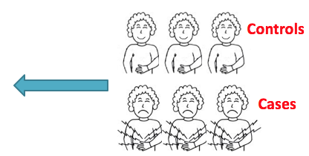
Case-Control Study
Identification of factors that are more common in people with a health outcome (cases) compared to a control group without the health outcome
Select based on outcome
    Outcome is measured before the exposure
Did you have the pastry?
(Exposure)

