Slide 1
Rhode Island State Innovation Model (SIM) Test Grant
March 2019
Marti Rosenberg, SIM Project Director

Slide 2
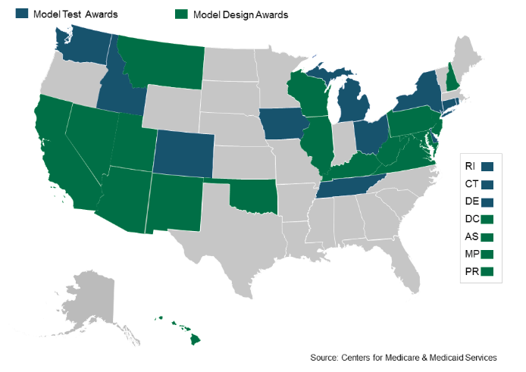
SIM Background
$20 million grant from the Centers for Medicare and Medicaid Services (CMS)
Transforming the way we deliver and pay for healthcare
Enhancing the way individuals are engaged in their health
Notes:
What is SIM? RI is one of 24 states to receive an award. It is a 4-year, $20 mil grant from CMS, awarded to the state, to improve our healthcare system
Focused on payment reform & healthcare system transformation
Who makes up SIM. It’s a very broad mix of people – outside of state government (insert names)
We have a steering committee made up of stakeholders from all parts of the healthcare delivery system, including Insurers, Healthcare Providers, Patient Advocates, and Community Organizations
Interagency Team includes:
EOHHS (Medicaid, BHDDH, DCYF, DOH)
OHIC
HealthSource RI
Note to discuss that we earned SIM based on previous efforts of these agencies and leaders

Slide 3
SIM’s Ultimate Goal
Adapting the Triple Aim
Healthier People
Better Care
Smarter Spending
Adapted from Institute for Healthcare Improvement, 2012
Notes:
Before we go deeper into SIM, I want to take a moment to orient us all to the ultimate goal of this project, which aligns with overarching federal and state reform efforts.
The Triple Aim was conceived by Don Berwick and his team at the Institute for Healthcare Improvement in 2008. Basically, it articulates a three part vision – a healthier population, reduced costs of healthcare, and improving the quality of care patients receive – that we should strive for as we shape and transform the healthcare system.
Make the points raised by Al C. Smarter Spending can be taken a couple ways. We need to spend carefully, and we need to find ways to spend less. MACRA will be a part of that, but also keeping people well will do that in the long term.

Slide 4
SIM Theory of Change
Empower Patients
Support Providers
Address Determinants of Health
Improved Population Health
&
Progress Toward Triple Aim
Notes:
The way SIM proposes to achieve this goal – a healthier population, smarter spending, and a higher quality of care – is through these three components. By supporting providers, empowering patients, and addressing the things that influence our health, we can improve population health and make progress toward the triple aim.
LB comment – Not sure if this is too similar to the SIM strategies on slide 6. If we cut this one, I recommend moving the triple aim up to be slide 2.

Slide 6
SIM’s Major Strategies
1. Strengthening Community/Clinical Linkages, to support value based payments (linking payments to outcome) and patient engagement
2. Integrating Physical and Behavioral Health, to support population health improvements
3. Building Workforce Capacity as a part of developing infrastructure for quality care
4. Integrating Health Information Technology and Data, as a part of developing infrastructure for quality care
5. Contributing to a Culture of Collaboration within state government and through public/private alignment, to support all of the strategies above

Slide 7
Other SIM Priorities
1. Integration & Alignment
2. Addressing Social Determinants of Health
3. Population Health Planning
4. Institutionalizing Activities through Training

Slide 8
SIM’s Final Year Activities
1. Completing program implementation
2. Data collection and evaluation
3. Continuing to explore additional funding and non-financial support for those projects for which sustainability is indicated
4. Determining how to best communicate SIM’s value and lessons learned

Slide 9
RI SIM Culture of Collaboration
Alignments for more effective health system transformation throughout Rhode Island
SIM Steering Committee
BHDDH
DCYF
RIDOH
DHS
OHIC
DHS/DEA
HSRI
EOHHS/ Health IT
EOHHS/ Medicaid
Notes:
JG Suggestion to change title to Maximizing Impact: SIM Integration & Alignment Initiative
there were CORE team member suggestions to change to interagency, but want to be consistent with communications if this is a project we’re “advertising”
SO, our IPHP was a monumental effort to describe the landscape of efforts in RI to improve the health of our population.
And now what comes next?
The first major project of the IPHP is the Integration & Alignment Project. SIM will leverage it’s interagency structure and convening role to support IPH Collaborations that cross sectors and span across multiple state agencies. SIM will work with agencies to leverage resources and coordinate service delivery to avoid duplication of work and maximize the impact of existing and planned projects.
Throughout the summer, SIM convened a working session with leaders and representatives from all of these state agencies to start a dialogue of collaboration and brainstorm on concrete alignment proposals relevant to the IPH Health Focus Areas
An example of this work is in drawing together state agencies to address Maternal & Child health. SIM is bringing each of these partners together (click through 8 times to animate each SIM/State Partner link) so that we can figure out how agencies can coordinate pediatric and family physical and behavioral health services, streamline how these services are covered and paid for, and leverage each other’s efforts and resources to maximize impact (click 1 more time to animate the rest of the links) – Marti I’m sure you can tighten up this example and make it relevant to each audience
Note: dentist that is a joint employee with RIDOH and Medicaid to highlight oral health piece

Slide 10
Example: Quality Measure Alignment
Before SIM Measure Alignment Work Group
Transition to OHIC Measure Alignment Work Group
Provider
Provider
CMS Programs
Other Programs
Commercial Payers
OHIC PCMH Program
SIM Aligned Measures
Medicaid Managed Care
Facilitated by the RI Quality Reporting System
Notes:
Because providers were burdened by having to calculate and report a large amount of quality measures to different payers or programs (often as a mechanism for earning performance incentive dollars), and because these measures differed by payer/program, SIM led a measure alignment process to simplify reporting for providers and reduce administrative burden. Now all commercial health plans must use measures from the SIM aligned measure sets in any contract with a quality component, and Medicaid has agreed to adopt the SIM aligned measures.

Slide 11
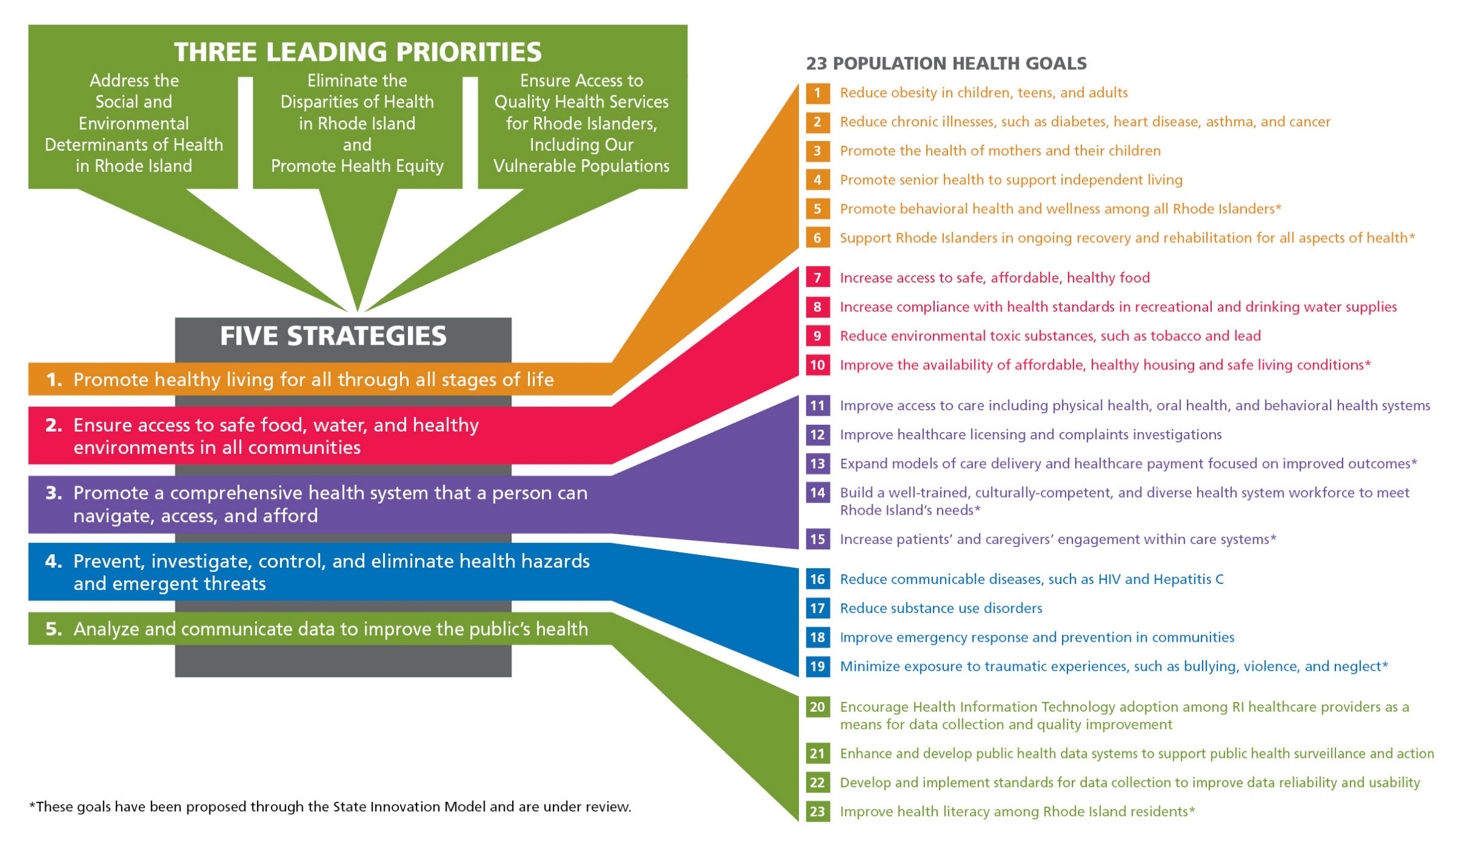
Slide Title is Georgia 36 point

Slide 12
QUESTIONS?

