Slide 1
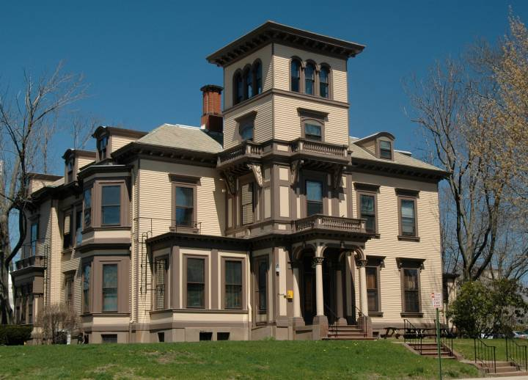
OSP Brown Bag December 6, 2018
Enter Date Here

Slide 2
OSP Brown Bag December 6, 2018
Diane Lipscombe
Director, Carney Institute for Brain Science

Slide 3
OSP Pre Award Updates
Michael Kostyshak
Assistant Director, Pre Award, OSP

Slide 4
Proposal submission Holiday due dates
For proposals due anytime during Winter Break:
Proposals follow the standard 5 day rule, deadline becomes Friday, Dec 21st.
Proposals will be due to OSP/BMRA by 5pm on Thursday, December 13^{th.}
Proposals due January 7th:
Administratively complete proposals are due to OSP/BMRA by 5pm on Wednesday, Dec 19th.
Final science will be due by 5 pm on Wednesday, Jan 2nd.
CONTACT OSP/BMRA AS SOON AS POSSIBLE FOR EXCEPTIONS

Slide 5
Proposal submission Holiday due dates
Mid-scale Research Infrastructure-1 (Mid-scale RI-1)
FOA: NSF 19-537
Preliminary Proposal Due: February 19, 2019 (required)
Full Proposals Due: May 20, 2019 (May 12 in OSP/BMRA),
by invitation only.
Award Amount: Design projects: $600,000-$6M; Implementation projects: total project cost ranging from $6 M to $20 M
PI: Individual faculty can only be a PI or co-PI on one proposal

Slide 6
Proposal submission Holiday due dates
All faculty submitting preliminary proposals for this NSF program must:
consult with Leah Vanwey, Associate Provost for
Academic Space, on what physical space needs their project would involve
(2) send a paragraph description of the project, a list or description of potential users at Brown & beyond, and a ballpark budget to research_opps@brown.edu by 5 pm on Wednesday, December 19.

Slide 7
Award Notices
Award Notice Distribution
Sent upon receipt from OSP Resadmin
to all PIs except the Division
BioMed award notices sent directly to BMRA
Before account create, compliance checks required (e.g., COI, Training, IRB, IACUC)
Set up 5 – 7 days from clearance for standard award
Let us know of any “priority” award set-ups by contacting your Grant & Contract Administrator

Slide 8
Cost Sharing Policy 2.2 Oct 2018
Proposal Stage
Associate Vice President for Research (AVP) coordinates documentation of OVPR cost share/ institutional support
AVP will notify the PI, Department Admin and OSP via email of OVPR cost share/institutional support amount
AVP will obtain the required signatures and return the completed cost share form to the Department Administrator for inclusion in the Coeus record (if applicable)
Notes:
New sections on OVPR and Division of Biology & Medicine in documenting institutional commitments.

Slide 9
Cost Sharing Policy 2.2 Oct 2018
Award Stage
OSP will notify the AVP of any new award which includes OVPR cost sharing/ institutional support
AVP will send confirmatory notification to department of the appropriate work tags for funding source
Notes:
New sections on OVPR and Division of Biology & Medicine in documenting institutional commitments.

Slide 10
Cost Sharing Policy 2.2 Oct 2018
Division of Biology & Medicine
Division of Biology & Medicine cost share approval is under the auspices of either Senior Associate Dean of Biology, and Senior Director, Finance & Data Initiatives.
Notes:
New sections on OVPR and Division of Biology & Medicine in documenting institutional commitments.

Slide 11
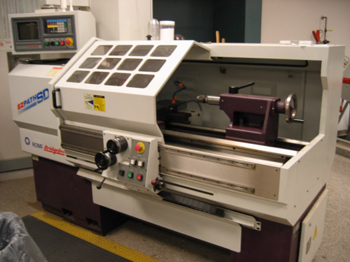
Equipment Procurement
Major Equipment or Instrumentation
Purchases on sponsored funds
Purchasing’s Uniform
Guidance Procurement Standards
Micro-purchases: up to $25,000
2. Small purchases: Between $25,001 and $250,000
3. Sealed bids/Competitive proposal/ Sole source purchases $250,001 and above
Notes:
New sections on OVPR and Division of Biology & Medicine in documenting institutional commitments.

Slide 12
Equipment Procurement
If non-competitive method used for items at $250,001 and above, recommended text for proposal when applicable:
XYZ Equipment item was selected from Vendor ABC after solicitation of a number of sources, and the competition was determined inadequate.
OR
XYZ Equipment item is available only from a single source.
Notes:
New sections on OVPR and Division of Biology & Medicine in documenting institutional commitments.

Slide 13
Equipment Procurement
Every time a sole source purchase is made, we are now required to include a price analysis.
Purchasing is developing new guidance to walk through the price analysis steps
If using sealed bid or competitive proposal process and the price is expected to exceed $250K (for federal awards) there is a requirement that the bid be publicized.
Notes:
New sections on OVPR and Division of Biology & Medicine in documenting institutional commitments.

Slide 14
National Science Foundation
Proposal & Award Policies & Procedures Guide (PAPPG) for all proposals submitted, or due, on or after January 28, 2019.
Allowable font styles is updated, Ch II.B.2
No Arial narrow allowed
“RAPID”, “EAGER” and “RAISE” must be included in proposal project title
Conference proposals over $50,000 and all equipment proposals must include the Collaborators and Other Affiliations information
Notes:
New sections on OVPR and Division of Biology & Medicine in documenting institutional commitments.

Slide 15
National Science Foundation
Proposal & Award Policies & Procedures Guide (PAPPG)
Implementation of NSF’s policy on sexual harassment and other forms of harassment, or sexual assault
If foreign organization is considered essential to project, the box for “funding of a Foreign Organization” must be checked on coversheet
Incorporation of existing patent policy into the PAPPG.
Notes:
New sections on OVPR and Division of Biology & Medicine in documenting institutional commitments.

Slide 16
National Institutes of Health
Budget matters: NIH received a 5.6 percent increase over the FY 2018 to $39.3 billion
$711,000,000 authorized under the 21st Century Cures Act Specific increases for Alzheimer’s disease, the All of Us Research Program, and the BRAIN Initiative.
NRSA Stipends and Tuition/Fees Effective for Fiscal Year 2019 have been announced. Details here averages about a 2% increase
Salary cap remains at Executive Level II or $189,600.
Notes:
New sections on OVPR and Division of Biology & Medicine in documenting institutional commitments.

Slide 17
National Institutes of Health
Next Generation Researchers Initiative Policy:
In FY19 NIH will prioritize meritorious R01- equivalent applications from Early Stage Investigators PD/PIs per the policy announced in this NIH Guide notice
ESI status is based on Commons account, so be sure to complete degree information
October 2018 publication of NIH’s revised Grants Policy Statement can be found here
Notes:
New sections on OVPR and Division of Biology & Medicine in documenting institutional commitments.

Slide 18
General Reminders
Advance Accounts – If a sponsor name changes after Advance Account is created, Department must transfer expenses to new account with new sponsor name
Pre-existing terms at proposal stage - Non-federal application submissions may contain terms “binding” on the University
Alert OSP and provide a copy of the proposal materials as soon as possible
Notes:
New sections on OVPR and Division of Biology & Medicine in documenting institutional commitments.

Slide 19
OSP Post Award Updates
Heather Dominey
Assistant Director, Post Award, OSP

Slide 20
Travel Policy
Sponsored Travel Policy Update:
Frequently Asked Questions (FAQs)
provide guidance and/or clarity on the treatment of complicated issues relating to Airfare purchase.
For the complete version of the updated policy and FAQs, please check the Sponsored Travel Policy page.
Notes:
Minor changes have been made to this policy and the Frequently Asked Questions (FAQs) section updated to provide guidance and/or clarity on the treatment of some of the complicated issues relating to Airfare purchase.

Slide 21
EFFORT REPORTING

Slide 22
Effort Reporting Stats for 2018
Thank you for your hard work!
Notes:
2018 is drawing to a close, so the first thing we wanted to highlight is a snapshot of the number of effort reports generated for the year. Effort reporting is a big part of the work that we all do here at Brown with over 4,200 reports being analyzed, reviewed and certified. Thank your for your time and commitment.

Slide 23
Upcoming Effort Reporting Dates
Certification Period | Report Run Date | Employee Type
09/30/18-10/27/18 | December 10, 2018 | Non-exempt staff and undergraduates
10/28/18-11/24/18 | January 08, 2019 | Non-exempt staff and undergraduates
11/25/18-12/22/18 | February 08, 2019 | Non-exempt staff and undergraduates
07/01/18-12/31/18 | February 08, 2019 | Faculty, graduate students, exempt staff
Notes:
Just a brief reminder of the deadlines for effort reporting. Effort reports are delinquent if not certified within 30 days of being generated per the policy. This becomes an audit risk at the 30 days! Any uncertified effort reports still delinquent at 60 days will be subject to an official communication to the department head. To avoid delinquency, please review the “effort certification summary report” regularly to ensure that there are no outstanding effort reports for your department. ECP’s should continue to follow up with PI’s, faculty and staff to ensure that the reports have completed the process.
Now that we’ve reviewed the reminders, the following upcoming effort reporting run dates are listed here for your reference.

Slide 24
Effort Reporting
Please send effort related questions and feedback to
effort-reporting@brown.edu
Notes:
That concludes the effort reporting section of the presentation. Are there any questions? If not, please feel free to send any questions that may arise to the effort-reporting email provided on the slide. Also keep in mind that feedback is always welcome!
Thank you!

Slide 25
Office of Research Integrity
Keri Godin
Director, ORI

Slide 26
Data Use Agreements (DUAs)
ORI officially took over review of Research DUAs on Nov 12th
Overall goals:
Centrally manage all DUAs involving research data
Coordinate all behind-the-scenes required reviews (CIS, OGC)- one-stop shopping!
Track where Brown’s data reside
Education and outreach

Slide 27
Data Use Agreements (DUAs)
Week 3 Updates:
New DUA webpage
New DUA email: DUA@Brown.edu
Developed DUA online intake form
Mtgs with IECV, CIS, OGC, Library

Slide 28
Data Use Agreements (DUAs)
Future Vision:
Analyze scope & types of DUAs and overall research needs of the Brown community
Develop policy/procedures to improve transparency & turnaround time for our research community
Online DUA training

Slide 29
Common Rule Changes
Effective January 21, 2019
Rather than operate under pre-2019 and post-2019 requirements contemporaneously (with two sets of requirements, SOPs and policies), Brown is transitioning all active studies to the 2019 Common Rule as of the effective date
Upcoming in-person training sessions:
December 18, 2018 – 11:30-1:00, SSL Room 538
January 7, 2019 – 11:30 – 1:00, SSL Room 538
January 14, 2019 – 11:30 – 1:00, SSL Room 538

Slide 30
Common Rule Changes
Effective January 21, 2019
Major change: Continuing Review
Release from Continuing Review (a.k.a, annual progress reports)
Individual emails have already gone out for Jan/Feb due dates;
Remainder being sent out this month
Full Board studies will complete a new progress report form after the effective date
Doesn’t apply to FDA regulated studies

Slide 31
Common Rule Changes
Effective January 21, 2019
Major change: Informed Consent revisions
Key Information: reformatting of all informed consent documents
HRPP created a special amendment form to facilitate this change
Investigators receiving a self-assessment checklist to evaluate other potential changes needed to informed consent documents – can submit now, approval will be held

Slide 32
Common Rule Changes
Effective January 21, 2019
Major change: Exemption categories
Exemptions: New categories and clarification of existing categories
Some exemptions may require "limited IRB review" (similar to an expedited review process)
Brown is not implementing exemption #8 re: Use of identifiable data/biospecimens obtained with Broad Consent

Slide 33
Common Rule Changes
Effective January 21, 2019
Human Subject: Expanded definition
to cover the collection of biospecimens (this does not include non-identified biospecimens)
“A living individual about whom an investigator, whether professional or student conducting research: (1) obtains information or biospecimens through intervention or interaction with the individual, and uses, studies, or analyzes the information or biospecimens; or (2) obtains, uses, studies, analyzes, or generates identifiable private information or identifiable biospecimens.”

Slide 34
Common Rule Changes
…and there’s more! Come to one of our trainings to learn about ALL of the changes, including:
Elimination of IRB protocol – grant congruency review
Our new Reportable Events Policy
Our One-Protocol Policy

Slide 35
Office of Research Integrity
Jules Blyth
Associate Director, ORI

Slide 36
Conflict of Interest Update
Annual Conflict of Interest disclosure cycle
Kick-off planned for early February 2019
Post-docs will be included
A few additional and/or revised questions (aligned with staff COI form)

Slide 37
Conflict of Interest Update
New! Purchasing COI Statement
Per Brown University Policy, one cannot make, direct, or influence business decisions, including purchases or contracts, if these involve a conflict of interest.
Examples
requesting a purchase from a company that is owned by a family member
requesting a purchase from, or contracting to, a company in which one or a member of one’s family has a financial interest (income, stock, stock options)

Slide 38
Responsible Conduct of Research
Next BEARCORE (OVPR’s RCR training course):
Course dates: Feb 28 – March 21, 2019
approx. 8 hour in-person training
combination of core and elective sessions
Fulfills NIH and NSF RCR requirements
Registration opens early January 2019
ORI will email PIs on qualifying grants with RCR training reminder
will cc department administrators

Slide 39
Export Control Update
Department of Commerce, Bureau of Industry and Security (BIS) - additions to the Restricted Entity List, including one research institution
Reminder: the Restricted Entity List contains several Chinese universities, including Sichuan, Beihang, and Northwestern Polytechnical University.
Good Practice: Screen your visitors and visiting scholars.
ORI can help. It takes <1 minute to screen.

Slide 40
Export Control Update
Update from Washington:
bipartisan concern about espionage, foreign influence, and IP diversion
push to develop new or revise and tighten existing regulations/policies to protect the U.S. critical technology advantage
academic institutions under pressure from Washington
to protect IP and research results
review its ties with China, Iran, Russia

Slide 41
Export Control Update
National Defense Authorization Act (NDAA)
directs DoD to work with academic institutions on developing policies and practices that protect intellectual property and information about critical technologies.
prohibits federal agencies from entering into contracts, including research contracts, with entities that use Chinese-origin telecommunication equipment, systems, or services (effective 8/2020)

Slide 42
Export Control Update
Which Chinese Telecommunication Companies cannot be used?
Huawei Technologies Company
ZTE Corporation
Hytera Communications Corporation,
Hangzhou Technology Company,
Dahua Technology Company
any subsidiary or affiliate of the above entities

Slide 43
What to expect in the coming year
Regulatory changes, including revisions to Export Control Regulations to protect “critical technologies”
Potential restrictions and increased oversight for any research on “critical technologies”
Increased scrutiny around foreign research support, including gifts
Visits and outreach activities from FBI and other law enforcement agencies
Campus-wide education on IP protection, international collaborations, and export control regulations

Slide 44
What to do if FBI agents show up?
Hello!
We have a few quick questions
Call the Office of the General Counsel!

Slide 45
Brown Bag Listserv
To be added to OSP’s Brown Bag Listserv, please email:
resadmin@brown.edu

