Slide 1
OSP Quarterly Brown Bag December 7, 2017

Slide 2
Coeus Update
Andrea Mucci
Senior Research Business Analyst

Slide 3
Coeus Update
*New* Coeus User Attached S2S forms
Two new forms available to be uploaded in the User Attached S2S Forms section:
Project Abstract Form version 1.2
Attachments Form version 1.2
These forms are required in various Department of Defense opportunities.
Implementation plan is for January 2018

Slide 4
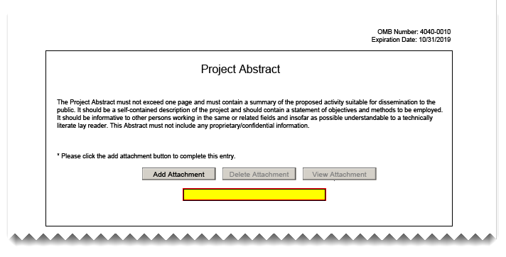
Coeus Update
Project Abstract Form version 1.2

Slide 5
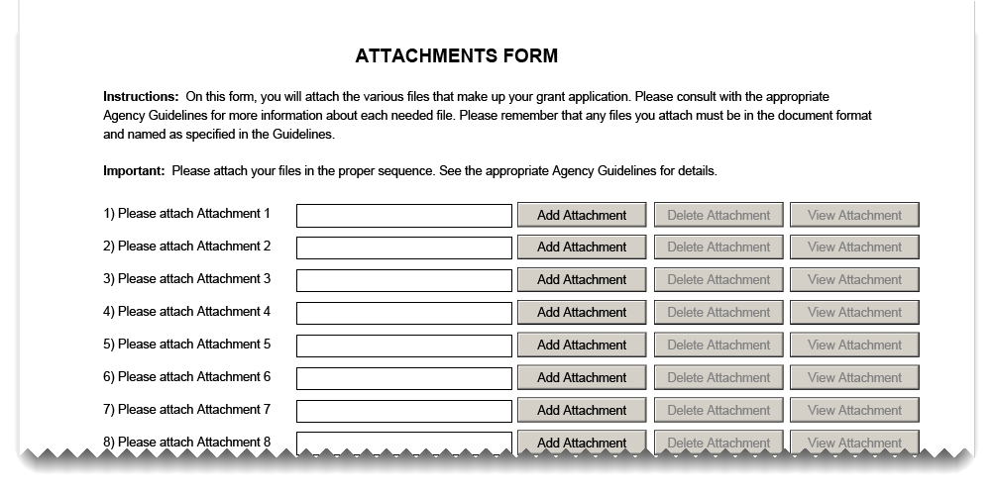
Coeus Update
Attachments Form version 1.2

Slide 6
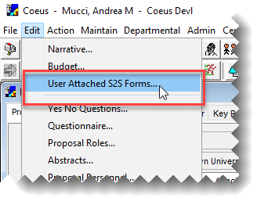
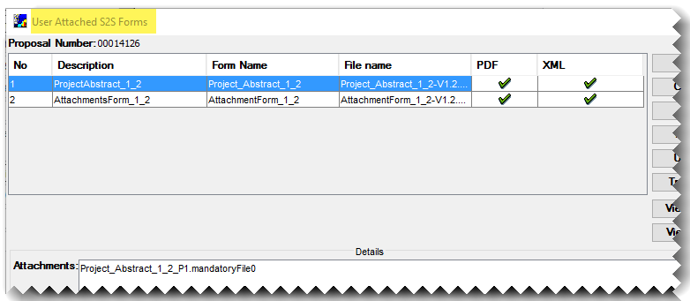
Coeus Update
User Attached S2S Forms in Coeus

Slide 7
Coeus Update
*New* PHS Human Subjects and Clinical Trials Information Form
(Grants.gov Forms-E)
A new Coeus Lite interface was designed to address the questions contained on the new form.
The Human Subject Study Record is completed as a live adobe attachment and will be uploaded in this section.

Slide 8
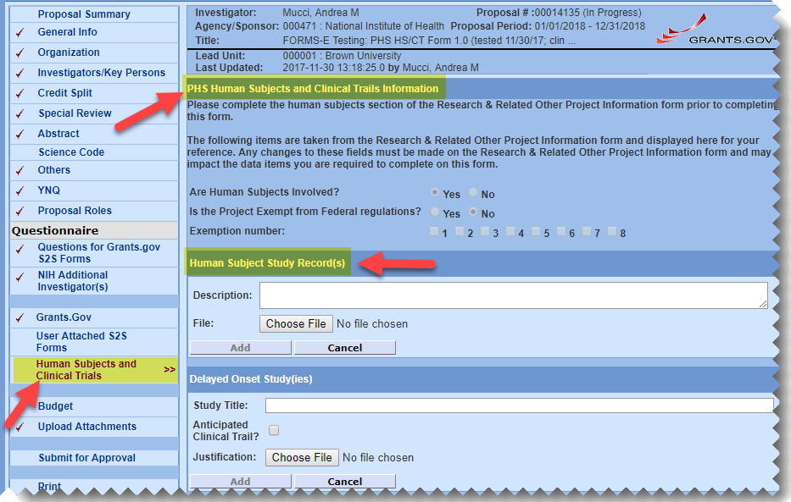
Coeus Update
Preview- PHS Human Subjects and Clinical Trials Information Form

Slide 9
Coeus Update
RAIS is in the process of testing the new form procedure.
Short informational sessions to be held the first week of January – stay tuned for an announcement for this.

Slide 10
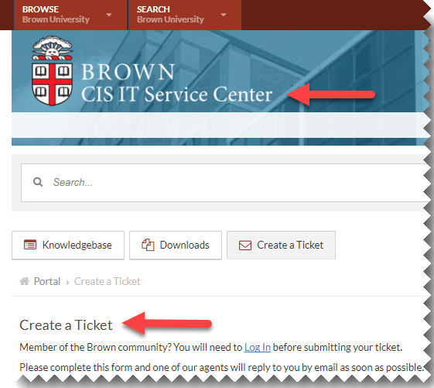
Coeus Update
*New* Coeus Help Ticket
Replaces emailing coeus_help
Easy to find at: ithelp.brown.edu/new-ticket

Slide 11
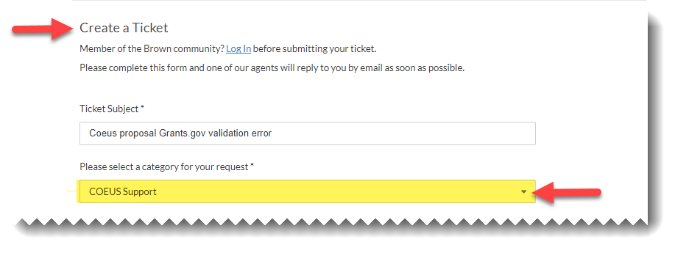
Coeus Update
Available 1/02/2018

Slide 12
RAIS
Grants.gov Workspace Update
Workspace officially replaces the legacy .pdf packages at Grants.gov on 12/31/2017
Preferred submission methods are still:
Coeus system-to-system (S2S)
Sponsor submission systems
(e.g., ASSIST, Fastlane.)

Slide 13
RAIS
Grants.gov Workspace Update
Workspace is used if:
A Grants.gov form is not available in Coeus (proposal cannot be submitted S2S) and it cannot be submitted via a sponsor’s portal
OR
Sponsor specifies Grants.gov Workspace-only, per their funding opportunity announcement

Slide 14
RAIS
Grants.gov Workspace Update
Grants.gov Workspace accounts:
Remember to choose Organizational account if you sign up
If you think you need to prepare a proposal via Workspace, please contact your OSP Pre-award administrator to confirm the sponsor funding opportunity’s requirements.

Slide 15
Undergraduate Student Effort Certification
Maria Mento
Research Services Analyst

Slide 16
Undergraduate Student Effort Certification Change: PI Certifies
Changes:
Undergraduate Student Effort Reports will route to PI for certification
PI will certify undergraduate student effort
PI will receive notifications

Slide 17
Undergraduate Student Effort Certification Change: PI Certifies
Effective Date:
December 6, 2017
Any undergraduate student effort report run
on/after December 6, 2017 will route to PI(s)
prior to December 6, 2017, and not yet submitted, will route to undergraduate student

Slide 18
OSP News and Updates
Michael Kostyshak
Assistant Director

Slide 19
Location, Location, Location
We’ve moved to the South Street Landing
Official address is:
Office of Sponsored Projects
Brown University, Box 1929
Providence, Rhode Island, USA 02912
If a street address is necessary
350 Eddy Street

Slide 20
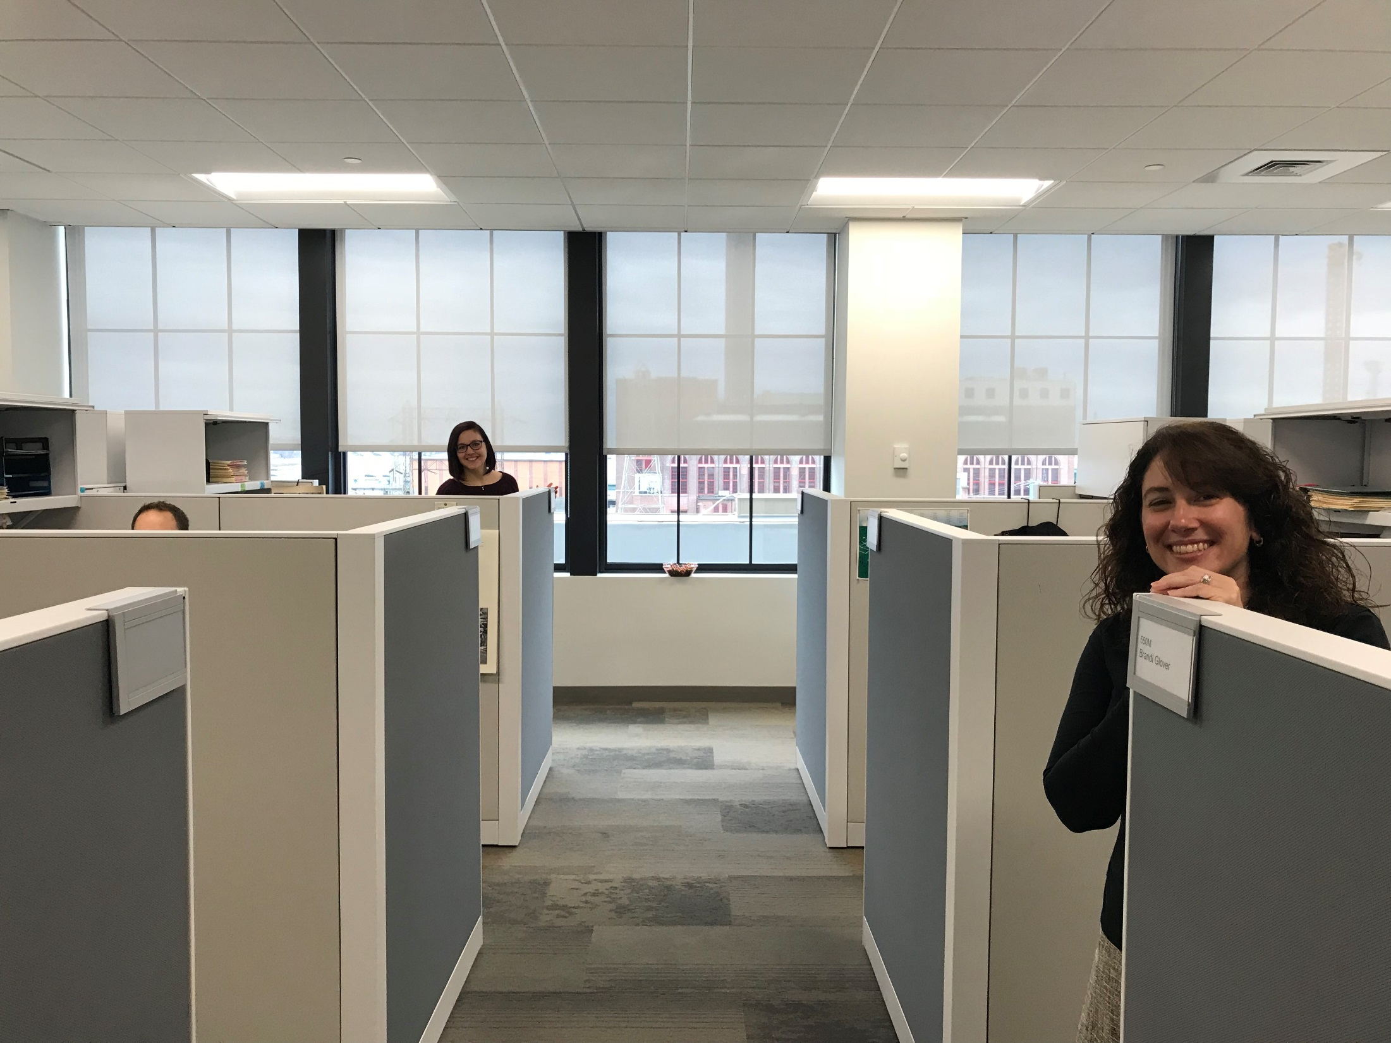
Location, Location, Location

Slide 21
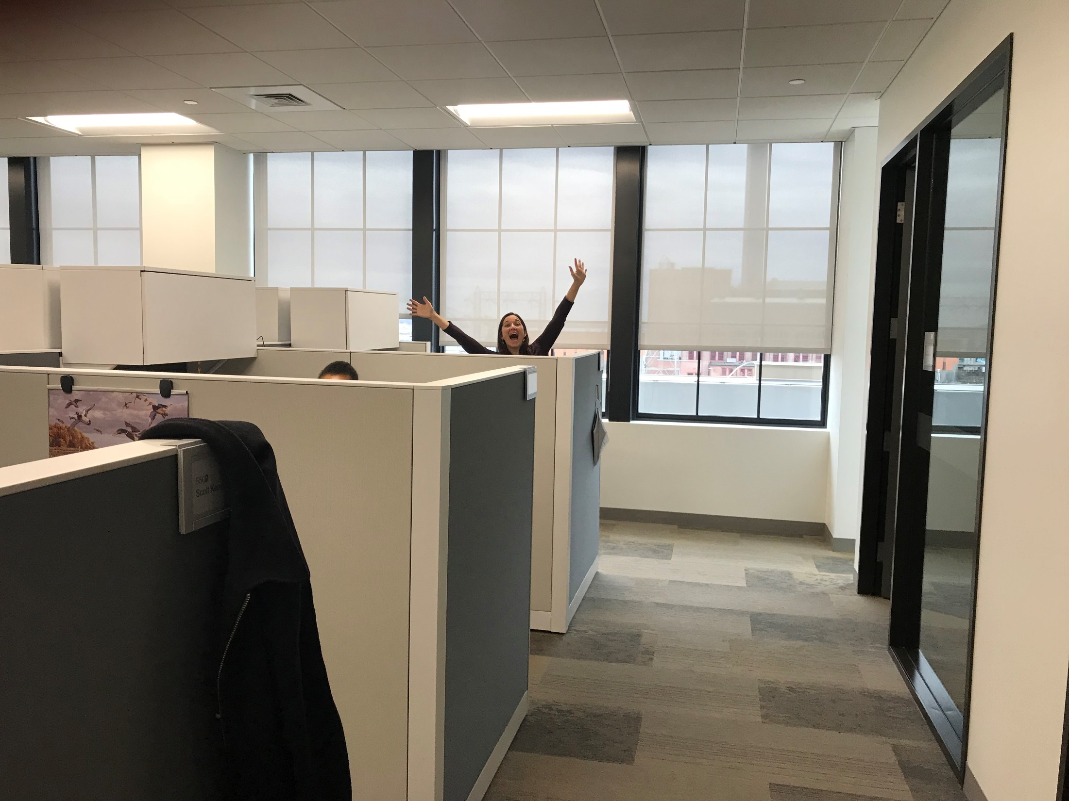
Location, Location, Location

Slide 22
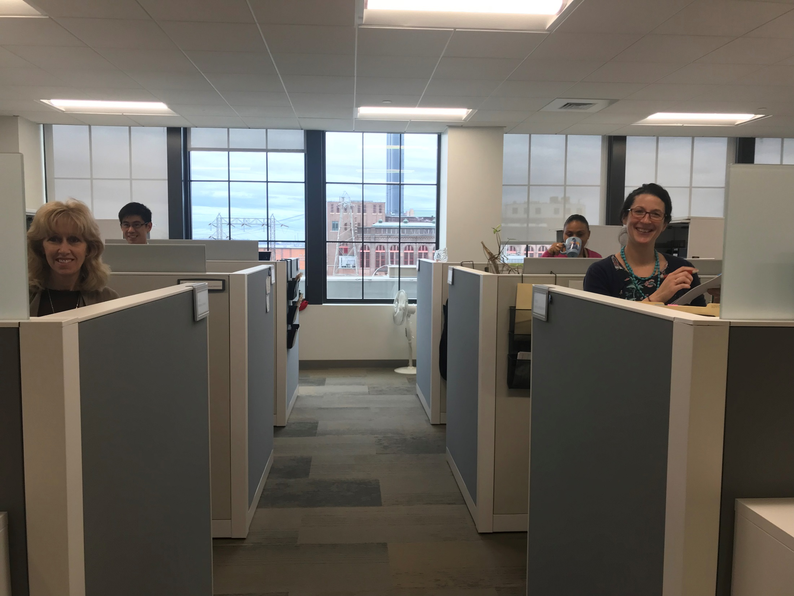
Location, Location, Location

Slide 23
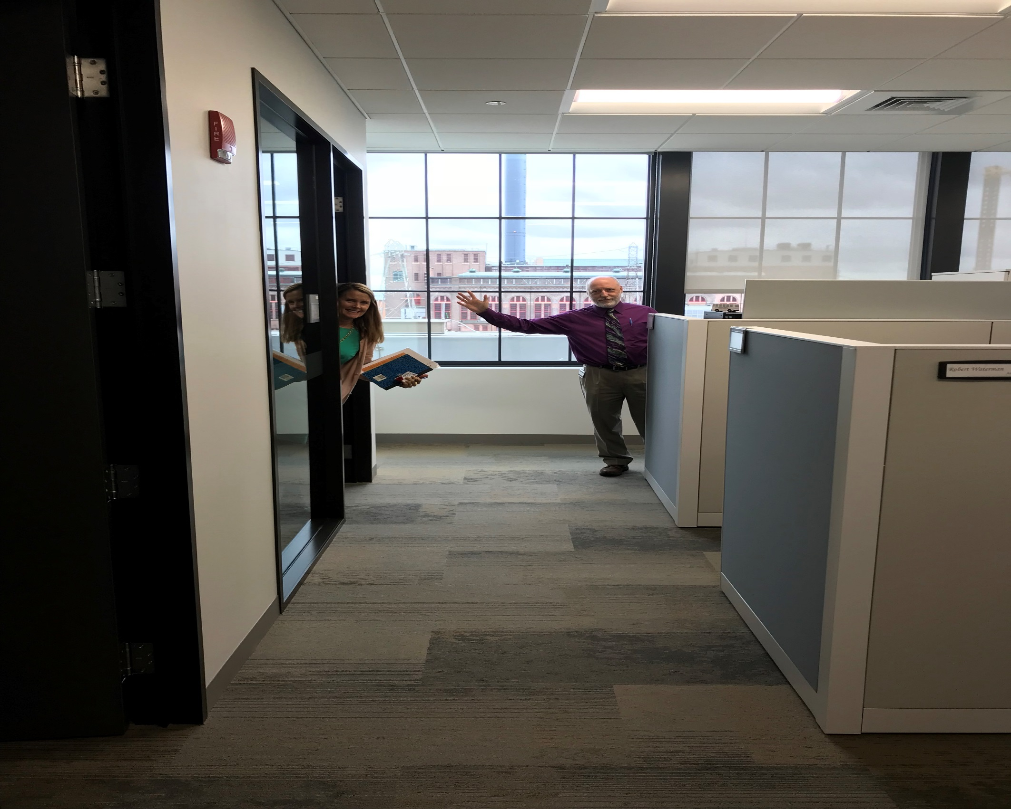
Location, Location, Location

Slide 24
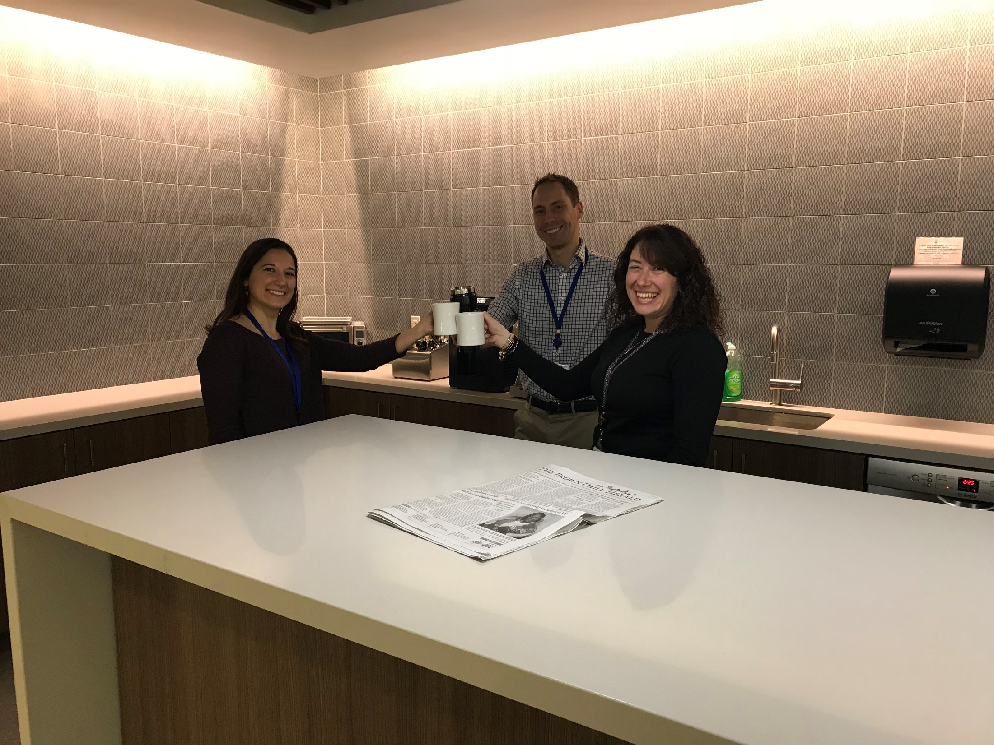
Location, Location, Location

Slide 25
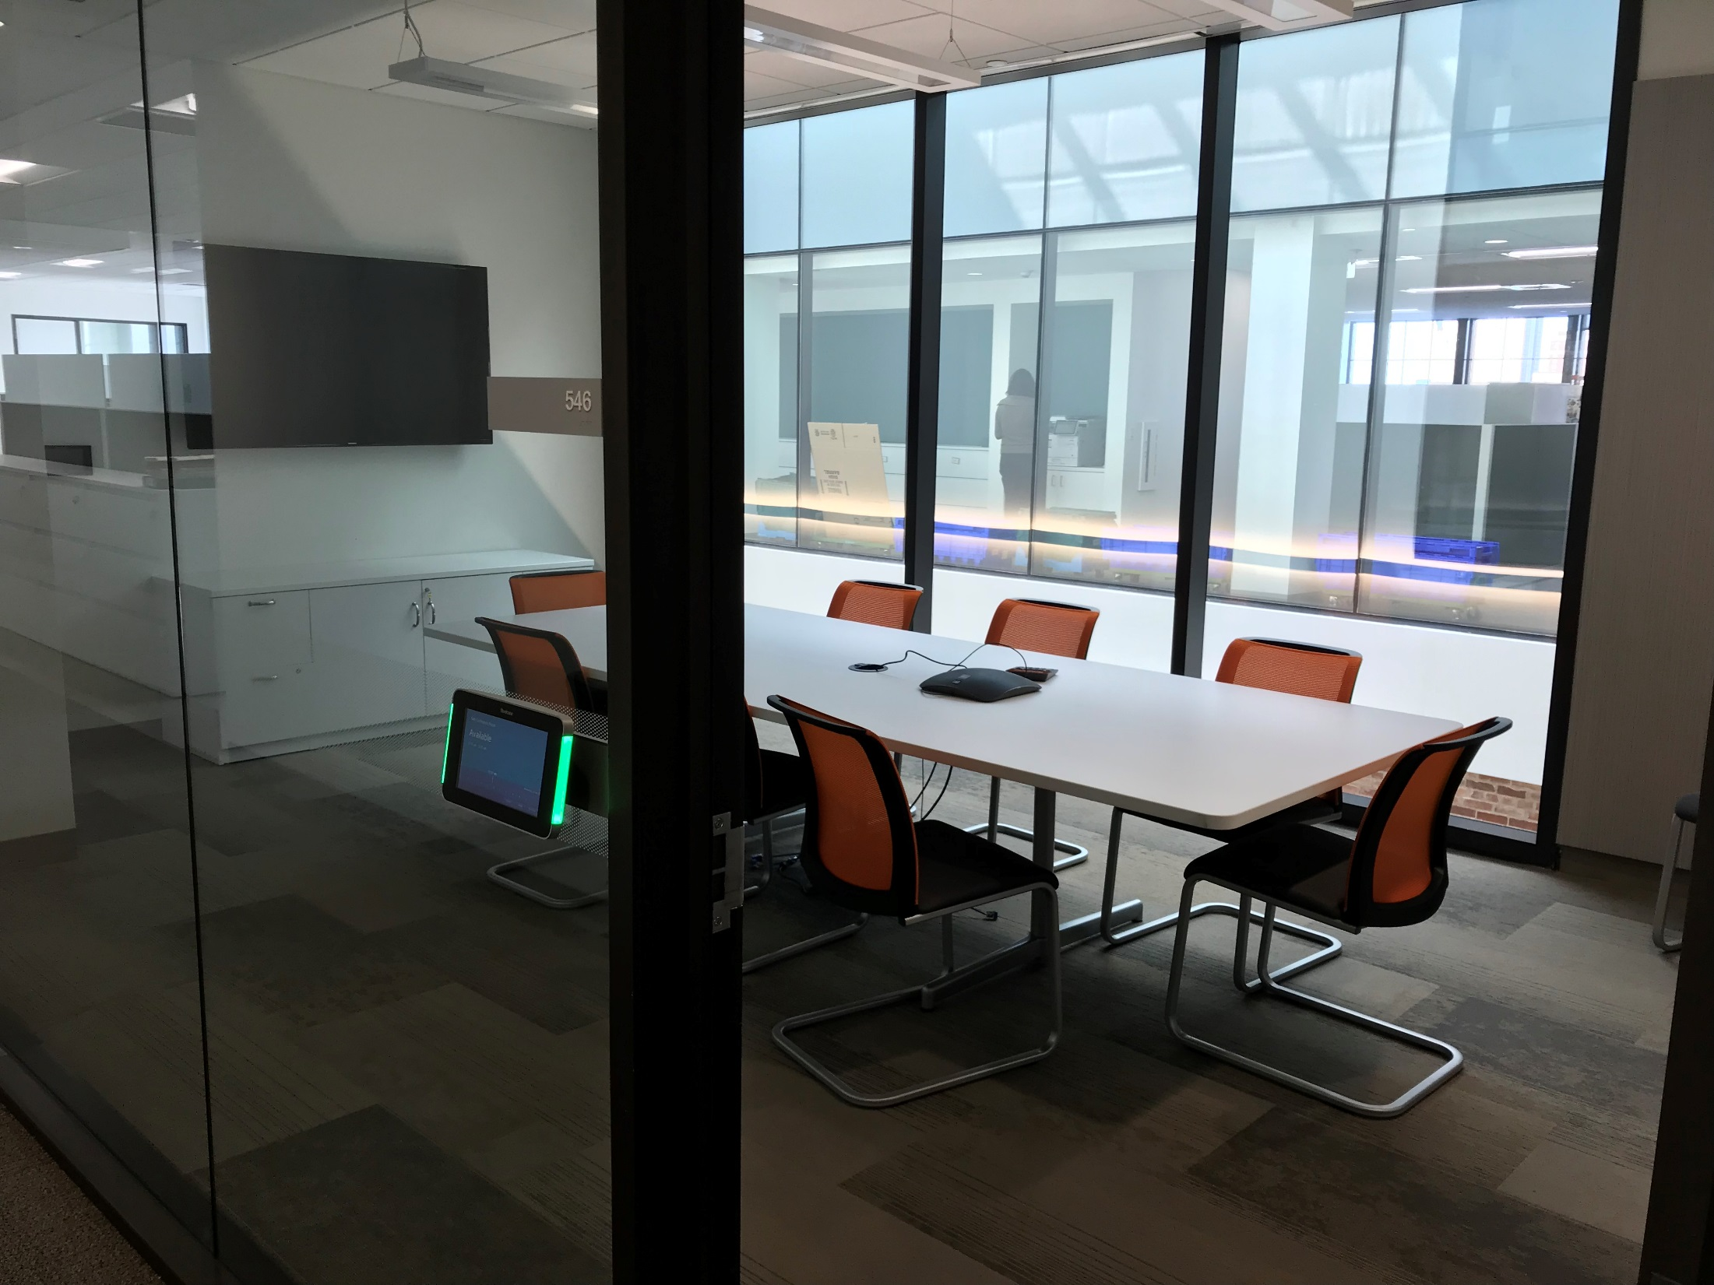
Location, Location, Location

Slide 26
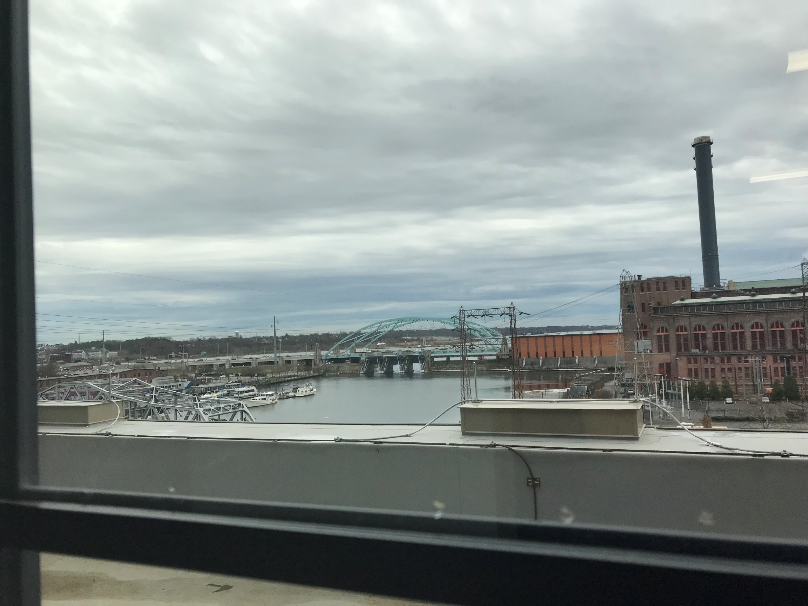
Location, Location, Location

Slide 27
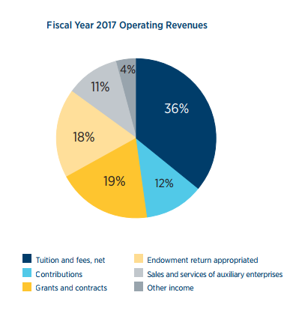
2nd Largest source of revenue

Slide 28
Holiday reminders
Winter Break
Brown will close at the end of your department’s normal workday on Winter Solstice, Thursday, December 21, 2017, and will re-open at the beginning of your department’s workday on Tuesday, January 2, 2018.
For all proposals with deadlines that fall during Winter Break the deadline to OSP/BMRA is Thursday December 14, 2017 by 5pm.
For programs with deadlines in early January (AIDS and AIDS-Related Research and SBIR/STTR) please contact OSP/BMRA as soon as possible to establish a mutually acceptable submission schedule. These deadlines move to Monday, January 8th in 2018.
Please submit all financial data, including return of rough drafts and financial close-out materials well in advance of Winter Break.

Slide 29
Holiday reminders
December 31, 2017, PDF single-file Adobe packages will no longer be available for download from Grants.gov.
Priority ranking of submission methods:
(S2S) via Coeus Proposal Development
Sponsor website NIH ASSIST or NSF FastLane or NASA NSPIRES, etc.
Grants.gov WorkSpace

Slide 30
NASA
No-cost extension requests for grants & cooperative agreements
Due within a 20 day window, no earlier than 30 days and not later than 10 days prior to the end date.
Annual progress report must be attached. NSSC on-line web form will not be accepted if report is missing
Send report and request to OSP using UPAS form

Slide 31
National Science Foundation
"No-Deadline," Full-proposal Submission Process for Most Programs in the Directorate for Biological Sciences begins January 2018
Core programs in the Division of Environmental Biology (DEB), the Division of Integrative Organismal Systems (IOS), the Division of Molecular and Cellular Biosciences (MCB), and to the programs in the Research Resources Cluster of the Division of Biological Infrastructure (DBI).
Much more detail in FAQs here.

Slide 32
National Science Foundation
Proposal & Award Policies & Procedures Guide
Effective date January 29, 2018
COA – use standard NSF COA template in .xls or .xlsx format, some information requested in prior versions of the PAPPG is no longer requested.
Project Description must contain separate section specifically identified as “Intellectual Merit”
Budget Justification may now be 5 pages

Slide 33
National Science Foundation
Results from Prior NSF Support – clarifies timeframe which requires reporting, END date in past 5 years or current award in NC Ext)
Indirect costs – amounts for indirect should be specified in Budget Justification
Data Management Plans – added guidance for collaborative projects

Slide 34
National Science Foundation
Collaborators and Other Affiliations
No longer included in the NSF biographical sketch
No longer need to be provided in alphabetical order
No longer required to list postdocs sponsored

Slide 35
National Science Foundation
Collaborators and Other Affiliations
Part B of the template: category “G” is for the investigator’s own PhD advisors, while category “P” refers to the investigator’s non-PhD graduate advisors (e.g. Master’s advisor).
https://www.nsf.gov/bfa/dias/policy/coa.jsp

Slide 36
National Science Foundation
Collaborators and Other Affiliations
Proposers using the Collaborators and Other Affiliations template for more than 10 senior project personnel will encounter proposal print preview issues.
Click here for additional guidance

Slide 37
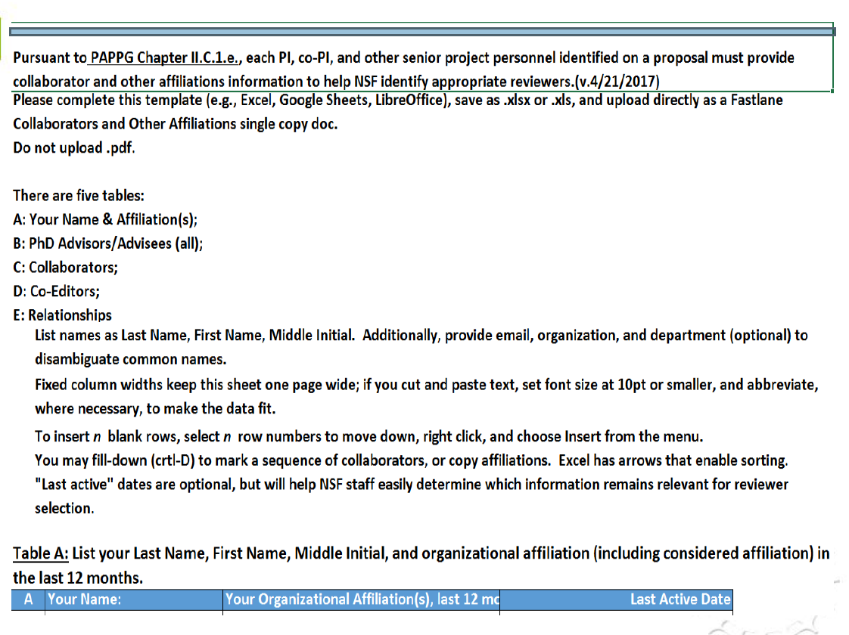
National Science Foundation

Slide 38
National Science Foundation
A webinar on the new PAPPG will be held on December 8th at 2PM EST. Registration is required, please see the link in the OSP November 2017 Newsletter

Slide 39
National Institutes of Health
Reminders
FORMS E transition (required January 25,2018)
New parent FOAs with FORMS-E labeled as either “Clinical Trial Required” or “Clinical Trial Not Allowed.”
Clinical Trials definition here

Slide 40
National Institutes of Health
Project Outcomes section of Interim and Final RPPRs are available via NIH RePORTER beginning on Oct 1, 2017
For further detail see NOT-OD-18-103 and Open Mike Blog “reviewing reported outcomes is part of our stewardship of the public’s investment in research.”

Slide 41
National Institutes of Health
Writing the Outcomes portion (Section I) ensures that it is:
Written for the general public in clear and concise language
Suitable for dissemination to the general public
Does not include proprietary, confidential information or trade secrets
Not more than half a page

Slide 42
FDP Faculty Workload Survey
Federal Demonstration Partnership
Survey conducted in 2005, 2012
Faculty reported that roughly 42% of their research time is required for administrative tasks
Results used by Nat’l Science Board and Nat’l Academics to advocate for reducing burden
Next Survey in Spring 2018 – encourage faculty to participate

Slide 43
Post Award Update
Heather Dominey
Senior Grant/Contract Accountant

Slide 44
Post Award Update
OSP Welcomes New Staff Member!
Brandi Glover, Grants/Contracts Accountant I
Some of the departments she will be servicing include:
Applied Math, Cognitive Linguistic and Psychological Sciences, Centralized departments within the Division of Biology and Medicine
There is currently one opening for a Grants/Contracts Accountant – Interested candidates please apply in Workday: https://brown.wd5.myworkdayjobs.com/staff-careers-brown/job/Brown-Office-Building/Grant-Contract-Accountant-I-II_REQ137924

Slide 45
Post Award Update
NCURA Region I Spring Meeting
Monday, April 30 – Wednesday, May 2, 2018 Sheraton Portsmouth Harborside Hotel Portsmouth, NH
Preliminary Program will be available 2/14/18
Registration will open 2/19/18

Slide 46
OSP Effort Reporting
Tanitia Sello
Grant/Contract Accountant

Slide 47
Effort Re-Certifications and PAAs
Although PAAs can now be generated from original effort certifications in progress, the re-certification process has not changed.
(See OSP Effort Reporting and Cost Transfer Policies for further details.)

Slide 48
Effort Re-Certifications and PAAs Review
Department - Initiates PAA- attaches cost transfer form with re-certification request
OSP - Grant Accountant reviews PAA request
PAA cost transfer form approved by OSP managing directors
Grant Accountant consults with ECA to initiate effort re-certification
Re-certification routes to department for completion

Slide 49
Terminated Worker Effort Report in Progress with ECP
If a worker terminates while an effort report is in progress awaiting administrative (ECP) review:
Do not submit the electronic effort report. This will result in a bypass of the certification step. Instead, contact the ECA for a manual certification form.
Workday Operations is working on this issue.
Prevention is the best cure…make every effort to ensure that reports are certified before the worker’s departure!

Slide 50
Effort Policy Reminder
All effort reports should be certified within 30 days of distribution, including re-certifications and terminated worker reports.
For any reports that will not be certified on time, ECPs should request an extension in advance of the due date.
Late certifications and multiple certifications are an audit risk for the University.

Slide 51
Workday Effort Reporting
Upcoming reporting dates
Certification Period | Report Run Date | Employee Type
10/01/17-10/28/17 | December 08, 2017 | Non-exempt staff and undergraduates
10/29/17-11/25/17 | January 08, 2018 | Non-exempt staff and undergraduates
11/26/17-12/23/17 | February 08, 2018 | Non-exempt staff and undergraduates
07/01/17-12/31/17 | February 08, 2018 | Faculty, graduate students, exempt staff

Slide 52
Thank you
Total Delinquent Effort Reports (Nov. 1-Nov. 30)
-70%
Thanks for your hard work in resolving these certifications!

Slide 53
OSP Training
Final class of the year Effort Certification
Dec 13, 2017

Slide 54
HRPP Updates
Christiana Provencal
QA/QI Administrator, ORI
Notes:
Good afternoon everyone. I’m _______ . We have a few HRPP updates to review today.

Slide 55
New Guidance for Investigators
Guidance for the Management of Human Research Studies Involving Drugs and Medications
Purpose:
Assist Investigators, licensed practitioners and other members of the research team with ensuring that research procedures involving prescription medications are consistent with applicable federal and state regulations as well as Brown University policy.
Scope:
The guidance covers the use of investigational new drugs, drugs that are currently approved, by the Food and Drug Administration (FDA) as well as Schedule I-V drugs which may be regulated by the Drug Enforcement Agency (DEA).
Notes:
The first of these updates is to let you know about new guidance we’ve developed regarding research that involves prescription drugs and medications. The new guidance is designed to: Assist Investigators, licensed practitioners and other members of the research team with ensuring that research procedures involving prescription medications are consistent with applicable federal and state regulations as well as Brown University policy. It covers the use of investigational new drugs, drugs that are currently approved, by the Food and Drug Administration (FDA) as well as Schedule I-V drugs which may be regulated by the Drug Enforcement Agency (DEA).

Slide 56
New Guidance for Investigators
PROCUREMENT AND TRANSFER
STORAGE AND SECURITY
PACKAGING AND LABELING
WHO CAN PRESCRIBE
WHO CAN DISPENSE
WHO CAN ADMINISTER
DESTRUCTION/RETURN OF UNUSED DRUGS
DOCUMENTATION
Notes:
Some of the specific topics that this guidance addresses are: the procurement and transfer of the medications (so, how are the drugs obtained? from the drug manufacturer, wholesaler, or a pharmacy or some combination), how drugs are stored and controlled at the study site, the packaging and labeling, who can prescribe, dispense and administer the medications to study participants, the destruction/return of unused drugs, and best practices for the documentation of all aspects of the management of drugs in this type of research protocol.

Slide 57
New Guidance for Investigators
Additional components of this guidance
New form for study submissions:
Prescription Drug/Medication Addendum
Educational Session:
ORI is offering an informational session, "Where do you get your drugs?” on Tuesday, January 30, 2018, 10:00am-11:00am 190 Thayer Street, Metcalf Lab, room 115.
Space is limited, register early on Learning Point!
Notes:
In addition to the guidance document the HRPP has also developed a new form to be submitted as part of an IRB submission for any protocols which involve drugs and medications. This form will further guide investigators to provide the information needed for IRB review and allow the HRPP to assess compliance of study procedures with federal and state regulations. . Also, we are offering an educational session which will provide an overview of the new guidance. This session is open to any interested PIs or study staff who may be currently conducting this type of research or who are planning to in the future. We are also available to meet with individual investigators or study teams to conduct this session, at their request.

Slide 58
Additional Educational Offerings
Additional educational offerings are scheduled and posted on our HRPP/IRB home page. We will also announce trainings for which registration is required on Today@Brown.
Social Media for Research Recruitment: Ethical and Practical Aspects
Wednesday 12/13, 12:30pm-1:45pm, South Street Landing, 4th Floor, Room 445
(No registration required)
This webinar will include topics such as:
-a review of empirical information on the effectiveness of social media as a research tool
-a discussion related to utilizing sound methodology for the design and review of social media recruitment techniques
-a review of how the ethical principles of respect for privacy and investigator transparency apply in the social media context
Notes:
Additional HRPP educational offerings are scheduled and posted on our HRPP/IRB home page. We will also announce trainings for which registration is required on Today@Brown. One other upcoming offering is the webinar, Social Media for Research Recruitment: Ethical and Practical Aspects. This is an important and timely topic as many research protocols include online recruitment procedures and often involve social media sites for advertising and recruiting study participants. If you or any of your investigators are using social media for research recruitment, please join us for this webinar.

Slide 59
Revised OHRP Regulations
The Office of Human Research Protections (OHRP) released revised regulations in January and they will become effective on January 19, 2018.
To facilitate a smooth transition from December 20, 2017 thru January 19, 2018, there will be a freeze on protocol submissions to the HRPP.
Protocol submissions that are received, reviewed and approved after January 19, 2018 will be subject to the new regulations (and this is a good thing!).
Any protocols submitted prior to the December 20, 2017, may require additional changes (an amendment submission) in order to become compliant with the revised regulations.
Under the new regulations examples of a reduction in burden include:
-a continuing review may no longer be required for some minimal risk research, including studies where the only remaining activity is the analysis of identifiable data/biospecimens or activity to obtain follow-up clinical data.
- new exempt categories and clarification of existing categories of exempt research may be applicable to some research studies that currently require expedited review.
Notes:
As you may already be aware, the Office of Human Research Protections (OHRP) has released revised regulations which will become effective on January 19, 2018. HRPP has been preparing for this transition over the last several months. Part of that preparation involved informing the the research community that beginning December 20, 2017, there would be a freeze on all new protocol submissions to the HRPP. The response to this announcement has been pretty reactive, as we have been swamped with submissions over the last few weeks. We want to take a moment to remind our research community that waiting to submit until after January 19, 2018 to avoid confusion during the review and to take advantage of new regulations and procedures that may mean less work for the investigator. The HRPP will consider exceptions to the freeze period for urgent situations, such as JIT requests, to be evaluated on a case-by-case basis.
So unless the research needs to begin in January or February of 2018, we suggest that it would be best and less burdensome to wait and submit the protocol until after the implementation of the new regulations in January If you are concerned about the timing of a particular submission, please consult with HRPP staff and we'll be happy to help you figure out the best way forward.

Slide 60
Intersection of HSR & the IBC
Holly Clifford
Research Compliance Specialist

Slide 61
What Role Does ORI Play?
IACUC
Contact the IBC (BSO/Analyst) to find out if the PI already has IBC approval for the proposed work prior to IACUC approval.
IRB
Direct the PI to the IBC and/or provide applicable IBC forms to the investigator following the IRB pre-review process.
IACUC will not approve a protocol that requires IBC review/approval until IBC approval has been obtained.
There is nothing in place to prevent the IRB from approving projects that require IBC review/approval.

Slide 62
HSR that May Require IBC Oversight
Blood
Refers to human blood, human blood components, and products made from human blood.
Bloodborne Pathogens
Pathogenic microorganisms that are present in human blood and can cause disease in humans. These pathogens include, but are not limited to, hepatitis B virus (HBV) and human immunodeficiency virus (HIV).
Other Potentially Infectious Materials (OPIM)
In addition to blood, other bodily fluids or tissues can carry BBP's and they are commonly referred to as Other Potentially Infectious Materials (OPIM).

Slide 63
Other Potentially Infectious Materials
Semen
Vaginal Secretions
Cerebrospinal Fluid
Breast Milk
Amniotic Fluid
Pleural Fluid
Pericardial Fluid
Peritoneal Fluid
Synovial Fluid
Cell Cultures
Saliva in dental procedures.
Any body fluid visibly contaminated with blood.
Any unfixed tissue or organ (other than intact skin) from a human.
HIV-containing cell or tissue cultures, organ cultures, and HIV- or HBV-containing culture medium, or other solutions.
Undifferentiated fluids – all body fluids in situations where it is difficult or impossible to differentiate between body fluids.

Slide 64
Initiating Research
Submission
Biological research requiring IBC oversight cannot begin until approval has been granted.
IBC Meeting
Investigators will be notified by the committee regarding the status of the submission once a decision has been made. The submission may be approved without any modifications or approval may be withheld until all requested modifications have been completed.
Approval
Most approvals are granted for a period of 3 years, however, some approvals may be granted for a shorter period.
Modifications
As with any other approval, any changes must be submitted through an amendment prior to initiating any of the changes.

Slide 65
What Role Does the Investigator Play?
Submit a complete submission by the drop-dead date.
Ensure all applicable sections are complete.
Ensure training has been completed by both the PI and all personnel included within the Biological Research Authorization (BRA).
This differs from the tracking of training for IRB submissions.
Prompt response to email modification requests.
Ensure all appropriate attachments are included – ex. ECP & they match!!
Ensure coordination with all Committee meeting calendars (IACUC, IRB, IBC, etc.)
** Ensure all appropriate approvals have been granted before initiating work **

Slide 66
Contact Information
Holly Clifford
Research Compliance Specialist
(401) 863-3050
IRB@brown.edu
Biosafety@brown.edu
Shannon Benjamin
Biosafety Officer
Biosafety@brown.edu

Slide 67
ORI Update
Jules Blyth
Associate Director, ORI

Slide 68
ORI Update - RCR
Responsible Conduct of Research (RCR)
Registration now open for BEARCORE 2018 (“The Brown Ethics And Responsible Conduct Of Research Education”)
course dates: March and April, 2018
open to all students/faculty having to complete RCR
satisfies NIH and NSF RCR requirements
https://www.brown.edu/research/conducting-research-brown/preparing-proposal/research-integrity/ori-staff-directory/bearcore

Slide 69
ORI Update - COI
Conflict of Interest
Next Annual Disclosure cycle kicks off in early February 2018
all ‘regular’ faculty
all Investigators on government and foundation funded research

Slide 70
ORI Update – Export Control
CUBA
OFAC revised Cuban Assets Control Regulations (CACR – 31 CFR 515) – effective Nov 9, 2017
No direct financial transactions with certain entities/sub-entities that are under the control of, or act on behalf of, the Cuban government, military, intelligence (list of entities is maintained by Department of State)
Amended General License for Educational Activities
Travelers require a letter from the institution confirming status and purpose of activity
GL 515.564 - Professional research and professional meetings in Cuba: remains unchanged but check that State Department List!

Slide 71
ORI Update – Export Control
IRAN
OFAC’s Iranian Transactions and Sanctions Regulations (ITSR – 31 CFR 560) prohibit many transactions with Iran and Iranians, including the import and export of services
“services” - includes consulting, teaching, translating, presenting, and conducting research.
use regulatory exemptions, General Licenses, or apply for specific license

Slide 72
ORI Update – Export Control
New for DoD funded research:
Fundamental Research Statement (required)
Template language will be provided
Civil and Military Use Statement (strongly recommended if scope of work involves developing/modifying equipment/materials)
Template language will be provided
Mention civil applications in proposal

Slide 73
ORI Update – Export Control
Why?
Ensure that Fundamental Research Exclusion is preserved
Certain ITAR Categories include developmental items and specially designed parts, components, accessories, “funded by the DoD” (e.g., Cat XIII – Materials and Miscellaneous Articles)
Unless: identified in the relevant DoD contract or other funding authorization as being developed for both civil and military applications.

Slide 74
ORI Update – Export Control
NEW Federal Requirement:
NIST 800-171 – Protecting Controlled Unclassified Information in Nonfederal Information Systems
DFARS 252.204-7012 – Safeguarding Covered Defense Information and Cyber Incident Reporting
DoD amended the regulations governing acquisitions to require non-federal organizations conducting business with DoD to adopt NIST 800-171
Effective when? – December 31, 2017 (Happy New Year!)

Slide 75
ORI Update – Export Control
What is Controlled Unclassified Information (CUI)?
Information or data that is unclassified but nonetheless requires protection against public disclosure on the basis of statute, regulation, or agency policy. CUI includes sensitive information related to law enforcement, defense, nuclear security, or grand jury proceedings.
there are several CUI categories and subcategories (e.g., Financial, Emergency Management, Nuclear, Export Control, Legal, Patent, Law Enforcement)
What is Covered Defense Information?
Unclassified Controlled Technical Information or other CUI related to defense.

Slide 76
ORI Update – Export Control
Why are we telling you this?
PIs/researchers may be receiving documents from sponsors or outside collaborators marked “CUI” or “CDI”
Don‘t ignore!
Special security requirements for CUI and CDI
CIS is working on a security requirements document
If export controlled CUI/CDI – call ORI

Slide 77
Brown Bag Listserv
To be added to OSP’s Brown Bag Listserv, please email:
resadmin@brown.edu

