Slide 1
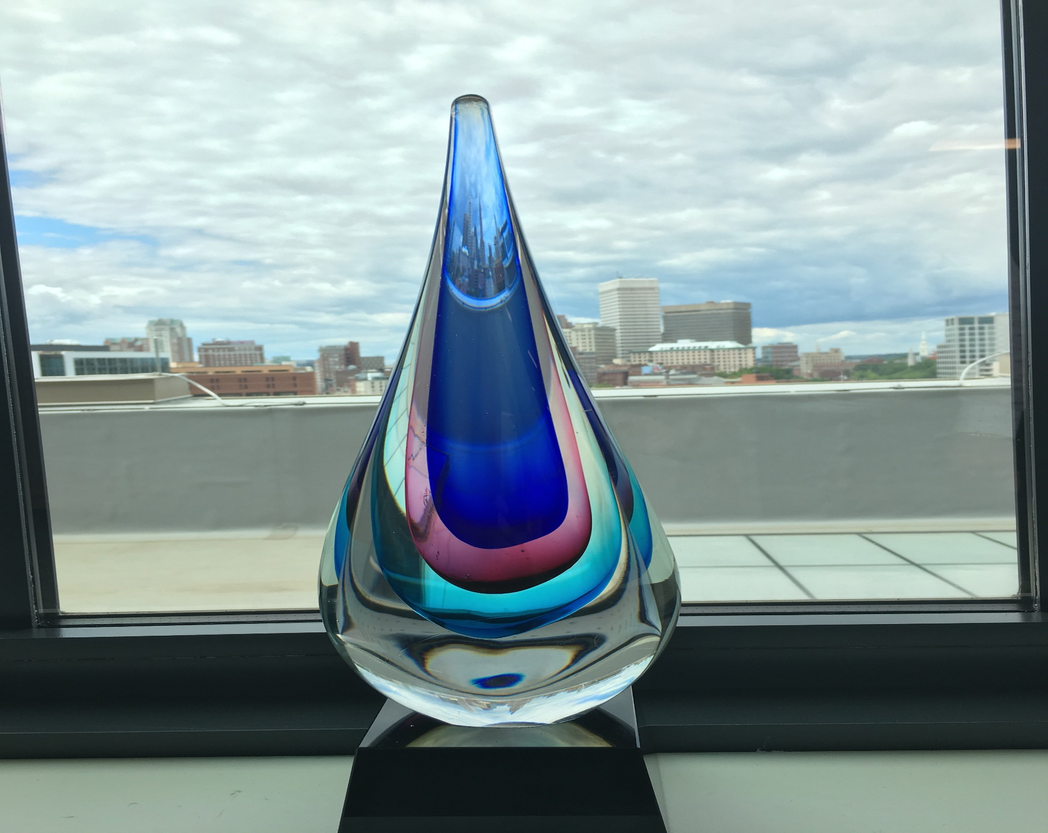
OSP Brown Bag June 17, 2019
Enter Date Here

Slide 2
OSP Pre Award Update
Katie Fleck
Associate Director

Slide 3
OSP Pre Award Update
Sponsor Systems Submission (S³) Pilot Update
Based on a successful 8 week pilot, we have determined that submitting proposals in Sponsor Systems has no negative effect on the review or submission process
Trainings for ASSIST will be available this summer, with WorkSpace training coming soon
Please refer to the FAQ document or call/email your Pre-Award contact with any questions

Slide 4
OSP Pre Award Update
Some important S³ Pilot-takeaways:
Always ensure that you have access to the required systems before attempting a Sponsor System proposal
Workspace submissions require a Grants.gov log-in
Access to ASSIST proposals is managed by Signing Officials in OSP/BMRA. Contact these offices if users need to be added to existing ASSIST records
It is important to double check keyed-in information (DUNS, zip code, etc.)

Slide 5
OSP Pre Award Update
Some important S³ Pilot-takeaways:
Some sponsor Preview documents do not include all proposal documents. For example, the following items do not appear in the Preview generated by ASSIST:
Appendix items
Cover Letter
Assignment Request forms
If these documents are included in a submission, they must be separately uploaded into COEUS alongside the Preview document

Slide 6
OSP Pre Award Update
NIH Update
Salary Cap has been raised to $192,300 retroactive to January 6, 2019
Reminder that any Prior Approval Request that can be submitted via eRA Commons should be sent via that method
We have learned that some Institutes within NIH do not have a dedicated Grants Management Specialist in the last year of the award, so emailing requests is not recommended

Slide 7
OSP Pre Award Update
NIH Update (contd.)
Human Subject Enrollment Levels Under Scrutiny
Over the past few weeks we’ve had multiple instances of NIH questioning Human Subject Enrollment numbers for active projects
OSP will be working closely with ORI to review the sponsor’s recent requests and ensure that we include the necessary information in any guidance regarding the Enrollment Forms
New expanded Post Submission Guidance for Training (T) proposals (NOT-OD-19-083)
3 pages allowed for Publication List
Additional clarifications

Slide 8
OSP Pre Award Update
NSF Update
Preview of 2020 PAPPG is now available in the Federal Register, comments due by end of July
Research.gov has been upgraded to allow for Collaborative Submissions
Though Brown still uses FastLane for NSF submissions, it is possible that we may need to use Research.gov for Collaborative Proposals if Lead Proposer institutions are submitting via that method
If you need to prepare a Research.gov submission, please reach out to your Pre-Award Contact

Slide 9
OSP Pre Award Update
NSF Update (contd.)
NSF will be recommending the use of SciENcv to create biosketches
SciENcv is linked with MyNCBI, so it can help Investigators keep all their biosketch information in one place
This tool can also be used to create NIH biosketches

Slide 10
OSP Pre Award Update
NSF Update (contd.)
Reminder about No Cost Extension Justifications
Though the first NCE is a Notification and not a Request, the justification will still be kept on file in OSP and NSF
The justification should not suggest that the NCE is needed in order to expend funds, as this is contrary to Brown’s and NSF’s policies
No personal information should be included

Slide 11
OSP Pre Award Update
Subawards Update
In order to get subawards issued as quickly as possible, OSP would like to begin the Subrecipient Monitoring process for New Subawardees at JIT stage
If you receive a JIT request for a proposal that includes a subawardee which is new to Brown, please forward the contact name at that institution to your Pre-Award Representative in OSP
If you’re unsure if the subawardee is new to Brown, you can inquire with subawards@brown.edu

Slide 12
OSP - Pre Award Update
Change in Subaward Process
From: Purchase Orders and Change Orders
To: Supplier Contracts and Amendments
When: End of July, 2019

Slide 13
OSP - Pre Award Update
Why Change the Subaward Process?
to process Subawards, which are contracts and not purchases, as contracts within Workday.
to better align with Brown’s Sustainability Initiative (less physical printing of POs)
to shorten processing time as Purchasing will no longer be part of the routing

Slide 14
OSP - Pre Award Update
Supplier Contract & Amendment Training
Job Aids
Open Labs
Available after Year End
Additional info to follow

Slide 15
OSP Pre Award Update
COEUS Update
Over the past 3 months we have encountered three instances where the FOA listed in COEUS did not match the information in eRA Commons after submission
These proposals were previously connected to a different opportunity, and seemingly remained attached to that prior FOA even after a new opportunity was connected
RAIS and CIS are working together to find a solution to this issue
In the meantime, please contact OSP or BMRA if you are working on a proposal that was previously linked to a different opportunity

Slide 16
OSP Pre Award Update
From the Mailbag!
Federal-Wide Unique Entity Identifiers will be changing in December 2020
DUNS numbers will be phased out in favor of SAM Managed Identifier (SAMMI)
This new Identifier will be integrated in the SAM system, eliminating the need for extra registrations
Notice can be found here: NOT-OD-19-098
To: OSP

Slide 17
OSP Pre Award Update
Questions?

Slide 18
OSP Post Award Update
Comfort Brownell
Associate Director

Slide 19
OSP Post Award Update
Faculty Summer Salary Costing Allocations When completing faculty summer salary costing allocations in Workday please complete and attach the Summer Salary Costing Allocation Template to the costing allocation in Workday.
This form can be found here:
https://www.brown.edu/research/conducting-research-brown/managing-award/award-management#summersalary

Slide 20
OSP Post Award Update
Fiscal Year End Closing Schedule
The Year End Schedule has been posted to the Controller’s Website: https://www.brown.edu/about/administration/controller/workday-project/year-end-schedule
*OSP requires a lead time of 3-5 business days prior to Year End Deadlines*

Slide 21
OSP Post Award Update
Fiscal Year End Closing Schedule Example:
All operational transactions (i.e.: supplier invoices, expense reports, PAA’s) must be routed to OSP by July 10th at 4pm in order to ensure the expenses are approved by the Controller’s Office closing schedule of July 15th at 4pm.
All cost transfer journal entries must be routed to OSP by July 15th at 4pm in order to ensure the entries are completed through the business process by the Controller’s Office deadline of July 18th at 4pm.
We will do our best to facilitate late submissions, however, we cannot guarantee that late submissions will be posted to FY18 if received after the OSP deadline.

Slide 22
Post Award Update- NSF Audits
NSF Office of the Inspector General (OIG) Audit recent findings https://www.nsf.gov/oig/reports/reviews.jsp#external
Airline upgrade to business class
Purchases near the award expiration
P Card rebate
Business meal which included space & speaker fee
Travel costs for PI who attended conference but did not present a paper

Slide 23
OSP Post Award Update
University to Pay $1.5 Million to Settle False Claims Act Allegations
“… when a Federal Award recipient receives rebates and discounts on purchases for Federal Awards, those rebates and discounts must be credited to the Awards. Because the University failed to do so with respect to various rebates and discounts, the United States alleged that the University overcharged it and is liable to the United States under the False Claims Act.”

Slide 24
OSP Post Award Update
Unreasonable and Unallocable Payroll Transfers: “$28,004 in salary and wages transferred to NSF award after award expiration. The transfer was from non-Federal departmental funds to the NSF award. Email supporting transfer noted that X needed to “finalize this in April or NSF will get funds back. You have approximately 47K direct to spend ....” This email was dated 72 days after the award expiration date.
Unreasonable Transactions: “Three MacBook Air Computers – $5,695 for the purchase of three MacBook Air computers. The invoice was dated August 30, 2013. The cost of the computers was transferred from an internal designated fund to the NSF award on January 28, 2014, 5 months after the original purchase date and 1 month after the NSF award expired on December 31, 2013.”

Slide 25
OSP Post Award Update
Reminders & Other Updates

Slide 26
Post Award Update-Cost Transfer
Importance of Cost Transfer Policy:
To establish internal control and timely review of accurate costing to federal awards
To ensure billing/draw down of funds are for allowable costs.
To Identify and evaluate possible breakdown in internal controls.
And take necessary action to improve controls

Slide 27
Post Award Update-Cost Transfer
UG Policy/Requirement-
§ 200.303 Internal controls-
(a) Establish and maintain effective internal control over the Federal award that provides reasonable assurance that the non-Federal entity is managing the Federal award in compliance with Federal statutes, regulations, and the terms and conditions of the Federal award.

Slide 28
Post Award Update-Cost Transfer
NIH Grant Policy Statement(GPS)
“The recipient should have systems in place to detect such errors within a reasonable time frame; untimely discovery of errors could be an indication of poor internal controls. Frequent errors in recording costs may indicate the need for accounting system improvements,

Slide 29
Post Award Update-Cost Transfer
enhanced internal controls, or both. If such errors occur, recipients are encouraged to evaluate the need for improvements and to
make whatever improvements are deemed necessary to prevent reoccurrence.”
https://grants.nih.gov/grants/policy/nihgps/nihgps.pdf

Slide 30
Post Award Update-Cost Transfer
Cost Transfer Risk Areas
Transfers made after or closer to the award end date
Transfers lacking sufficient justification or supporting documentation or approvals
Salary transfers made after effort reports are certified

Slide 31
Post Award Update – Website Update
What is the FDP?
This article will shed some light on the who, what, when, where, why, and how of the FDP.
Research at Brown
How Do I…?
Manage an Award
What is the FDP?
https://www.brown.edu/research/conducting-research-brown/how-do-i

Slide 32
OSP Post Award Update
OSP- EFFORT REPORTING

Slide 33
Terminated Employee
Initiate timely termination process within Workday to trigger off-cycle effort report as soon as possible.
Please review your inbox for emails from effort reporting for outstanding manual effort reports. Several outstanding effort reports >60 days are pending for terminated employees. Certified reports should be sent to effort-reporting@brown.edu ASAP.
R
E
M
I
N
D
E
R
S

Slide 34
Upcoming Effort Reporting Dates
Certification Period | Report Run Date | Employee Type
04/28/19 - 05/25/19 | July 15, 2019 | Non-exempt staff and undergraduates
05/26/19 - 06/22/19 01/01/19 - 06/30/19 | August 21, 2019 | Non-exempt staff and undergraduates; semi-annual faculty & exempt staff and graduate students
06/23/19 - 07/20/19 | September 9, 2019 | Non-exempt staff and undergraduates

Slide 35
OSP Post Award Update
QUESTIONS

Slide 36
Office of Research Integrity
Rebecca Haworth
Research Integrity Manager, ORI

Slide 37
Export Control Updates
Visas
*NEW* ORI will screen all J Visas
New intake form
Similar to H-1B/O-1 Deemed Export Certification
To be used for:
H, O, and J visas
Visitors from comprehensively embargoed countries

Slide 38
Responsible Conduct of Research
Internal Audit
Auditing RCR Compliance:
Training
Documentation
Faculty are responsible for students and trainees on their awards.
Students/trainees must keep documentation.

Slide 39
Responsible Conduct of Research
BEARCORE
ORI will be offering BEARCORE during the Fall semester.
Space is limited and the wait-list is extensive.

Slide 40
RAIS
Andrea Mucci
Senior Research Services Business Analyst
Research Administration Information Systems (RAIS)

Slide 41
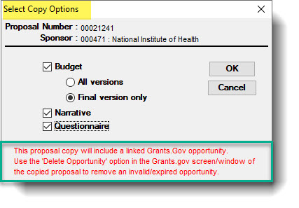
Coeus Best Practices
Steps to Disconnect and Change a Grants.gov FOA in a PD record
If you are copying a PD record, a message appears reminding you to disconnect the old FOA by using ‘Delete Opportunity’ from the Grants.gov window.

Slide 42
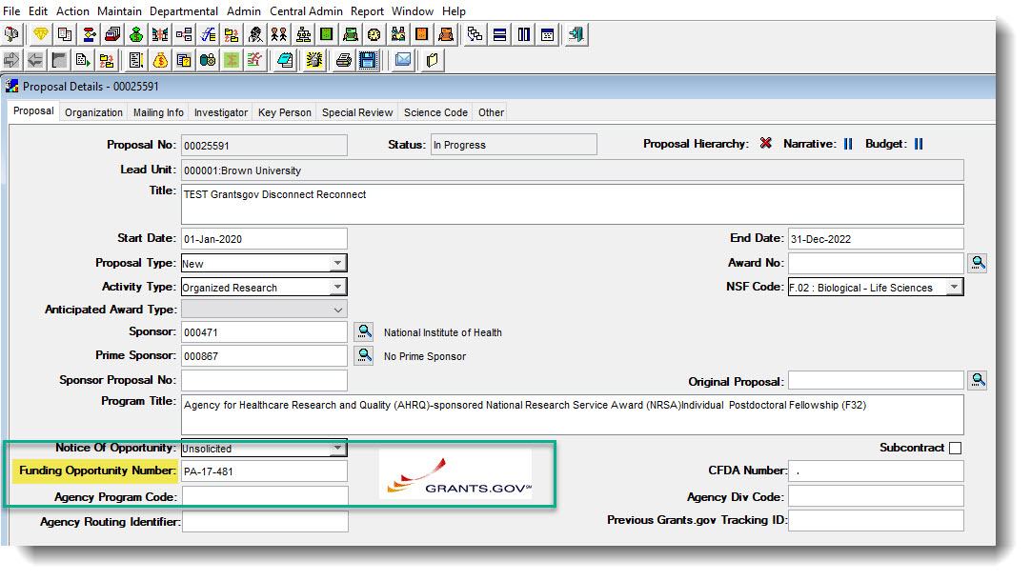
Coeus Best Practices
Whether or not you are using a copied record, the FOA that is connected will appear in the record like this:

Slide 43
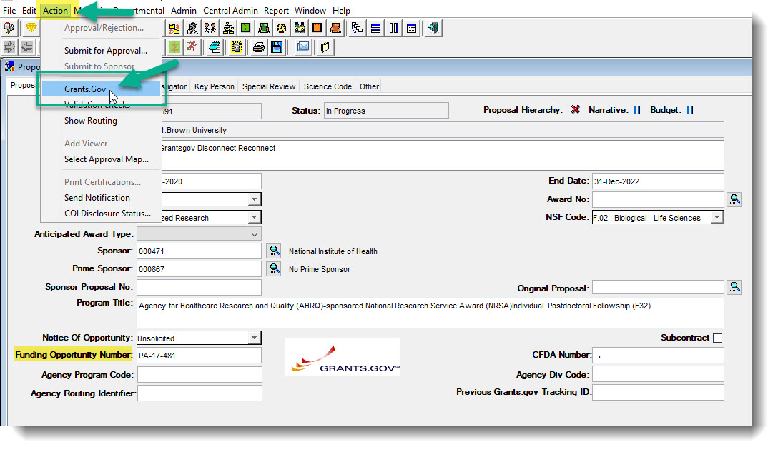
Coeus Best Practices
2. From the Action menu, click Grants.gov to open the Grants.gov window:

Slide 44
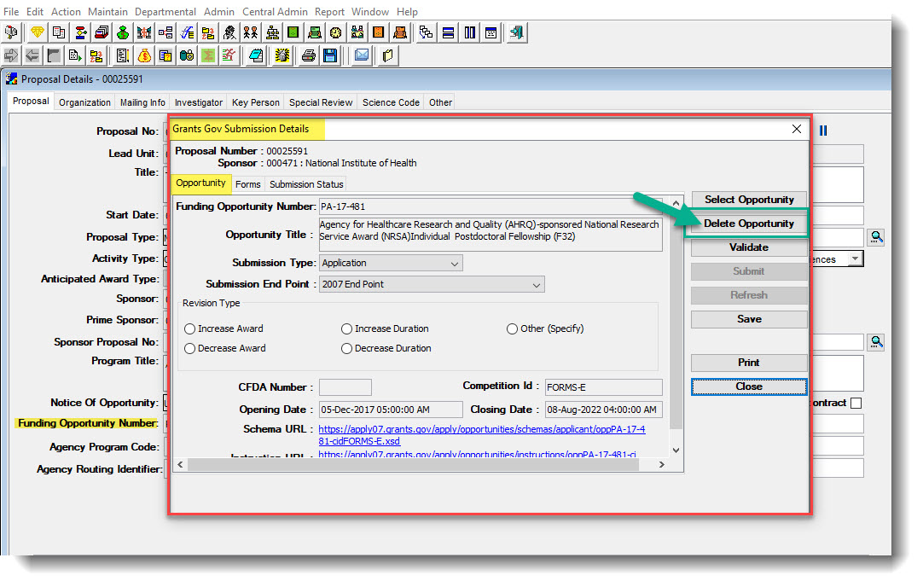
Coeus Best Practices
3. In the ‘Opportunity’ tab of the Grants.gov Submission Details window, click ‘Delete Opportunity’.

Slide 45
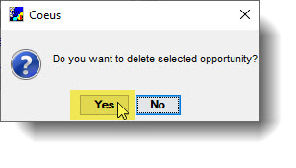
Coeus Best Practices
4. Next, click ‘yes’ to delete the opportunity:

Slide 46
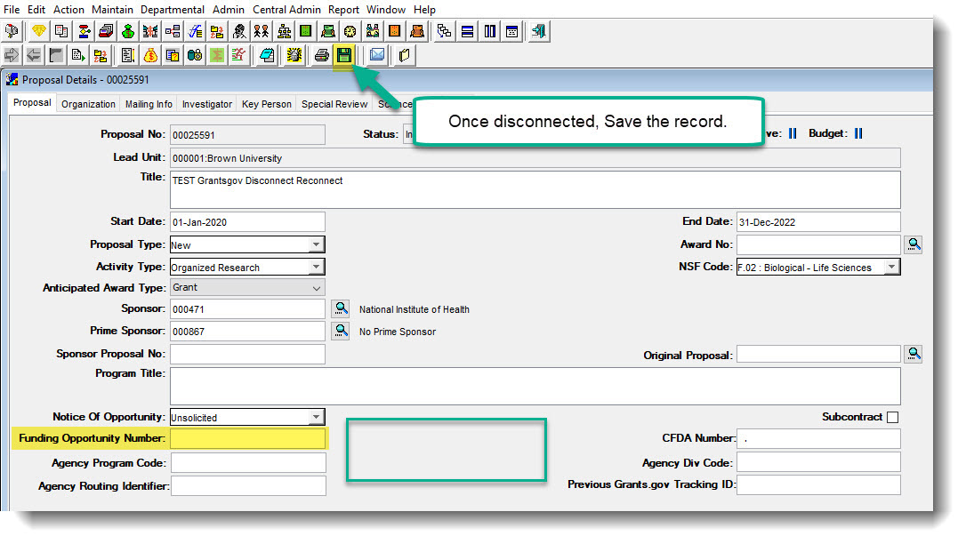
Coeus Best Practices
5. Once the opportunity is deleted, Coeus closes that window and you will be back at the ‘Proposal’ tab of the PD record. The FOA field will now be blank and no Grants.gov icon shows on that page.

Slide 47
Coeus Best Practices
Important: You will want to Save the entire PD record and then completely Exit the record. Close the record after you have saved the disconnection.
6. Re-enter the PD record via ‘Edit’ mode and then type the new FOA number into the Funding Opportunity Number field in Coeus, shown here:

Slide 48
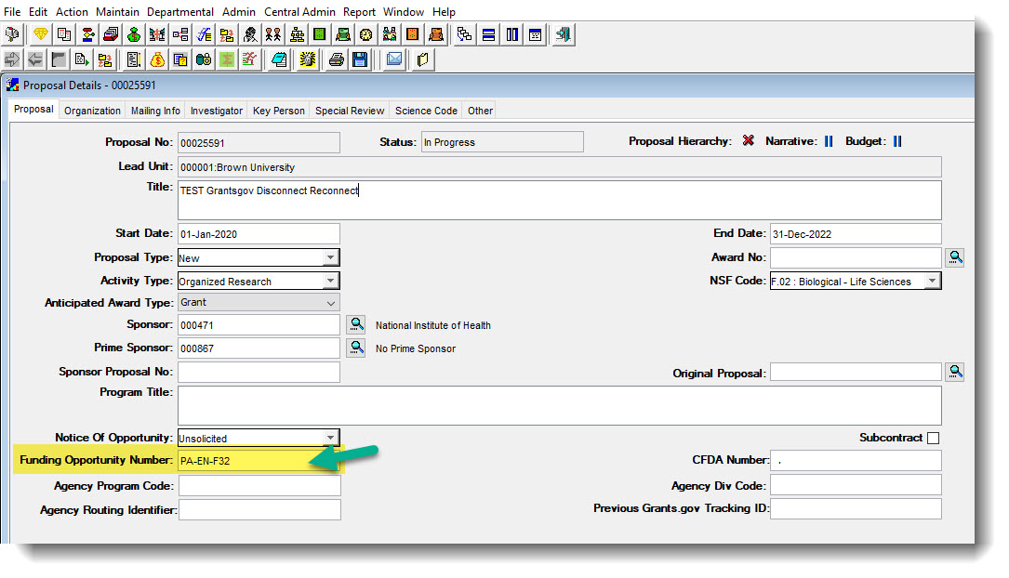
Coeus Best Practices
6:

Slide 49
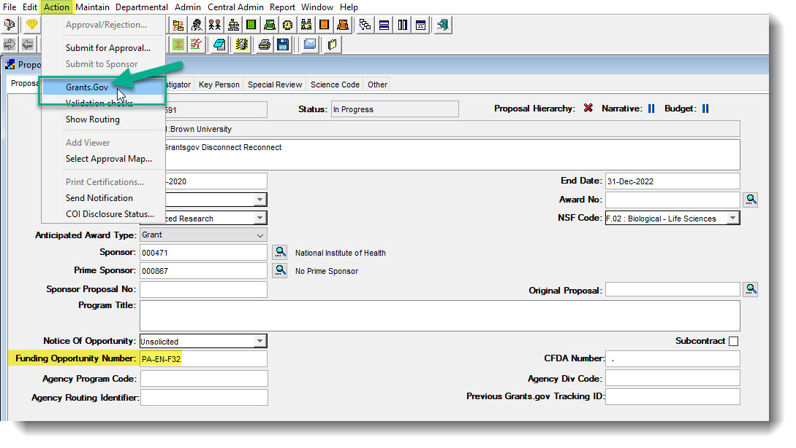
Coeus Best Practices
Save this change.
7. From the Action menu, click Grants.gov to get back to the Grants.gov window:

Slide 50
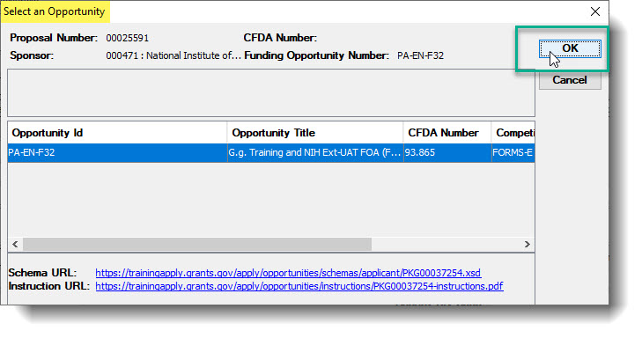
Coeus Best Practices
8. The ‘Select Opportunity’ window appears. Review the Opportunity Id to ensure it matches the FOA you entered. Click ‘OK’ to select that FOA/Opportunity:

Slide 51
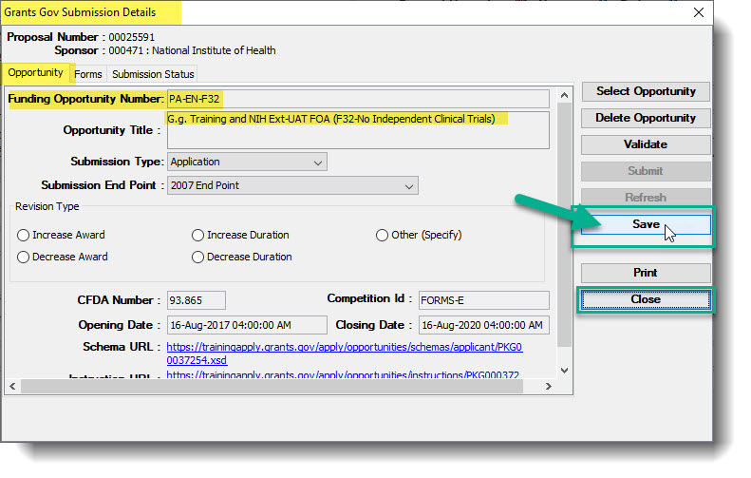
Coeus Best Practices
9. From the ‘Opportunity’ tab of the Grants.gov Submission Details window, save this new FOA and then click ‘Close’ to close this window.

Slide 52
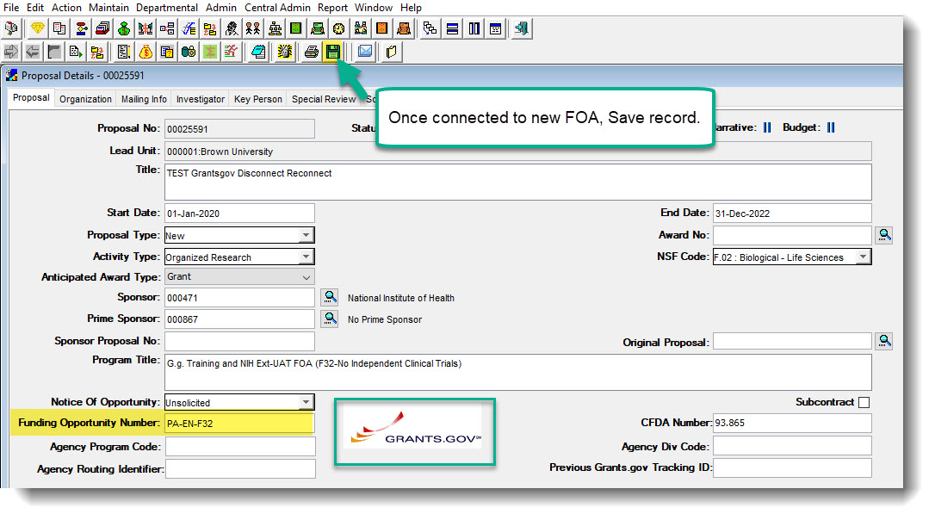
Coeus Best Practices
10. Back at the ‘Proposal’ tab, you will see the Grants.gov logo appear to show that you are reconnected to submit S2S once completed. Save the record.

Slide 53
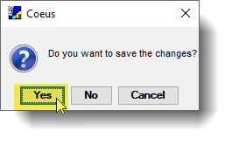
Coeus Best Practices
11. Exit the record entirely to be sure that the save completely saved. If for any reason Coeus has not saved the information, it will ask you upon exit to confirm:
The record should now be connected to the new/correct FOA and the information saved.

Slide 54
Brown Bag Listserv
To be added to OSP’s Brown Bag Listserv, please email:
resadmin@brown.edu

