Slide 1
OSP Quarterly Brown Bag September 25, 2018

Slide 2
OSP Quarterly Brown Bag September 25, 2018
Jill Pipher
Vice President for Research

Slide 3
Updates from Purchasing Services
Jeanne Hebert
Sr. Director, Insurance & Purchasing Services

Slide 4
Updates from Purchasing Services
July 1, 2018 Federal Uniform Guidance Procurement Standards
The focus is on increased competition and transparency in the procurement process.
There are five general procurement standards that cover the purchase of property, supplies and services under the Uniform Guidance:
1. The organization must maintain written policies and procedures for procurement covering the methods available under these regulations.
2. Costs must be reasonable and necessary
3. Must provide for full and open competition
4. The organization must maintain written standards of conduct covering internal and external conflicts of interest
5. The organization must maintain documentation addressing cost and price analysis and vendor selections where applicable based on the method of procurement used.
The University’s policies governing the use of a competitive bid process are guided by these principles Procurement guidance is specifically located in sections 200.317-200.326 of the Code of Federal Regulations https://www.ecfr.gov/cgi-bin/text-idx?SID=4de7a5d290be42d6f3c5c180b7d0a81e&mc=true&node=sg2.1.200_1316.sg3&rgn=div7

Slide 5
Competitive Bid Requirements
Impact to Brown’s Purchasing policies:
The most significant impacts to the University’s procurement policies are the limited circumstances that can be used to justify a “sole source”/use of noncompetitive purchases using sponsored funding and making bid opportunities public for purchases exceeding $250,000.
The use of “sole source” (non-competitive purchases) will be reviewed by Purchasing Services for compliance with the regulations and University policies and will require a price/cost justification.

Slide 6
Competitive Bid Requirements
Sole Source: When using sponsored funding -in order to qualify as a “sole source”/ procurement using a non-competitive process - the transaction must meet one of the following four requirements:
● The item is available only from a single source;
● The public exigency or emergency for the requirement will not permit a delay resulting in exemption from competitive solicitation requirement;
● The Federal awarding agency or pass-through entity expressly authorizes noncompetitive proposals in response to a written request from the non-Federal entity (Brown); or
● After solicitation of a number of sources, competition is determined inadequate

Slide 7
Competitive Bid Requirements
When purchases using federal funding exceed $250,001, there must be an opportunity for a public bid to be posted. This will require involving Purchasing Services early enough in the process to enable our department to assist with developing an RFP and to be able to post the opportunity for public bids to be received. The purchase can only proceed once these steps have been taken, the bid responses have been reviewed and the business is awarded to the successful bidder. The federal funding sponsor may require that they have an opportunity to review the RFP.
Notes:
In instances where internal funding is provided for the purchase of goods or services, University competitive bid and/or sole source policies are still applicable.

Slide 8
Purchasing Services
Purchasing Services can:
Assist with identifying suppliers to use for obtaining competitive bids
Assist with developing and managing RFP’s and RFQ’s (requests for proposals or requests for quotes).
Assist with identifying preferred suppliers
Assist with identifying purchasing methods that support University initiatives such as sustainability, utilizing local and diversity suppliers, making use of strategic sourcing strategies.
Contact list:
https://www.brown.edu/about/administration/insurance/about/staff
Purchasing Services Website:
https://www.brown.edu/about/administration/purchasing/
Notes:
Sole Sources purchases should be an exception, not the norm. Look for resources within Brown (ex. Subscriptions through the Library, software through CIS). Please complete the sole source form completely and include the name of the individual who made the selection of the supplier.

Slide 10
Research Development Update
Amy Carroll
Director, Research Development

Slide 11
Research Development Update
Equipment consults
Including equipment purchases in a grant proposal?
Consult with Associate Provost for Academic Space, Leah VanWey, as early as possible
Get a cost estimate for any potential space allocation or installation costs in just one hour

Slide 12
Research Development Update
Strategic Funding Opportunities Website
Curated funding opportunity announcements targeted to Brown research areas of interest and strengths
Visit www.brown.edu/go/strategicfunding to view and search the list of opportunities
Share this link with faculty

Slide 13
Research Development Update
Limited Submission Calendars – New!
2019 Early Career Limiteds Calendar (Projected)
2019 Major Limiteds Calendar (Projected)
Earlier deadlines, more time to plan for high-profile, regularly-occurring limited submission opportunities
Will be sent to Departments each semester; also posted at www.brown.edu/go/limitedsubmissions

Slide 14
Research Development Update
Broader Impacts Workshop
Thursday, October 18 from 11:30 am-1 pm
Run by Brown’s Engaged Scholarship & Broader Impacts Joint Committee: www.brown.edu/go/ESBI
Exposes investigators to Brown resources to partner with programs that demonstrate the broader impacts of their proposed research
Registration open now at www.bit.ly/BIW101818

Slide 15
Research Development Update
Frontlines of the Opioid Crisis: Innovative Community Solutions
Tuesday, October 23 at 6 pm
Features Michael Botticelli (President Obama’s “Drug Czar”) and Brown researchers
Co-sponsored by American Academy of Arts and Sciences

Slide 17
RAIS Updates
Andrea Mucci
Sr. Research Business Analyst

Slide 18
RAIS Update
New newsletter from RAIS
Focusing on electronic research administration
(ERA) topics such as:
Systems- Coeus, InfoEd, Workday Grants/Effort
Reporting
Agency/Sponsor ERA communications (Grants.gov, etc…)

Slide 19
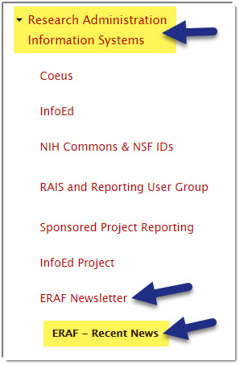
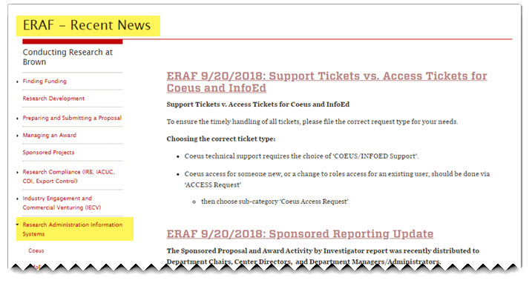
RAIS Update
Also available at the RAIS website

Slide 20
Coeus Update
System update for transmitting S2S proposals
Grants.gov is implementing a new Header to capture FOA attributes that are sent S2S.
(This is behind the scenes!)
New requirement goes into effect 10/20/18
RAIS & CIS working on implementing the new requirement in Coeus.

Slide 21
Coeus Update
Deployment will be after 10/5 deadline
Once deployed- for Proposals that are “In Progress” and connected to an S2S opportunity:
You will need to delete the opportunity and reselect it to ensure you have the updated header.
We will follow up with more details as we get closer.

Slide 22
Coeus Update
Coeus Training
Coeus training will be available in Workday Learning
Learn at your own pace with electronic courses
Current offering:
Navigating Proposals & Award Basics

Slide 23
Coeus Update
Coeus Training
More classes coming Oct.- Nov. 2018
Need in-person training?
Contact RAIS@brown.edu

Slide 24
Coeus Update
Requesting a Sponsor or Organization
9/04- Phased out the online request form
Now request via a support ticket at
https://ithelp.brown.edu/new-ticket

Slide 25
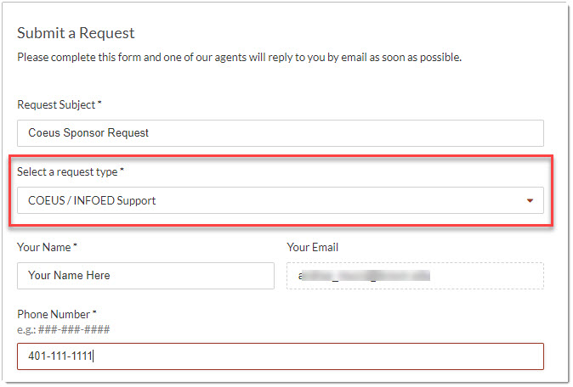
Coeus Update: Sponsor or Organization Requests
Complete & Submit a Sponsor or Organization request:

Slide 26
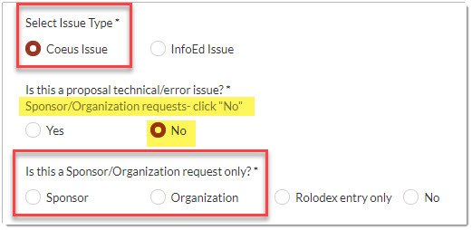
Coeus Update: Sponsor or Organization Requests
Select Coeus Issue
Select “No” for technical/error issue.
Select Sponsor or Organization accordingly

Slide 27
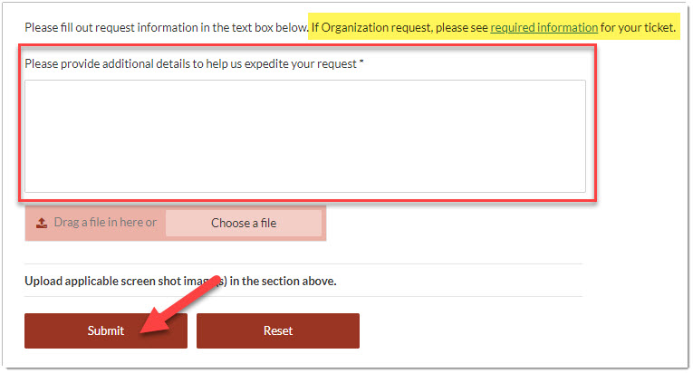
Coeus Update: Sponsor or Organization Requests
Provide full details for Sponsor or Organization
Click Submit

Slide 28
Other Ticket Requests: Support and Access for Coeus and InfoEd
Overview of the various other ticket types:
Support Ticket: Coeus and InfoEd
Technical issues- Coeus or InfoEd
Sponsor/Organization- Coeus
Access Ticket: Coeus and InfoEd
New user needs access to system
Existing user needs new role
User needs access/role- specific Award

Slide 29
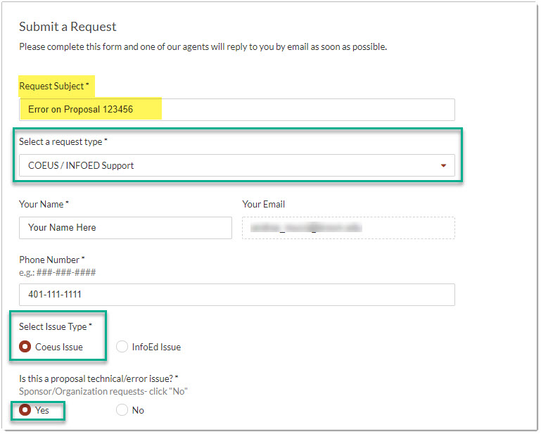
Support Ticket: Coeus
Coeus Proposal Technical Issue Support Ticket

Slide 30
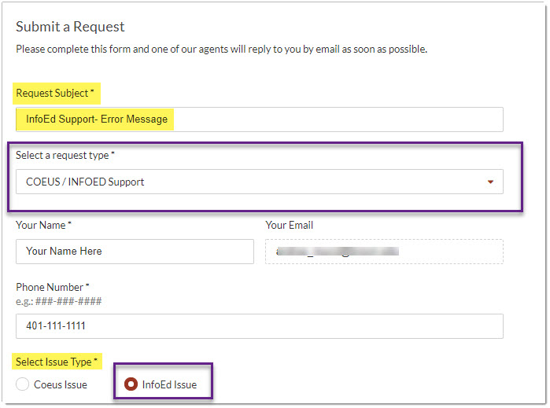
Support Ticket: InfoEd
InfoEd Technical Issue Support Ticket

Slide 31
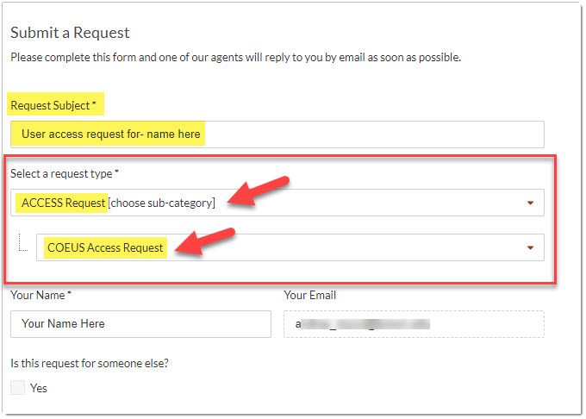
Access Ticket: Coeus
Submit for new user, roles or further access

Slide 32
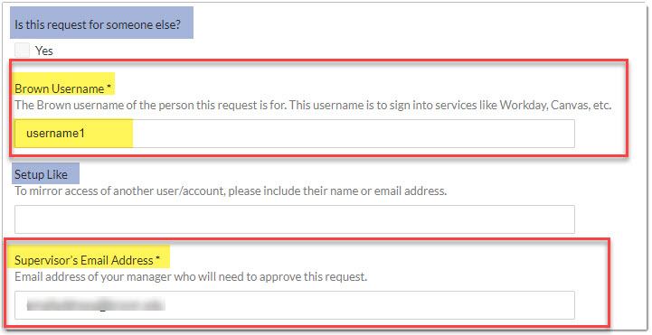
Access Ticket: Coeus
Complete username & supervisor email
If requesting for someone else, check “yes”
‘Setup Like’ is to set up like another active user

Slide 33
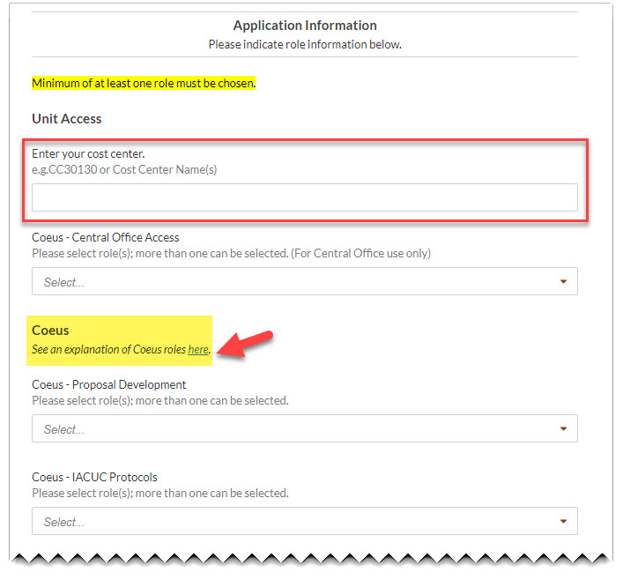
Access Ticket: Coeus
Enter cost center(s) you need access to
Complete the selection of role(s) needed, choosing from the dropdown lists

Slide 34
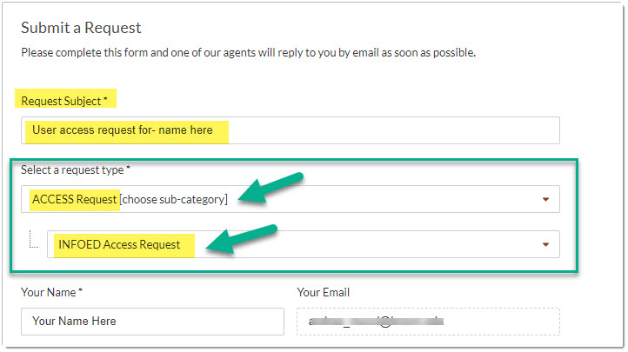
Access Ticket: InfoEd
Currently- Submit for access/roles for LA module

Slide 35
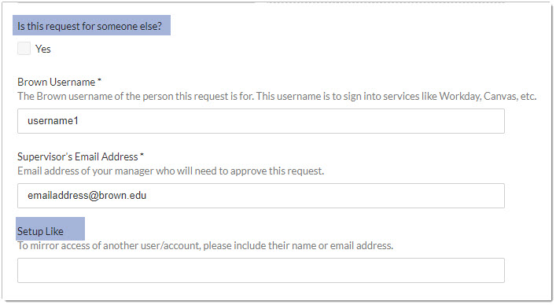
Access Ticket: InfoEd
If requesting for another user, select “yes”
‘Setup Like’ is to set up like another active user

Slide 36
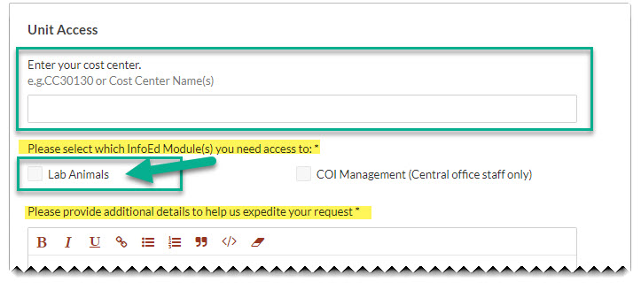
Access Ticket: InfoEd
Enter cost center(s) you need access to for LA
Enter any other details in the text box

Slide 37
RAIS Update
Marisa Schasel
Director, RAIS

Slide 38
OSP Brown Bag September 25, 2018
Enter Date Here

Slide 39
Pre Award Update
Katie Fleck
Associate Director, Pre Award Services

Slide 43
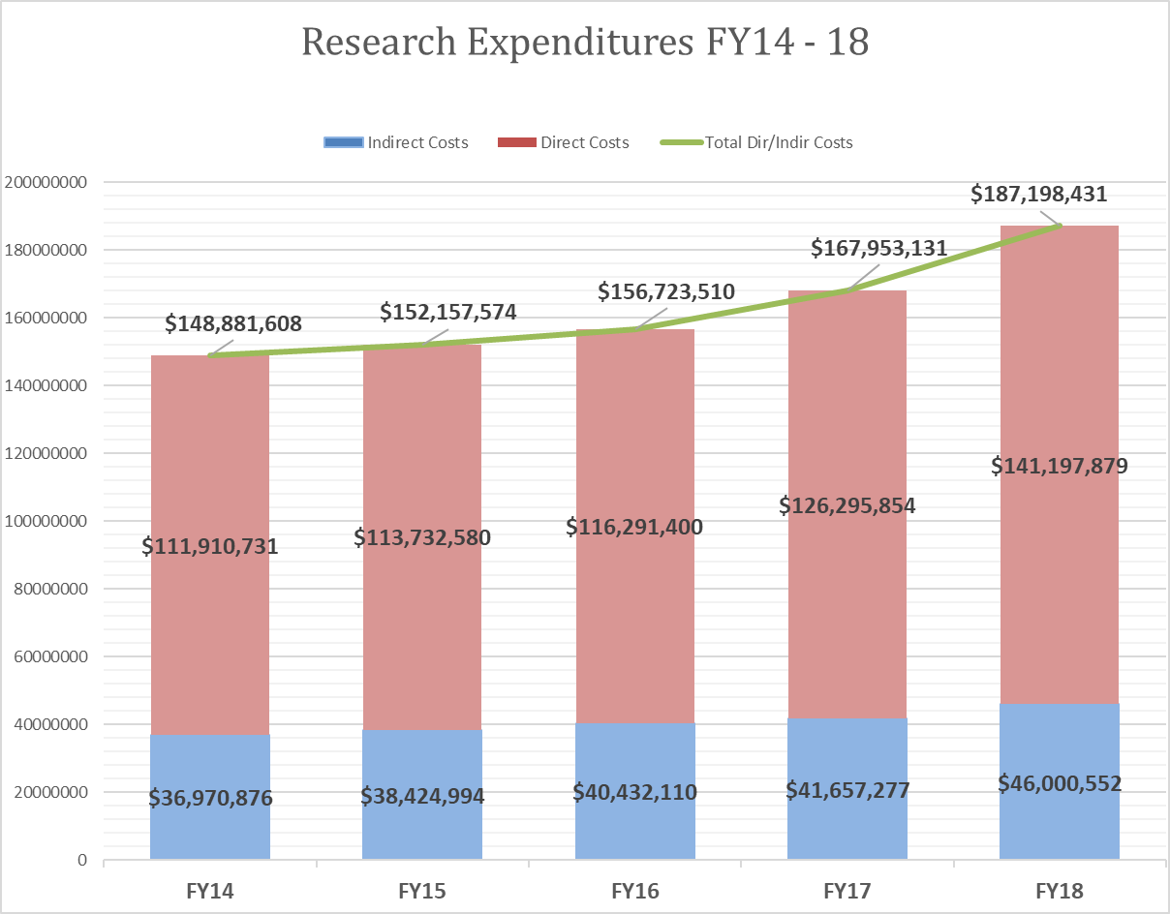

Slide 44
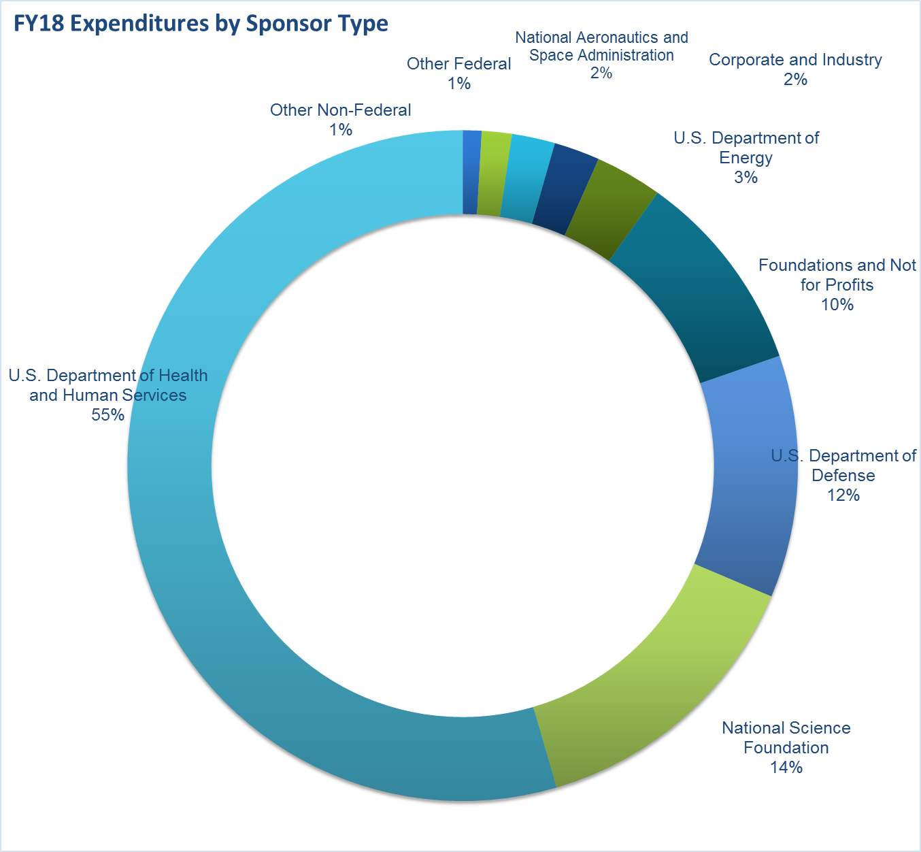

Slide 45
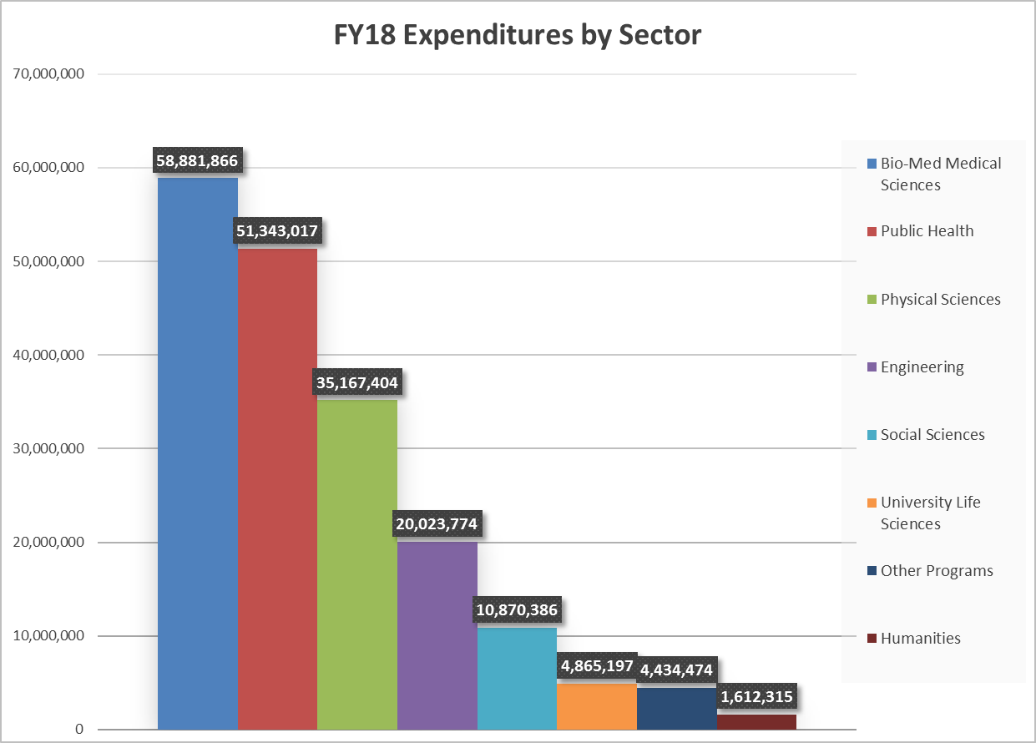

Slide 46
NIH – Agency Update
NIH - eRA Commons Prior Approvals
Many actions requiring NIH Prior Approval can be created and submitted within eRA Commons. Using this functionality can help decrease paperwork and improve tracking ability.
Prior Approval Actions in eRA Commons include:
Second No Cost Extensions
Proposal Withdrawals
Carryover Request
Change of PD/PI

Slide 47
NIH – Agency Update
NIH - Inclusion Policy Changes
Individuals of all ages, including children, must be included in all human subjects research conducted or supported by NIH, unless there are ethical reasons not to include them
Applies to all competing grant applications for due dates on or after January 25, 2019.
Policy has been expanded to include individuals across the lifespan.
Clinical research studies are expected to submit de-identified individual level data on sex/gender, race, ethnicity and age at enrollment with annual progress reports.
See NOT-OD-18-116.html

Slide 48
NIH – Agency Update
NIH to Allow Decimals in RPPR Personnel Reporting Section D
NIH has changed its RPPR format to allow effort to include decimals.
It appears that this format change applies only to PI
See NOT-OD-18-202

Slide 49
NSF – Agency Update
NSF Important Notice No. 144 Harassment – Next Steps
Effective October 21, 2018 in new awards and funding increments
New term and condition will requires Brown to notify NSF of any findings/determinations of sexual harassment, other forms of harassment, or sexual assault regarding an NSF funded PI or co-PI.
NSF will consult with the authorized organizational representative, or designee prior to making a final determination
NSF may initiate the substitution or removal of the PI or any co-PI, reduce the award funding amount, or where neither of those previous options is available or adequate, to suspend or terminate the award.

Slide 50
NSF – Agency Update
NSF PAPPG effective January 28, 2019
RAPID, EAGER and RAISE sections supplemented with reminders that these proposal types are not subject to reconsideration
Foreign Organizations
New checkbox on the proposal coversheet
Requirement to describe in the Project Description
Synergistic Activities section of the biographical sketch is limited to five (5) distinct examples only

Slide 51
NSF – Agency Update
NSF PAPPG effective January 28, 2019
Eligibility for unaffiliated individuals has been revised to state that unless specifically authorized in an NSF solicitation (i.e., postdoctoral fellows), unaffiliated individuals are ineligible to receive direct funding from NSF
Participant Support enhancements
Speaker vs. Participant
Inclusion of answers to FAQs on this topic
Conference proposals over $50,000 and equipment proposals must include Collaborators and Other Affiliations information

Slide 52
ONR – Agency Update
Office of Naval Research (ONR)
Going forward ONR is likely to fund research grants with initial increment for:
24 months and annually thereafter, or
If P.I. does not have a proven track record, 12 months and then a subsequent 24 month increment if sufficient progress is demonstrated
• Intention is to ensure ONR projects can attract and retain the best and brightest researchers and graduate students
• The more reliable funding stream resulting from this change is expected to limit the number of No Funds Extension requests

Slide 53
ONR – Agency Update
Office of Naval Research (ONR)
ONR grant form no longer has summary description on page 2 of the reports required by grant, must look for those requirements in the Award Terms &Conditions.

Slide 54
Air Force – Agency Update
Air Force Research Laboratory (ARL) and
Air Force Office of Scientific Research (AFOSR)
No-Cost Extension Process
Must be in writing
Must be submitted by OSP/BMRA at least 30 days prior to expiration of award
Must be submitted to Program Officer at appropriate e-mail listed in BAA AND
Must be submitted to GRANTS OFFICER at
afrl.afosr.pkcontracting@us.af.mil

Slide 55
Army – Agency Update
Congressionally Directed Medical Research Programs (CDMRP)
Sample of Current Programs:
• Alcohol and Substance Abuse Disorders
• Amyotrophic Lateral Sclerosis
• Breast Cancer
• Gulf War Illness
• Orthotics and Prosthetics
• Prostate Cancer
• Reconstructive Transplant
• Tick-Borne Disease
• Tuberous Sclerosis Complex
• Vision
Assistance Agreements
Opportunities announced through BAA or PA advertised at www.grants.gov
Contract
Solicited by RFQ, RFP and BAA advertised at www.fbo.gov

Slide 56
OSP Brown Bag
Proposal Submission Reminders
Proposal submission via web portal – be sure to affiliate OSP if Institutional Signature or approval is necessary in system
FastLane Cover Sheet Reminder – Degree Information may not display correctly for S2S proposals
If you are working on a proposal in which a subaward to a foreign institution or High Risk subrecipient is anticipated, please contact OSP to discuss appropriate proposal language relating to Fixed Price Subcontracts
When preparing Current and Pending or Other Support documents, be sure to include all sources of funding, even those from international sources

Slide 57
OSP Update
New OSP Staff member Post Award Grant & Contract Accountant Peter Salant
OSP Fall Training Curriculum
And survey coming soon !

Slide 58
OSP Update
Michael Liu,
Grant & Contract Administrator,
Pre-Award Services

Slide 59
SUBAWARD ORDER FORM
Brown PI: ___________________________________ Subrecipient Organization: ___________________
Requested By: _______________________________ Subrecipient Contact Name: __________________
Request Date: ________________________________ Subrecipient Contact Email: __________________
New Subaward Proposal #: _____________________
Period of Performance: Start Date: _____________ End Date: ______________
Scope of Work & Budget: As Proposed, or See Attached
Funding: $______________________
Is this funding from the Parent Account? Yes No
If no, please provide the funding source account #: ________________________
Cost Sharing on the subaward? YES, indicate dollar amount $_______________ No
Automatic Carry Forward? Yes No

Slide 60
Are Human or Animal Subjects Involved in Subrecipient’s Scope of Work?
Human Subjects: Yes No Approval Attached, or Pending
Animal Subjects: Yes No Approval Attached, or Pending
If not approved, can other work be performed prior to approval? Yes No
Exchange of Human Subject Research Data (select all that apply):
Brown to Sub Sub to Brown No Exchange
Is the award subject to a Data Management/Sharing Plan? Yes No
Brown Financial Contact for Invoices (name and email): _________________________________
Other Terms: ____________________________________________________________________________________________________________________________________________________________________________________

Slide 61
Modification to Existing Subaward Subaward #: ______________________
New End Date: _________________
Amount of NEW funds to be added: (indicate if a decrease) $________________
Is this funding from the Parent Account? Yes No
If no, please provide the funding source account #: _____________________
If Carry Forward is NOT Automatic please complete the following:
1 – Amount of unexpended funds from previous period $________________
2 – Amount from line 1 to be allowed for current year $________________
New Cumulative Total (including carry forward if applicable) $________________
Cost Sharing on the subaward? If YES, indicate dollar amount $_________________ No
Other Terms: (e.g. change of PI, change of scope, etc.) ____________________________________________________________________________________________________________________________________________________________________________________

Slide 62
The updated form is now posted on the
Research at Brown – Forms and Policies webpage:
Subaward Order Form
Thank you!

Slide 63
OSP Update
Robin Eubank
Grants & Contracts Accountant
and
Effort Certification Administrator

Slide 64
Effort Reporting Statistics

Slide 65
Reminder - Effort Reporting Policy
Effort Reports Generated
30 Days to Certify
Late Certifications =
Audit Risk!
60 Days = Official Delinquent Notification

Slide 66
Reminder - Terminated Employee
Goal
Reduce manual forms prepared for terminated employees
Initiate termination process timely
Off-cycle effort generated

Slide 67
Reminder – Add/Remove ECP
WD ticket initiated by Dept.
Ticket routed to ECA for review & approval
Workday Operations completes process

Slide 68
Upcoming Effort Reporting Dates
Certification Period | Report Run Date | Employee Type
07/22/18-09/01/18 | October 9, 2018 | Non-exempt staff and undergraduates
09/02/18-09/29/18 | November 8, 2018 | Non-exempt staff and undergraduates
09/30/18-10/27/18 | December 10, 2018 | Non-exempt staff and undergraduates

Slide 69
Effort Reporting
Please send effort related questions and feedback to
effort-reporting@brown.edu

Slide 70
OSP Update
Patrice Carroll
Director, OSP

Slide 71
Brown Bag Listserv
To be added to OSP’s Brown Bag Listserv, please email:
resadmin@brown.edu

