Slide 1

OSP Brown Bag
March 23, 2015

Slide 2
Staffing / Pre-Award Updates
  Patrice Carroll
  Director, Pre-Award Services
  Office of Sponsored Projects

Slide 3
OSP Staffing Update
Shelly Hull named Manager
  Subrecipient Monitoring
  FFATA Reporting
  Pre-Award Compliance
  Biennial Inventory
  Equipment Surplus and Disposals
  Equipment Fabrication Accounts

Slide 4
Pre Award Update
  NIH- Correction for Subawards Not Active in All Budget Periods
  NIH Guide Notice: NOT-OD-15-073

Slide 5
Pre Award Update
On February 26, 2015 - NIH issued a notice to inform the community of a correction to the General Application Guide SF424 (R&R) – Form C instructions under Section 4.8 –
Submitting Subaward Budgets That are Not Active for All Periods of the Prime Grant:
The updated instructions are to complete all budget periods in the R&R Budget form for your subaward budgets, aligning the budget period numbers & start and end dates with the budget periods of the prime.
For Example:
  The prime fills out an R&R Budget form with the following periods:
    period 1 - Jan 1, 2016 – Dec 31, 2016
    period 2 - Jan 1, 2017 – Dec 31, 2017
    period 3 - Jan 1, 2018 – Dec 31, 2018
    period 4 - Jan 1, 2019 – Dec 31, 2019
    period 5 - Jan 1, 2020 – Dec 31, 2020
  The budget period numbers and dates should be the same in the R&R Budget forms for the subawards.

Slide 6
Pre Award Update
The R&R Budget forms do not allow for "empty" budget periods. Each budget period contains several required fields which must be completed (even for inactive periods) in order to successfully submit.
Provide the following information for “inactive” budget period:
  Organization DUNS
  Budget Type = Subaward/Consortium
  Budget Period Start/End Dates (align with budget periods and dates of the prime budget)
  In section A: Senior/Key Person, provide a single entry including the following:
    PD/PI or subaward lead First and Last names
    Project Role (may default to PD/PI; should be adjusted as needed)
    Calendar Months = .01 (smallest amount effort allowed in the field)
    Requested Salary = $0
    Fringe Benefits = $0
  Explanation of the inactive budget periods in the budget justification
The next version of the General Application Guide SF424 (R&R) – Forms Version C will include this correct.
For more information, please see the NIH issued notice NOT-OD-15-073

Slide 7
Pre Award Update
ASPIRATIONAL FOUNDATION LIST
Gates *Ford * R.W. Johnson * W. K. Kellogg
MacArthur * Moore *Rockefeller *Simons
W. M. Keck * Sherman Fairchild *Paul G. Allen
Charles A. Dana *Richard and Susan Smith
Kavli Foundation
Notify Kathryn_Tompson@brown.edu of planned proposals

Slide 8

Pre Award Update
Department of Energy
Portfolio Analysis and Management System (PAMS)
No-cost Extension
Change of PI
PI departure notifications
Progress reports in the RPPR format (effective 2/2/15)

Slide 9
Pre Award Update
Department of Energy No-Cost Extension
The reason why project could not be completed
Explanation of the work to be done including confirmation that all work is part of original work scope
Confirmation that DOE funds remain available for the proposed work

Slide 10
Pre Award Update
Biographical Sketch - NSF Instructions:
(d) Synergistic Activities
A list of up to five examples that demonstrate the broader impact of the individual’s professional and scholarly activities that focuses on the integration and transfer of knowledge as well as its creation.

Slide 11
Pre Award Update
Biographical Sketch –
NSF (Economics) reviewer response:
“[PI's] Biographical Sketch has exceeded the limit of 5 specific Synergistic Activities. The information listed under each heading counts as multiple activities. Please shorten the list to only 5 specific activities.”

Slide 12
Pre Award Update
Biographical Sketch – NSF (STS) reviewer response:
“[PI's] Biographical Sketch exceeds the limit of 5 specific Synergistic Activities. Each bullet may only include one specific activity. You may not, for example, include a list of journals you review for or societies you are a member of as one Synergistic Activity. However, you may list reviewing for journals generically, and then mention a specific journal (such as Science) as one of your activities. “

Slide 13
Pre Award Update
Biographical Sketch - NSF (Policy Office) response:
“The NSF Grant Proposal Guide (GPG) does not indicate a specific number of items that can be included in each example. However, as mentioned, it is important that the list does not appear to expand the number of examples of activities beyond five, which would be in violation of the GPG. It is up to the program review of proposals to make the determination on if they feel the list expands the number of examples of activities beyond five.”

Slide 14
Pre Award Update
NIH/AHRQ Biosketch revisions May 25, 2015
For R’s, K’s, T’s
    Formatting – up to five pages
    Revision to personal statement to include expertise along with publications
    New section “Contribution to Science”
    MyNCBI reference can now appear on Biosketch
    NOT-OD-15-032

Slide 15
Pre Award Update
NIH Biosketch revisions May 25, 2015
Individual fellowships, R36 dissertation grants, and diversity supplements should follow Samples and detail at Fellowship Biographical Sketch

Slide 16
Pre Award Update
Uniform Guidance -Contractor vs. Subrecipient Determinations
Pass-through entities must make determinations of subaward vs. contractor
“Contractor” has replaced “vendor”
Characteristics of a Subrecipient – entity carrying out a portion of the federal award
Characteristics of a Contractor (vendor) –obtaining goods or services for the pass-through entities own use in a procurement relationship

Slide 17
Pre Award Update
Uniform Guidance – Fixed Price Subawards
  “A specific level of support without regard to actual cost incurred”
  Fixed price (FP) subawards limited to Simplified Acquisition Threshold (currently $150,000)
  Prior written approval to enter into FP Subaward, may not be used if mandatory cost-sharing included
  Requirement to certify to the pass-through entity at close-out that all work is complete

Slide 18
Pre Award Update
Uniform Guidance – NIH Interim Guidance
The de minimus rate for organizations without a negotiated Facilities & Administrative (F&A) cost rate
  Domestic subawards is 10% MTDC
  Foreign subawards is 8% MTDC
  *With the exception of the American University of Beirut and the World Health Organization, which are eligible for full F&A cost reimbursement

Slide 19
Pre Award Update
NSF Public Access Plan announced
January 2016, any new research funded wholly or partially by NSF, must be made public as soon as possible, and no more than 12 months after publication. This is similar to U.S. Education Department rules, which since 2012 have required published studies to be submitted to its online public database within a year.

Slide 20

Pre Award Update
Today's Data Tomorrow's Discoveries

Slide 21
Uniform Guidance Update
  Heather Dominey
  Grants / Contracts Accountant II
  Office of Sponsored Projects

Slide 22

Uniform Guidance Webpage
  http://www.brown.edu/research/proposals-awards-research-administration/proposals-awards-research-administration/uniform-guidance

Slide 23
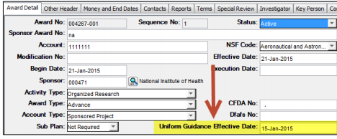
New Field in COEUS
Uniform Guidance Effective Date
  Is the Uniform Guidance applicable to my award?
  Find out in COEUS under the Award Detail Tab:

Slide 24
Uniform Guidance
Updated Award Notice - Standard

Slide 25
Uniform Guidance
Updated Award Notice - Standard

Slide 26


Uniform Guidance
Updated Award Notice - Standard

Slide 27


Uniform Guidance
Updated Award Notice - Standard

Slide 28
Uniform Guidance
Updated Award Notice -NIH
Unique to NIH Awards:

Slide 29

Uniform Guidance
Updated Award Notice -NSF
Unique to NSF Awards:

Slide 30
Post Award Update
Marisa Schasel
Managing Director, Finance, Operations and Systems
Office of Sponsored Projects

Slide 31
Payroll Accounting Adjustment Process
Process
  Complete and submit the payroll accounting adjustment (PAA) google form
  Complete and send via email the Cost Transfer Justification Form to post award accountant
    Required responses
      Questions 1 and 2 for all PAA’s
      Questions 3 & 4 if > 90 days
    Recertified effort report(s) if applicable
      Address recertification

Slide 32
High Volume of Payroll Accounting Adjustments
Why?
  Not requesting awards be set up in advance
  Not reviewing current costing resulting in workers being charged to
    Incorrect grants
    Grants that have ended
    Default costing allocations
  Lack of regular and timely reviews of salary costs on awards with PI’s
  Infrequent reviews of non-sponsored funding
  Inadequate communication when two departments are involved
Notes:
What OSP is seeing from departments
not getting advance account numbers when work is beginning on projects not yet funded
2) not reviewing current costing for workers (employees have been charged to incorrect awards and awards that have ended or their costing has ended and they are charged to their default costing)
3) accounts not being reviewed timely and regularly with the PI resulting in late transfers or transfers at closeout to spend down awards
4) infrequent review of non-sponsored accounts (finding workers costed to non-sponsored accounts when they are working on sponsored projects.
5) if two departments are involved (e.g. dept and Grad School; dept and DOF; dept and POSC; two depts) each is not sure of who is responsible for completing a PAA - there is infrequent and little communication

Slide 33
High Volume of Payroll Accounting Adjustments
Best Practices
  Request awards be set up when work begins on sponsored awards
  Review costing allocations prospectively for grant personnel with PI’s
  Review award expenditures monthly with PI’s
  When two departments are involved understand which department is responsible for
    costing allocations
    payroll accounting adjustments
  Recently hired Grant Managers should pursue training
Notes:
In short, departments need to develop their "upfront" procedures, obtain advance a/c's, review costing allocations prospectively (they have reports to do so), reconcile quarterly, etc. More is done at the back end and even at closeout and it appears in some cases PAA's are being used to manage accounts.

Slide 34
Fiscal Year End Closing Schedule
Looking ahead……………
OSP will follow the Controller’s Office closing schedule for all business processes including:
    Payroll accounting adjustments (PAA’s)
    Cost transfer journals
Exceptions:
    Delayed receipt of an award
    Removal of costs to non-sponsored funding source
Best Practice: Begin reviewing sponsored awards now

Slide 35
Financial Reports/Invoices to our Sponsors
Transactions after award end date
  Pending Expenditures
    Reflect in adjustments column on rough draft financial report
    Complete and submit transaction in Workday
      Transactions not executed in Workday will not be reported to sponsor and will be the responsibility of the department
  Expenditures to be removed from the award
    Complete and submit transaction in Workday
      OSP will move to your CC if not done in a timely manner

Slide 36
Financial Reports/Invoices to our Sponsors
Removal of Overexpenditures
  Creating manual work when this is not done
  Will be handled centrally = OSP will move to your cost center
Notes:
Expect question about allowing these write-off’s to occur in FY 16

Slide 37
Coeus Replacement Project Update
Vendor Evaluation Committee
Vendor on site demos
Recommendation to Executive Sponsors
Notes:
Expect question about allowing these write-off’s to occur in FY 16

Slide 38
Sponsored Award Budget to Actual Report
Live in Production!
Accessing Report
  Type title in search bar
  New Dashboard – Supplemental Reports
Notes:
Expect question about allowing these write-off’s to occur in FY 16

Slide 39
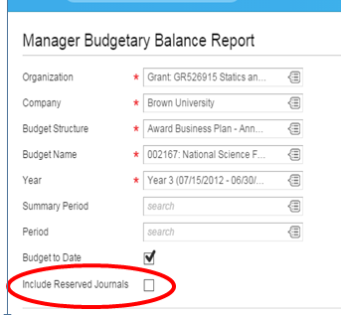
MBBR Report – New Field
New field does not pertain to Brown!
  If selected, will not affect results

Slide 40
Effort Reporting Update
Maria Mento
Effort Reporting Manager
Office of Sponsored Projects

Slide 41
Effort Reporting
Upcoming - Due Dates
Upcoming –Due Dates
Graduate Students (Terminated)
  Faculty and Exempt Staff (Terminated)
  July – December 2014: Due March 26th
  Non Exempt Workers and Undergraduate Students
    Feb 8 – March 7: Due April 9th
      Outstanding: 50 reports

Slide 42
Effort Reporting
Delinquent Effort Reports
Delinquent Effort Reports (as of March 19th)
  Non Exempt Staff and Undergraduate Students
        11 effort reports
  Semi-Annual Effort Reports:
    Graduate Students
        49 effort reports; 12%
    Faculty and Exempt Staff
        83 effort reports; 10%
        Terminated Graduate Students
            9 effort reports; 32%

Slide 43
Effort Reporting
Oversight & Monitoring
Effort Certification Summary Report
      Management reporting tool
      Data Analysis
      Proactive monitoring
      Communicate with certifier
Screencasts and job aids available
Contact Effort Certification Manager (Maria Mento) with any questions or recommendations for improvements.
      Remedy Ticket system

Slide 44
Effort Reporting
Next Steps
Brown University Effort Reporting Activities:
    Establish a working group
    Develop standard practice for Undergraduate Students
    Assess internal controls to enable move to Project Certification

Slide 45
Workday Effort Reporting
Workday Grants & Effort Development Team
  Working group to be established
    Department representation
  Enhancement requests submitted; e.g.
    Ability to enter multiple change reasons
    Dollar amounts remain static when making a non-costed change

Slide 46
Effort Reporting
Contact Information:
Effort Reporting Manager:
Maria Mento @ 863-2275
Email: Maria_Mento@brown.edu

Slide 47
Coeus Update
  Jennifer Quinn
  Research Services Manager
  Office of Sponsored Projects

Slide 48
Coeus Update
NSF / Grants.gov Submissions
NSF / Grants.gov (S2S) Research & Related Forms will be updated in March 2015
NSF Opportunities are transitioning to the Forms C Grants.gov Packages and will include a new NSF Cover Page - Version 1.6.
The following updates have been made to the Cover Page :
  Two new Attachment fields added to append the Data Management Plan and Mentoring Plan documents
    Previously they were appended to the R&R Other Project Information form as “Other Attachments.”

Slide 49
Coeus Update
NSF / Grants.gov Submissions
New Drop-down field to track the Funding Mechanism field that was implemented in FastLane in 2014.
  This required drop-down includes all the funding mechanisms as per NSF policy.
    Conference
    EAGER
    Equipment
    Facility / Center
    Fellowship
    Ideas lab
    International Travel
    RAPID
    Research – other than RAPID or EAGER

Slide 50
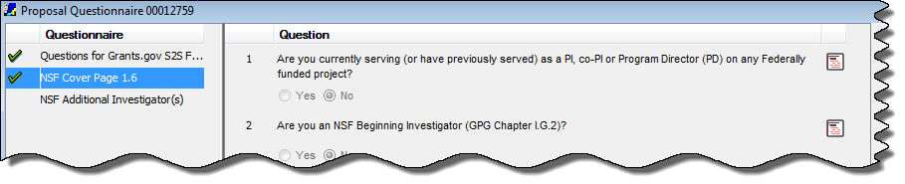
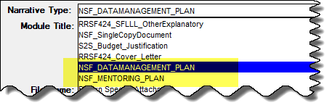
Coeus Update
NSF / Grants.gov Submissions
Coeus updates to accommodate the New NSF Cover Page:
New NSF questionnaire - NSF Cover Page 1.6
  New drop-down field for Funding Mechanism
New Narrative / Attachment Types
  NSF_DATAMANAGEMENT_PLAN
  NSF_MENTORING_PLAN

Slide 51
Coeus Update
NSF / Grants.gov Submissions
The NSF Grants.gov Instructions have been updated:
NSF Grants.gov Application Guide – Effective 12/26/15.

Slide 52
Coeus Update
Updates to Proposal Development
De-activating Fields on the Other Tab (Premium) / Others Screen (Lite)
The following fields have been inactivated and will no longer be required to complete on the proposal submission:
  Number of Grad Students
  Other Fees
  Stipend
  Student Tuition

Slide 53
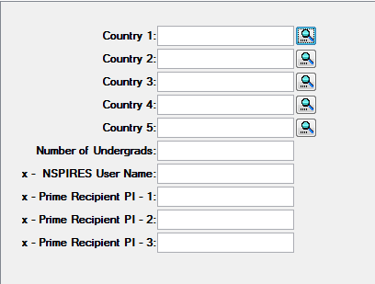
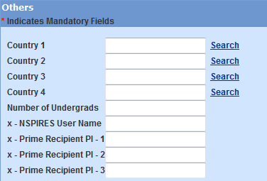
Coeus Update
Updates to Proposal Development

Slide 54
Coeus Update
Updates to Proposal Development
If a Proposal Development record is “In Progress”, when the fields are deactivated , they will still appear in the record. The validations will no longer be run against these fields and you can submit without entering information.
If you copy a proposal an older proposal with all the data elements already completed, they will copy over on the new proposal. You can delete the data in the unrequired fields.

Slide 55
Coeus Update
Updates to Proposal Development
Change to wording of Yes / No Question 0B16
Current Wording
Is the maximum F&A rate allowed by the sponsor? (If No, this is considered cost sharing / PI Consideration)?

Slide 56
Coeus Update
Updates to Proposal Development
Change to wording of Yes / No Question 0B16
New Wording
Is the F&A rate applied in the proposal budget the maximum F&A rate allowed by the sponsor? (Note: If the Sponsor does not allow F&A the answer is Yes).

Slide 57
Coeus Update
Updates to Proposal Development
Change to wording in the
Cost Sharing – Direct Cost Questionnaire
Current Wording
Cost Sharing has been identified in this proposal; is any of it considered IN KIND Contributions? (Note: All IN KIND Contributions must be captured in detail on the Cost Sharing Commitment Form which must be approved and included in the Narrative Section of this Proposal).

Slide 58
Coeus Update
Updates to Proposal Development
Change to wording in the
Cost Sharing – Direct Cost Questionnaire
New Wording
Does the Proposal have IN KIND Contributions? Please select Yes if your proposal has contributions for project costs that are not requested from the sponsor and are not funded by a Cost Center. *Salary dollars over the sponsor’s salary cap are NOT considered IN KIND Contributions* (Note: All IN KIND Contributions must be captured in detail on the Cost Sharing Commitment Form which must be approved and included in the Narrative Section of this Proposal).

Slide 59
Coeus Update
Bug in Coeus Lite
Unable to change budget start/end dates in Coeus Lite
When you change your proposal start/end dates in the General Info section of a proposal that already contains a budget version, the start/end dates of that budget will not update.

Slide 60
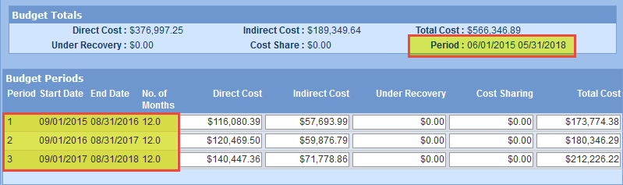
Coeus Update
Example - Bug in Coeus Lite
Original proposal dates were 06/01/2015 – 05/31/2018.
Changed the proposal dates to 09/01/2015 – 08/31/2018 in the General Info section.
The budget periods adjusted correctly to reflect the new start/end date, however, the start/end dates of the entire budget remained unchanged, causing an error when submitting the proposal.

Slide 61
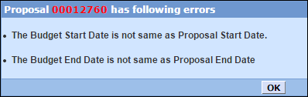
Coeus Update
Bug in Coeus Lite
This bug issue will prevent the proposal from being submitted for approval. Clicking the “Submit for Approval” link will result in the following error messages:
CIS is working on a fix for this bug.
In the meantime, if you need to change your proposal dates, do so using Coeus Premium. If you are primarily a Coeus Lite user, please contact Coeus_Help@brown.edu and someone will assist you with making the necessary updates.

Slide 62
Coeus Update
Upcoming Delete Proposal Development Script
April 1st, 2015
The Delete Development Proposal Script runs quarterly to remove proposals that cannot be deleted from the system manually.
  (Proposals with the status of “Rejected” or “Approval in Progress”)

Slide 63
Coeus Update
Upcoming Delete Proposal Development Script
Please follow the process below to delete proposals that are no longer needed:
Review any proposals with the status of “Approval in Progress”. Have the next approver reject the proposal to change the status to “Rejected”. For any proposals with the status of “Rejected” – Change the Proposal Type to “X – Delete from the System” in the proposal tab and save the record. All proposals with the Proposal Type marked as [X – Delete from the System] will be deleted from the system when the script is run. Once deleted from the system, they will NOT be able to be recovered!

Slide 64

Brown Bag Listserv
To be added to OSP’s Brown Bag Listserv, please email:
Shelly_Hull@brown.edu

