Slide 1
OSP BROWN BAG
September 21, 2015

Slide 2
Agenda
OVPR Update
TVO Update
Special – PIVOT
General
Pre-Award Update/Subaward
Post-Award Update
Systems/Coeus
Workday Grants – Updates
Effort
Coeus Replacement Project
Reporting
Staffing Updates

Slide 3
OVPR Update
Carleen A. Brunelli
Associate Vice President for Research

Slide 4
TVO Update
Katherine Gordon
Managing Director,
Technology Ventures Office

Slide 5
TVO’s Mission
To catalyze the transfer of Brown’s innovative research-generated technology to the commercial sector as a means of creating societal impact and generating revenue for inventors, the institution and the research enterprise.

Slide 6
Partner with PIs to identify and develop opportunities for commercialization
Develop & implement business and IP strategies
Market our opportunities to potential partners
Negotiate agreements – with startups & partners from industry
Manage relationships with our partners
Network with industry to enhance visibility
Enhance formation of startups

Slide 7
Contact TVO early
TVO_patents@brown.edu
We would like to use our template agreements to start
We will attempt to negotiate optimal terms – full o/h and multi-year arrangement
We will establish a relationship with the company
PI – driven (PI comes in with a contact )
Inquiry from the outside
Introduction was made through a TVO-marketing program
Response to an RFP

Slide 8
Logistics
TVO will negotiate agreements with companies (please contact us early in the process)
The financial teams will prepare full budgets as usual and input into Coeus. Please coordinate with TVO as well so that we work from the same set of assumptions
OSP has responsibility for all agreements that originate with government funding (even if government funding subcontacts to industry which then subcontracts to Brown)

Slide 9
PIVOT
Ian B. Straughn
Joukowsky Family Librarian,
Middle Eastern Studies

Slide 10
Pre-Award Training Modules
Fall Offerings
Reading an FOA (10/2/15)
Budgeting Basics (10/13/15)
NIH Career Development K awards (10/15/15)
Cost Sharing (12/8/15)
NIH Fellowships (TBD)
NIH Training Grants (TBD)
ASSIST Training (12/10/2015)

Slide 11
Post Award Training Modules
Fall Offerings
Commitments (9/28/15)
Documentation & Justifications (10/5/15)
Direct Charging of Administrative Costs (10/20/15)
Financial Closeouts (11/6/15)
Cost Transfers (11/18/15)
Allocation of Costs (12/3/15)
Traveling on Sponsored Funds (12/9/15)

Slide 12
Coeus Training Modules
Fall Offerings
Coeus Lite (10/7/15)
Viewing Proposals and Awards (10/5/15)
Proposal Creation and Finalization (premium)(10/23/15)
Advanced Budgeting (11/19/15)
Proposal Hierarchy (11/30/15)
How Coeus Populates your Grant.gov Forms (12/3/15)

Slide 13
OSP Brown Bag
Pre-Award Update

Slide 14
Pre-Award Update
Patrice A. Carroll
Director, Office of Sponsored Projects

Slide 15
Federal Agency Update
NSF -PAPPG Effective January 25, 2016
Enforcement of 5pm deadline across all solicitations
Language removed permitting different type size, margin and spacing requirements in solicitations
Collaborator & other affiliations moved OFF Biosketch, it will now be submitted as single copy document
Biosketches and Current/Pending cannot be submitted as single pdf. This is to ensure compliance checks are done.

Slide 16
Federal Agency Update
NSF -PAPPG Effective January 25, 2016
Internal funds allocated toward specific projects has been added as an example of current/pending support
All Notifications & Requests must come through AOR
Public Access & DURC requirements are implemented
Additional information added regarding costs for conference proposals
Due date of Final TECHNICAL Report will move to 120 days

Slide 17
Federal Agency Update
NSF - Reduction of Administrative Burden
Pilot Project underway to adopt “Just in Time” practice
Initial Proposal will not require budget, just justification
Detailed budget only if recommended for award
Physics, SBIR/STTR and Math Directorates are participating

Slide 18
Federal Agency Update
NSF –Notifications and Requests moved from FastLane to Research.gov on August 24th
Long-term disengagement of PI or co-PI
Pre-award Costs in excess of 90 days
Significant Changes in Methods/Procedures
Significant Changes/Delays of Events of Unusual Interest
Changes in Objectives or Scope
Reallocation of Funds provided for Participant Support Costs
Change in Person-months Devoted to the Project
Withdrawal of PI or Co-PI
Rearrangements/Alterations in excess of $25,000 (Construction)
Conflicts of Interest

Slide 19
Federal Agency Update
Office of Naval Research
90 day “No Funds Extension”
Due 10 days before end of original grant period
Submit via OSP/BMRA to ONR Regional Admin Officer
Does not require ONR Program Officer approval
NFE > than 90 days
Due at least 30 days before grant period ends
Requires ONR Program Officer approval
Cumulative NFE’s cannot exceed 15 months from original period of performance

Slide 20
Federal Agency Update
Air Force
Defense University Research Instrumentation Program (DURIP) closes 9/25/2015
Defense Multidisciplinary Research Program of the University Research Initiative (MURI) closing 12/7/15
Young Investigator Research Program closing 10/09/2015
Must have received Ph.D. no earlier than Jan 1 2010
Coming soon: University Nanosatellite Program
SPENDING RATES CONTINUE TO RECEIVE CLOSE SCRUTINY

Slide 21
Federal Agency Update
Army
Medical Research Acquisition Activity (USAMRAA)
Located Ft. Detrick, Maryland
Applications and awards through Congressionally Directed Medical Research Program Office (CDMRP)
FY15 Funding of $1.375B
Funding Opportunity Announcements on Grants.gov
CFDA No. 12.420
eBRAP system used for LOI and Pre-applications
PIs encouraged to use ORCID (research registry)
IDs available at http://orcid.org/

Slide 22
Federal Agency Update
NIH
Request for Information: Strategies for Simplifying NIH’s Grant Application Instructions here due by 9/25/2015
Research Training Data Table Format transition FY16
see August OSP Newsletter and NOT-OD-15-112
Research Terms and Conditions to implement Uniform Guidance

Slide 23
Research Terms and Conditions
Federal Research Terms and Conditions Working Group
NIH
NSF
Department of Agriculture
Department of Commerce (NIST/NOAA)
Department of Energy
Department of Homeland Security
Department of Transportation (FAA)
Environmental Protection Agency
NASA
Department of Defense is working on their own

Slide 24
Pre-Award Update
Pre-Award Team
Portfolio rebalancing underway
Subaward
Subaward Order Form
Exiting PI Checklist for Research Faculty
Excellent form available from BioMed Research Admin website Comprehensive list of items to complete Volunteer reviewers needed

Slide 25
Certificate Training
Certificate Training Program in Research Administration & Compliance is under development
Send names of interested staff and new hires to resadmin@brown.edu

Slide 26
Post-Award Update
Mary West
Senior Grant / Contract Accountant
Office of Sponsored Projects

Slide 27
Award Closeout Report
New Workday report OSP uses for rough drafts
Captures financial transactions whose accounting dates are equal or prior to the reporting period end date
Contains the grant budget, PTD expenditures, adjustments column, total expenditures and cost sharing expenditures
Contains all ledger accounts to ensure all financial activity is captured
Department can reconcile to the Sponsored Award Budget to Actuals report
Notes:
- Produces the same results when run now or in the future for a given accounting period end date

Slide 28
Award Closeout Report
What to do when completing the award closeout report
Review financial transactions with accounting after the reporting period end date to determine if they properly belong in the reporting period
Enter those transactions in the adjustments column
Provide Workday transaction id # or supporting documentation (e.g. p-card purchases) for adjustments
Enter f & a adjustment for transactions in the adjustments column

Slide 29
Award Closeout Report
What to do when completing the award closeout report
Provide other documentation requested by grant/contract accountant
Complete questions re: patents and inventions, subcontracts and p.o.’s
Sign
Department administrator
PI

Slide 30
Business Class Airfare on Non-Federal Funds
Travel on non-federal funds requires compliance with the University Travel Policy
Business class travel is not allowed if the sponsored award specifically prohibits use of business class

Slide 31
Business Class Airfare on Non-Federal Funds
University Policy states business class airfare is permissible only when:
The destination is four or more time zones away, or more than eight hours direct flight time, and
The funding department has adequate budget resources; and
It is clear that this form of travel is for a valid University purpose and would be the best use of the funds available.

Slide 32
Research Reserve (RR)
FY15 Research Reserve Distribution Timeline:
October 5th-9th – RR Communication will be mailed to department chairs/directors
Communication reflects:
FY15 RR amounts
Adjustments to RR (if applicable)
Worktags-Cost Center, FD130 & PRG103

Slide 33
Research Reserve (RR)
FY15 Research Reserve Distribution Timeline:
October 7th-14th – RR funds deposited as follows:
If no adjustment to RR amount – total amount will be transferred to CC
If adjustment required, difference between RR amount and adjustment will be transferred
Any balance will be transferred after unreconciled accounts are cleared.

Slide 34
Research Administration Information Systems Update
Emily Derby
Systems Analyst

Slide 35
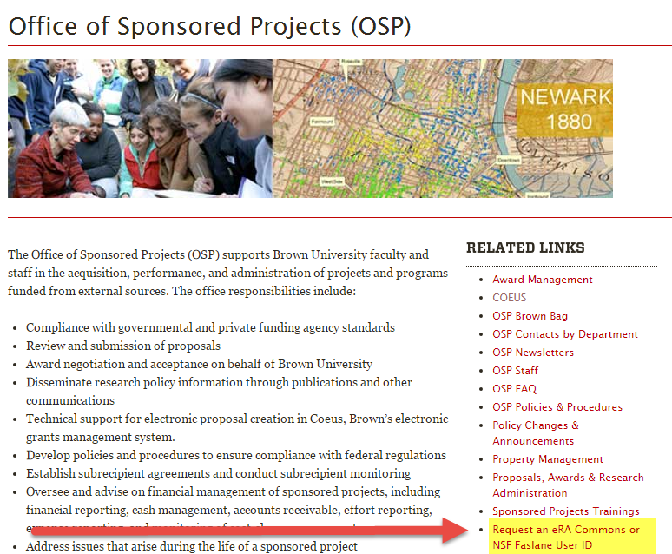
Requesting an NIH erA Commons ID or NSF Fastlane ID
A new form has been created to capture the details needed to set up faculty or Graduate Students with an NIH eRA Commons ID or NSF Fastlane ID:
http://www.brown.edu/research/about-brown-research/policies/obtaining-user-id-nsf-fastlane-or-nih-era-commons
Form is located on the OSP webpage > Under Related Links: Request an eRA Commons or NSF Fastlane ID

Slide 36
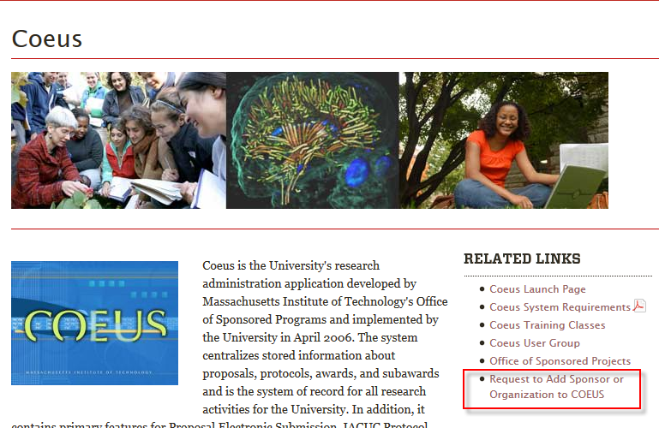
Requesting to Add a Sponsor or Organization to Coeus
New Process to Request to Add Sponsor or Organizations to COEUS - Complete form with all required information:
Request to Add a Sponsor or Organization to COEUS
Form is located on the Coeus Homepage > Under Related Links: Request to Add Sponsor or Organization to Coeus

Slide 37
Next Coeus User Group
Tuesday October 20, 2015
Rhode Island Hall, Room 108
Time: 10:00 to 11:30
If you have ideas for discussion topics, please email Coeus_Help@brown.edu

Slide 38
Research Services Update
Marisa Schasel
Director, Research Administration Systems
& Reporting

Slide 39
Effort Reporting Upcoming - Due Dates
Upcoming –Due Dates
Non Exempt Workers and Undergraduate Students
Pay Period July 26 – September 5: Due October 9th
Outstanding (In Process): 139 reports (45%)

Slide 40
Effort Reporting Delinquent Effort Reports
Delinquent Effort Reports (as of September 17)
Semi-Annual Effort Reports (July – Dec. 2014):
Faculty and Exempt Staff
1 effort report

Slide 41
Effort Reporting Delinquent Effort Reports
Delinquent Effort Reports (as of September 17)
Semi-Annual Effort Reports (Jan. – June 2015):
Graduate Students
3 effort reports
Faculty and Exempt Staff
16 effort reports

Slide 42
Effort Reporting Delinquent Effort Reports
Delinquent Effort Reports (as of September 17)
Weekly and Bi-weekly Effort Reports
Non Exempt and Undergraduate Students
Pay Period 6/28/15 to 7/25/15
9 effort reports
Pay Period 5/31/15 to 6/27/15
1 effort report

Slide 43
Effort Reporting Upcoming Reporting Cycles
Upcoming Reporting Cycles
Weekly and Bi-weekly Effort Reports
Non Exempt and Undergraduate Students
Pay Period 9/6/15 to 10/3/15
Generate reports week of October 5th

Slide 44
Effort Reporting Cost Shared Effort
Cost Shared Effort – Costing Allocations
Costing allocations that include FD120 and a grant worktag are captured on an effort report
Cost sharing from other funding sources (example: FD600, FD400) and/or a FD120 with no grant ID must be manually reflected on the effort report

Slide 45
Effort Reporting Cost Shared Effort
Cost Shared Effort – Cost Share Certification
FY15 is the last year we will be manually capturing cost sharing via the Annual Cost Share Certification process
FD120 and a grant work tag must be used when costing allocations
The certified effort report will support certification of cost shared effort

Slide 46
Effort Reporting Contact Information
Contact Information:
Effort Reporting Manager:
Maria Mento @ 863-2275
Email: Maria_Mento@brown.edu

Slide 47
Reporting Update
Bethany Cherms
Systems Manager

Slide 48
New Enhancement Available
Workday and FRS Expenditures are now captured in the Coeus Data Warehouse.
Enables Workday Expenses to now be included in Cognos Sponsored Projects Reports.
Standard Award, Proposal, Expense Report
Now contains Workday Expenses and FRS Expenses.
The Account Number and/or Grant Worktag detail is included in the Expenditure portion of the report.

Slide 49
Sponsored Projects Reports for Departments
Cognos ‘Sponsored Projects Reports for Departments’ folder contains:
Proposal Reports
Monthly Proposal Activity Report
Proposals by Sponsor
Report of Proposals by Agency Type
Summary Report of Proposals by Department
Custom Proposal Activity Report
Award Reports
Monthly Award Activity Report
Report of Awards by Agency Type
Report of Opens Award
Summary Report of Awards by Department
Proposal/Award/Expenditure Activity Reports
Standard Award, Proposal, WD Expense Activity
Award & Proposal Activity by Investigator

Slide 50
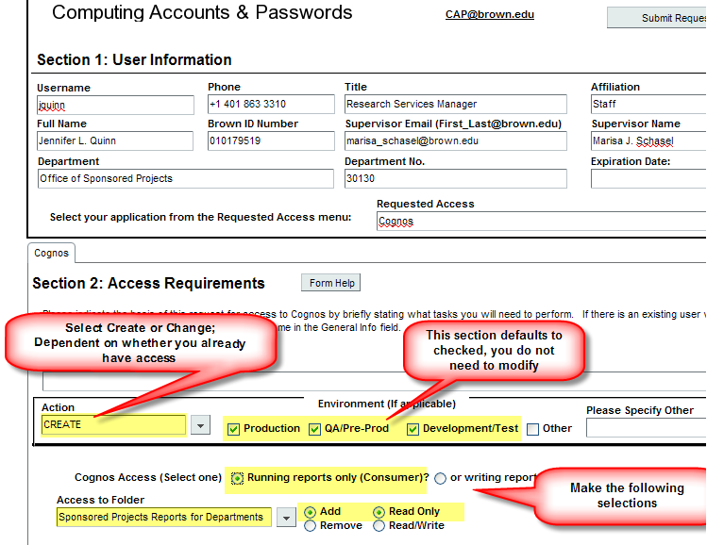
Requesting Access to Cognos Department Reports

Slide 51
Reporting Reminder
Award & Proposal Activity by Investigator Report
Automatically Distributed Quarterly to:
Department Chairs
Department Managers
Distribution is based on the Department Head and Administrative Officer setup in Coeus.
Report is located in the Cognos ‘Sponsored Projects Reports for Departments’ folder
Report can be run on demand by department personnel

Slide 52
Reporting Reminder
Award & Proposal Activity by Investigator Report Features:
Based on the Principal Investigator’s Home Department
Captures both PI and Co-I Activity
Report totals are for PI activity only
Contains a Summary & Detail Report for Awards and Proposals
Revised Budgets are excluded from the Proposal Report

Slide 53
Brown Bag Listserv
To be added to OSP’s Brown Bag Listserv, please email:
Daniel_Mueller@brown.edu

