Slide 1
Grants Management Reports
Awards Expiring in 90 Days
Portfolio of Awards
Positions Currently Funded by Your Awards
Sponsored Award Budget to Actual (Includes All Your Active Awards)

Slide 2
Accessing the Dashboard
Accessing the dashboard:
From your home page, click the Grants Management app
Reports will render based on your role associated with the respective award or award line

Slide 3
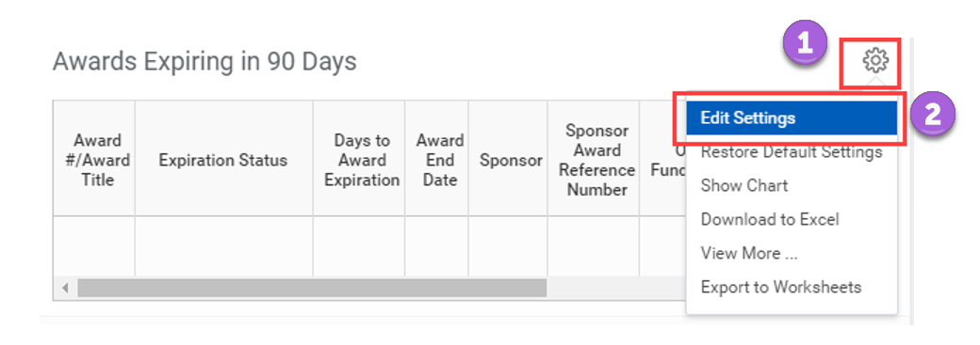
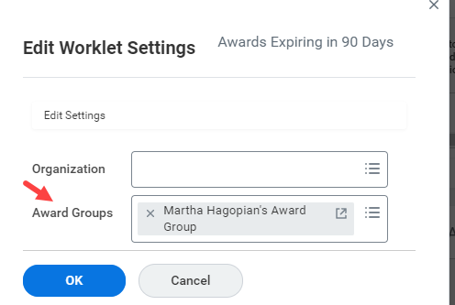
Filtering by Award Group
Data renders based on your role associated with an award or award group. To narrow or filter your results, prompt for a specific award group for a PI or Co-PI

Slide 4
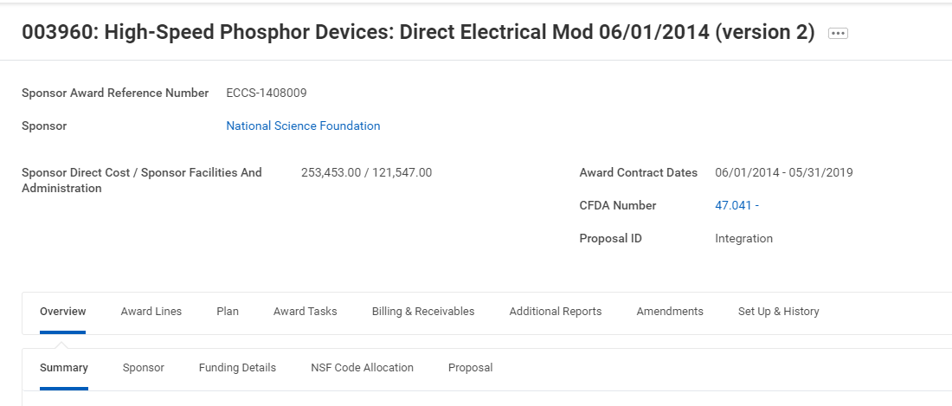
Access Details of Report Output
All blue fields are actionable
Right click on award hyperlink to open details in another window
All details on award will be accessible

Slide 5
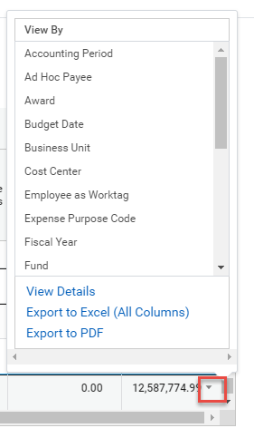
Access Details of Report Output
Filtering expenses can be performed on any line total or report total by hovering to the right of the total and clicking the arrow
View by options include, cost center, employee, award, etc.
All details can also be downloaded to excel on any screen

