Slide 1
Professionalize Your
Department's Communications
June 8, 2017
Office of University Communications
Jim Kempster, AVP Marketing Communications
Jill Weaver, Editorial Manager
Nick Dentamaro , Communications Photographer

Slide 2
Professionalize Your
Department's Communications
Visual Identity
Jim Kempster
AVP Marketing Communications
Notes:
START:
Reflect on difference between terms we throw around like ”BRAND” and ”VISUAL IDENTITY”
>> Visualize the logo for a brand you like and trust:
you use regularly and makes your life better
you recommend to others
you can’t wait to see what their next product or development will be

Slide 3















Notes:
BRANDS THAT INSPIRE
Emotional Connection and Loyalty FOR ME
NOTE:
Rome's she wolf with Romulus and Remus
Modena DOC
Subaru - everyone else now mine

Slide 4
Difference between “brand” & “visual identity?”
Brand
reputation
personality
promise
mission/strategic plan
Where is it?
what we say about ourselves
how we treat people
how we present the University
Visual Identity
logo
fonts & colors
photography & illustration
video footage
Where is it?
publications
advertising
promotional materials
signage, vehicles
Notes:
Start with "brand" because: HEAR that word a lot
what is it?
WHO do you SAY you are?
WHO do you REALISTICALLY
want people to THINK you are?
What is visual identity?
Subset of Brand - how we present ourselves

Slide 5
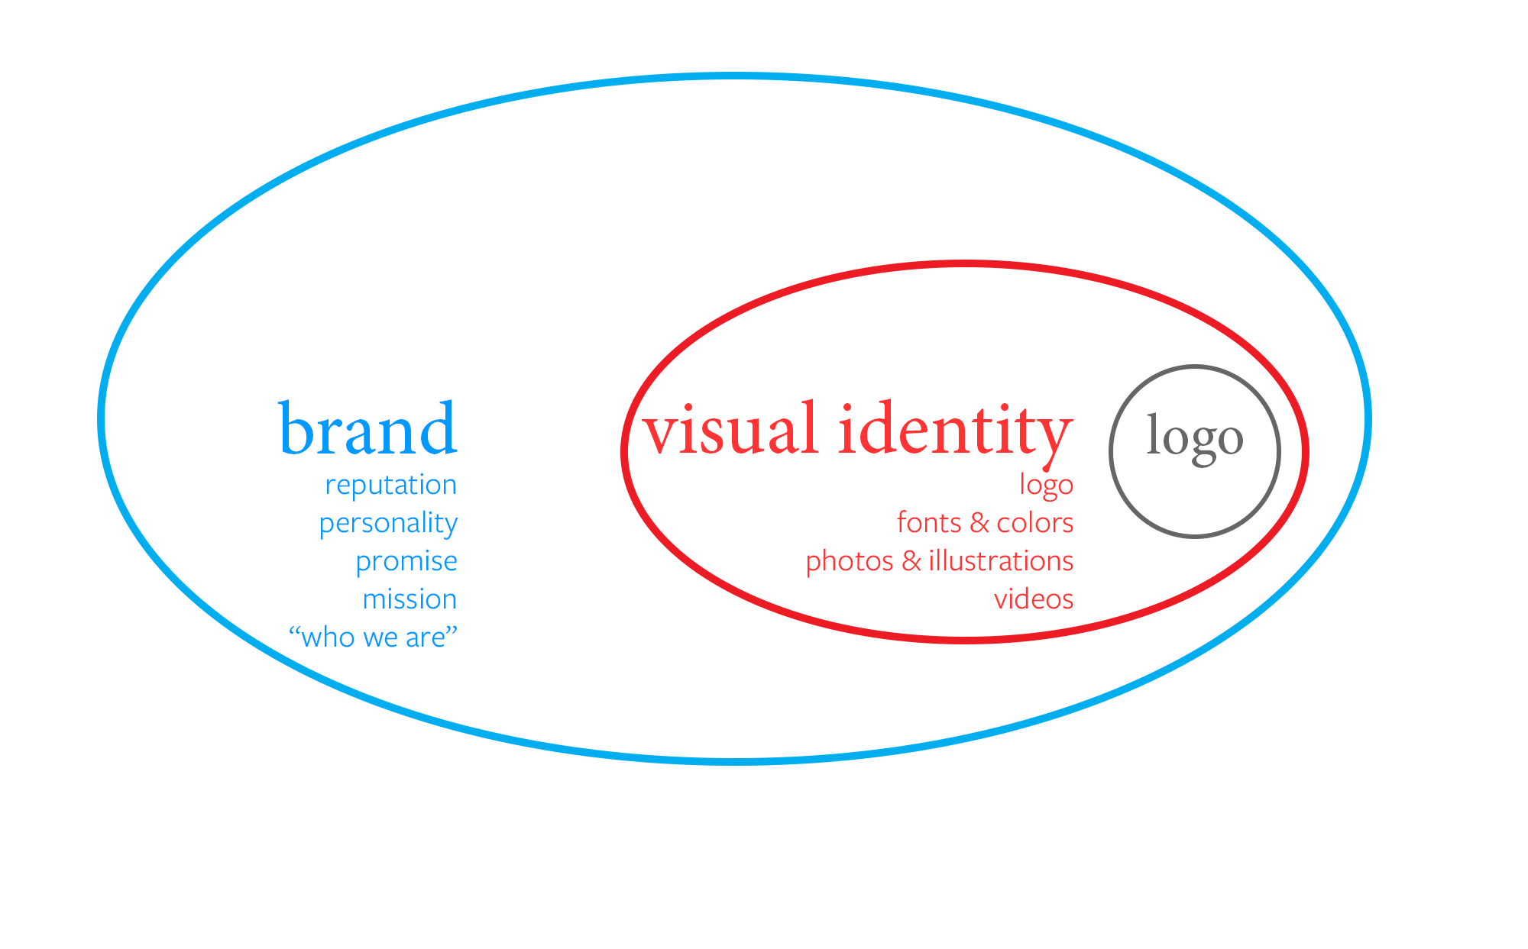
Difference between brand, visual identity & logo
Notes:
Visualization: visual identity and logo - part of but not equal to brand.
Brand is WHO WE ARE – the people, departments, programs and initiatives that make up WHO WE ARE
Visual identity: consistent representation - people SEE and immediately CONNECT with “who we are.”
Our logo is the graphic SYMBOL - by itself easily recognizable to conveys “who we are.”

Slide 6
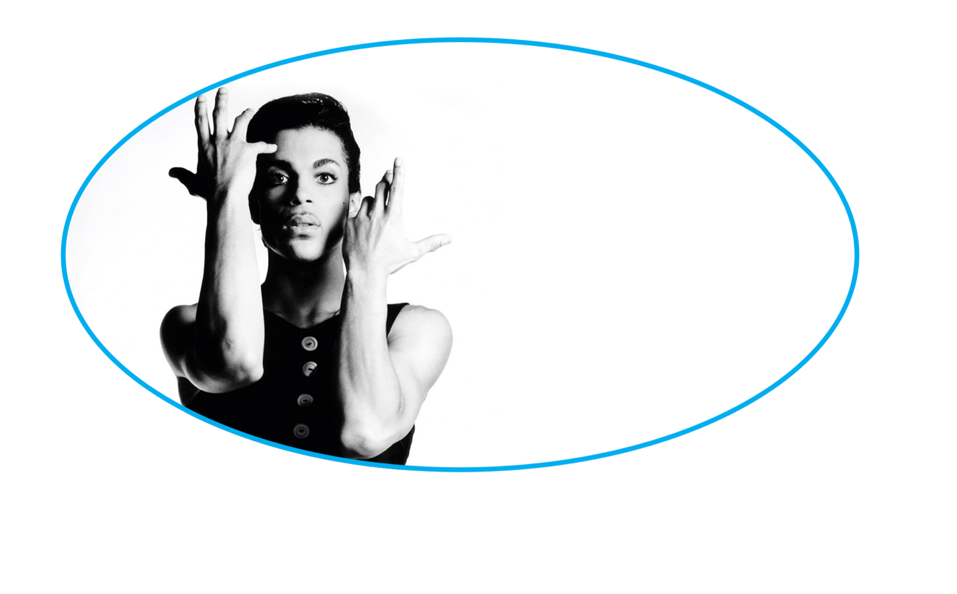
Difference between brand, visual identity & logo
Notes:
PRINCE:
He himself, his persona, his music, presentation of himself is his BRAND

Slide 7
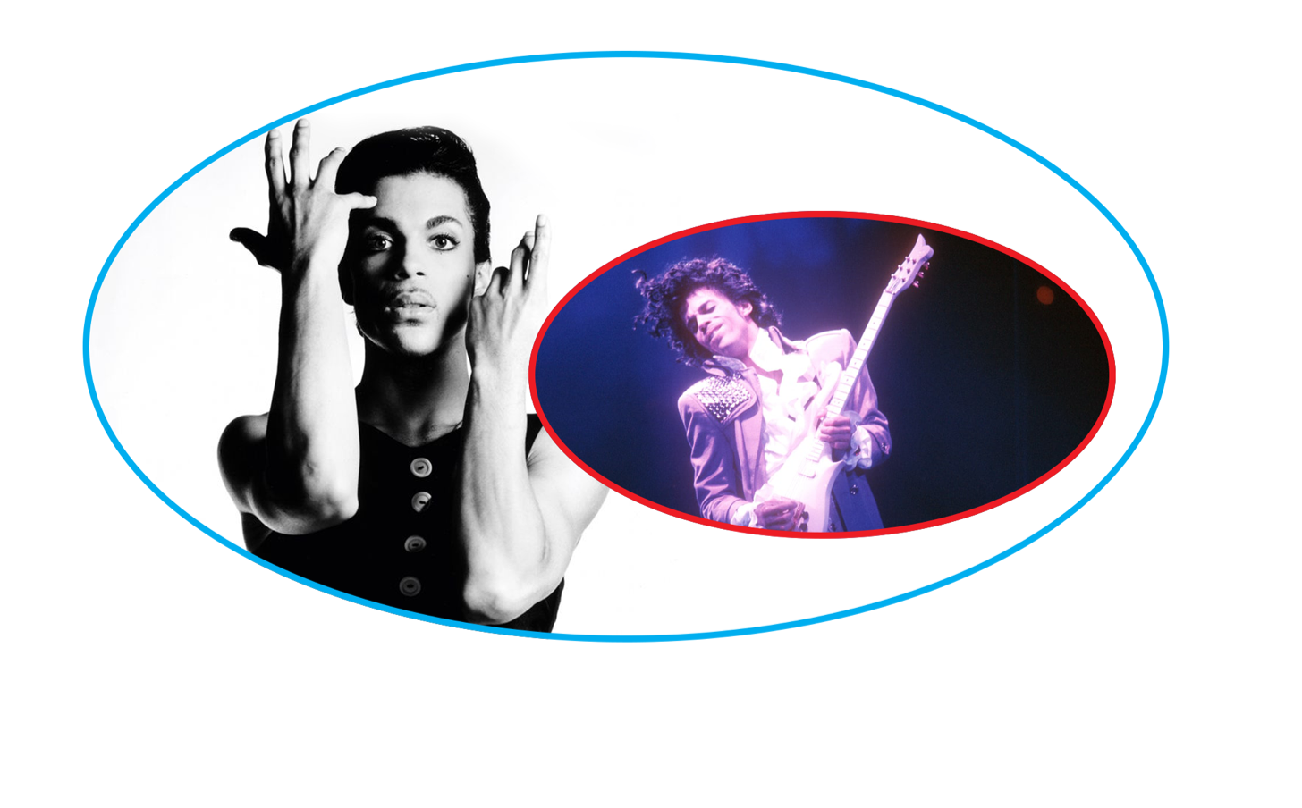
Difference between brand, visual identity & logo
Notes:
PRINCE:
Purple, clothing and hair style, VISUAL IDENTITY
Might argue a MUSICIAN has an AUDIO IDENTITY: guitar, rhythms, lyrics that make a PRINCE song EASILY RECOGNIZABLE

Slide 8
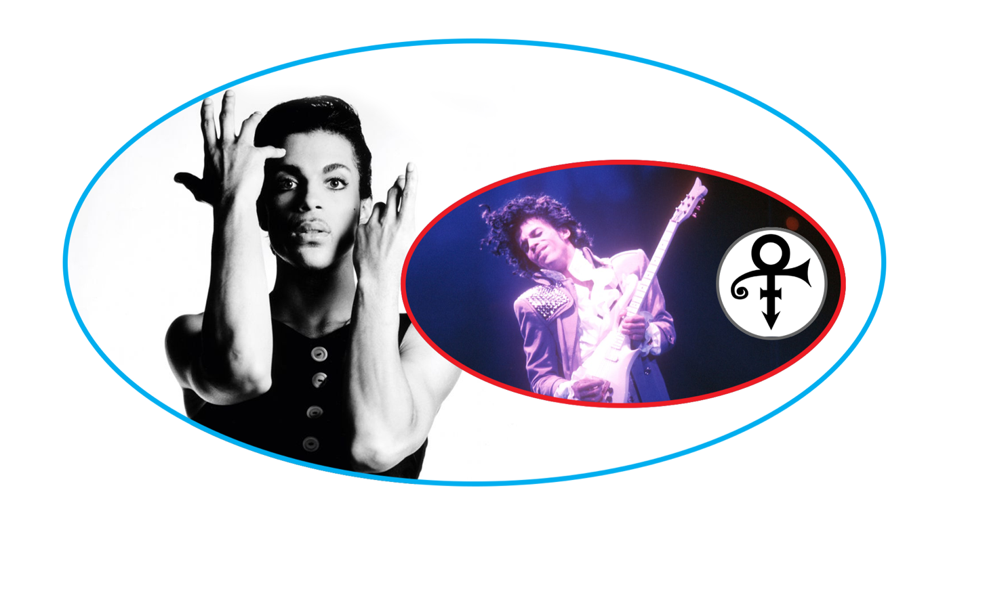
Difference between brand, visual identity & logo
Notes:
PRINCE
About 10 years into his career…CHANGED his name to this SYMBOL, no one could pronounce
Already had reputation, personal style, 13 volumes of music behind him
so we associated the SYMBOL with the EXISTING reputation and person
we would not remember it otherwise
BROWNS PROBLEM:
we often want to START with the symbol, before we establish the “WHO WE ARE”

Slide 9
Why do we need a visual identity?
1
6,000
“On an average day
consumers are exposed to
six thousand advertisements
and, each year, to more than
twenty-five thousand new products….
[Recognizable] brands help consumers
cut through the proliferation of choices
available in every product and service category.”
Scott M. Davis
Brand Asset Management:
Driving Profitable Growth Through Your Brands
25,000
Notes:
(read and quickly go to next side for illustration)

Slide 10
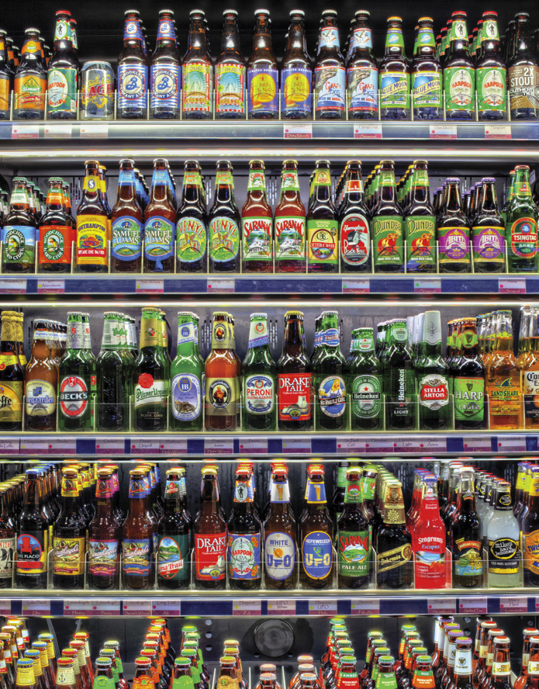
Illustration from Alina Wheeler’s
Designing brand identity: an essential guide for the whole branding team
Notes:
Blue Moon in the top right
some stronger than others
- visually
- reputationally

Slide 11
What makes a visual identity strong?
different from peers
professional and trustworthy
unique and recognizable
emotional connection and loyalty
consistent
can’t be misinterpreted
flexible, adaptable and scalable
timeless and sustainable
Notes:
Going to emphasize 2
ONE OF THE MOST IMPORTANT TO ME
- and to our MISSION on this project
stop and VISUALIZE
products or companies
that have your LOYALTY

Slide 12
Brown’s Logo Soup
Notes:
LOGO SOUP
Some DON’T MENTION Brown at all
Stand alone and Separate
NOT RECOGNIZABLE beyond small audience
Look like SOFTWARE
Show their AGE (unprofessional)

Slide 13
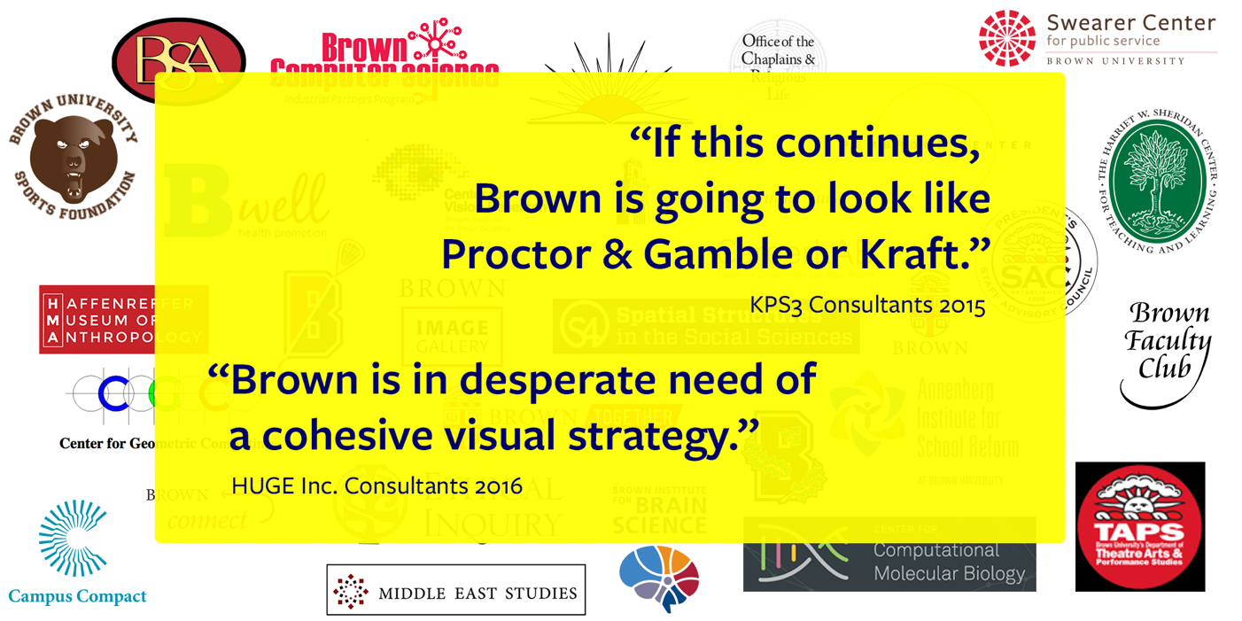
Brown’s Logo Soup
Notes:
(Read quotes with brief context)

Slide 15

Visual Identity Policy & Strategy
Notes:
Began with working group of Brown Designer
Graphic Services
Advancement
OUC’s web group
A draft was workshopped with communicators around the University, in major schools, departments and programs, from:
Athletics to Alpert Medical,
Student Life to School of Professional Studies
Released in July 2016

Slide 16
Visual Identity Policy & Strategy
What is Introduced:
Implements 2003 graphic identity: consistency
Introduces new University red
Requires new logo files (available online)
Creates standards for sub-identities
Defines difference between “brand” and “logo”
Clarifies University position on “independent”
logos and identities
Notes:
Implementing 2003 graphic identity: consistency
Introducing new Brown red: end of rogue reds
Requires download of new logo files: (has new red and also renders better via print and digital)
Creates standards for sub-identities (school, department and program logos)
Educates the community in “brand” vs. “logo”
Establishes clarity on position discouraging “independent” logos and identities

Slide 17
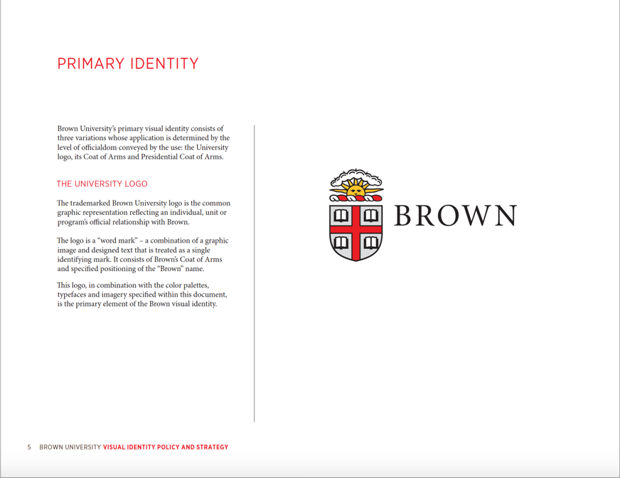
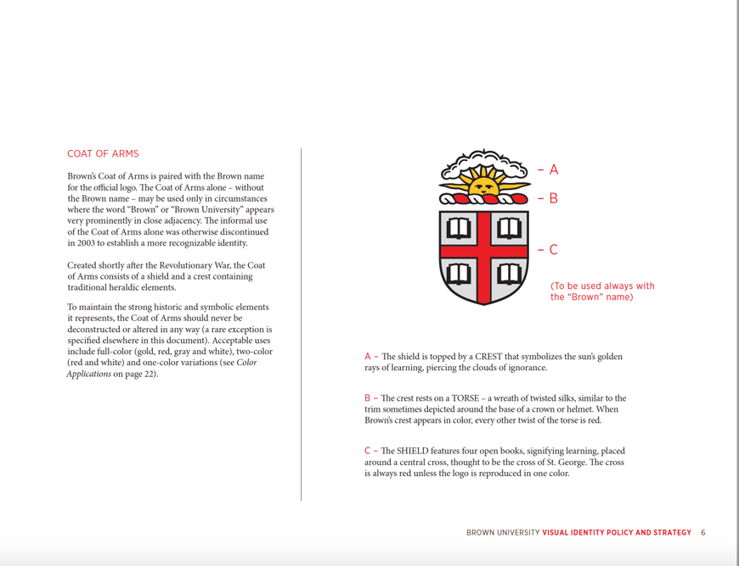
Primary Identity
Notes:
Brown University Logo as our primary identity
Describes the elements of the logo

Slide 18
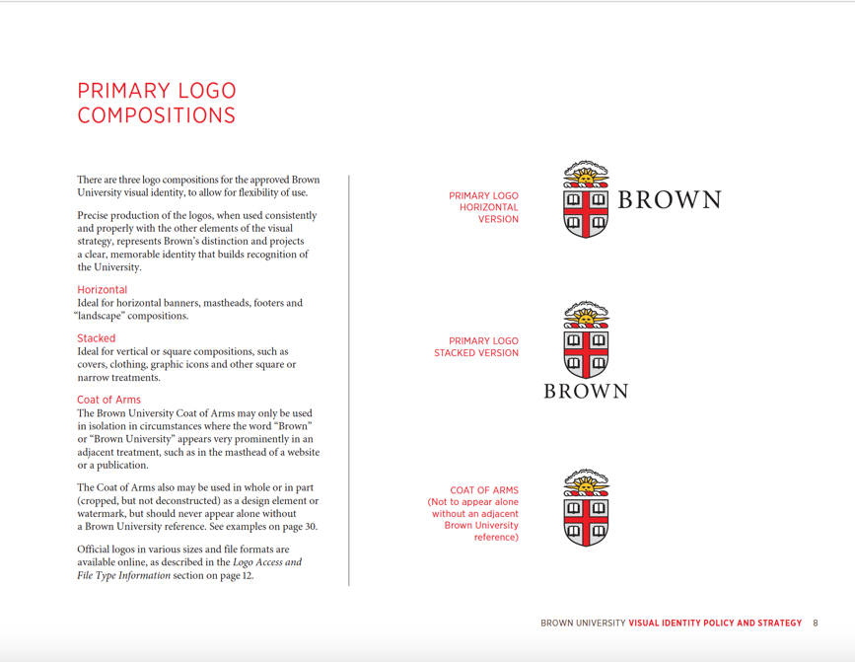

Compositions & Uses
Notes:
Compositions and Uses
Horizontal
Stacked
Coat of Arms alone
Presidential Logo

Slide 19
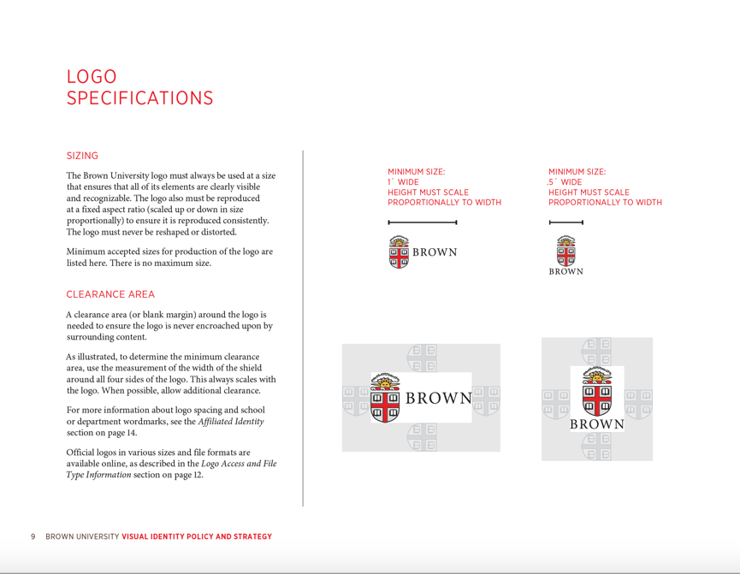
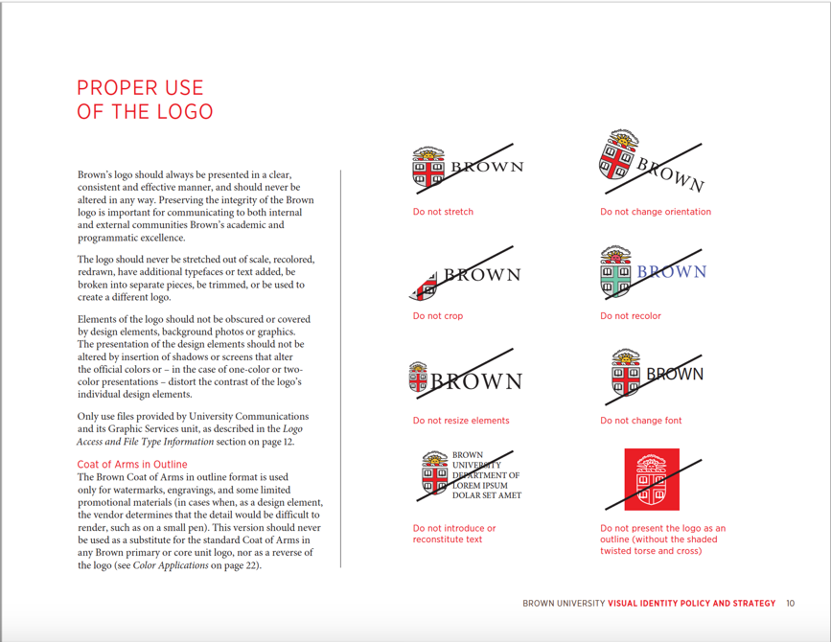
Specifications and Appropriate Uses
Notes:
Sizing
Clearance Area
Improper Uses
NB: outline version of logo

Slide 20
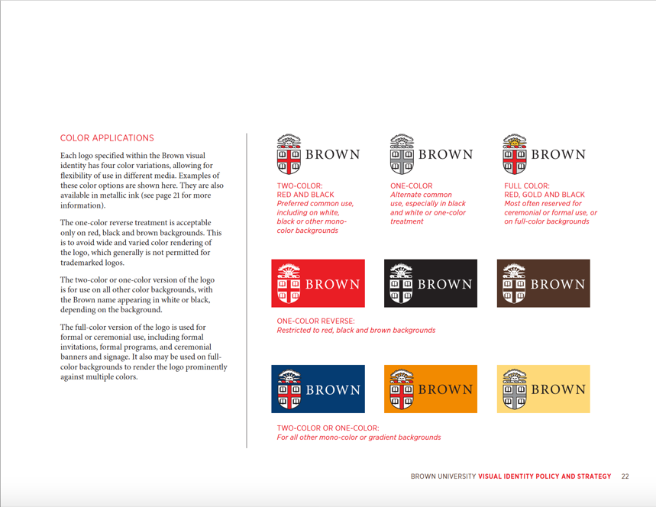
Color Applications
Notes:
2 Color Red and Black, One Color, Full Color
True Reverse on red, black or brown (do not use the outline version)
Two color or one color against any other color backgrounds

Slide 21
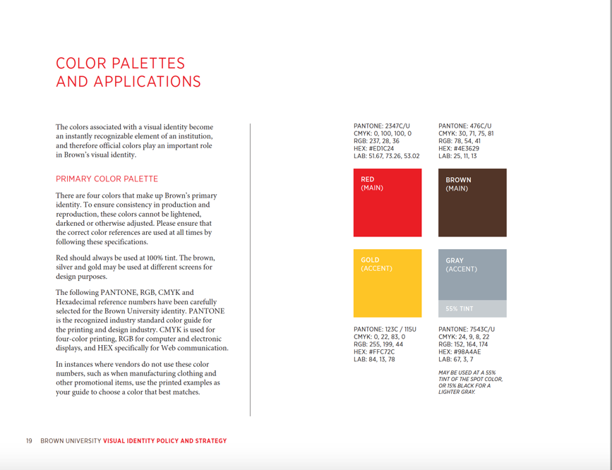
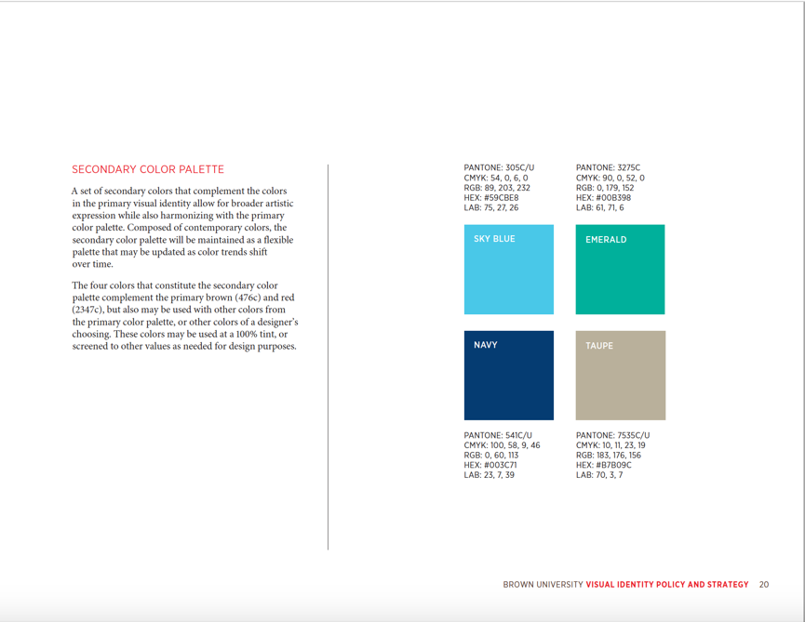
Primary and Secondary Color Palettes
Notes:
Sizing
Clearance Area
Improper Uses
NB: outline version of logo

Slide 22
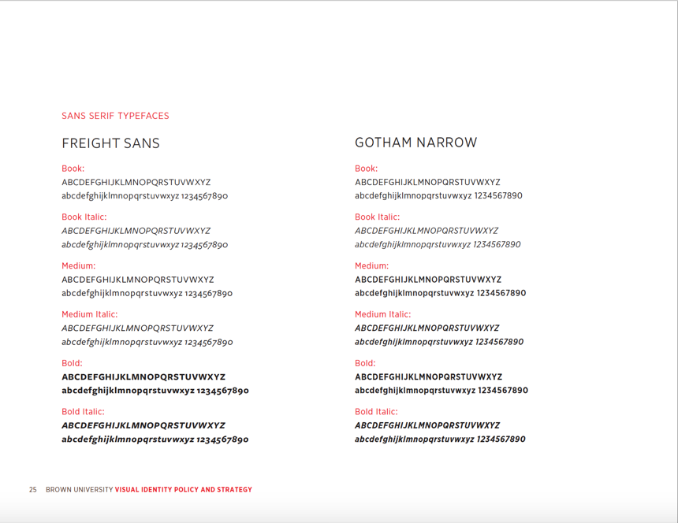
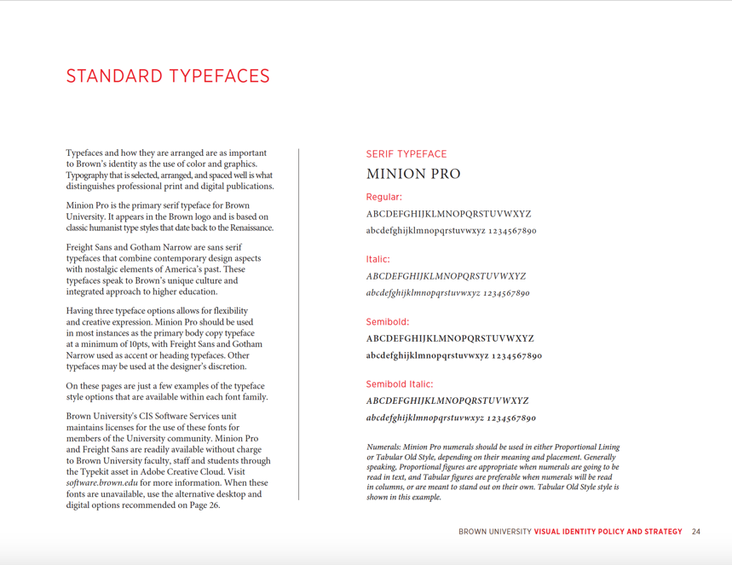
Standard Fonts: Minion Pro
Notes:
Minion Pro and Freight Sans available with Adobe Creative Cloud tool kit

Slide 23
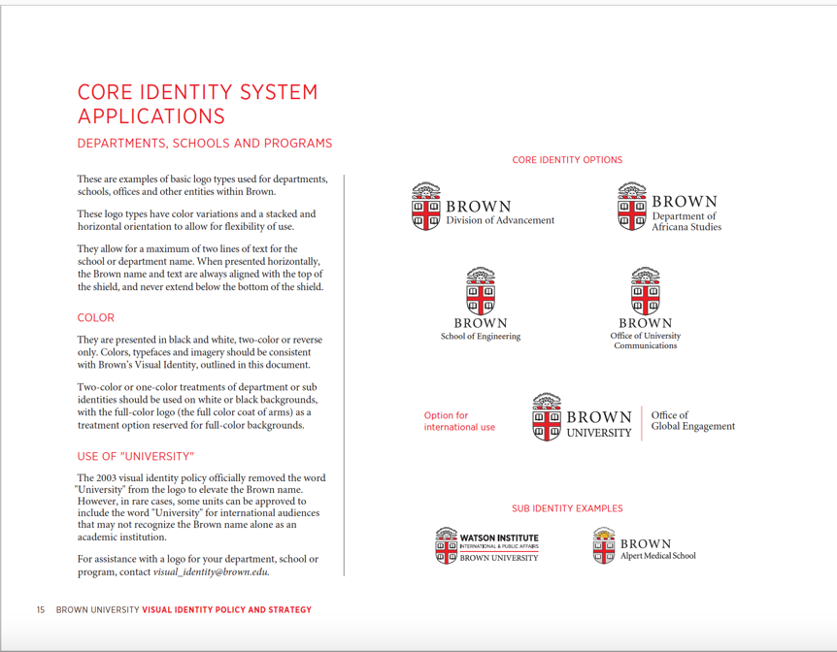
Core Identity System: Departments, Schools & Programs
Notes:
Variations for Use, Orientation, Color (reserve full color coat of arms for color backgrounds)
Use of ”University” for international audiences
Sub-Identities (similar, but differ slightly)

Slide 24
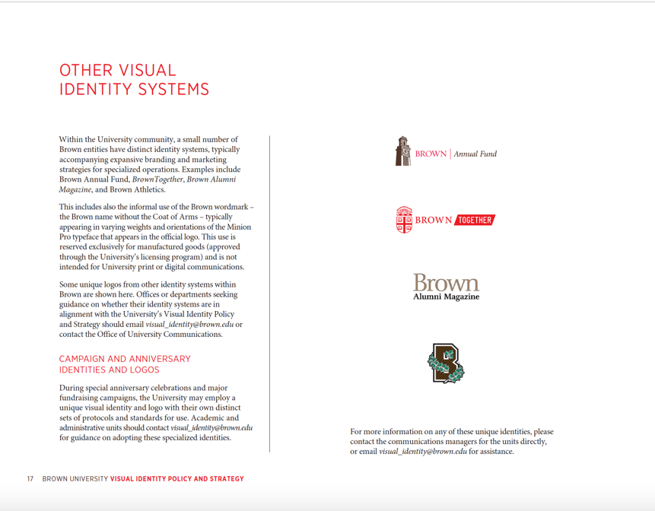
Other Visual Identity Systems
Notes:
Distinct Identities associated with specific branding and marketing strategies for:
anniversaries and fundraising campaigns
publications
athletics

Slide 25
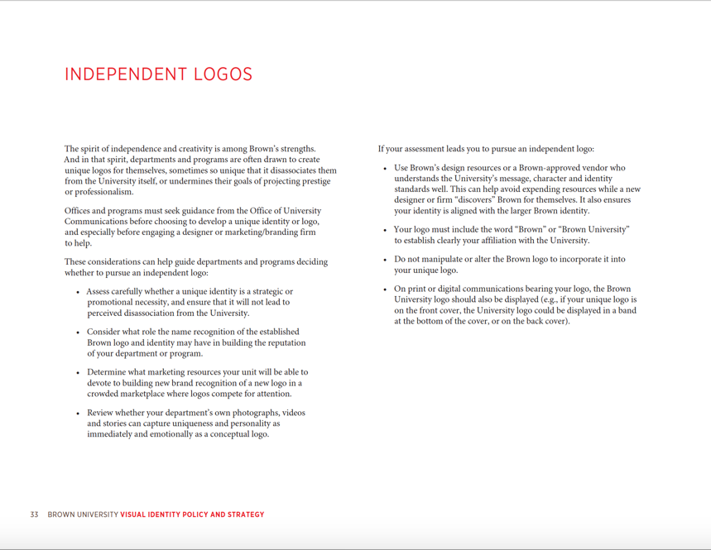
Independent Logos
Most peers have
sub-branding policy
PR firms and designers are happy to spend your money
Consumes your resources creating and building recognition
Being “Of Brown” is a two way street:
Brown depends upon your unit’s reputation
as much as your unit depends upon Brown
The end of “Logo Soup”
Notes:
Independent Logos
“…sometimes so unique that it disassociates them from the University intself or undermines their own prestige or professionalism”
Most peers have policies on sub-branding, but Brown did not
(reversing a trend that exploded in 2000s: universities vs. PR firms, because logos = $$$ for marketing plans)
“Logo soup” fractures an institution’s brand
Programs contributing to the university’s strength not recognized as part of the institution
The “identity” imparts the well-established brand of excellence to its composite elements, and the sub-identities imbue the “whole” identity with their characteristics – always strengthening what it means to be “of Brown.”
Consumes resources building brand identity
(programs invest in building recognition around an independent logo vs. benefitting from the established and recognized excellence of the institution)

Slide 26
Your visual identity
Notes:
When designing a communication (whether it’s a brochure, email blast, poster, etc.) it’s important to think about why you’re using images. Images shouldn’t be used solely to take up space. Its nice to have something that’s pretty, but there is visual information being conveyed and it should work for you.

Slide 27
Unique Color, Images & Type Treatments
use your Brown core identity logo
select photography that tells your story
identify secondary colors—and stick to them
create type treatments that are bold—but not logos
repeat, repeat, repeat
Notes:
Brown core identity logo anchors whatever design you create
select photography that tells your unique story
identify secondary colors—and stick to them
create type treatments that are bold—but not logos
repeat, repeat, repeat—don’t run off to something new, it remains to “new” to your audience for several years longer than it does for you

Slide 28


Unique Color, Images & Type Treatments
Notes:
Use of image and font across several publications and web banners

Slide 29



Unique Color, Images & Type Treatments
Notes:
Same graphic treatment and a special font for the event title, coupled with Brown’s standard font and Logo

Slide 30


Unique Color, Images & Type Treatments
Notes:
Bold color and a unique font for the title, coupled with Brown’s standard font and logo.
Important to the University that this initiative is present as Brown’s own initiative. We want to make it clear that we are telling this story from our own history.

Slide 31
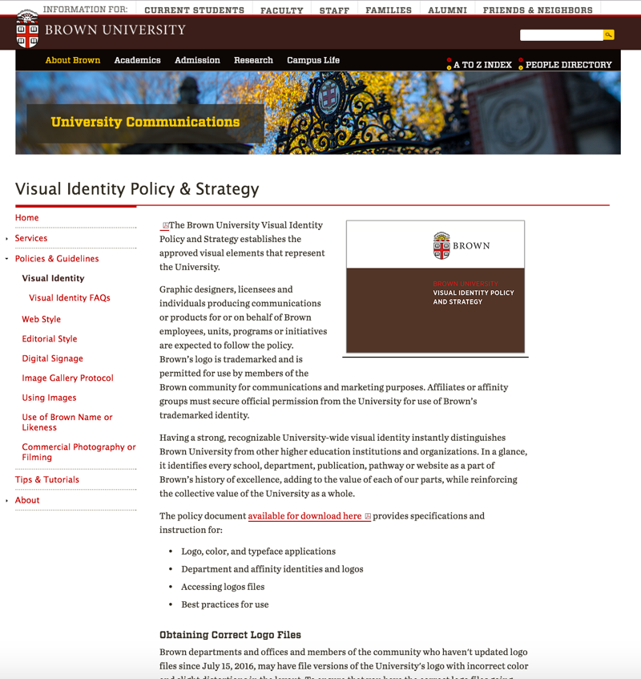
Brown’s Visual Identity Policy & Strategy
Notes:
Online resources

Slide 32
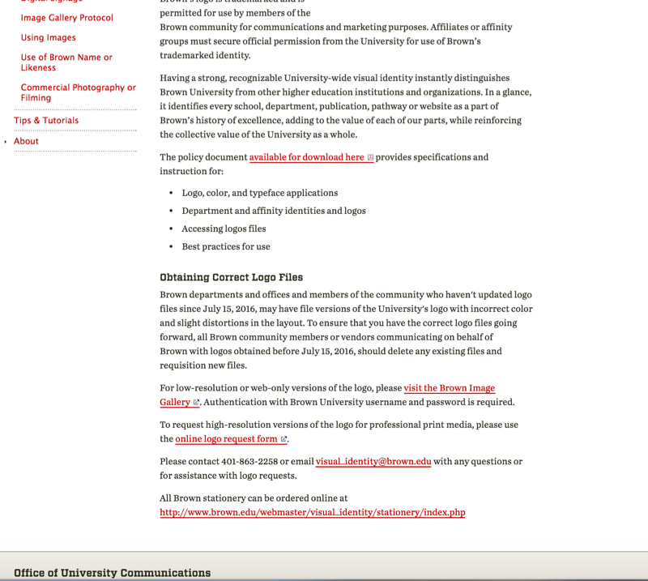
Brown’s Visual Identity Policy & Strategy
Notes:
Online resources

Slide 33
Questions?

Slide 34
Professionalize Your
Department's Communications
Tips for Clear, Persuasive Writing
Jill Weaver
Editorial Manager

Slide 35
Writing well is not easy
“Some editors are failed writers,
but so are most writers.”
- T.S. Eliot

Slide 36
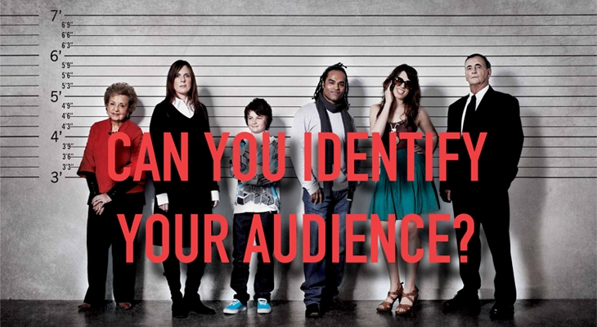
Before you write a word . . .

Slide 37
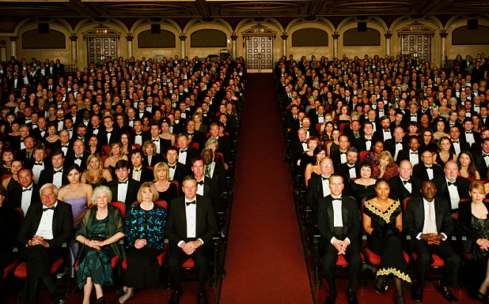

Slide 38


Slide 39
What do you want your audience to do?
Attend an event
RSVP
Make a donation
Apply
Learn more

Slide 40
What is the best format for delivering your message?
Poster
Email
Printed invitation / evite
Brochure
Web page, mobile app
Social media

Slide 41

Match your content to the format
Call me Ishmael. Some years ago—never mind how long precisely—having little or no money in my purse, and nothing particular to interest me on shore, I thought I would sail about a little and see the watery part of the world. It is a way I have of driving off the spleen and regulating the circulation. Whenever I find myself growing grim about the mouth; whenever it is a damp, drizzly November in my soul; whenever I find myself involuntarily pausing before coffin warehouses, and bringing up the rear of every funeral I meet; and especially whenever my hypos get such an upper hand of me, that it requires a strong moral principle to prevent me from deliberately stepping into the street, and methodically knocking people’s hats off—then, I account it high time to get to sea as soon as I can.
Notes:
Opening of Moby-Dick

Slide 42

Match your content to the format

Slide 43
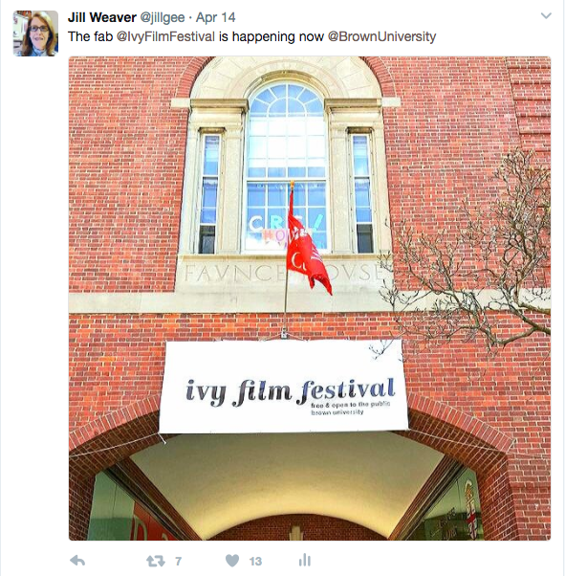
Match your content to the format
Social media
Notes:
Using Twitter can help you become a better writer. 140 character limit.

Slide 44
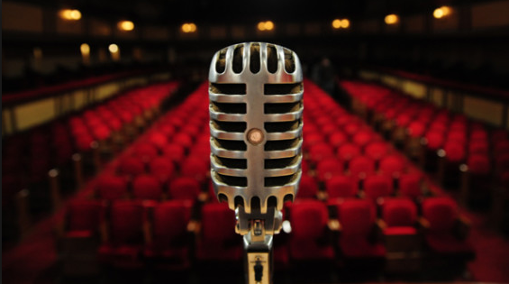
Match your voice to the audience
Tone
Word choice
Style (formal vs. informal)

Slide 45
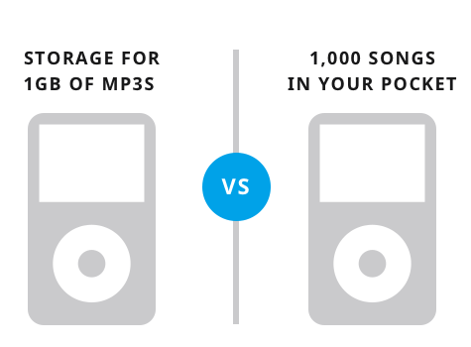
Describe benefits, not features
People have little interest in purchasing a bed.
What they want is a good night’s sleep.

Slide 46
Writing simply is not easy
“Say all you have to say in the fewest possible words, or your reader will be sure to skip them; and in the plainest possible words, or he will certainly misunderstand them.”
- John Ruskin

Slide 47
7 Tips for effective writing
Use clear, simple language.
Use active verbs.
Lead with the most important information.
Omit needless words.
Get to the point.
Be consistent.
Revise.

Slide 48

Tip #1: Use clear, simple language
“Style to be good must be clear. Clearness is secured by using words that are current and ordinary.” - Aristotle
Just say no to jargon.

Slide 49


Tip #2: Use active verbs
Active
Passive
it is bein’ loved by me
Notes:
\

Slide 50
Tip #3: Lead with the most important information
Which story grabs your interest?
a) It was raining out and I had forgotten my umbrella. I stepped into a doorway and waited for the rain to stop. When the rain let up, I headed to the ATM on the corner of Thayer Street and Waterman. Just before I got to the corner, I felt someone tugging on my backpack. I held tight to my backpack and turned around and . . .
b) I was robbed on my way to the bank.

Slide 51
Tip #4: Omit needless words
Empty phrase Equivalent
due to the fact that because
at this point in time now
has the capacity of can
in my opinion I think
it is often the case that often

Slide 52
Tip #4: examples
Before editing
At the time the committee members began their regular weekly meeting, Wilson tendered his resignation, in spite of the fact that there was a consensus of opinion that he should remain a part of the committee. (36 words)
After
At the weekly meeting Wilson resigned, despite a consensus that he should remain on the committee.
(16 words)

Slide 53

Tip #5: Get to the point
Answer: who, what, when, where, why
Anticipate readers’ questions.
Provide value.
Provide ways to learn more:
URL
Contact email address
Social media

Slide 54
Tip #6: Be consistent
When multiple writers are involved, rewrite to make sure there is a uniform tone and style. (If possible, set the style beforehand and ask the content contributors to follow the style.)
Use parallel structure.
Within sentences
With bullets

Slide 55
Tip #6: example – tone and style
From the draft schedule for A Day on College Hill:
11 p.m. – 12 a.m.
Jazz Jam: Stop by any time to listen, play and meet some of Brown’s jazz musicians at this biweekly jam session. All are welcome.
11 p.m. - 12 a.m.
Poler Bears Performance: We are a student-run pole-dancing troupe that strives to empower students and break the stigma attached to pole dancing and pole fitness. We welcome people of all experience levels.

Slide 56
Tip #6: example – parallel structure
Not parallel: My dog likes to play, chase cars and swimming.
Parallel: My dog likes to play, chase cars and swim.
Not parallel:
Follow this advice for a good night’s sleep:
Sleep in a dark room
No naps.
Sleep schedule.
Parallel:
Sleep in a dark room.
Avoid naps.
Stick to a sleep schedule.

Slide 57

Tip #7: Revise
Check for factual errors (dates, names, etc.).
Check for grammatical mistakes.
Proofread.
Have someone else proofread.

Slide 58
Bonus tip: Use the Brown editorial style guide
Available soon online!
Based on the Associated Press Stylebook:
www.apstylebook.com/brown_edu/
Available free to the Brown community.

Slide 59
Questions?

Slide 60
Professionalize Your
Department's Communications
Effective Images
Nick Dentamaro
Communications Photographer

Slide 61
Using Imagery
Notes:
When gathering images, it’s important to think about the end uses of them. Who is the audience. By keeping these thoughts in your mind you can more effectively create images or guide your hired photographers to create the kind of images you need.
Often people will overlook things that don not seem to be visual.
An images ability to quickly portray an emotion and illicit an emotional response, is one of the best reasons to use a picture. Maybe your area is very research heavy, people spending time at computers and reading books. Those can still be instances where good imagery can be made. By focusing more on the people and their experience as opposed to the process that is happening.
Take Commencement and Reunion Weekend as an example. As I’m out shooting images all weekend, I have in my head that I want to communicate what this experience is like, in the moment. I know my main audience is generally going to be undergrad students.
A large part of my job as the communications photographer is to document the amazing things our Brown community does. To do those things I need to be present in the moment when those things are happening.

Slide 62
Using Imagery
Audience
Visual style and voice
Intent
Notes:
When gathering images, it’s important to think about the end uses of them. Who is the audience. By keeping these thoughts in your mind you can more effectively create images or guide your hired photographers to create the kind of images you need.
Often people will overlook things that don not seem to be visual.
An image’s ability to quickly portray an emotion and illicit an emotional response, is one of the best reasons to use a picture.
Maybe your area is very research heavy, people spending time at computers and reading books. Those can still be instances where good imagery can be made. By focusing more on the people and their experience as opposed to the process that is happening.
Part of the Brown experience is people, and fulfilling goals, you want people to have the brown experience in whatever materials that you give to them.
It’s people its the conversation and experience so using your limited visual space to focus on the human experience is a good idea.
Take Commencement and Reunion Weekend as an example. As I’m out shooting images all weekend, I have in my head that I want to communicate what this experience is like, in the moment. I know my main audience is generally going to be undergrad students.
A large part of my job as the communications photographer is to document the amazing things our Brown community does. To do those things I need to be present in the moment when those things are happening.
Start with something more general
Then go through specifics and end with commencement procession thing.

Slide 63

Notes:
When gathering images, it’s important to think about the end uses of them. Who is the audience. By keeping these thoughts in your mind you can more effectively create images or guide your hired photographers to create the kind of images you need.
Often people will overlook things that do not seem to be visual. An images ability to quickly portray an emotion and illicit an emotional response, is one of the best reasons to use a picture. Maybe your area is very research heavy, people spending time at computers and reading books. Those can still be instances where good imagery can be made. By focusing more on the people and their experience as opposed to the process that is happening.
Part of the Brown experience is people, and fulfilling goals, you want people to have the brown experience in whatever materials that you give to them.
It’s people its the conversation and experience so using your limited visual space to focus on the human experience is a good idea.
Another useful thing photographs can do is take people to a place they wouldn’t normally get to be.
A large part of my job as the communications photographer is to document the amazing things our Brown community does. To do those things I need to be present in the moment when those things are happening. Reach out to me. Tell me about your interesting students, programs and faculty members. Not as interested in ribbon cuttings and such, but situations where

Slide 64
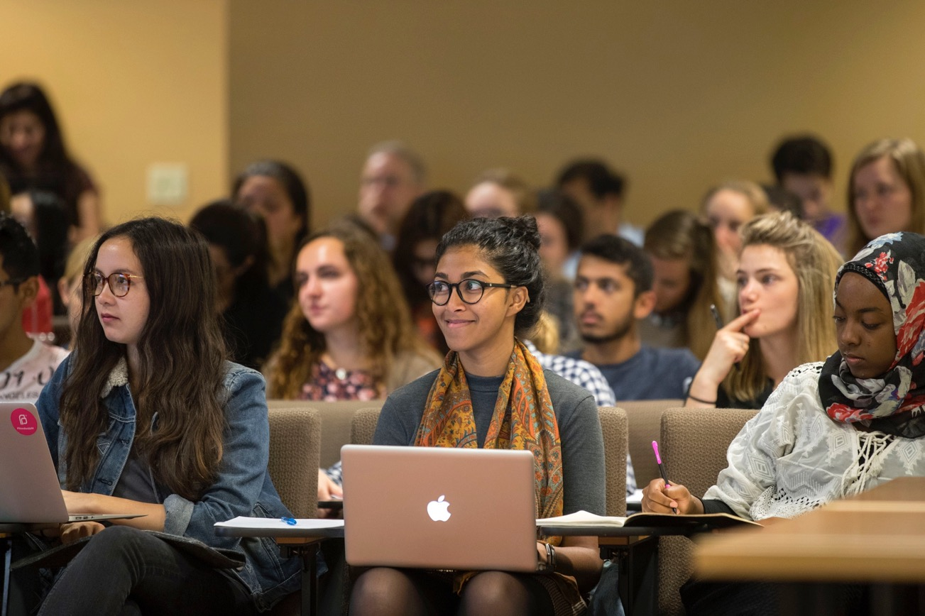
Notes:
When gathering images, it’s important to think about the end uses of them. Who is the audience. By keeping these thoughts in your mind you can more effectively create images or guide your hired photographers to create the kind of images you need.
Often people will overlook things that don not seem to be visual. AN images ability to quickly portray an emotion and illicit an emotional response, is one of the best reaosns to use a picture. Maybe your area is very research heavy, people spending time at computers and reading books. Those can still be instances where good imagery can be made. By focusing more on the people and their experience as opposed to the process that is happening.
Take Commencement and Reunion Weekend as an example. As I’m out shooting images all weekend, I have in my head that I want to communicate what this experience is like, in the moment. I know my main audience is generally going to be undergrad students.
A large part of my job as the communications photographer is to document the amazing things our Brown community does. To do those things I need to be present in the moment when those things are happening.

Slide 65
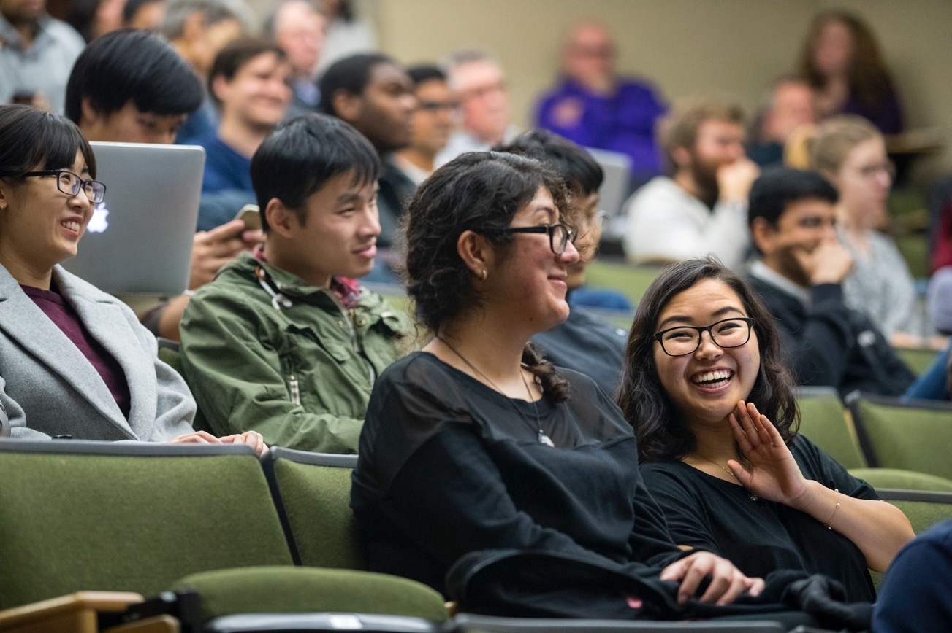
Notes:
When gathering images, it’s important to think about the end uses of them. Who is the audience. By keeping these thoughts in your mind you can more effectively create images or guide your hired photographers to create the kind of images you need.
Often people will overlook things that don not seem to be visual. AN images ability to quickly portray an emotion and illicit an emotional response, is one of the best reaosns to use a picture. Maybe your area is very research heavy, people spending time at computers and reading books. Those can still be instances where good imagery can be made. By focusing more on the people and their experience as opposed to the process that is happening.
Take Commencement and Reunion Weekend as an example. As I’m out shooting images all weekend, I have in my head that I want to communicate what this experience is like, in the moment. I know my main audience is generally going to be undergrad students.
A large part of my job as the communications photographer is to document the amazing things our Brown community does. To do those things I need to be present in the moment when those things are happening.

Slide 66
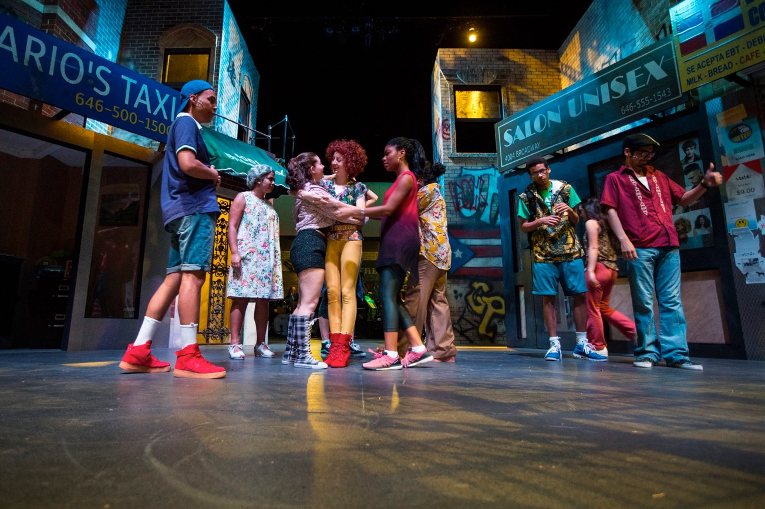
Notes:
When gathering images, it’s important to think about the end uses of them. Who is the audience. By keeping these thoughts in your mind you can more effectively create images or guide your hired photographers to create the kind of images you need.
Often people will overlook things that don not seem to be visual. AN images ability to quickly portray an emotion and illicit an emotional response, is one of the best reaosns to use a picture. Maybe your area is very research heavy, people spending time at computers and reading books. Those can still be instances where good imagery can be made. By focusing more on the people and their experience as opposed to the process that is happening.
Take Commencement and Reunion Weekend as an example. As I’m out shooting images all weekend, I have in my head that I want to communicate what this experience is like, in the moment. I know my main audience is generally going to be undergrad students.
A large part of my job as the communications photographer is to document the amazing things our Brown community does. To do those things I need to be present in the moment when those things are happening.

Slide 67
What Makes a “Good” Image?
Notes:
I often get the request, “Hey Nick, I’m looking for a really good image of ____.” That’ the most basic statement that can be made.
What makes a “good” image. A good image conveys the appropriate visual information for the situation and context it is presented in. If you’re creating a webpage that talks about the good and interesting work students in your department are doing, a wide photo of the building your department is in probably is not a “good” photo. A good photo for that section is probably something that shows one of your student’s engaged with some other work you talk about.
If you’re talk about the wonderful and unique spaces that the department offers to do work in, showing those spaces is a great idea, but only if the photo is large enough to read well.
Using images that are user generated can often be a good tool, too. Images that are less polished and “authentic” can give a different experience to a user and might be useful in the message you’re conveying.
Good images engage a viewer and make them feel emotion.
Look, a lot of this stuff is subjective. Arguments can be made for one image over another and vice-versa. The important thing is to not be arbitrary in your decision making
Less effective.
Arbitrary

Slide 68
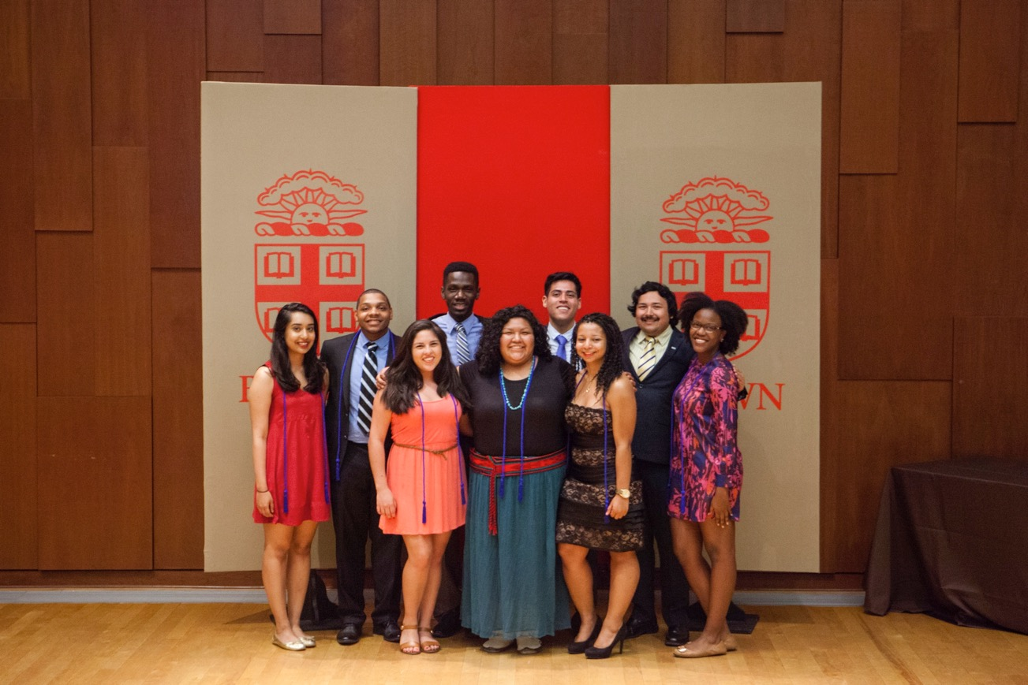
Notes:
When gathering images, it’s important to think about the end uses of them. Who is the audience. By keeping these thoughts in your mind you can more effectively create images or guide your hired photographers to create the kind of images you need.
Often people will overlook things that don not seem to be visual. AN images ability to quickly portray an emotion and illicit an emotional response, is one of the best reaosns to use a picture. Maybe your area is very research heavy, people spending time at computers and reading books. Those can still be instances where good imagery can be made. By focusing more on the people and their experience as opposed to the process that is happening.
Take Commencement and Reunion Weekend as an example. As I’m out shooting images all weekend, I have in my head that I want to communicate what this experience is like, in the moment. I know my main audience is generally going to be undergrad students.
A large part of my job as the communications photographer is to document the amazing things our Brown community does. To do those things I need to be present in the moment when those things are happening.

Slide 69
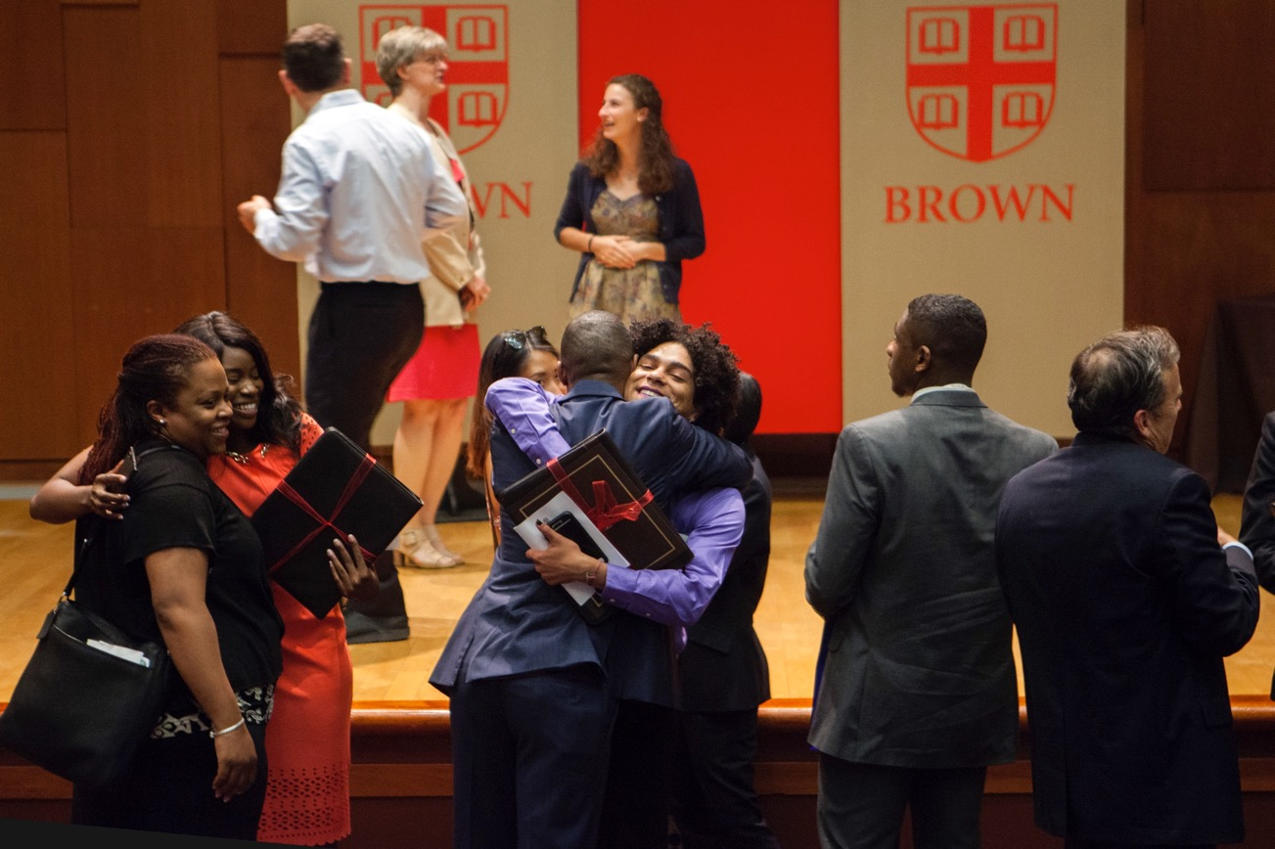
Notes:
When gathering images, it’s important to think about the end uses of them. Who is the audience. By keeping these thoughts in your mind you can more effectively create images or guide your hired photographers to create the kind of images you need.
Often people will overlook things that don not seem to be visual. AN images ability to quickly portray an emotion and illicit an emotional response, is one of the best reaosns to use a picture. Maybe your area is very research heavy, people spending time at computers and reading books. Those can still be instances where good imagery can be made. By focusing more on the people and their experience as opposed to the process that is happening.
Take Commencement and Reunion Weekend as an example. As I’m out shooting images all weekend, I have in my head that I want to communicate what this experience is like, in the moment. I know my main audience is generally going to be undergrad students.
A large part of my job as the communications photographer is to document the amazing things our Brown community does. To do those things I need to be present in the moment when those things are happening.

Slide 70
A Good Image
Conveys the appropriate visual information for the situation and context
Elicits an emotional response from a viewer
Aesthetically pleasing
Reads well
Notes:
I often get the request, “Hey Nick, I’m looking for a really good image of ____.” That’ the most basic statement that can be made.
What makes a “good” image. A good image conveys the appropriate visual information for the situation and context it is presented in. If you’re creating a webpage that talks about the good and interesting work students in your department are doing, a wide photo of the building your department is in probably is not a “good” photo. A good photo for that section is probably something that shows one of your student’s engaged with some other work you talk about.
If you’re talk about the wonderful and unique spaces that the department offers to do work in, showing those spaces is a great idea, but only if the photo is large enough to read well.
If you do research that is
Good images engage a viewer and make them feel emotion.
Look, a lot of this stuff is subjective. Arguments can be made for one image over another and vice-versa. The important thing is to not be arbitrary in your decision making
Less effective.
Arbitrary

Slide 71
Image Use Policy and BIG
Notes:
The university’s Image Use Policy now requires that department’s have a model release for all photos where you’re using someone’s likeness to promote the university through marketing or advertising. There are exceptions for news, editorial and documentary uses.
I’ve often seen concern from people talking about they don’t have the resources to obtain a release from everyone they photograph or have their freelancers shoot. It’s not necessary to have someone’s release on file just because you took their photo, only if you want to use it for a marketing or promotional purpose. By taking the time to inform people you’ve taken their photo and that you’re planning to use it for social media, or something similar, you can set concerns at ease. You then can follow up with them the next day or so to get consent from the people you know you have good images of.
Leverage technology to make obtaining image releases easier.
DAM
Brown’s digtial asset management system, the Brown Image Gallery, is a useful tool for department’s to help organize their images and use them effciently among their department and with the rest of the unviersity. It can also help you keep your releases associated with the images so you can always keep them together.

Slide 72
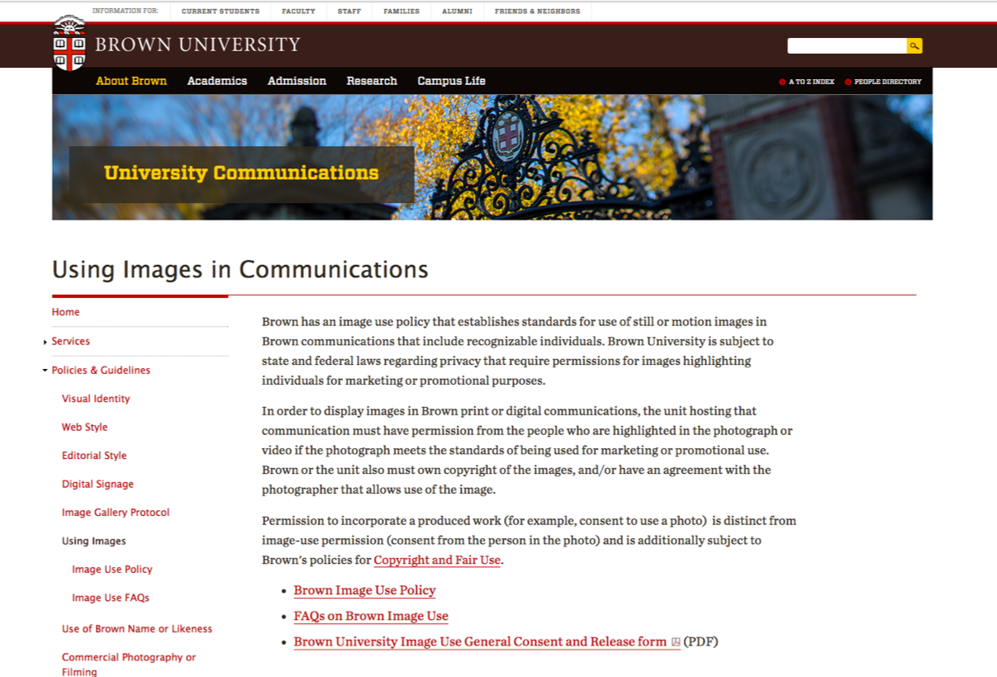
https://www.brown.edu/about/administration/communications/using-images-communications
Notes:
Thought we could talk a bit about the image use policy and some distinctions between someone being identifiable and using their likeness to promote the university.
There are instances where you may have someone’s face visible in an image, but your are not using their likeness to promote the university. It has to do with context.
Say you have a photo of the Main Green showing University hall and there are students walking by the building. You may be able to make out their faces, but if their faces are small and there are maybe many people, are in the photo, but the picture isn’t about them. The picture is about the building on campus. If it’s presented in that way there isn’t a need for a model release from those people.
Thought we could talk about some nuances and ways to work with the Image Use Policy
Think about how the photo will be read also. If it’s printed very small and the people are no longer Identifiable, you wouldn’t need a release.

Slide 73
Image Use Policy and BIG
Model Release Form
Use Event and Date fields to your advantage
Follow up with Email
Digitally sign
Notes:
Other schools say: We’re known for STEM, we’re known for our business program, we’re known for the arts.
Everyone at Brown agreed – that is not us. We’re not known for one thing. The integrative themes span disciplines.
It’s HOW we do research and educate and make an impact.

Slide 74
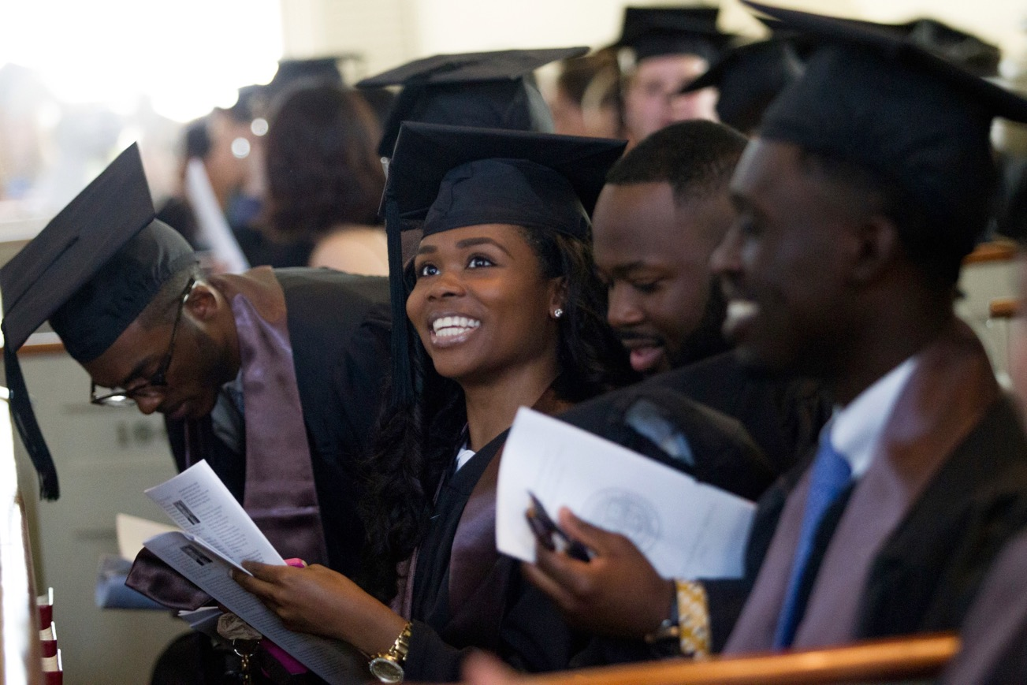
Notes:
When gathering images, it’s important to think about the end uses of them. Who is the audience. By keeping these thoughts in your mind you can more effectively create images or guide your hired photographers to create the kind of images you need.
Often people will overlook things that don not seem to be visual. AN images ability to quickly portray an emotion and illicit an emotional response, is one of the best reaosns to use a picture. Maybe your area is very research heavy, people spending time at computers and reading books. Those can still be instances where good imagery can be made. By focusing more on the people and their experience as opposed to the process that is happening.
Take Commencement and Reunion Weekend as an example. As I’m out shooting images all weekend, I have in my head that I want to communicate what this experience is like, in the moment. I know my main audience is generally going to be undergrad students.
A large part of my job as the communications photographer is to document the amazing things our Brown community does. To do those things I need to be present in the moment when those things are happening.

Slide 75
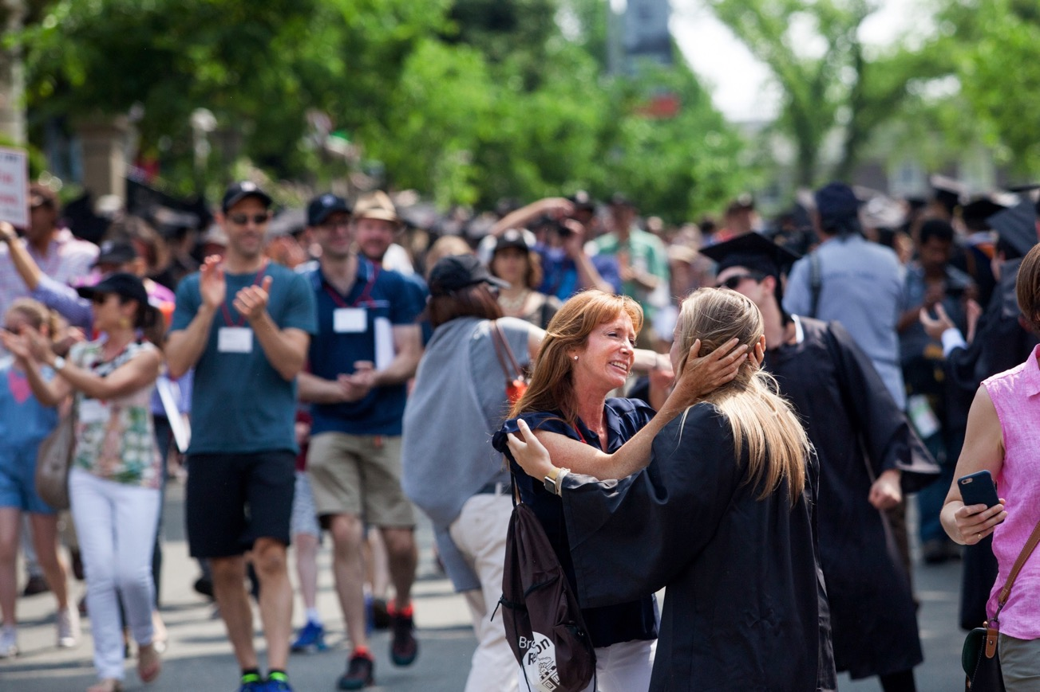
Notes:
When gathering images, it’s important to think about the end uses of them. Who is the audience. By keeping these thoughts in your mind you can more effectively create images or guide your hired photographers to create the kind of images you need.
Often people will overlook things that don not seem to be visual. AN images ability to quickly portray an emotion and illicit an emotional response, is one of the best reaosns to use a picture. Maybe your area is very research heavy, people spending time at computers and reading books. Those can still be instances where good imagery can be made. By focusing more on the people and their experience as opposed to the process that is happening.
Take Commencement and Reunion Weekend as an example. As I’m out shooting images all weekend, I have in my head that I want to communicate what this experience is like, in the moment. I know my main audience is generally going to be undergrad students.
A large part of my job as the communications photographer is to document the amazing things our Brown community does. To do those things I need to be present in the moment when those things are happening.

Slide 76
Questions?

